Slide 1
Big Data Systems Intelligence analytics
Image Captioning
Final Project presentation – fall 2018
By
Malick Fairoz Mitesh puthrAn

Slide 2
Image Captioning using Deep Learning
INTRODUCTION
Caption generation is a challenging artificial intelligence problem where a textual description must be generated for a given photograph.
It requires both methods from computer vision to understand the content of the image and a language model from the field of natural language processing to turn the understanding of the image into words in the right order.

Slide 3
Key technics used
Pre-Trained Model -- vgg16 Convolution Neural Networks (CNN)
This network takes input of size (224,224,3). The output layer contains 1,000 nodes.
Training Model – Long short-term memory (LSTM)
Used for sequence-to-sequence modelling
NLTK – Bilingual evaluation understudy (BLEU)
The method to evaluate the text similarities

Slide 4
Preliminary analysis
There are 8091 images and 5 captions for each image
Import caption data and converted to data frame
filename : jpg file name
index : unique ID for each caption for the same image
caption : string of caption, all in lower case

Slide 5
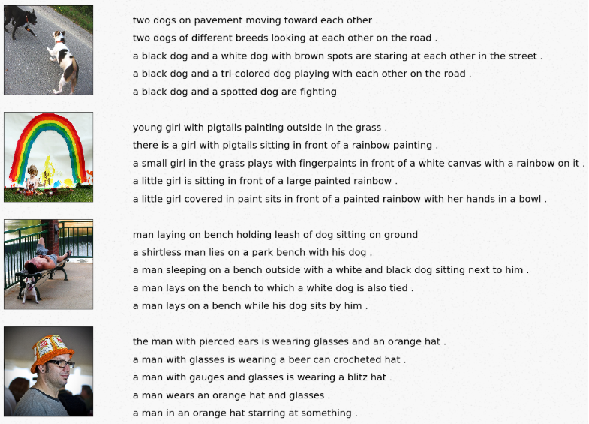
Examples of Image Captioning

Slide 6
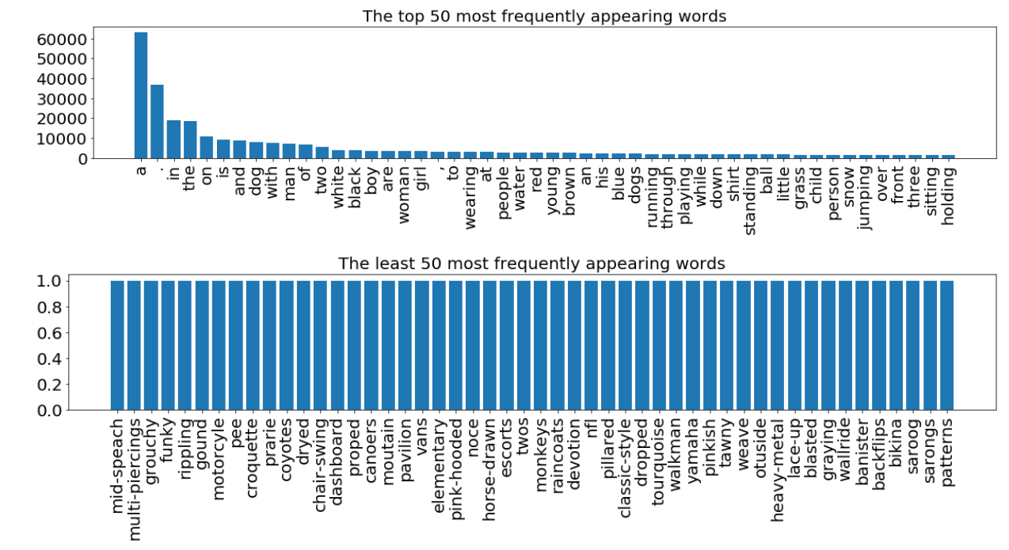
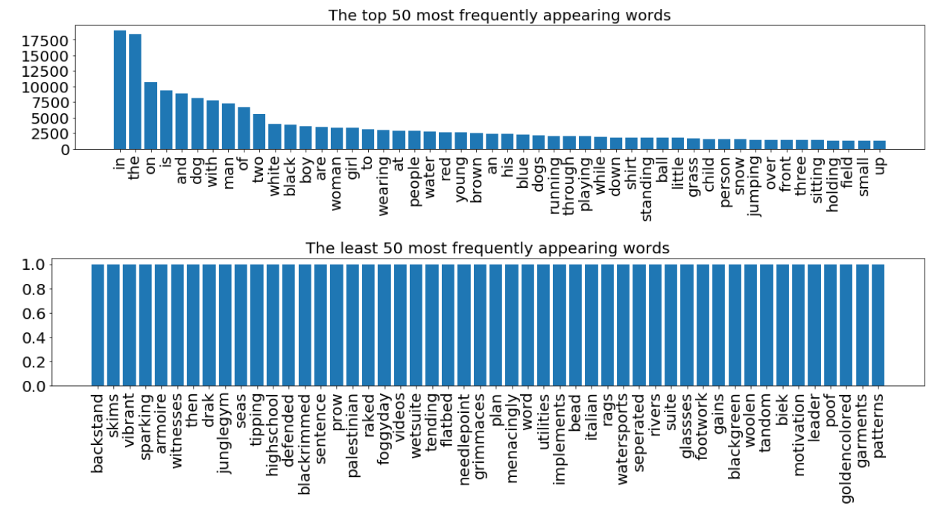
Data preparation
Text preparation
Word frequency
Cleaning
remove punctuation
remove single character
remove numeric characters
Add start and end sequence tokens
Tokenizer

Slide 7
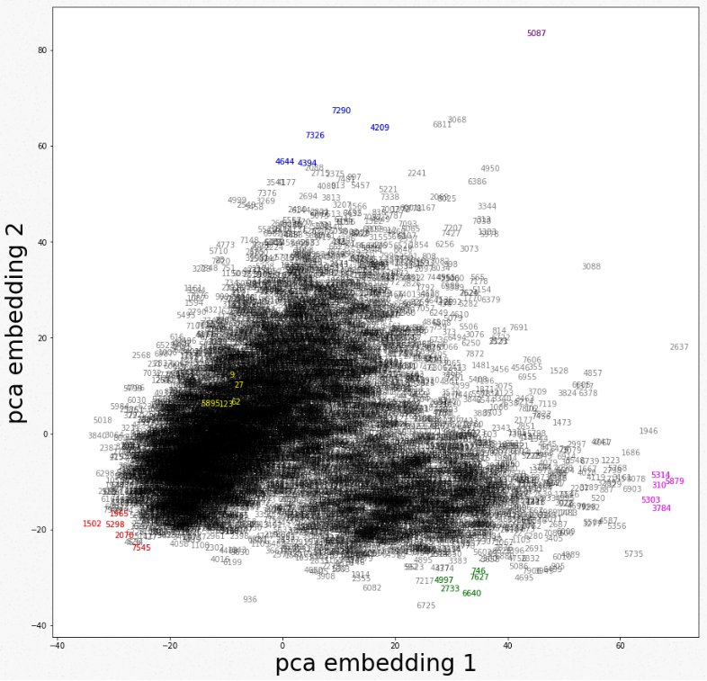
Data preparation
Image preparation
Create features for each image using VGG16's pre-trained networks
Visualization 2 out of 4096 features using PCA
Do photo features make sense?
red: many people are in one image
green: dogs on green, yard or on bed
magenta: dogs in snow or with water splash
blue: guys doing sports with helmets
yellow: not sure what these are?? I see many pictures are densely clustered around this area and Photo features seem to make sense!

Slide 8
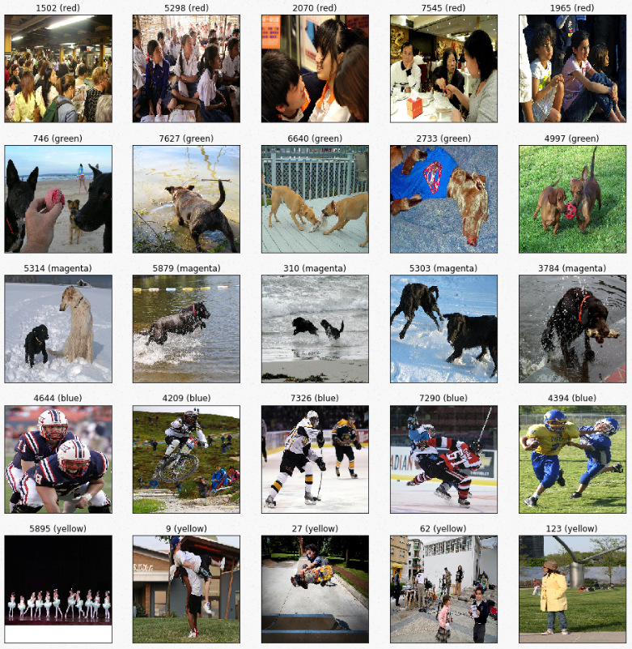

Slide 9
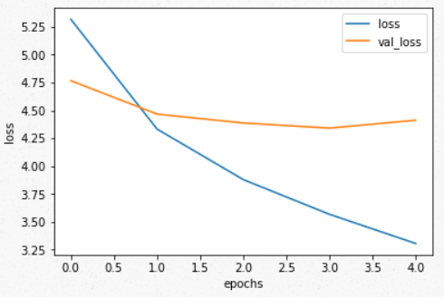
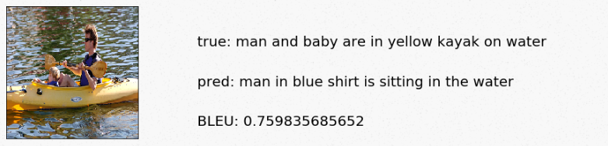
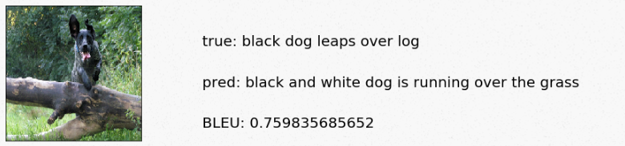
Training and prediction process
Split between training and testing data
Model training
Validation loss and training loss over epochs
Prediction

Slide 10
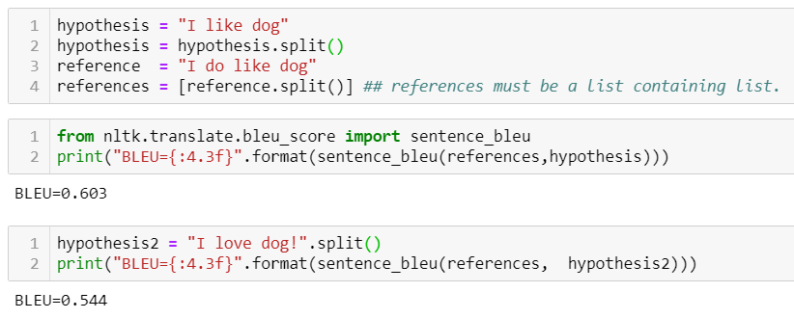
Bilingual evaluation understudy (BLEU)
BLEU is a well-acknowledged metric to measure the similarly of one hypothesis sentence to multiple reference sentences. Given a single hypothesis sentence and multiple reference sentences, it returns value between 0 and 1. The metric close to 1 means that the two are very similar.
Implementation
According to BLEU the two sentences are reasonably similar.
If I change the hypothesis sentence a bit, this worsen the BLEU.

Slide 11
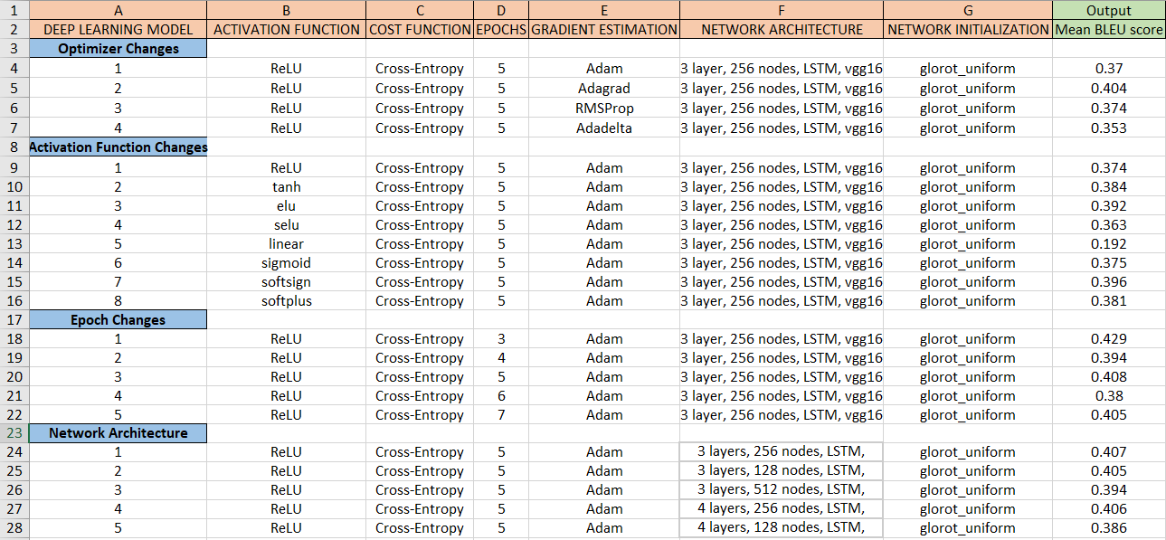
Hyper Parameter tuning

Slide 12
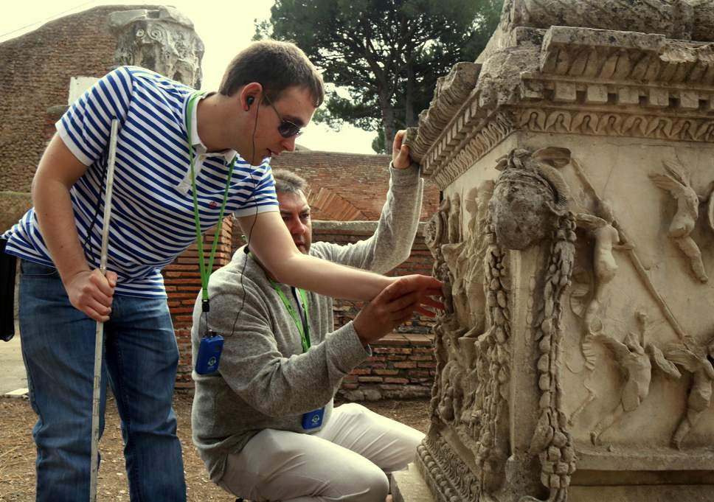
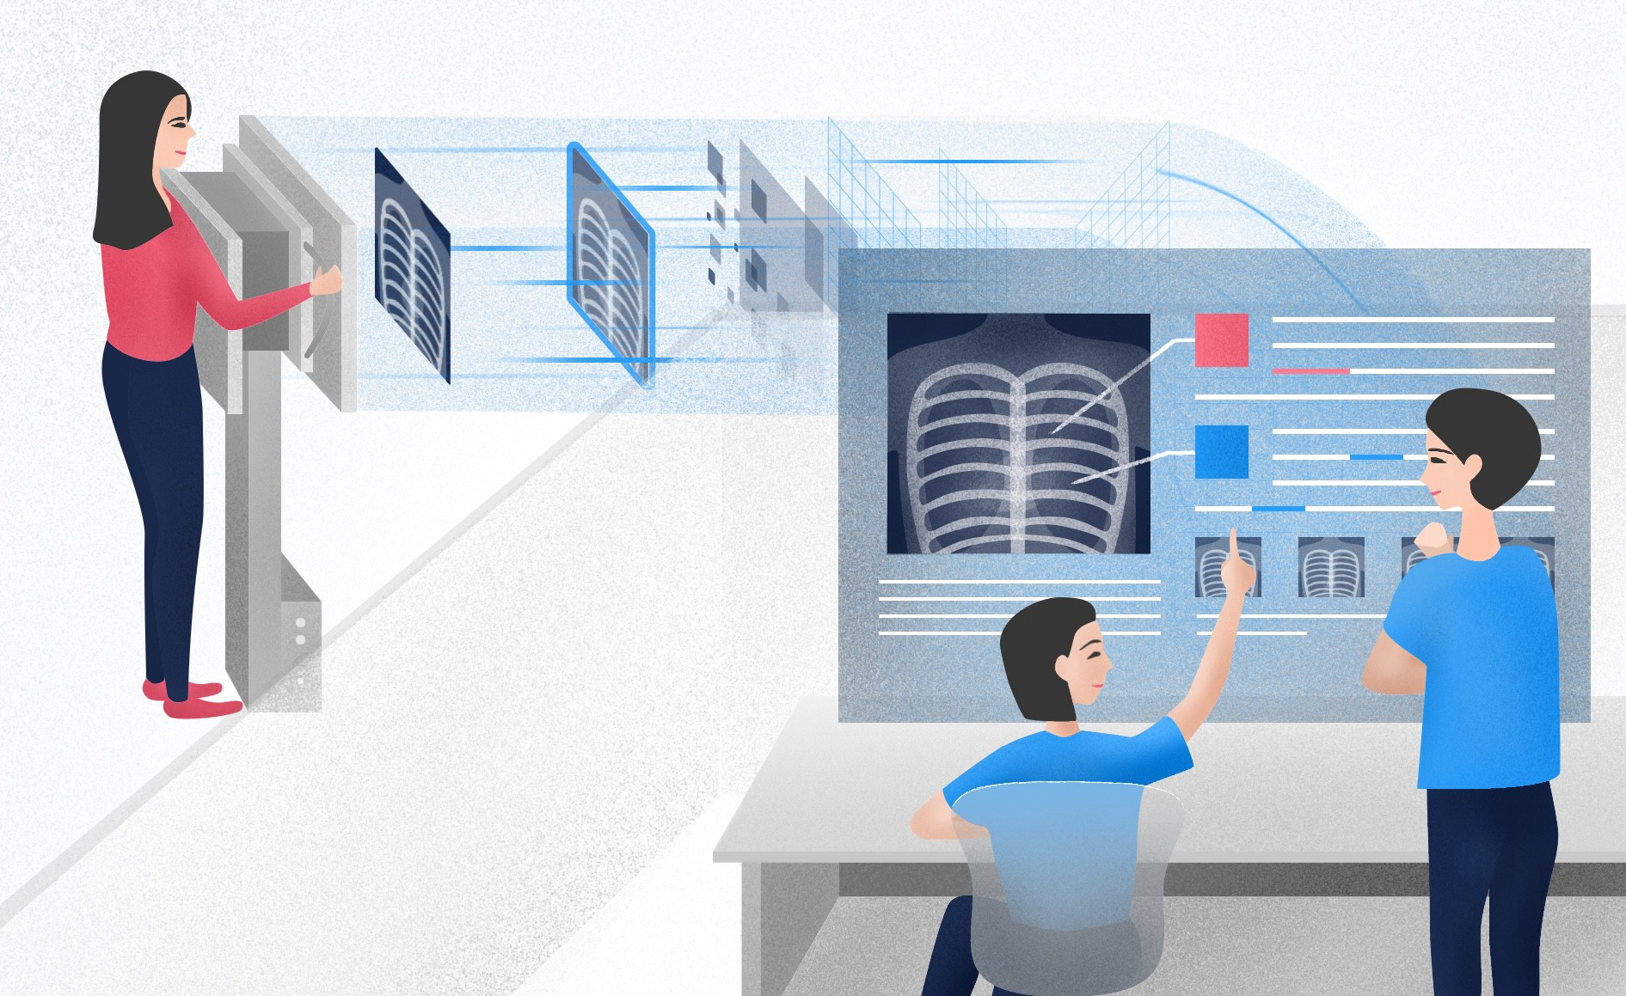
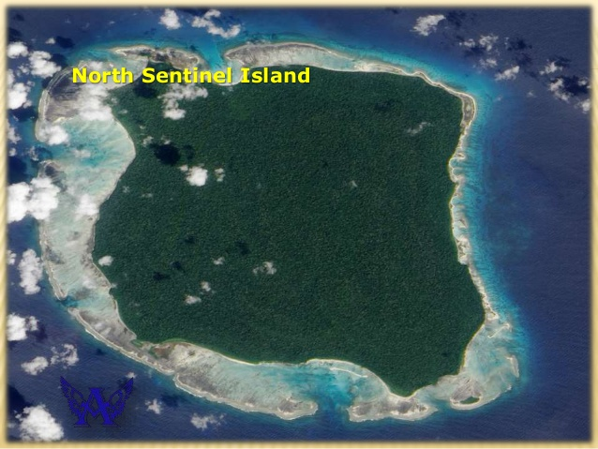
Purpose & future scope of this project
Visually impaired people who are trying to make sense of it
Caption medical images like X-rays, CT scan, MRI scan and generate reports
Caption satellite geo images and generate reports

Slide 13
Reference
Image captioning using deep learning material
https://machinelearningmastery.com/develop-a-deep-learning-caption-generation-model-in-python/
Download the Flickr8K Dataset
https://forms.illinois.edu/sec/1713398
http://nlp.cs.illinois.edu/HockenmaierGroup/Framing_Image_Description/KCCA.html
https://www.flickr.com/help/terms
Pre-trained Networks (vgg16_weights_tf_dim_ordering_tf_kernels.h5)
https://github.com/fchollet/deep-learning-models/releases/tag/v0.1

Slide 14
Thank you
Questions ?

