Slide 1
Spectrum
SHOP
Members:
Maliha Zaman 200042114
Nazia Karim Khan Oishee 200042137
Mohammad Ittehad Rahman Sami 200042131
Supervised by:
Rafid Haque,
Lecturer, CSE Department, IUT
01

Slide 2
Introduction
Spectrum is a website portal for different small and large pages and brands to sell their respective products.
Spectrum holds the basic properties of an e-commerce website along with an addition built-in chat system that allows the customers to communicate with the respective business owner.
02

Slide 3
Why do we need Spectrum??
Problem
Solution
Many small businesses can be seen run across various social media platforms with not so many followers. People want to do business but they do not get the attention of the customers.
Spectrum brings together such businesses under one roof along with big brands to gather the customer attention and to give them exposure.
Our website allows communication between the customers and the buyers through a built-in chat system.
03

Slide 4
Features
PAY
01
Buy/Sell
02
Report
03
Review
04
Chat system
04

Slide 5
Buy/Sell
Buy
Sell
Customers can access and buy products from our website
Brands and pages can sell products through our website
05

Slide 6
Report
Review
Customers can report sellers in case they have any complaints regarding the products
Customers can review the products
06

Slide 7
Chat System
Chat
Built-in chat system through which our customer can have direct contact with the owners of products on display.
07

Slide 8

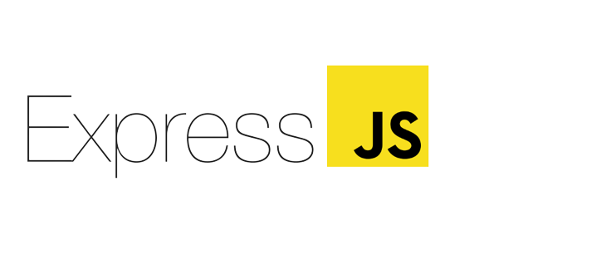

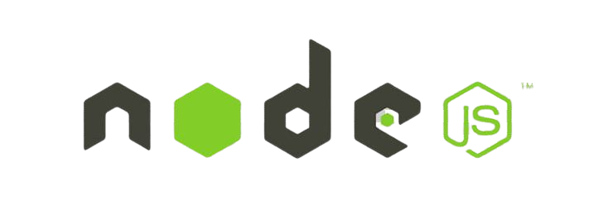
Technologies to be used
We will be using the MERN stack technology for our project and GIT for version control.
MongoDB
ExpressJS
ReactJS
NodeJS
Database to be used in our project
Frontend will be established using react along with HTML, CSS
Framework to help manage servers and routes
ExpressJS for the backend of the project
08

Slide 9
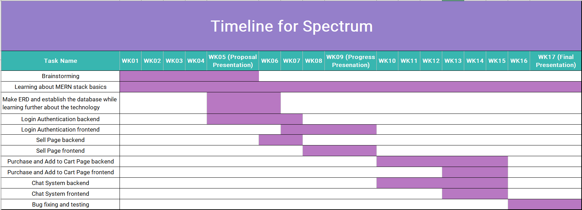
Timeline
09

Slide 10
THANK
YOU

