Slide 1
The A Team
Project 1 – Uber Data

Slide 2
Why Uber

Slide 3
The Questions
Does the time/date affect how often people order Uber’s?
How has the prices changed over time?
What distance are people using Uber’s for?

Slide 4

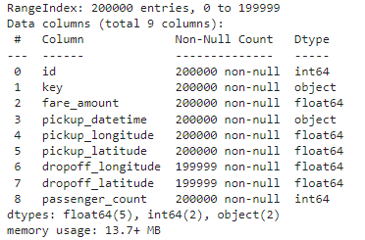
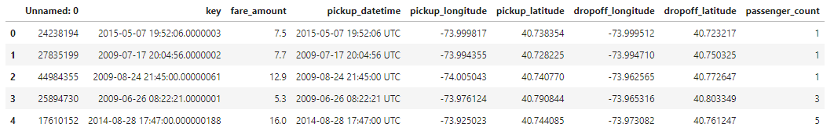
Data Exploration
Uber Data – csv file
Uber trips in New York 2009 - 2015
Kaggle Dataset - Uber Fares Dataset | Kaggle

Slide 5

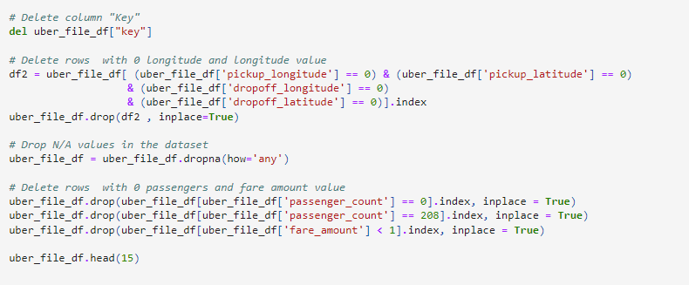
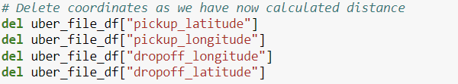
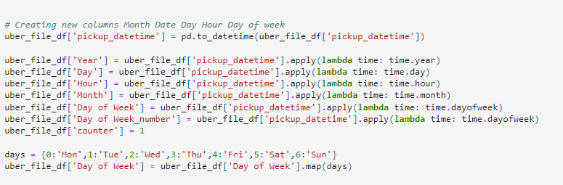
Clean-up process

Slide 6

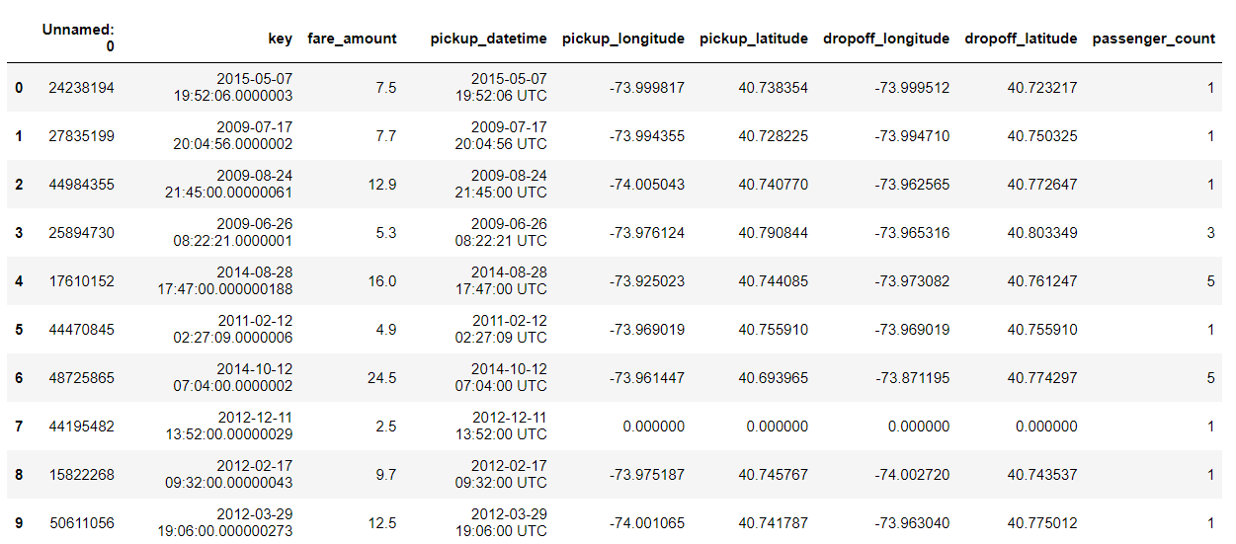

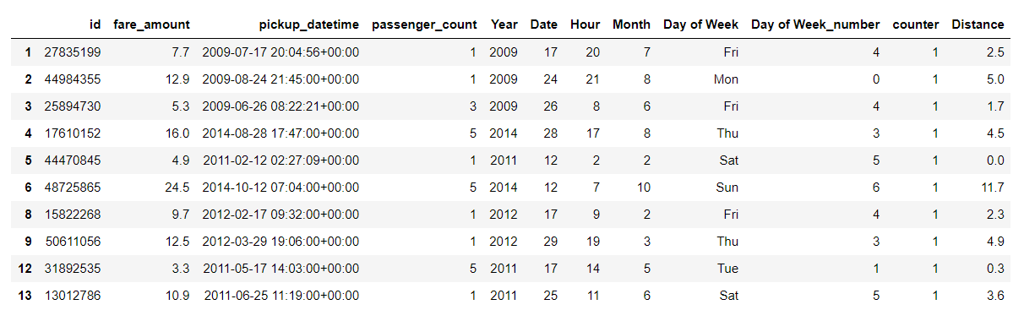

Final Data Frame
1. Raw data from csv file converted to a data frame
2. Formatted and filtered data frame without null values.

Slide 7

Analysis Process

Slide 8
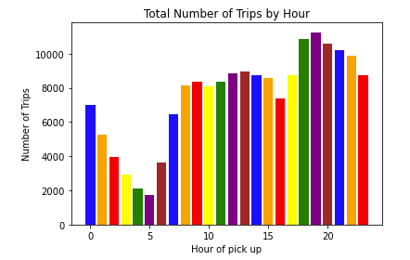
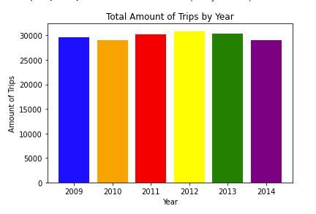
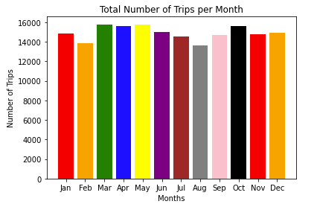
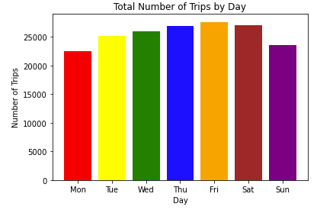
Time/Date

Slide 9
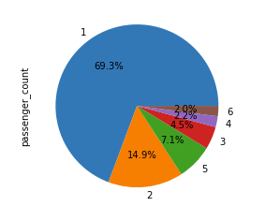
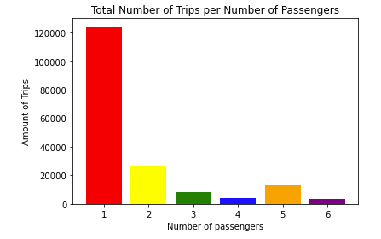
Cost

Slide 10
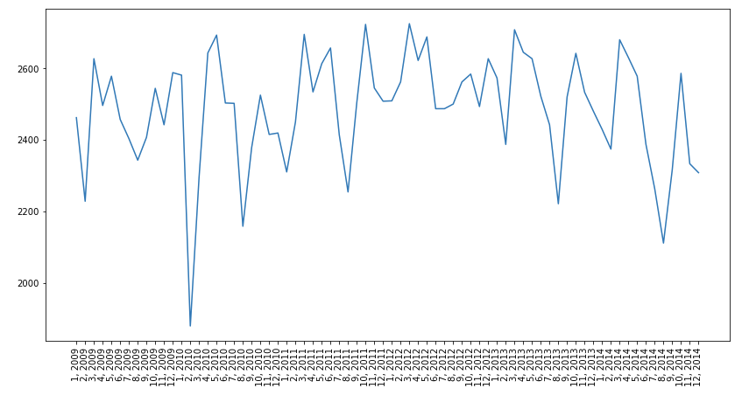

Slide 11
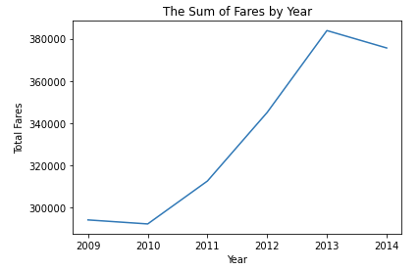
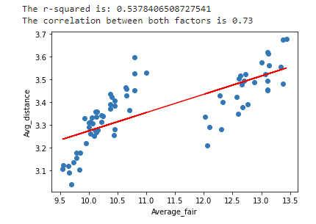
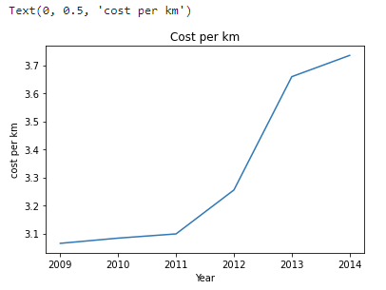
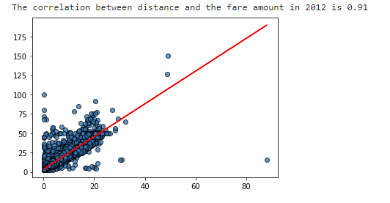
Distance

Slide 12
Conclusions and Implications

