Slide 1
Course Load Management System

Slide 2

Group Members
Team ID: 20
Maliha Noushin Raida (170042001)
Nawshin Ulfat (170042081)
Zannatun Naim Sristy (170042043)

Slide 3

!! Preface

Slide 4
Traditional Course Load System
Assigning courses to the teacher according to many conditions manually in course’s view.
Build a completely separate teacher’s view has no connection with course’s view.

Slide 5
Here The Problems Are …………
Check a lot of conditions manually
Possibilities of inconsistency
Time consuming
A lot of efforts

Slide 6

Want big impact?
Big concept

Slide 7
An interconnected system where the teacher wise load is generated automatically
by assigning courses to the teachers

Slide 8


User
Admin
Teacher

Slide 9
Features
Log in system
Semester wise course view
Teacher wise course view
Report Generation

Slide 10
Our process is …………
Log In system
Admin
Teacher
Works on course assigning
Report generate
Automatic
View Only
Teacher Wise Course View
Semester wise
Course View

Slide 11
How it is better…………
Consistent system
Check the conditions automatically
Reduce hassle
Time efficient

Slide 12
Our Protype
12

Slide 13
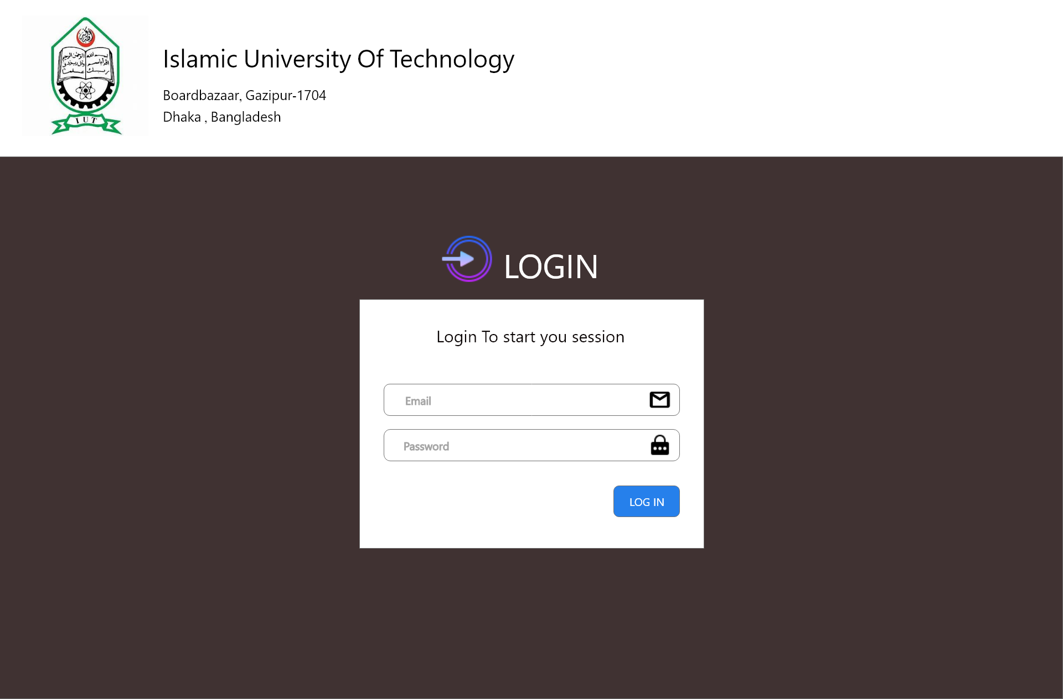
Our Prototype

Slide 14


Slide 15
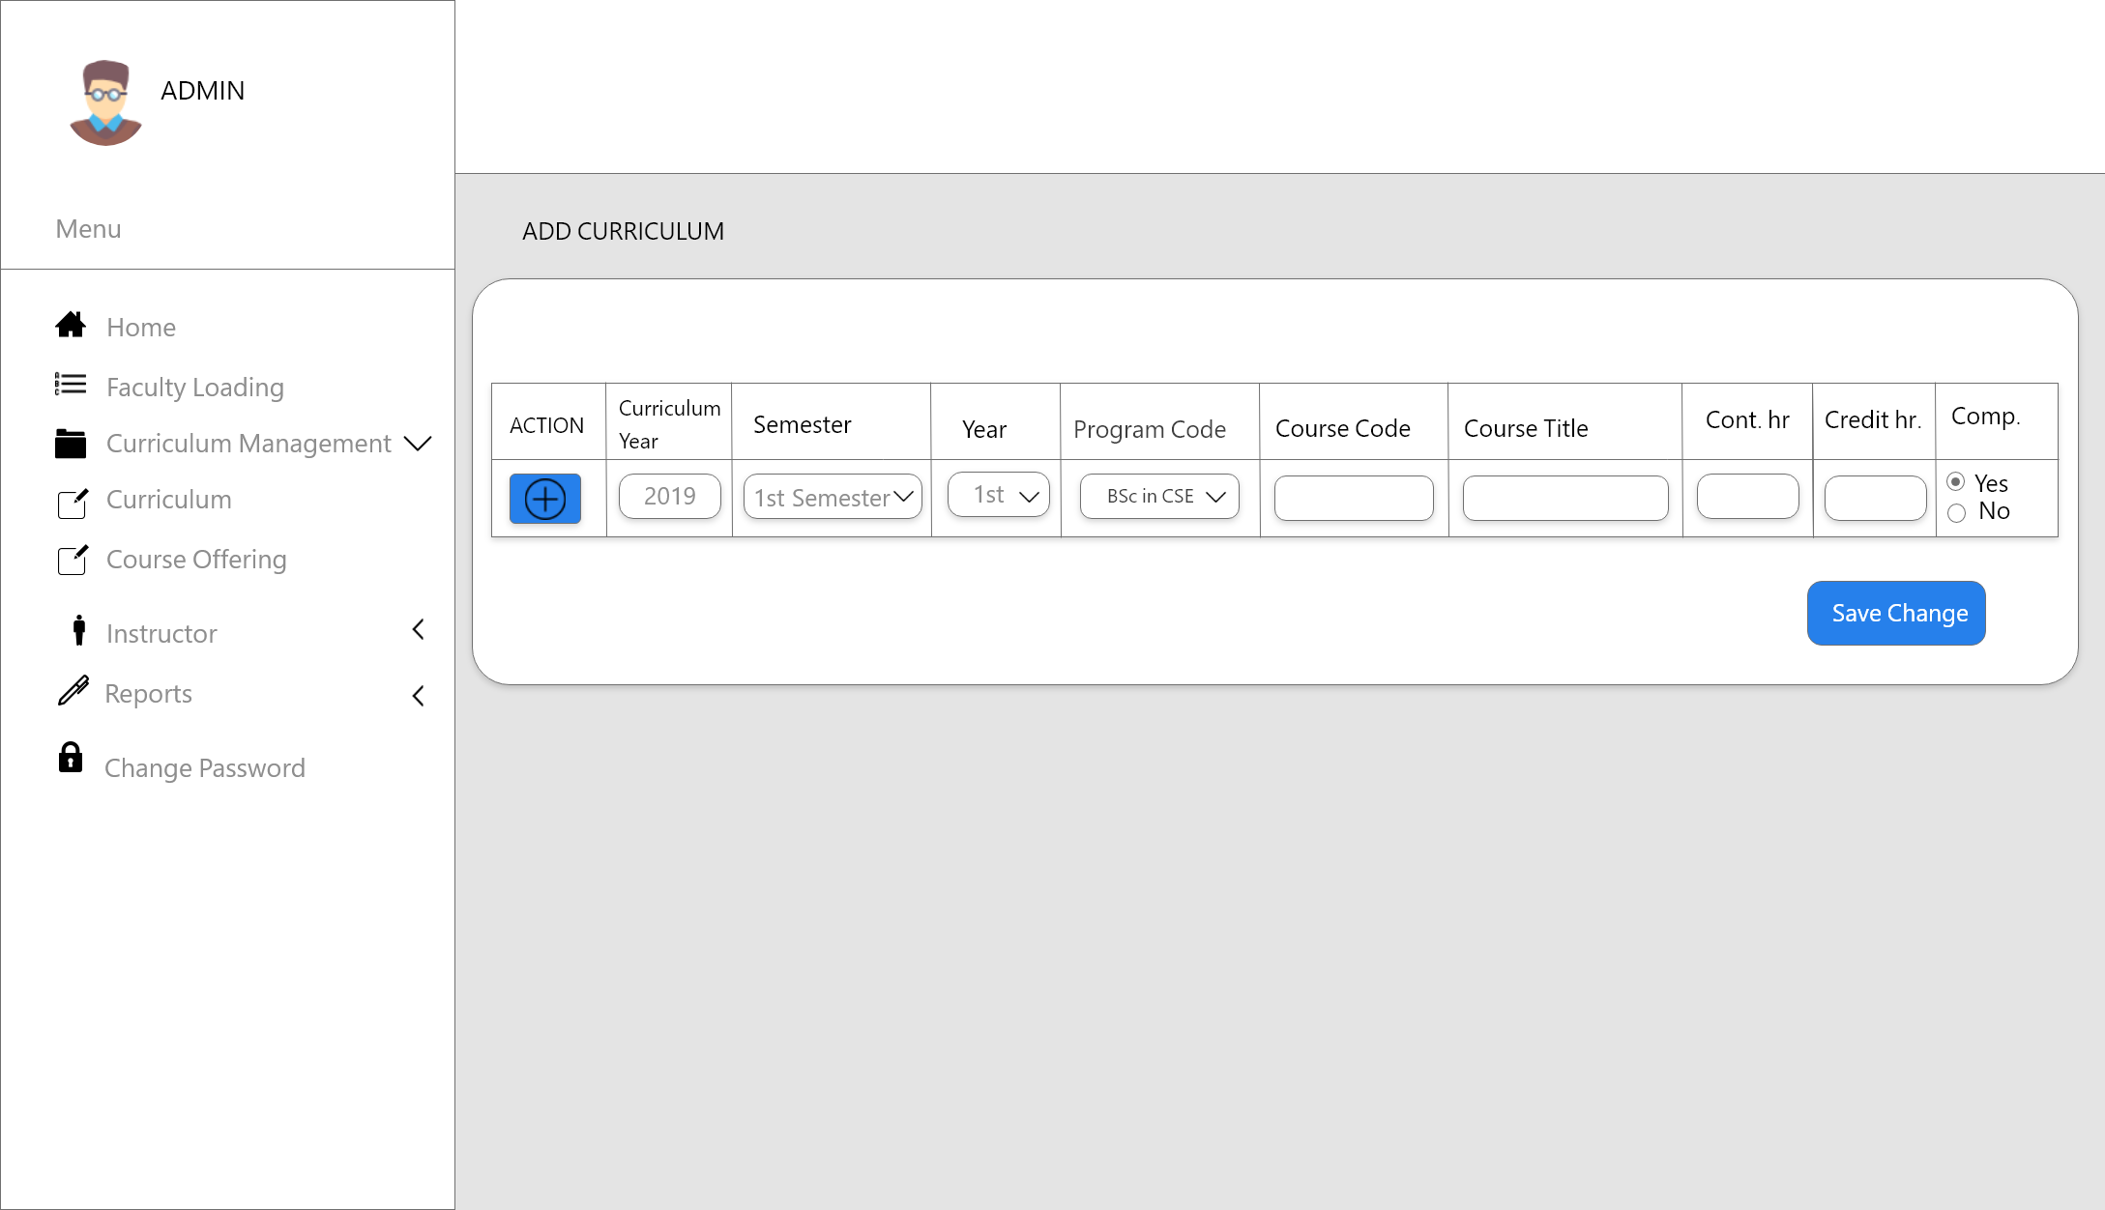
`

Slide 16
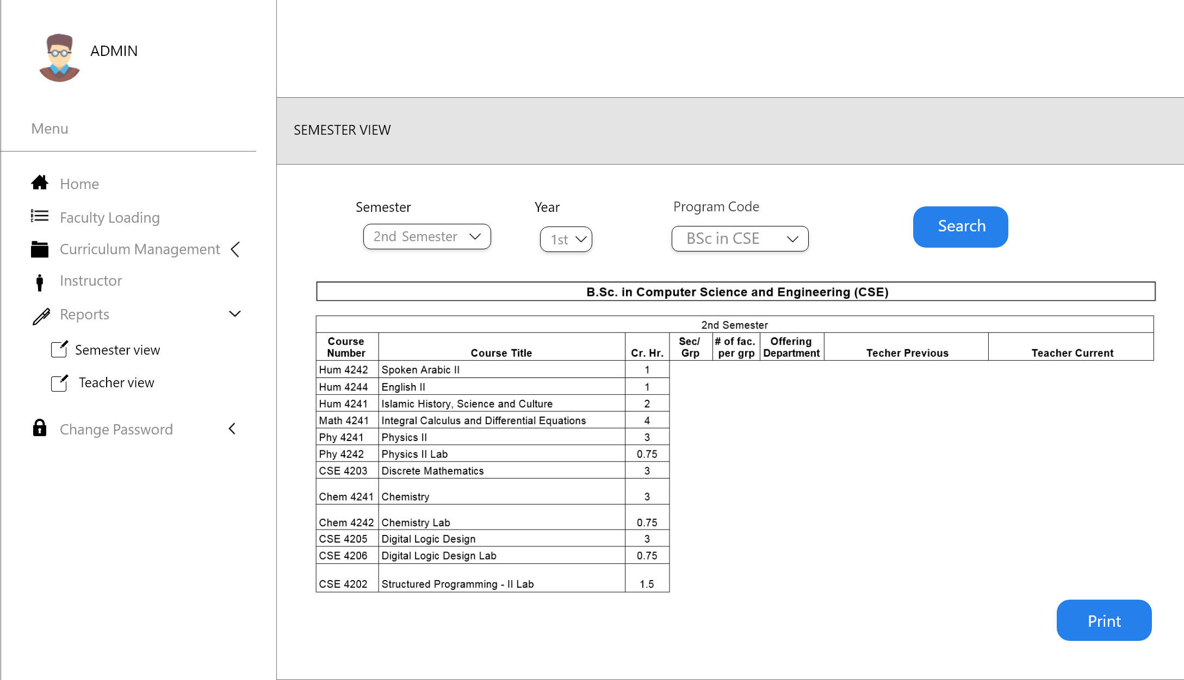

Slide 17
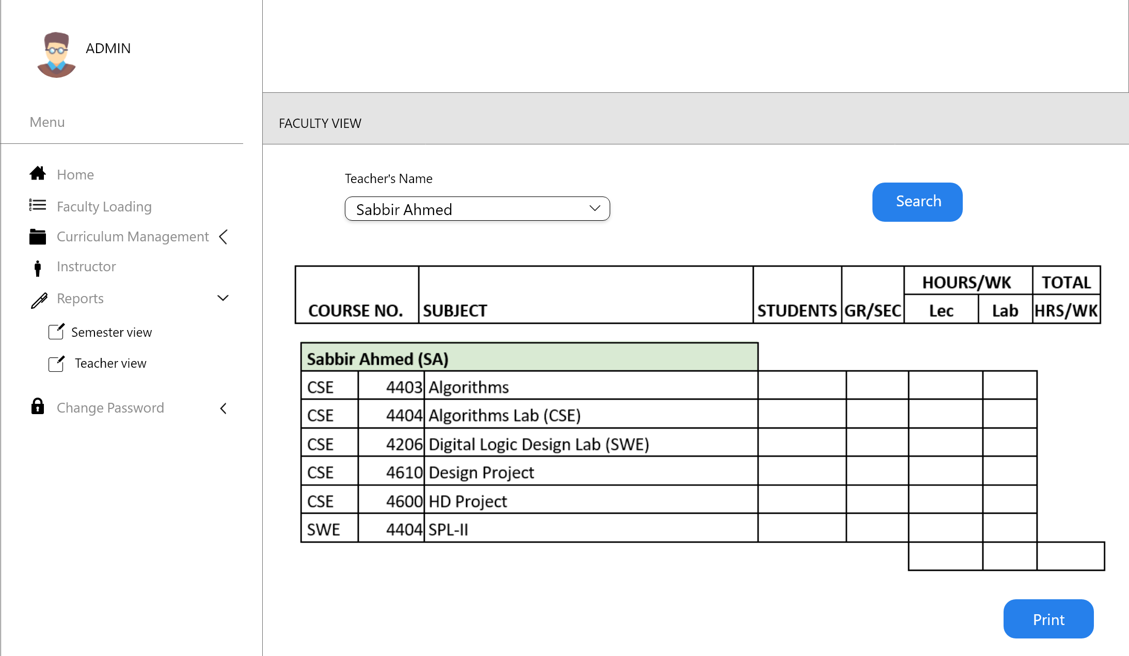

Slide 18
Requirments
Node.js
Bootstrap
Javascript
Mysql
Gitkraken
Jira Kanban board

Slide 19
Timeline
Log in & User Home &Course Entry
Teacher wise course view
Testing & Improvement
Jul: week 1 -
Jul: week 3
(1st-3rd )
Jul: week 4 -
Aug: week 2
(4st-6rd )
Aug: week 3 -Sep: week 1
(7th-10th )
Sep: week 2 -
Sep: week 3
(11th-12th )
Sep: week 4 -
Oct: week 1
(13th-14th )
Oct: week 2- Oct: week 3
(15th-16th )
System analysis & Background learning
Semester wise course view
Report generation

Slide 20
Future Goals
Scheduling System
Recreating SIS with CLMS

Slide 21
Thank You!

