Slide 1
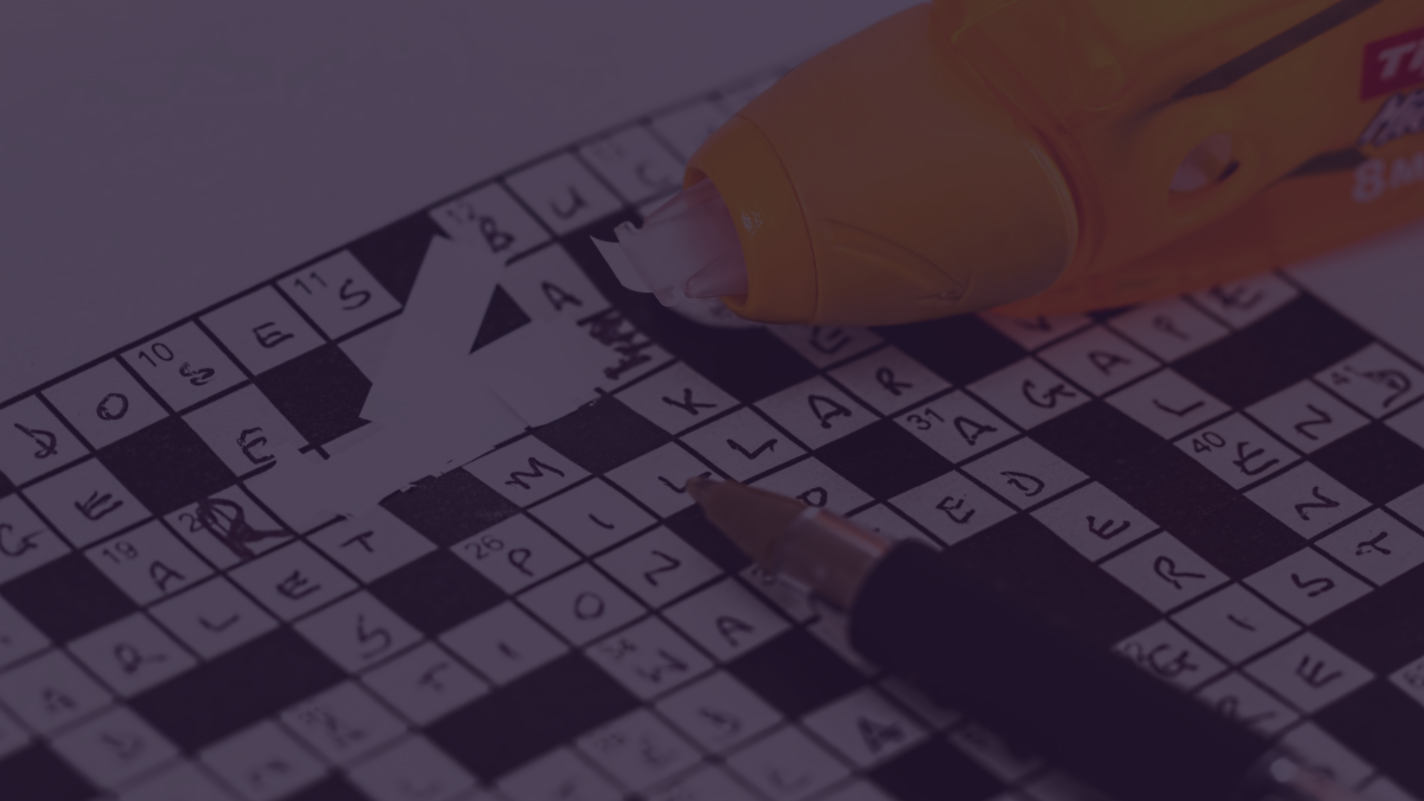
Deep Reinforcement Learning Approach Based Grammatical Error Correction
NAME: MALIHA MEHEJABIN
ID: 20301264
SECTION: 02
1

Slide 2

Summary
Hypothesis
Automate GEC using DRL on C4_200M dataset.
Address limitations of existing ML and rule-based techniques.

Slide 3
Contribution
DRL model outperforms ML and rule-based methods.
Demonstrates the effectiveness of leveraging deep reinforcement learning for GEC.

Slide 4
Methodology:
DRL optimizes Q-function for GEC.
Trains a DRL model for automatic grammatical error correction and sets baseline results using RL techniques.

Slide 5
Conclusion
Concludes that the proposed DRL model outperformed machine learning and rule-based techniques.

Slide 6
First Limitation
ML limitations include issues in generalization and manual feature engineering.
Rule-based techniques rely on annotated data and predefined rules, limiting coverage for all error types.

Slide 7
Second Limitation
ML models may struggle to disambiguate between multiple error corrections.
These techniques face challenges in adapting to evolving language patterns and may require frequent updates.

Slide 8
Synthesis
DRL Technique Benefits:
Captures complex language dependencies for nuanced corrections.
Offers a more dynamic and adaptable approach compared to traditional ML techniques.
Application Beyond GEC:
The DRL technique has potential applications in various NLP tasks.
Can enhance accuracy and effectiveness in machine translation, sentiment analysis, and information retrieval.

Slide 9
Conclusion
Emphasize the significance of the proposed DRL model in advancing grammatical error correction techniques.

Slide 10


