Slide 1
Telecommunication Company Customer Churn
by
< Maliheh Garoosiha>, <mgaroosiha@ torontomu.ca >
<Shadi Rashed>, <shadi.rashed@ torontomu.ca >
< Pooria Ghahramani>, < pooria.ghahramani@torontomu.ca>
Notes:
Title slide

Slide 2
Introduction
Problem: the company would like to know in advance which customers would churn in near future. This dataset has 21 attributes including binary class attribute about churn
Using Desition Tree for prediction of potential customers to churn
Improving customer service and attention for customers who use the service for more minutes during the daytime.
Notes:
First state the problem you are addressing. For example, if your project is on Churn analysis, then give a brief explanation of it. Second, write the summary of your classification results (e.g., accuracy). Note do not clutter slides, just write bullet points. If you would like to provide further explanation, write in the notes section here.

Slide 3
Introduction
Which customers would churn in near future.
Using decision tree algorithms
Identify customers with "Total Day Minutes"
Notes:
First state the problem you are addressing. For example, if your project is on Churn analysis, then give a brief explanation of it. Second, write the summary of your classification results (e.g., accuracy). Note do not clutter slides, just write bullet points. If you would like to provide further explanation, write in the notes section here.

Slide 4
Workload Distribution
Member Name | List of Tasks Performed
Shadi Rashed | cleaning data specially the important columns checking each datatype and if the datatypes are not according to what we expected change them. Handling missing value and remove duplicates. making the summary table (min, max, mean, …) and chart (histogram, box plot) for quantitative data and finding outlier values.
Pooria Ghahramani | Predicting Class Attribute Specifying the better algorithm between two supervise learning(Desision Tree and Naiive Bayes) Determining performance measures
Maliheh Garoosiha | Analyzing data according to the selected model(final Decision tree) suggestion Summarize findings by Drawing plots, tables for main variable(Churn) Writing suggestions according to the decision tree analysis to prevent churn
Notes:
Describe workload distribution here for each member.

Slide 5
Data Preparation
Step 1 preparation data: descriptive statistic tables, charts
Step 2 checking missing value
Step 3 converting incorrect Data type
list of selected features
Notes:
Write your steps of data preparation that you performed during analysis of data in the order your performed them. For example, handling missing values, categorizing column or converting to numerical values, selecting feature, etc. If you want to show any figure/table feel free to insert but keep in mind that slides should be readable.

Slide 6
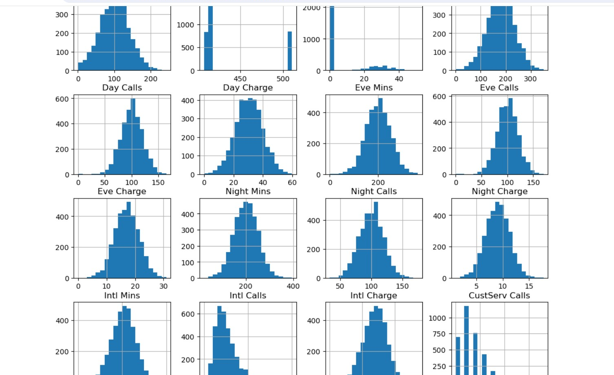
Data Preparation
Showing Outliers with histogram
Notes:
If there is anything else to report that didn’t fit on the previous slide then use this one, any sort of visualization or creativity, etc.

Slide 7
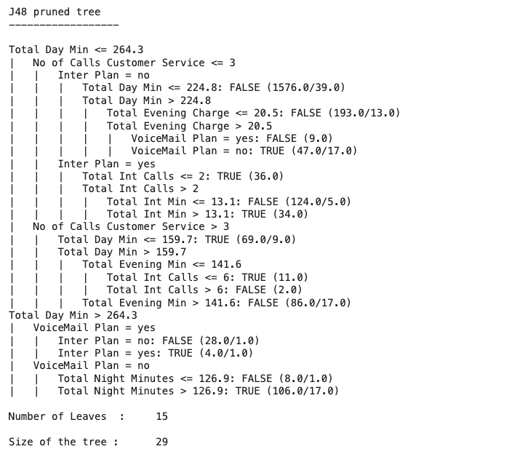
Baseline DT

Slide 8
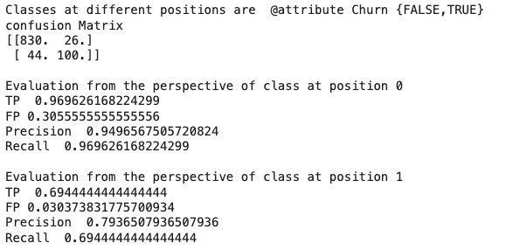
Metrics of DT for Baseline

Slide 9
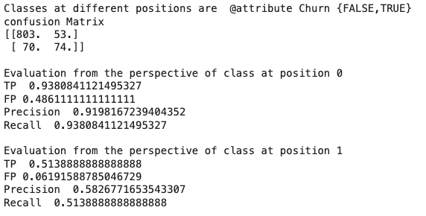
Metrics of NB for Baseline

Slide 10
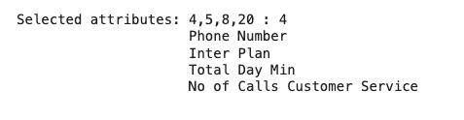
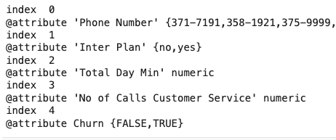
Weka Selected Attributes

Slide 11
Weka Selected Attributes

Slide 12
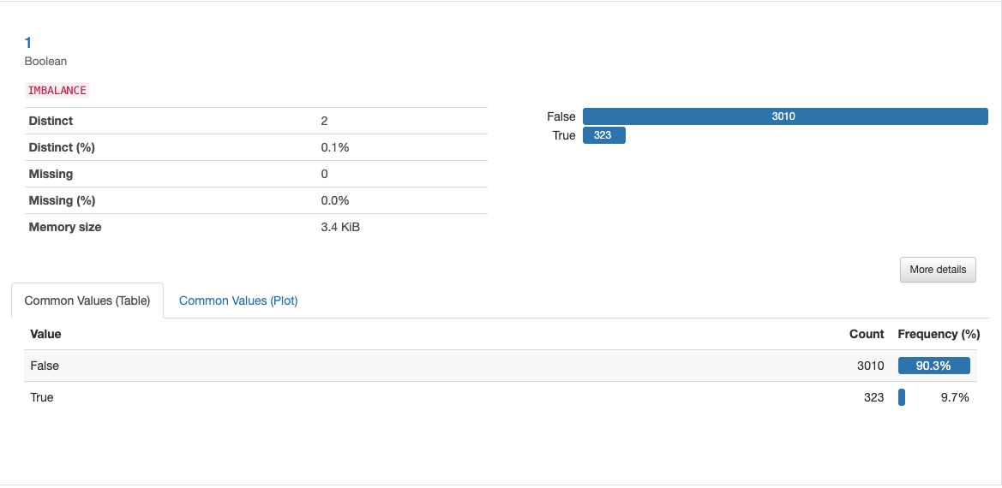
Weka Selected Attributes 1- International Plan

Slide 13
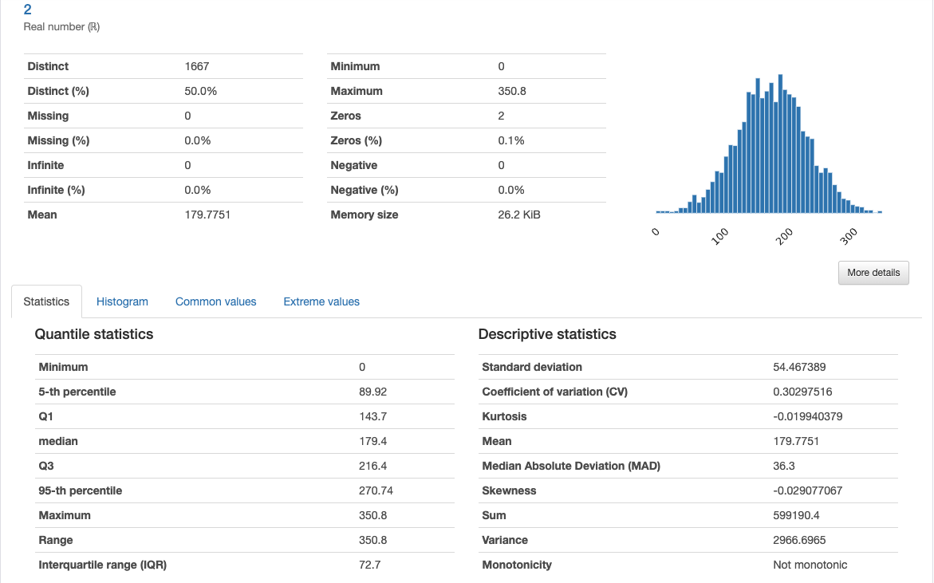
Weka Selected Attributes 2- Total Daily Minutes

Slide 14
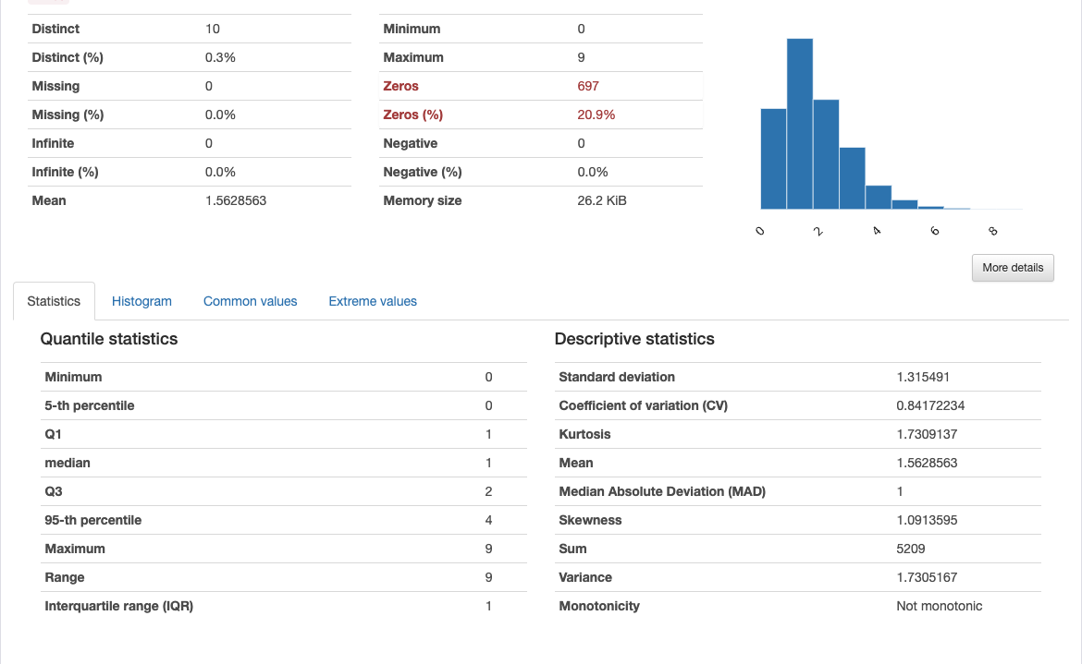
Weka Selected Attributes 3 - Number of customer Service Calls

Slide 15
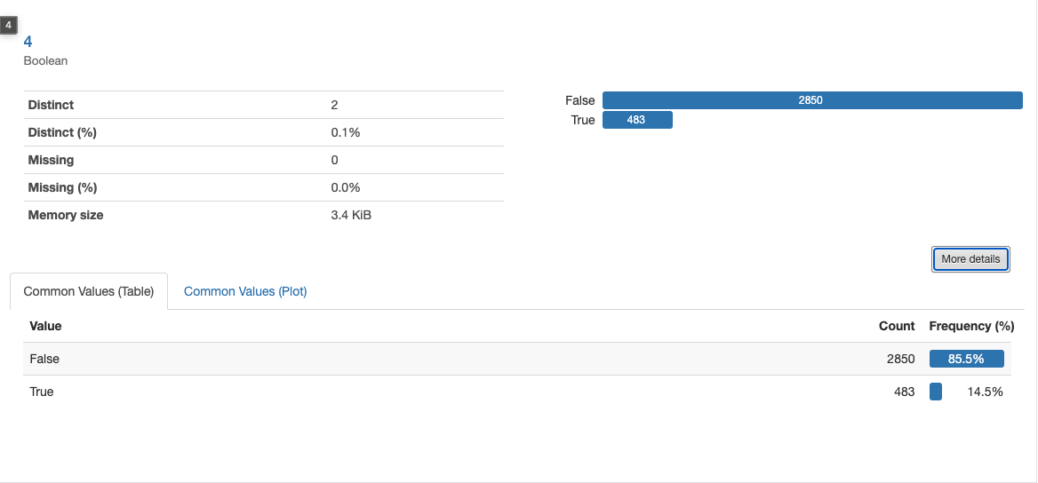
Weka Selected Attributes 4- Churn

Slide 16
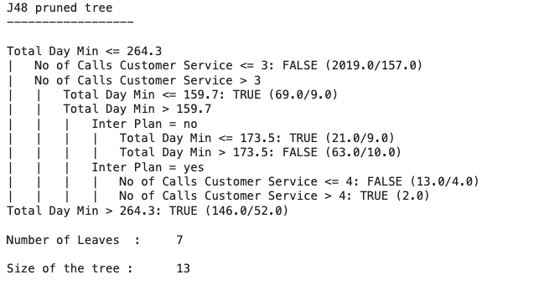
Filtered Data DT

Slide 17
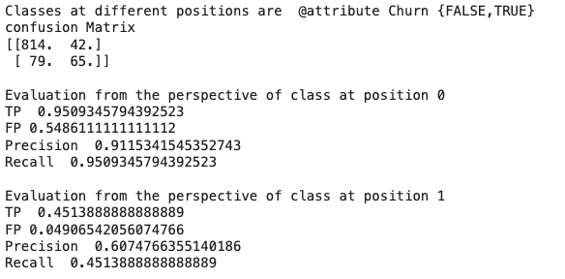
Metrics of DT for filtered data

Slide 18
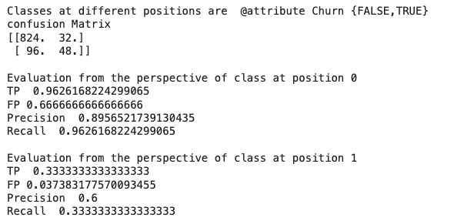
Metrics of NB for filtered data

Slide 19
Metrics Comparison
DT
NB
In this Model: what is desired for us is the FP of position 0 to below. So, the higher precision is desirable for us.
Also filtering data does not increase the percision.

Slide 20
Predictive Modeling
Evaluation method
Results
Model | Accuracy | Precision | Recall
Baseline decision tree | 93.6 | 94 | 98
Baseline Naïve Bayes | 87.6 | 91 | 93
Decision tree on selected features | 88.3 | 91 | 95
Naïve Bayes on selected features | 87.8 | 89 | 96
Notes:
Explain the evaluation method you used: cross validation or train-test set split
Fill out the table that will summarize your results
State which model is the best in your case. Are selected-features models they better than the baseline one?

Slide 21
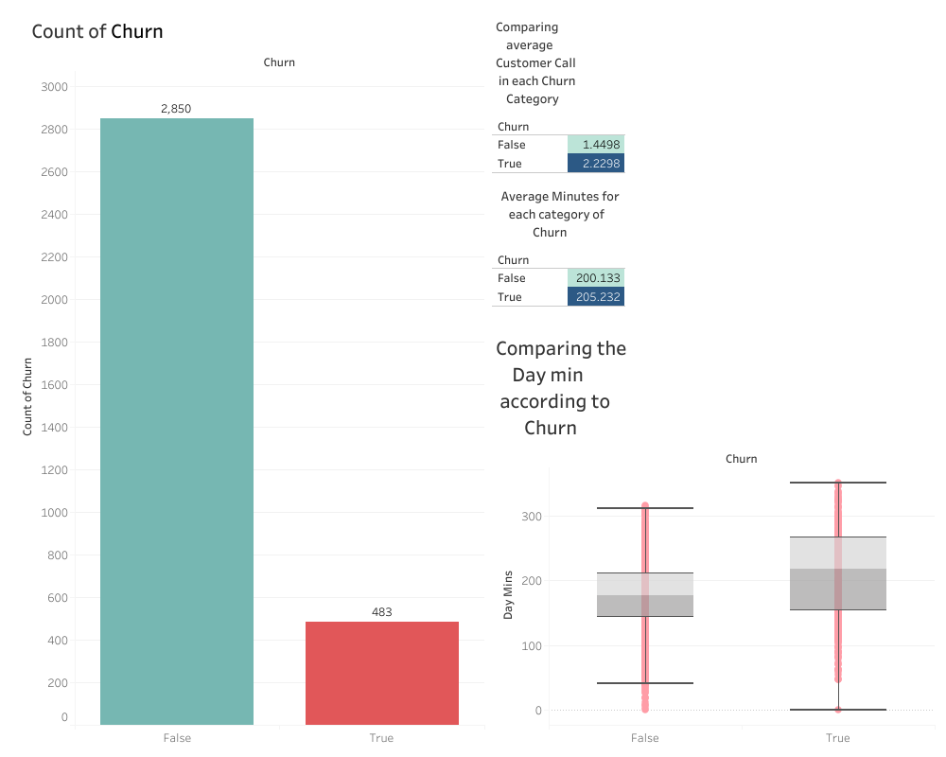

Slide 22
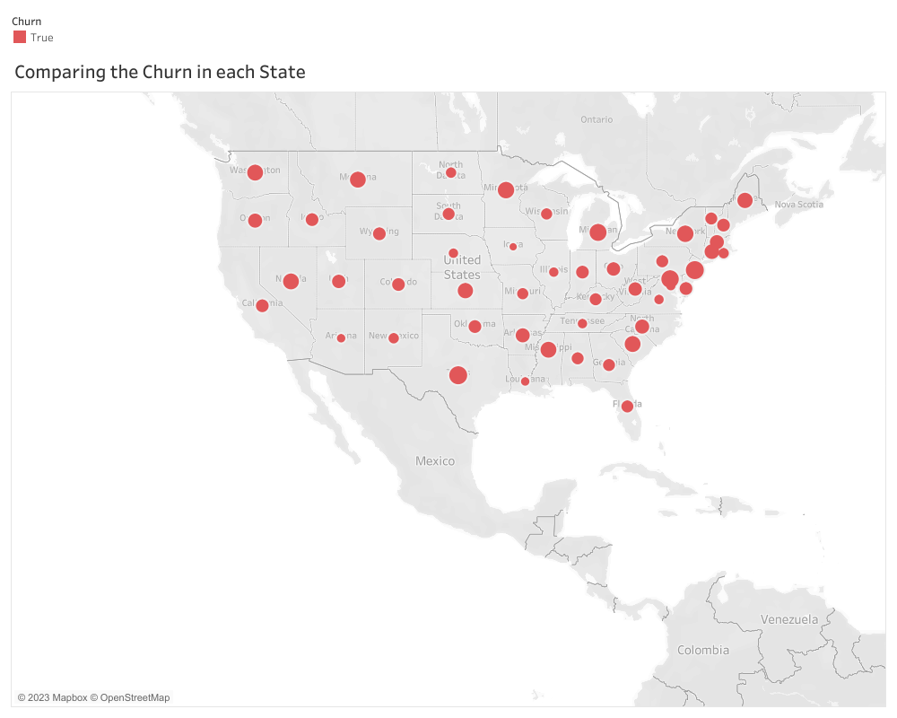

Slide 23
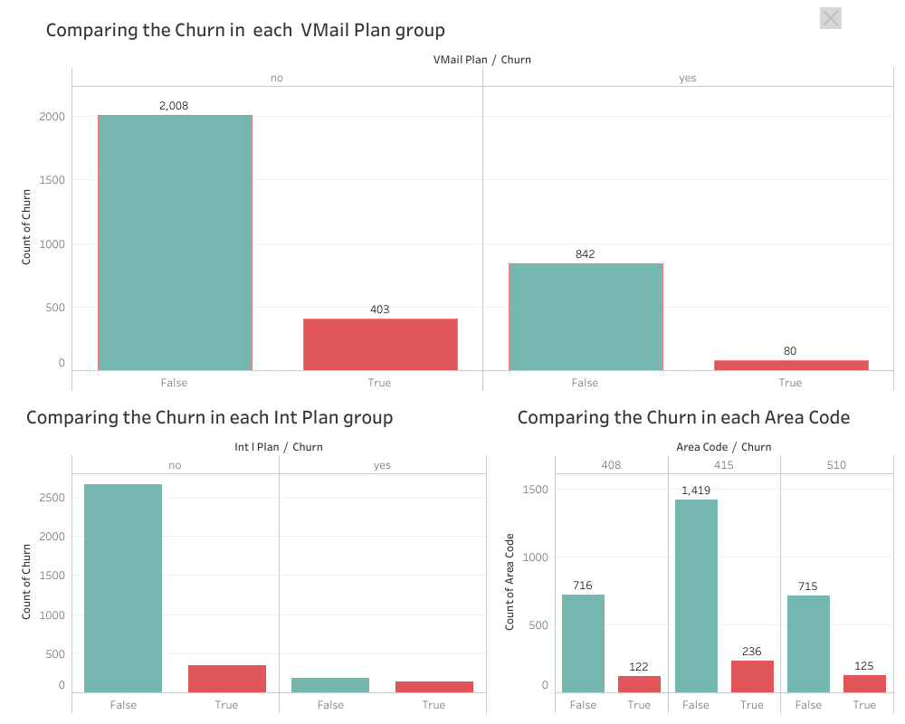

Slide 24
Findings according to data analysis
In the company, approximately 0.16% of the customers churned.
The average call number for customer service is higher for customers with churn (1.44 vs 2.22).
The median day minutes of speaking are higher.
Some states have a higher churn rate.
It seems that the number of churns in customers with a voicemail plan is lower.
Churn in customers with an international plan seems to be higher.
The number of churns in each area code is not significantly different.

Slide 25
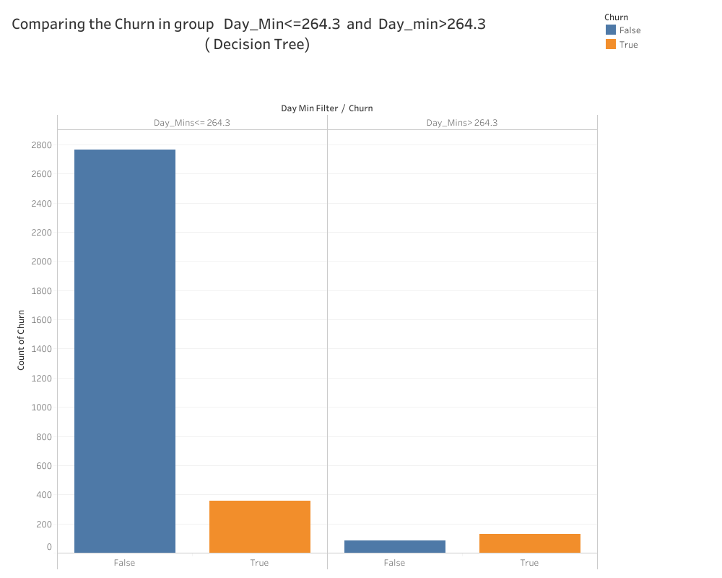

Slide 26
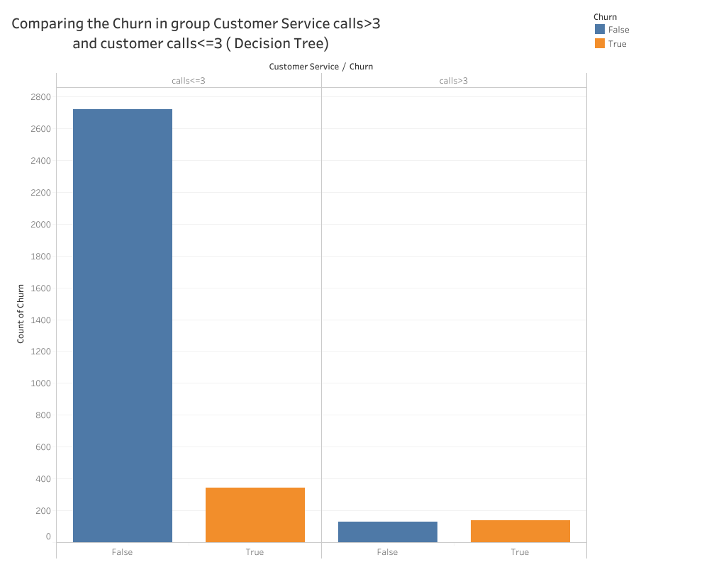

Slide 27
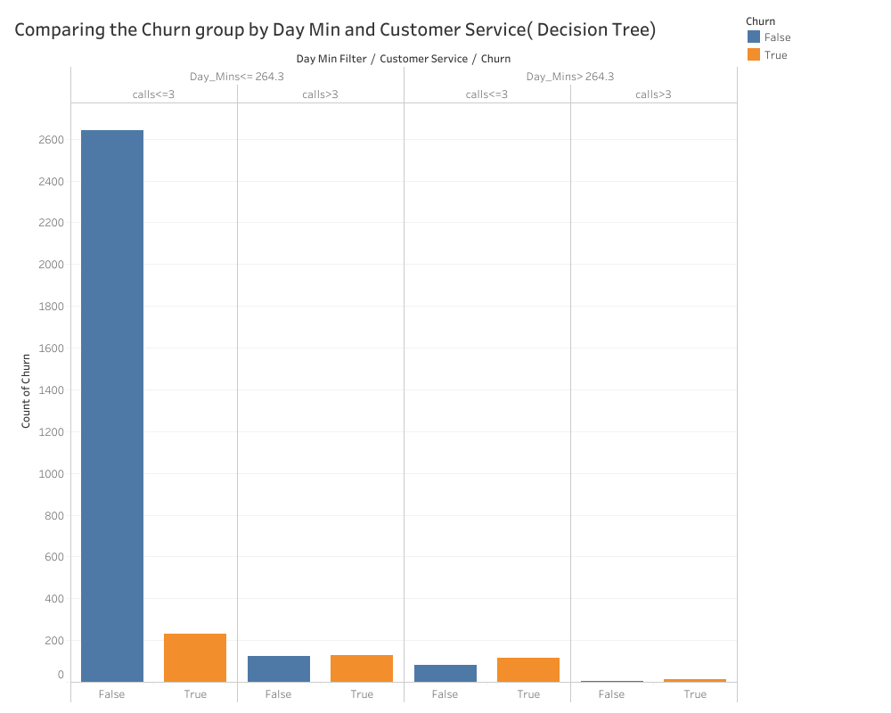

Slide 28
Findings and Suggestions: According to the decision
The number of churns in customers with Day minutes > 264.3 is truly significant; it implies that customers who use the telephone more are more likely to churn.
The number of churns in customers who call customer service more than 3 times is significantly higher.
If we consider these two factors as the roots of the issue, we have four situations:
Situation 1:
Day minutes <= 264.3 and customer service calls <= 3. Comparing to the column where we don't have churn, it seems natural. Maybe considering the state and, according to the high-risk state, offering a voicemail plan will be practical.

Slide 29
Findings and Suggestions: According to the decision
Situation 2: Day minutes <= 264.3 and customer service calls > 3. Work on customer service and handle the situation.
Situation 3: Day minutes > 264.3 and customer service calls <= 3. Giving discounts or promotions, such as international plans and voicemail plans, would be helpful.
Situation 4: Day minutes > 264.3 and customer service calls > 3. Investigate customer service problems and solve them

Slide 30
Conclusion and Recommendation
Identify customers with "Total Day Minutes" over 264.3 as potential churners. Create special campaigns to keep them as customers.
Improve the customer service experience . investigate the customer's issue. Understand the nature of the problem and gather all relevant information.
Offer discounts to increase their satisfaction and loyalty especially those with high "Total Day Minutes."It is good idea to offer them Int Plan or voice mail plan.
Regularly monitor customer usage patterns, especially "Total Day Minutes,"
Notes:
Tell the stakeholders (managers, CEOs, other data scientists, engineers) what are your final recommendation for the company.
Again the reminder, keep bullet points, figures or tables on the slide and for any additional explanation use the notes section on each slide.

Slide 31
Conclusion and Recommendation
Set up a feedback system to learn from customers facing issues
Offer exclusive benefits, rewards, or personalized communication to show customers they are valued.
Communicate effectively with customers in high-risk categories.
Regularly review and adjust pricing and plans to stay competitive.
Notes:
Tell the stakeholders (managers, CEOs, other data scientists, engineers) what are your final recommendation for the company.
Again the reminder, keep bullet points, figures or tables on the slide and for any additional explanation use the notes section on each slide.

