Slide 1
Host Behavior Analysis For Property Rental Company
SQL PROJECT- By Yaseen Malik
PREP1221053

Slide 2
Objectives for analysis
Analysis on different metrics to draw the distinction between Super Host and Other Hosts for Acceptance rate, response rate, instant booking, profile picture, identity verified, review scores.
Top 3 crucial metrics to become a Super Host.
Positive and Negative review analysis for super hosts and other hosts
Large property comparison between super host and Other hosts
Average price and availability of the listings for the upcoming year between Super Hosts and Other Hosts
Trends between Local Hosts or Hosts residing in other locations

Slide 3
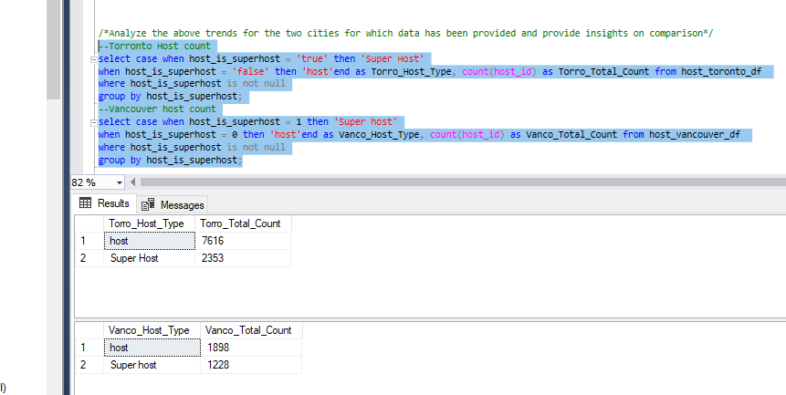
Hosts
Segregated super host and hosts for Toronto and Vancouver
Here we can see that
Toronto has the highest hosts 7616 compared with Vancouver which is 2353
Even the Super hosts in Toronto are comparably greater than Vancouver Super hosts.

Slide 4
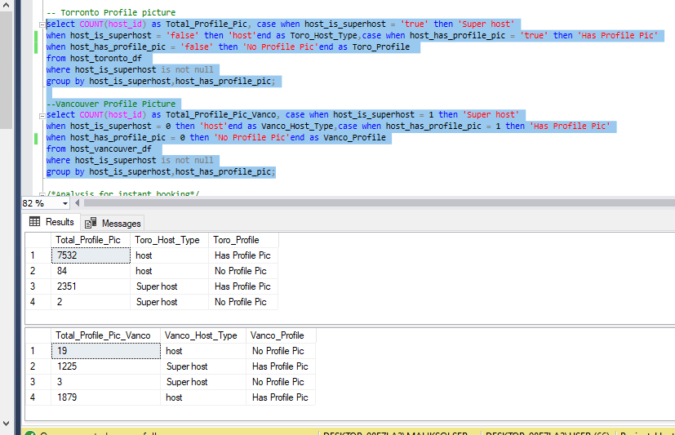
Profile picture
Most of the Super host has the profile pictures.
Super host who doesn’t have profile pictures comparably with the host is negligibly very low.

Slide 5
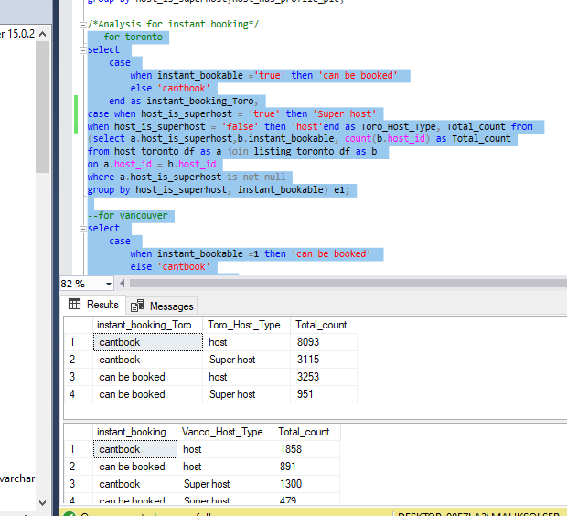
Instant booking
Super Host has very less rate of instant booking
Than the hosts

Slide 6
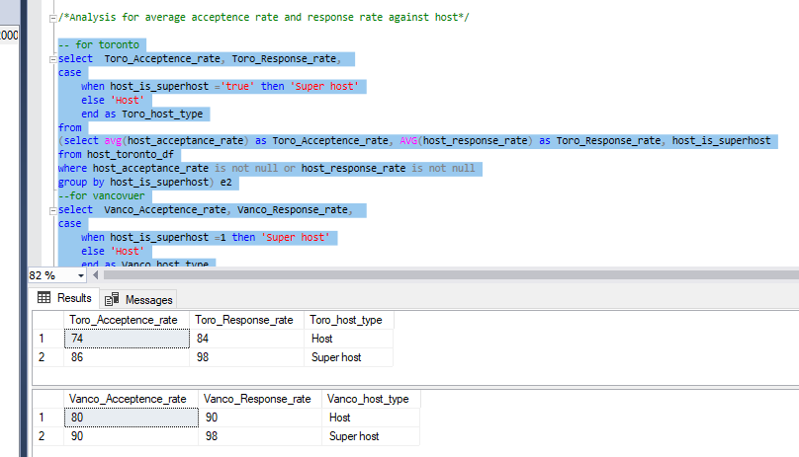
Acceptance and response rate
Average response rate and acceptance rate of Super hosts is higher than Hosts

Slide 7
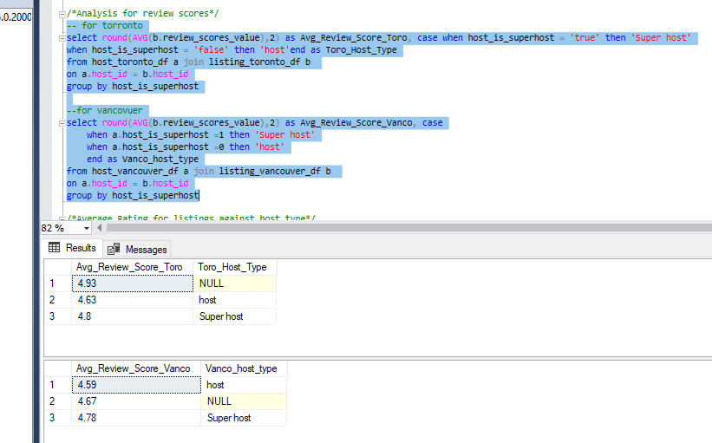
Average review score
Average review score of super host in Toronto is comparably good then super host in Vancouver.
If compared between host and super host, Super host has better average review score.

Slide 8
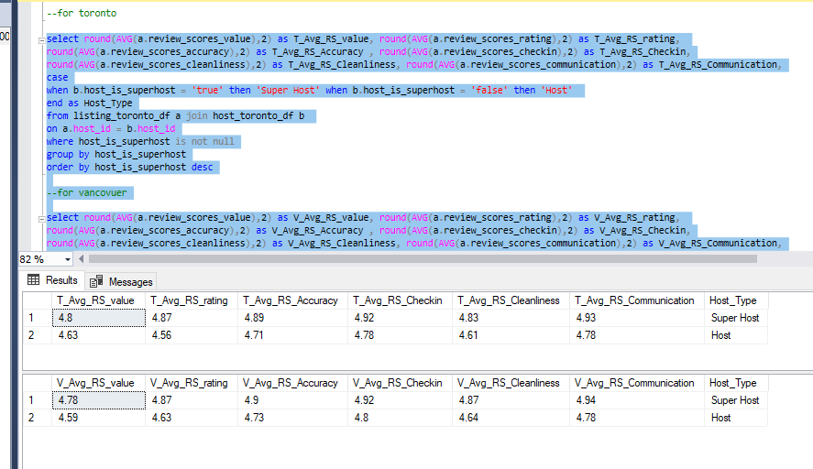
Review scores
Further review score analysis for different parameters in Toronto and Vancouver.

Slide 9
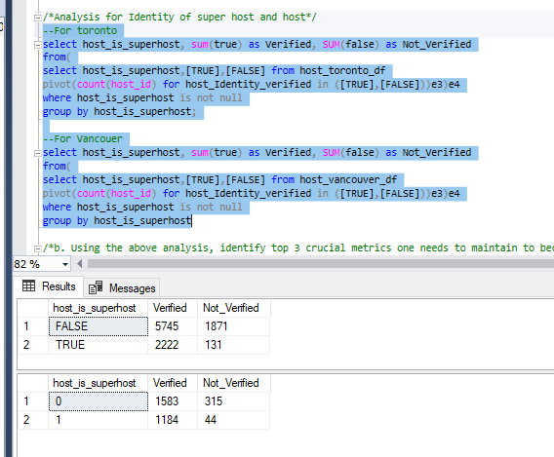
Host identity
Rate of Identity verified within super host is higher than the hosts.

Slide 10
Top 3 metrics
Three Important Parameters could be Profile Pic, Identity Verified and response/Acceptance rate. Host needs to fulfill these parameter to become super host

Slide 11
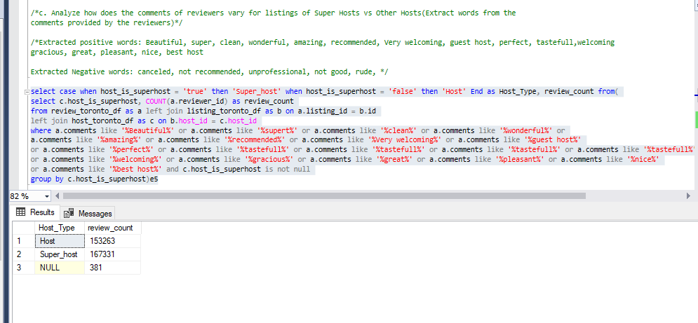
Positive and Negative Reviews
Analyzed positive and negative review count through same bag of positive and negative words.

Slide 12
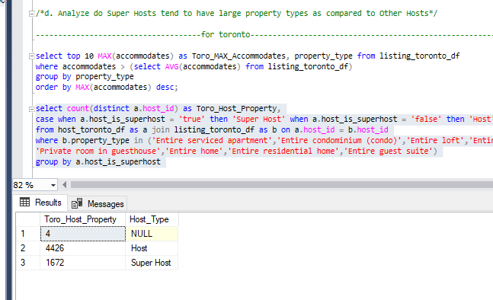
Host large property
Filtered out top 10 large property types on the basis of max accommodates.
Below is the analysis for the same large properties of super hosts and hosts in Toronto and Vancouver.

Slide 13
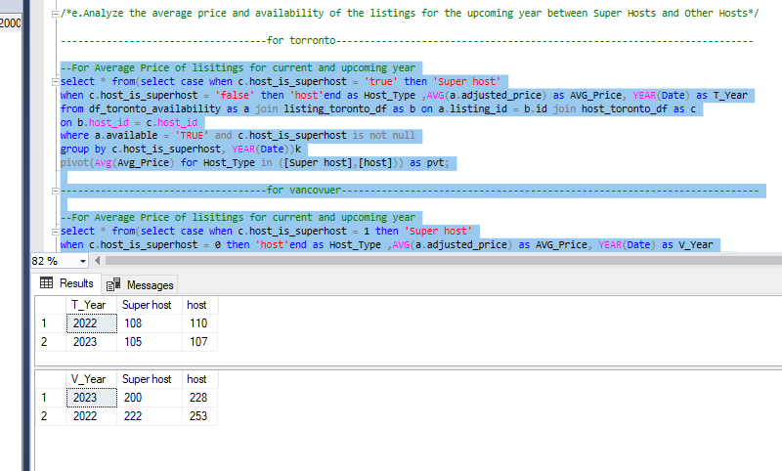
availability Listings for upcoming year
Availability listing of super host is low which shows the demand for upcoming year.

Slide 14
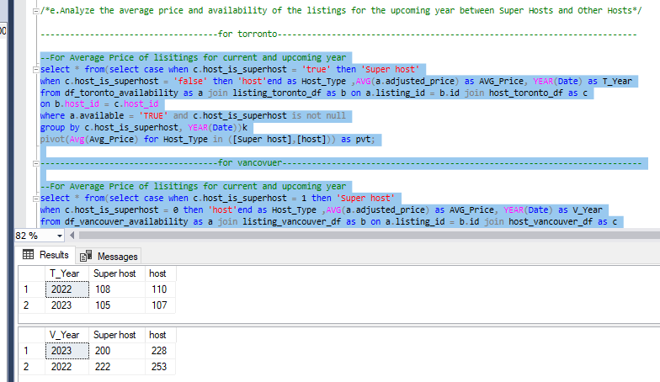
Price listing for upcoming year
Average adjusted Price for upcoming year has been analyzed where we can see Toronto average price for the listings is lower than Vancouver.

Slide 15
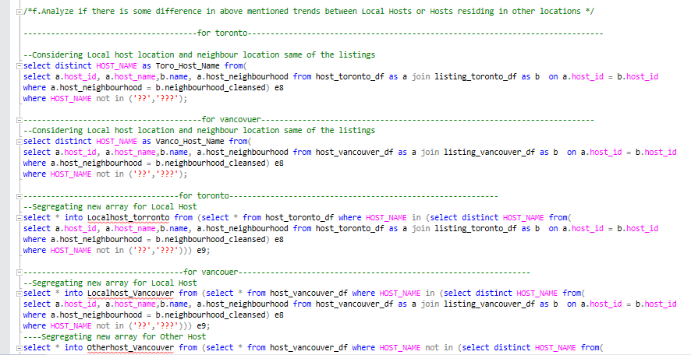
Localhost and otherhost
Segregated Hosts as localhost whose host location and their listing neighbour location are same.
And segregated remaining as the Other host.
Below is the analysis for Local and other host.

Slide 16
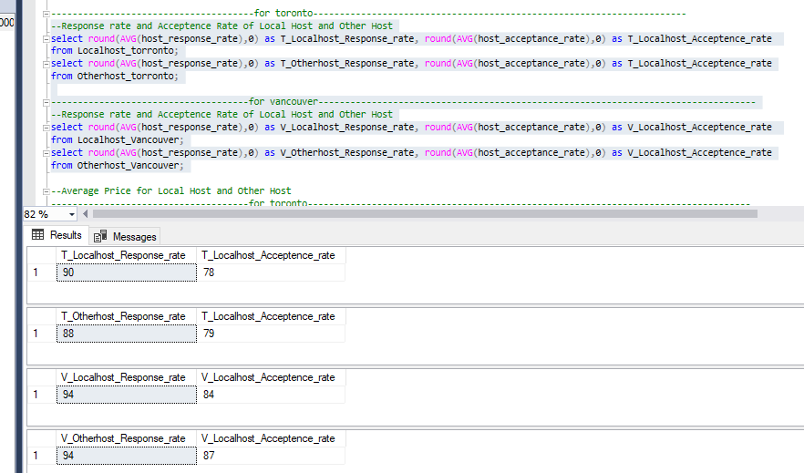
Response and acceptance rate for local and otherhost

Slide 17
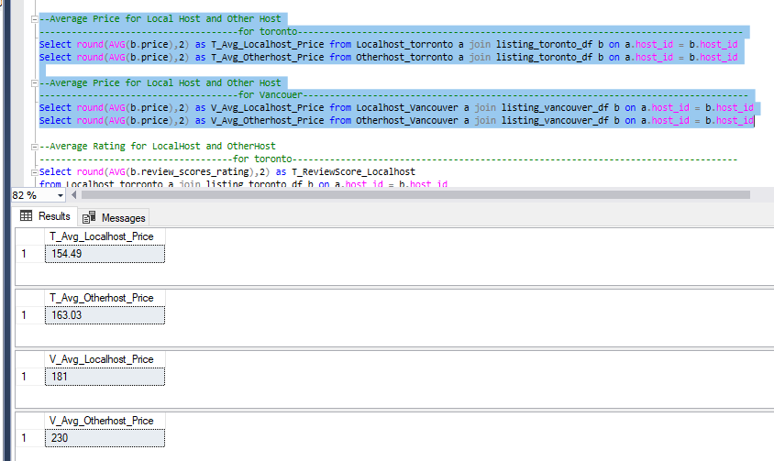
AVG price for local and other host

Slide 18
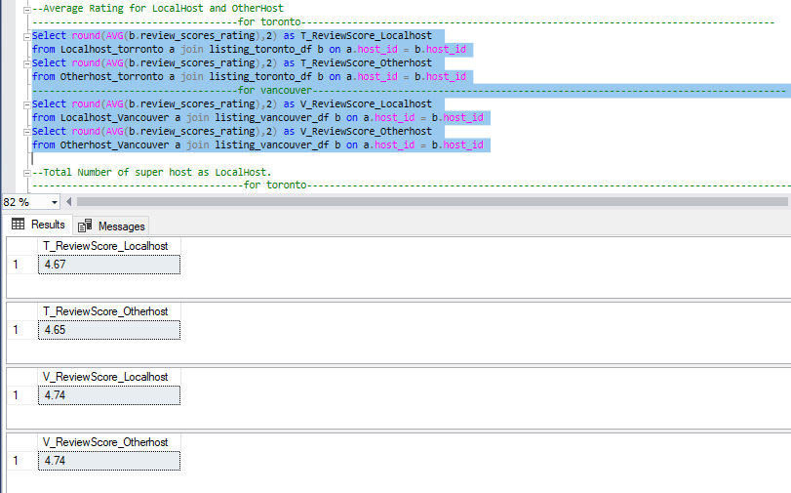
Average rating for local and other host

Slide 19
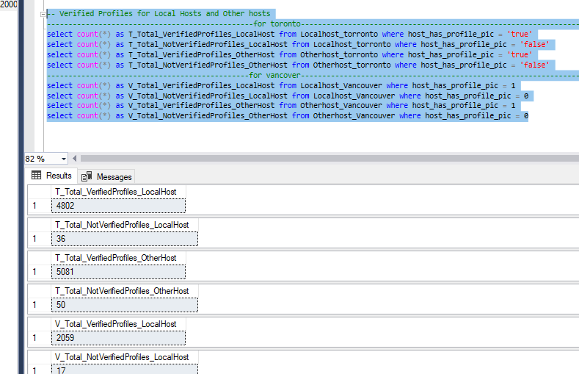
Verified profiles for local and other hosts
cc

Slide 20

Thank you

