Slide 1




NEXT GEN EMPLOYABILITY PROGRAM
Creating a future-ready workforce
Team Members
College Name
Student Name : MOHAMMED ABDUL MALIK
Student ID : au113321243027
VELAMMAL INSTITUTE OF TECHNOLOGY

Slide 2

CAPSTONE PROJECT SHOWCASE
Project Title
Music Web Application using Django Framework
Abstract | Problem Statement | Project Overview | Proposed Solution | Technology Used | Modelling & Results | Conclusion

Slide 3
Abstract
This project endeavors to develop a dynamic music web application utilizing the Django framework, aimed at providing users with a comprehensive platform for discovering, organizing, and enjoying music content. With a focus on user-centric design, the application will facilitate seamless user registration and authentication processes, ensuring secure access to personalized features and preferences. Users will have access to an extensive music library, enabling them to explore, search, and delve into a diverse collection of tracks, albums, and artists. Moreover, the application will empower users to curate their own personalized playlists, facilitating organization and easy access to their favorite songs. Leveraging Django's robust capabilities, the application will also offer seamless music streaming directly from the platform, eliminating the need for external software or plugins.
Source :

Slide 4
Problem Statement
The problem lies in the fragmented nature of current online music platforms, which lack a cohesive solution for personalized music discovery, organization, and social interaction. Users face challenges in accessing tailored recommendations and organizing their music libraries effectively, while the absence of robust social features limits their ability to engage with others. To address these issues, this project aims to develop a comprehensive music web application using the Django framework. By integrating personalized playlist creation, tailored music recommendations, and robust social interaction features, the application seeks to offer users a seamless and engaging music discovery experience, thereby filling the gap in the current online music landscape.
Source :

Slide 5
Project Overview
The project entails the development of a robust music web application utilizing the Django framework to provide users with an immersive and personalized music discovery experience. The application will feature functionalities such as user registration and authentication, a comprehensive music library, personalized playlist creation, music streaming, recommendation systems, and social interaction features. Through intuitive user interfaces and responsive design, the platform aims to ensure seamless accessibility across various devices. Leveraging Django's powerful capabilities, the project endeavors to address the fragmented nature of existing music platforms by offering a cohesive solution for discovering, organizing, and interacting with music content. By focusing on enhancing user engagement and satisfaction, the project aims to create a vibrant and dynamic community around music while filling the gaps in the current online music landscape.
Source :

Slide 6
Proposed Solution
The proposed solution is to develop a feature-rich music web application using the Django framework, designed to streamline music discovery, organization, and social interaction. The application will offer a user-friendly interface with seamless navigation, facilitating effortless access to a diverse music library. Key features include user authentication for personalized experiences, a comprehensive music catalog with search and browsing capabilities, and customizable playlist creation functionalities. Additionally, the application will integrate a recommendation system leveraging user preferences and listening history to offer tailored music suggestions. Social interaction features such as liking, commenting, and sharing will foster community engagement and facilitate music discovery among users. By prioritizing responsiveness and scalability, the proposed solution aims to deliver a cohesive and immersive music experience accessible across various devices, thereby addressing the shortcomings of existing music platforms and enhancing user satisfaction.
.
Source :

Slide 7
SOLUTION:
The proposed solution also includes robust backend infrastructure to support seamless music streaming directly within the application, eliminating the need for external plugins or software. Leveraging Django's powerful ORM and caching mechanisms, the application will ensure efficient data retrieval and delivery, enhancing overall performance and user experience. Furthermore, the integration of cloud storage solutions for music files will enable scalable and reliable content delivery, accommodating a growing user base and expanding music library.
Source :

Slide 8
SOLUTION:
Moreover, the project will prioritize user feedback and iterative development to continuously enhance and refine the application's features and functionalities. Through user testing and analytics, the team will gather insights to optimize the user experience, improve recommendation accuracy, and address any usability issues. Additionally, regular updates and maintenance will ensure the application remains secure, up-to-date with industry standards, and capable of meeting evolving user needs. By adopting an agile development approach and incorporating user-centric design principles, the proposed solution aims to deliver a cutting-edge music web application that sets new standards for personalized music discovery and engagement.

Slide 9

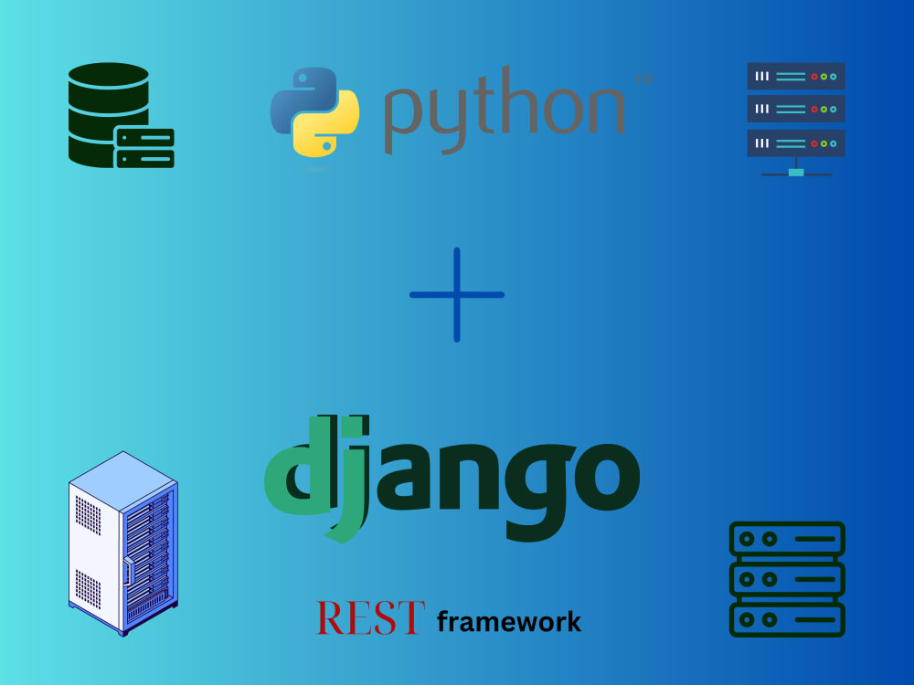
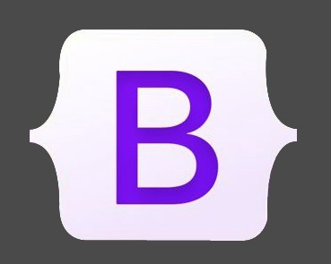
Technology Used
Front-end
Back-end
Source :

Slide 10
Modelling & Results
Data Modelling:
The project begins with data modelling, defining the database schema using Django's ORM (Object-Relational Mapping).
Entities such as User, Playlist, Song, and Artist are modelled, with appropriate relationships established to represent user interactions and music content organization.
Customizations such as defining primary keys and optimizing database queries are implemented to ensure efficient data storage and retrieval.
Implementation and Results:
Following data modelling, the implementation phase focuses on building features to enable music discovery, organization, and social interaction.
User registration and authentication functionalities are developed to provide personalized experiences and secure access to the application.
A comprehensive music library is implemented, allowing users to browse, search, and explore a vast collection of songs, albums, and artists.
Personalized playlist creation features enable users to curate their own collections of favorite songs, while recommendation systems suggest relevant music based on user preferences and listening history.
Source :

Slide 11
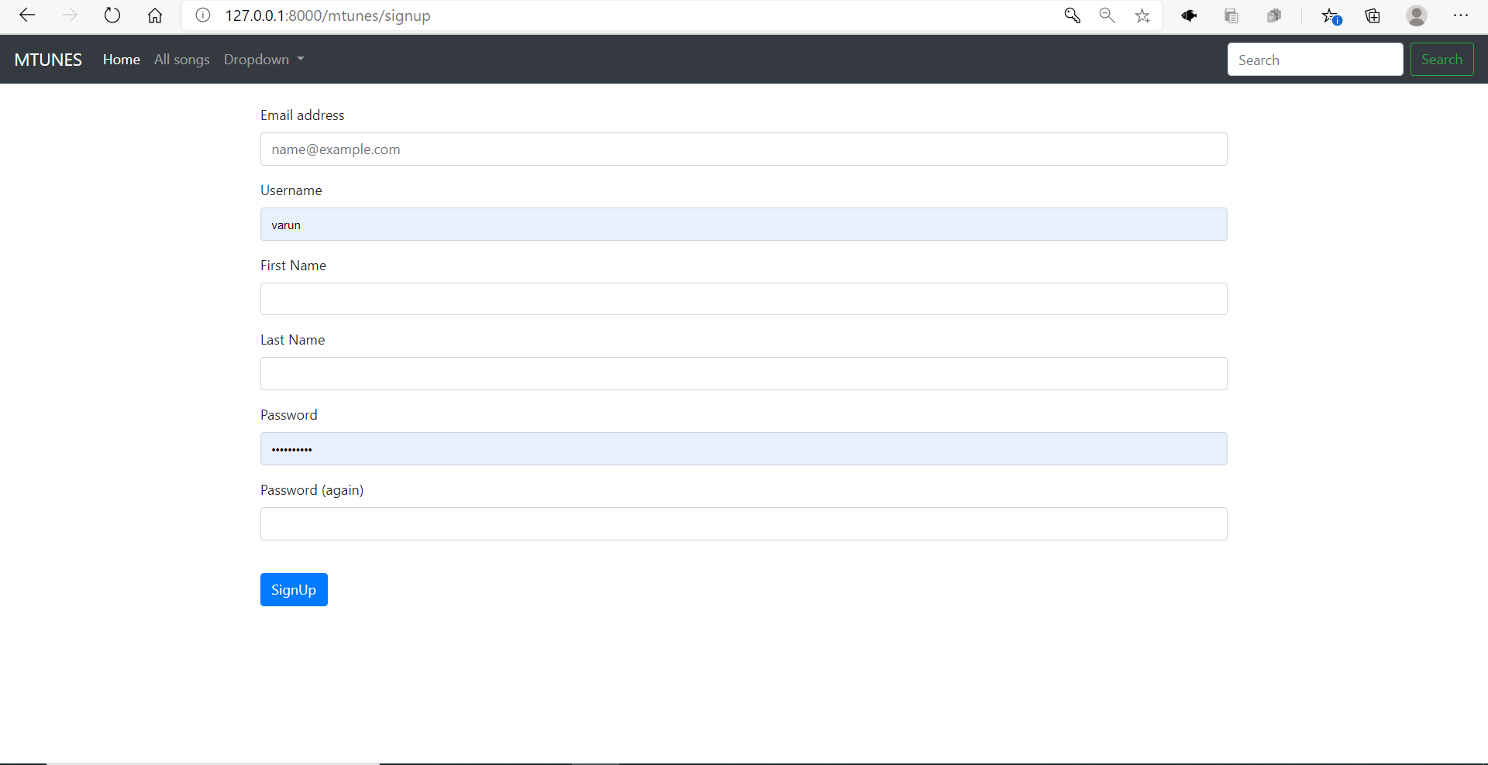
Signup Page

Slide 12
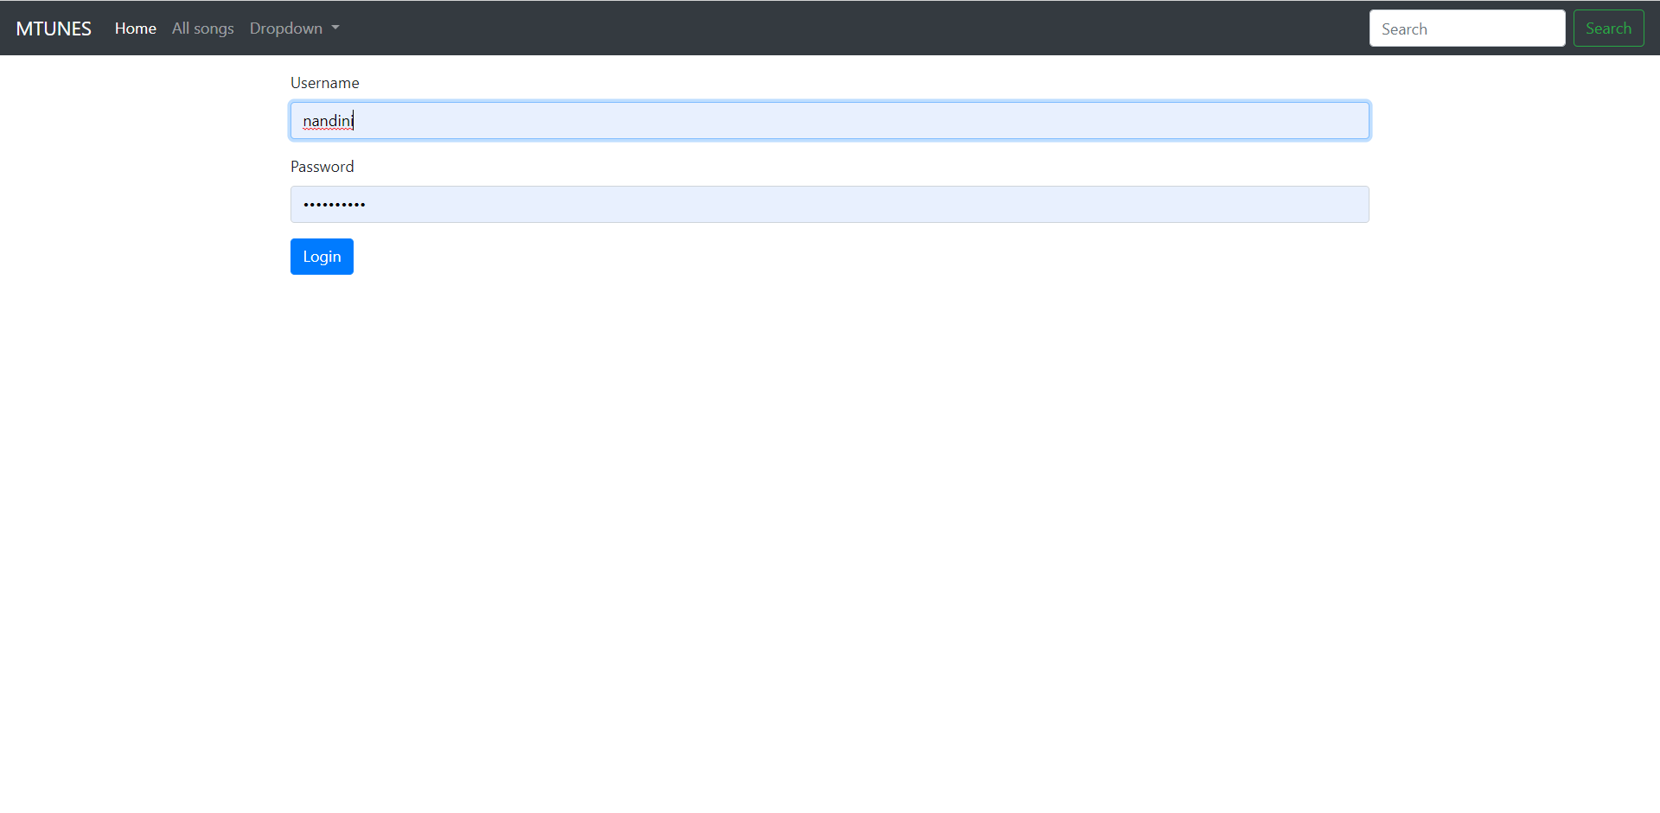
Login Page

Slide 13
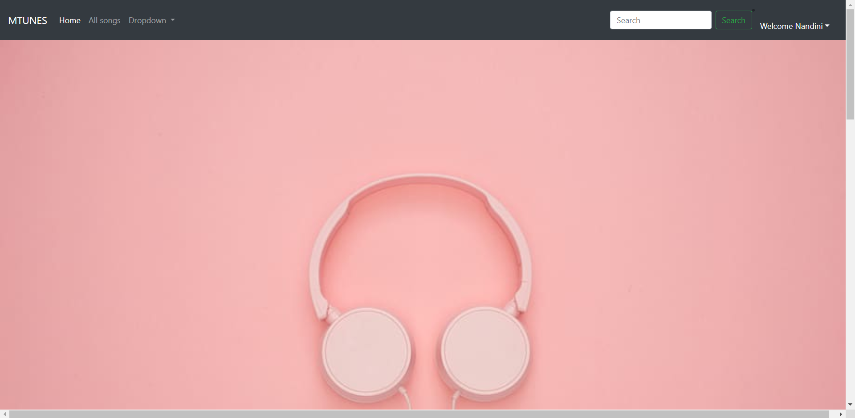
Home-Page

Slide 14
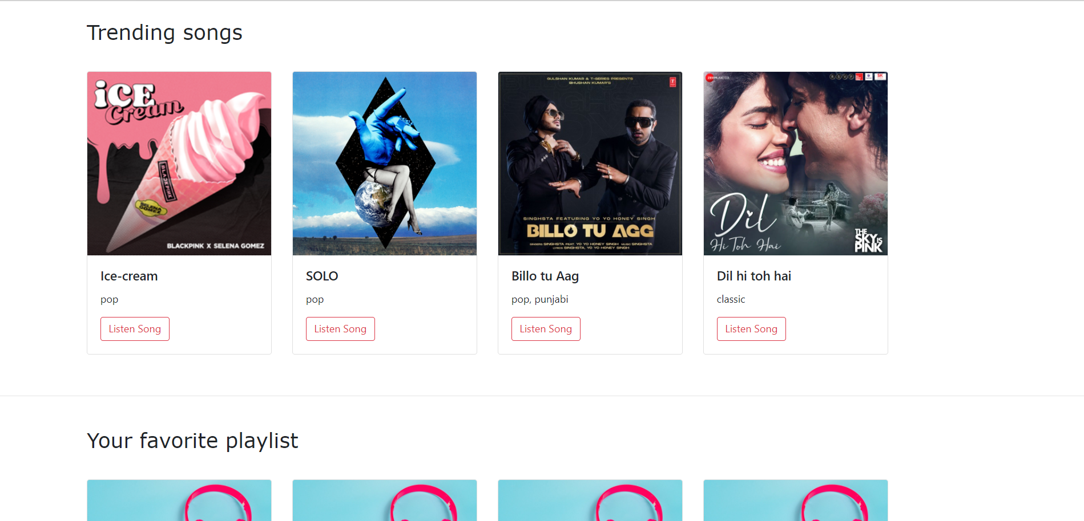
Home-Page 2

Slide 15
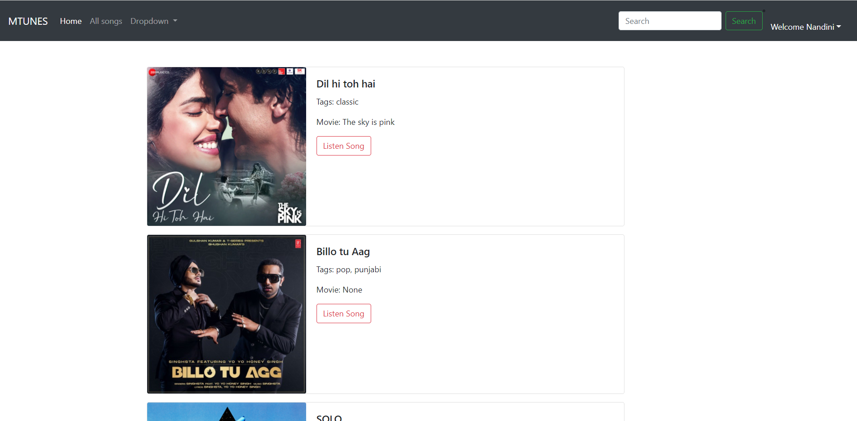
All songs

Slide 16
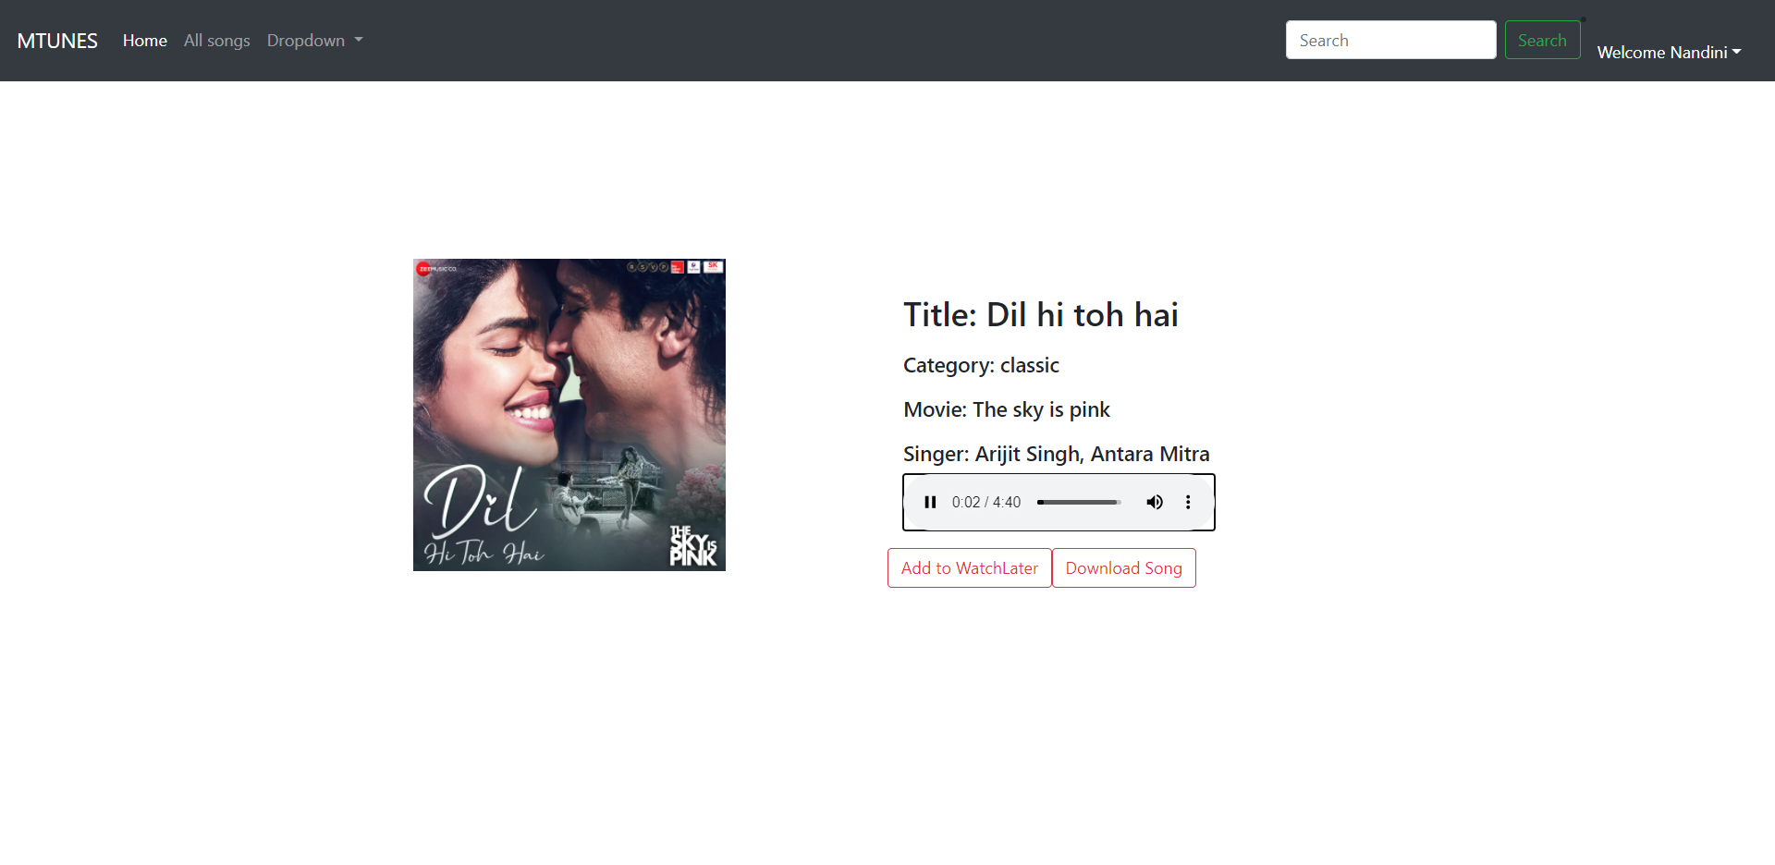
Song Page

Slide 17
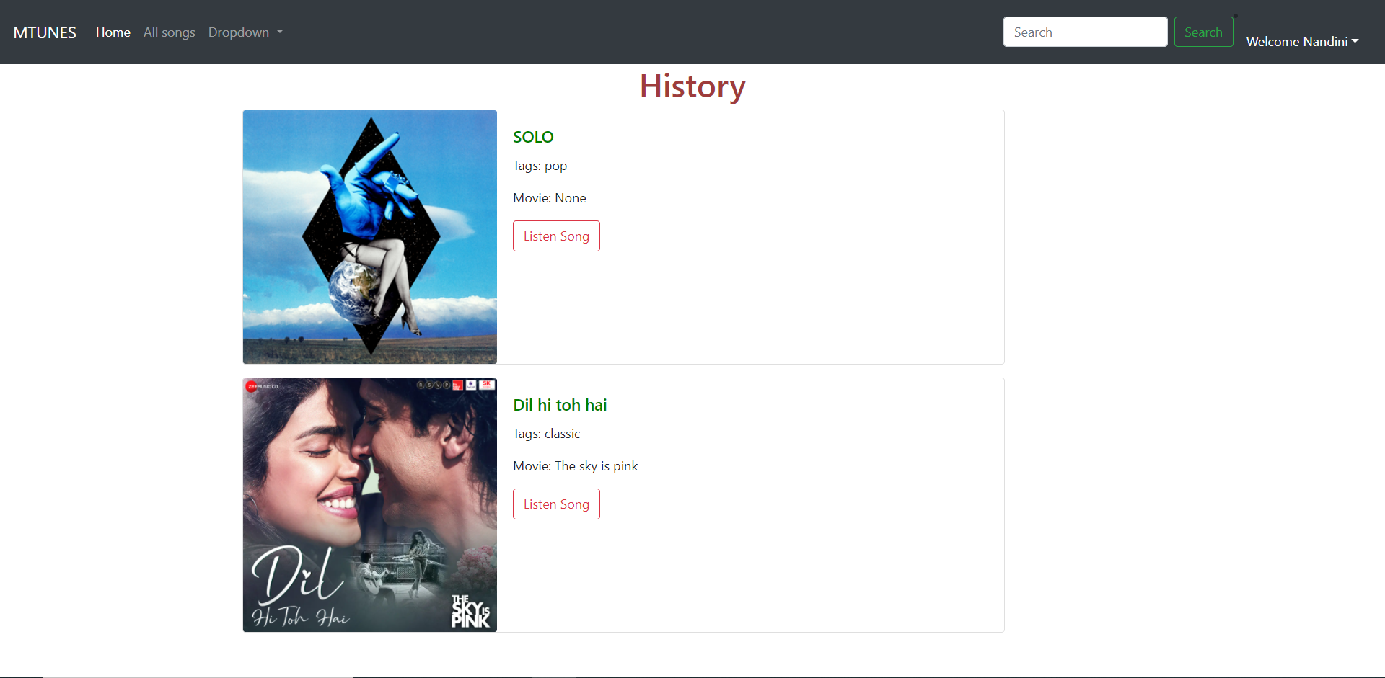
History Page

Slide 18
Future Enhancements:
Personalized Recommendations: Utilize advanced algorithms to analyze user listening habits, preferences, and contextual data to offer tailored music recommendations.
Social Integration: Implement features that enable users to connect with friends, share playlists, view what others are listening to, and collaborate on music discovery.
AI-Driven Playlist Creation: Employ artificial intelligence algorithms to curate playlists based on user preferences, mood, activity, and even contextual factors like weather or location.
Enhanced Discovery Tools: Develop tools such as interactive maps showcasing local music scenes, virtual concerts, or immersive experiences for users to explore new genres and artists.
Lyric Integration: Integrate lyrics into the app, allowing users to follow along with songs, search based on specific lyrics, and even provide translations for multilingual lyrics.
Live Streaming and Virtual Concerts: Partner with artists and venues to offer live streaming of concerts, virtual reality experiences, and exclusive behind-the-scenes content for users.
Music Education Resources: Provide tutorials, instrument lessons, music theory quizzes, and interactive challenges to help users learn more about music and improve their skills.
Voice Control and Integration: Enable voice-controlled commands for hands-free operation, allowing users to search for songs, control playback, and navigate the app using voice commands.

Slide 19
Conclusion
In conclusion, the development of a music web application using the Django framework presents an opportunity to address the existing challenges and gaps in the online music landscape. By leveraging Django's robust features and integrating personalized playlist creation, tailored recommendations, and social interaction functionalities, the proposed solution aims to provide users with a seamless and engaging music discovery experience. Through intuitive user interfaces, responsive design, and efficient backend infrastructure, the application seeks to streamline music streaming, organization, and community engagement. Furthermore, the project will prioritize continuous improvement through user feedback and iterative development, ensuring the application remains relevant, secure, and capable of meeting evolving user needs. Ultimately, the proposed solution holds the potential to redefine the way users discover, enjoy, and interact with music online, fostering a vibrant and dynamic community around shared musical interests.
Source :

Slide 20
Thank You!
Notes:
Thank You !!

