Slide 1
Presentation and Defense
By Malik Stewart

Slide 2
Introduction
The purpose of this project
To investigate how artificial data generation from original small sets can introduce bias as the data set increases
The scope involves data set selection (Iris), data generation technique (train_test_split), bias measurement (MI), results analysis, reporting, and future works.

Slide 3
Literature Review
Key takeaways
Literature review #1
Challenges (overfitting) and opportunities (new techniques) when working with small datasets.
Adaptation of of existing algorithms for large data sets to small data sets.
Bias in Transfer learning and synthetic data.
Literature Review #2
Defining small data
Applications of small data
Machine learning techniques for small data (SVM) (SD).
Notes:
Support vector machines, Synthetic data generation, applications involve health care.

Slide 4
Methodology
Topic: Measure how bias can occur when generating SD from a small data set
Bias qualification: Use of make_classification from scikit-learn to generate synthetic data.
Testing approach: Use Iris data set to generate synthetic data and measure bias with the use of Mutual Information.
Code Implementation: Use python to increase size of the data set, generate data, measure bias, and visualize results
Report the results

Slide 5
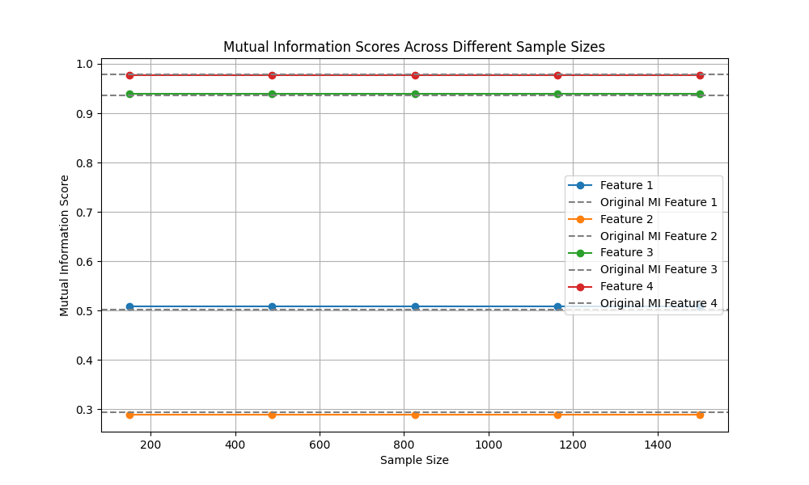
Results
Results: Concludes there is no bias because the MI remained stable as the set size increased.

Slide 6
Conclusion
Synthetic data generation can be used on smaller sets to create larger sets without resulting in bias.
Use of make_classification from scikit-learn can be used to generate data while keeping the integrity of the original data set.
The results show this method can be used on other datasets and yield similar results.

Slide 7
Future Work
Explore the applicability of this method on more complex data set.
Explore other data generation techniques and their results.
Explore other methods of measuring bias.

