Slide 1

George Vlad Manolache 1718986
Darian Balagiu 1719581
Petru Balan 1719379
Valentin Micu-Hontan 1718971
Horia Andrei Moraru 1710314
Detection of Negation and Uncertainty

Slide 2
Tagging tehniques
Rule Based
Machine learning
Deep learning

Slide 3
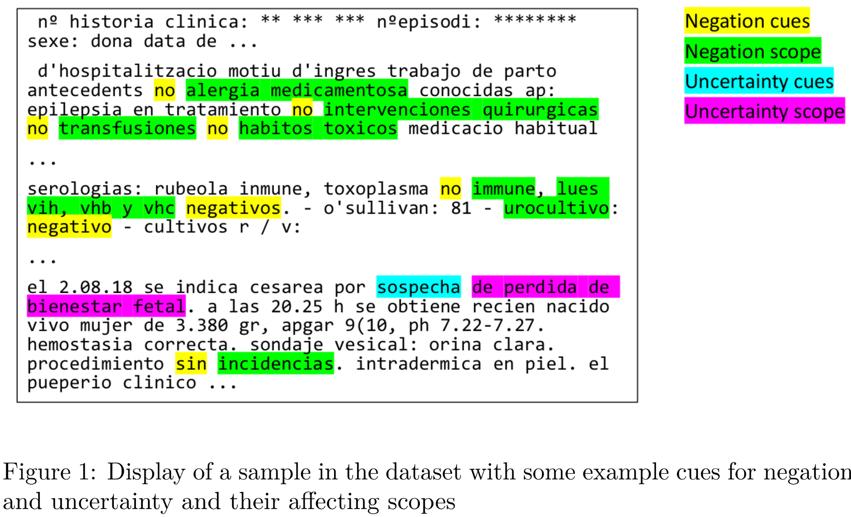
Introduction
The dataset we will be working with is a collection of real medical notes that have been manually labelled to find negation cues and negated sequences of words. The dataset is packaged in two JSON files.

Slide 4
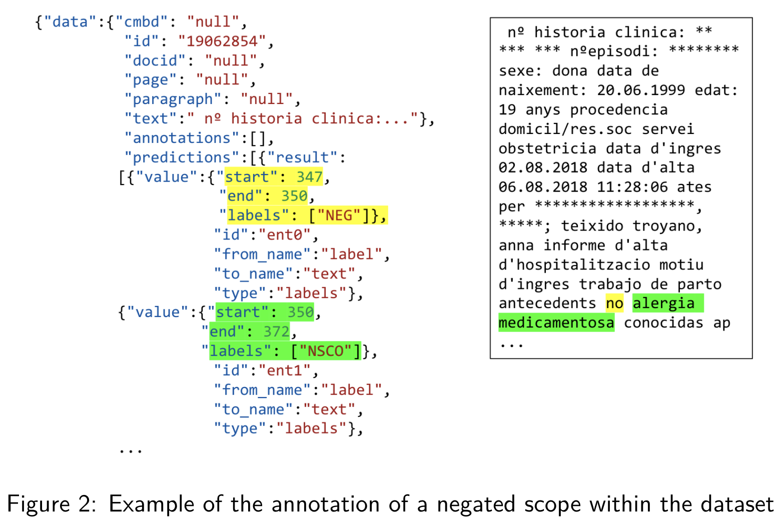
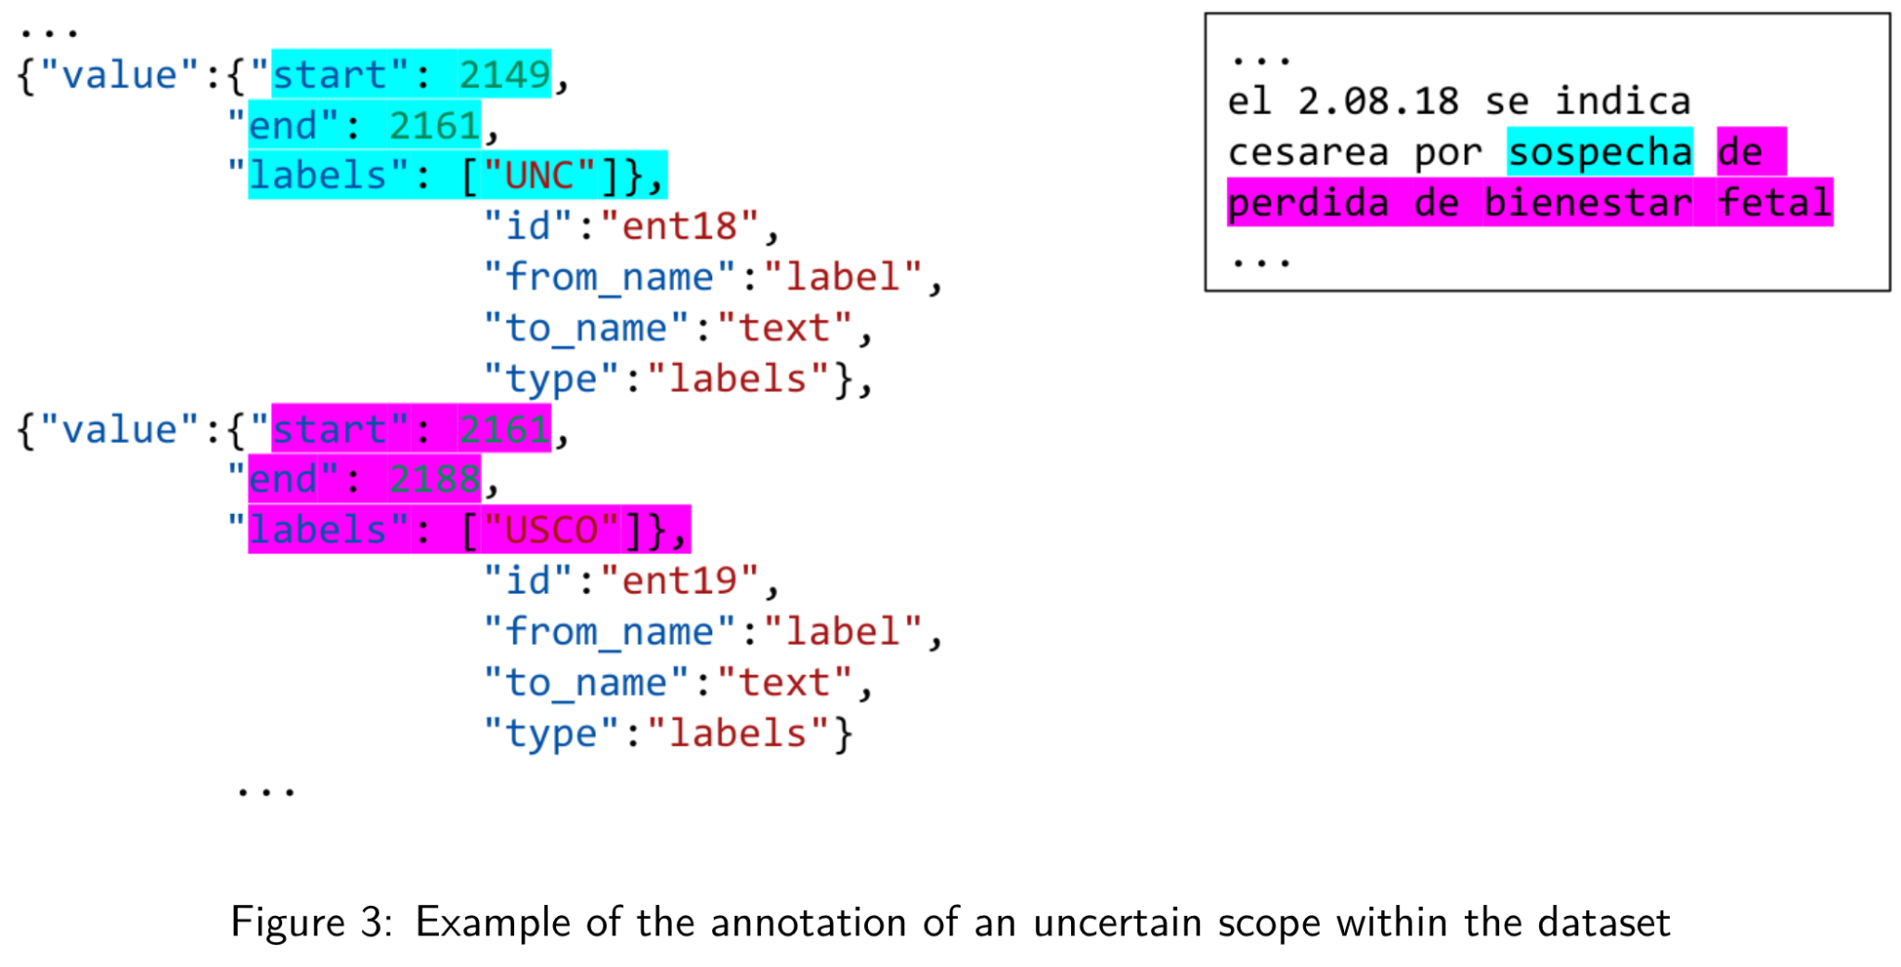
Extracting the Ground Truth

Slide 5
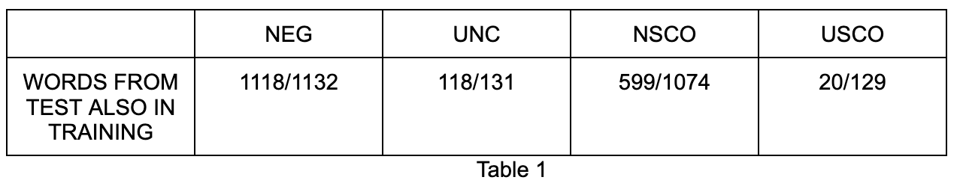
Data Set Analysis

Slide 6
Hypothesis
Negation and uncertainty cues are easier to find than scopes because they are easier to predict
NEG and UNC cues amount to much more constrained sets of words than NSCO and USCO scopes, so we can expect better precision on the cues
Scopes have unpredictable length and are a lot more likely to extend on various words
There is an obvious need for generating a corpus that contains medical terms that are likely to appear in documents
NEG | UNC | NSCO | USCO
no sin afebril niega negativo | posible probable compatible con sospecha de sugestiva de aparentemente probablemente | habitos toxicos incidencias doloroso a la palpación alergias medicamentosas alteraciones soplos ruidos sobreañadidos | integra malignidad proceso neoformativo la normalidad neoformacion broncopatia

Slide 7
Rule Based Model Algorithm
1.1 Create a vocabulary from training data. Extract words from the GT predictions.
1.2 Add CUTEXT terms
NEG: {'retiro', 'desaparicion del', 'afebril', 'suspendido', 'indetectable', 'se retira', 'ceden', 'excepto', 'arritmicos', … }
UNC: {'sugiera de', 'plantea', 'se desconoce', 'probablemente', 'desconocido', 'sospechan de', 'orientan', 'sugieran', … }
NSCO: {'itus', 'mg/dl -urocultivo', 'despistaje de virus respiratorio', 'reiniciar la vmni', 'palpo masas ni visceromegalias', … }
USCO: {'una polirradiculopatia senstivo-motora de caracteristicas desmielinizantes', 'crisis miastenica de predominio bulbar', … }
2. Generate a regex that is looking for cues and scopes next to each other
3. Apply the regex on each document
4. Map the words matched by the regex to the GT format: (start, end)
"start": 449,
"end": 452,
"labels": ["NEG"]
"start": 452,
"end": 468,
"labels": ["NSCO"]

Slide 8
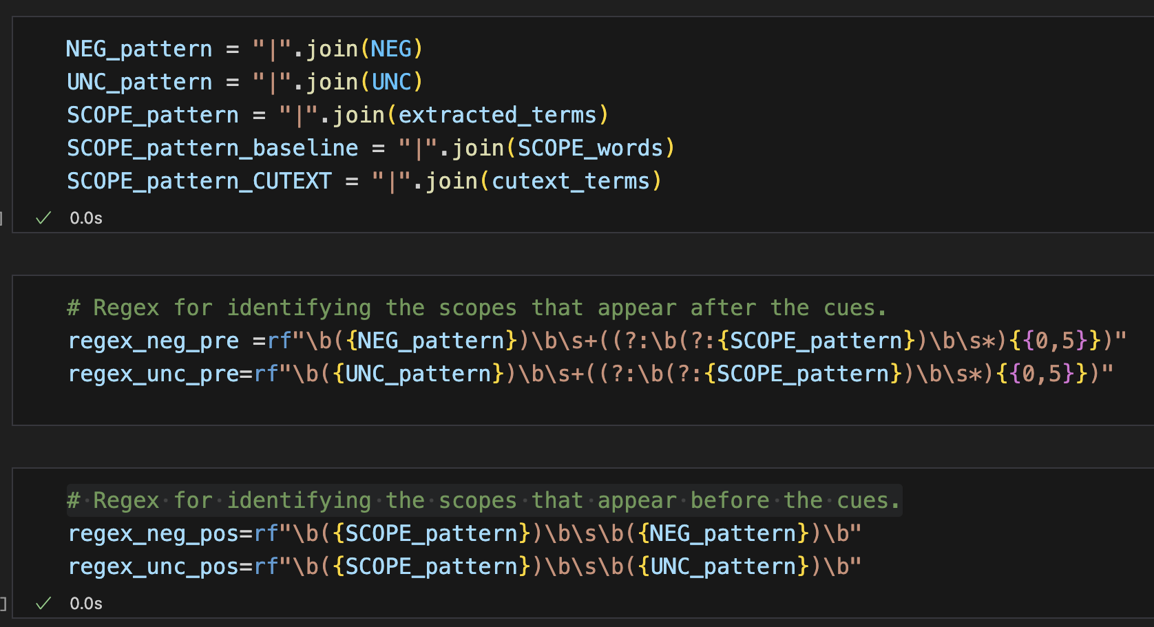
Generate the RegEx

Slide 9
Rule Based Model Algorithm
1.1 Create a vocabulary from training data. Extract words from the GT predictions.
1.2 Add CUTEXT terms
NEG: {'retiro', 'desaparicion del', 'afebril', 'suspendido', 'indetectable', 'se retira', 'ceden', 'excepto', 'arritmicos', … }
UNC: {'sugiera de', 'plantea', 'se desconoce', 'probablemente', 'desconocido', 'sospechan de', 'orientan', 'sugieran', … }
NSCO: {'itus', 'mg/dl -urocultivo', 'despistaje de virus respiratorio', 'reiniciar la vmni', 'palpo masas ni visceromegalias', … }
USCO: {'una polirradiculopatia senstivo-motora de caracteristicas desmielinizantes', 'crisis miastenica de predominio bulbar', … }
2. Generate a regex that is looking for cues and scopes next to each other
3. Apply the regex on each document
4. Map the words matched by the regex to the GT format: (start, end)
"start": 449,
"end": 452,
"labels": ["NEG"]
"start": 452,
"end": 468,
"labels": ["NSCO"]

Slide 10
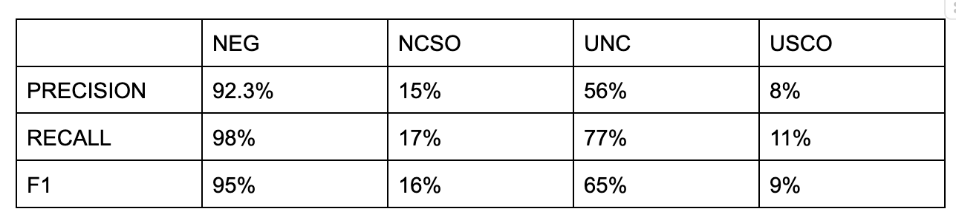
APPROACH 1: CUTEXT MEDICAL TERMS LIBRARY
There is not enough similarity between the imported corpus and the test set.

Slide 11
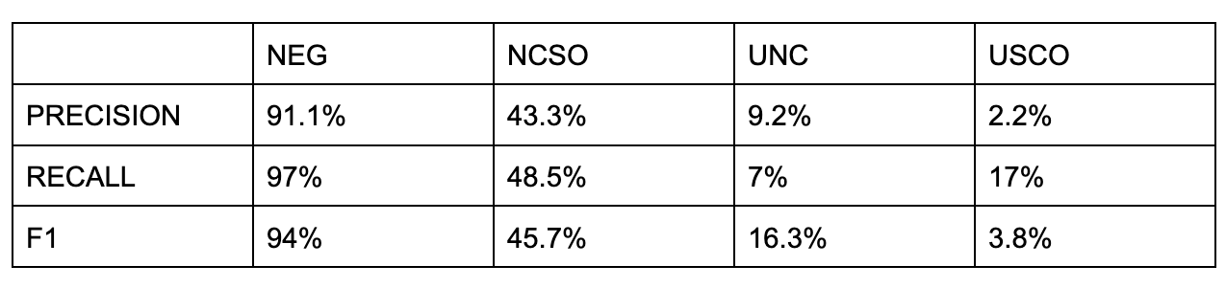
APPROACH 2: BASELINE
Cue words dispersion
NEG | UNC | NEG & UNC
‘Niega’, ‘negativo’, ‘negatividad | ‘Posible’, ‘Probable’, ‘Sospecha de’ | ‘Sin’ , ‘No’

Slide 12
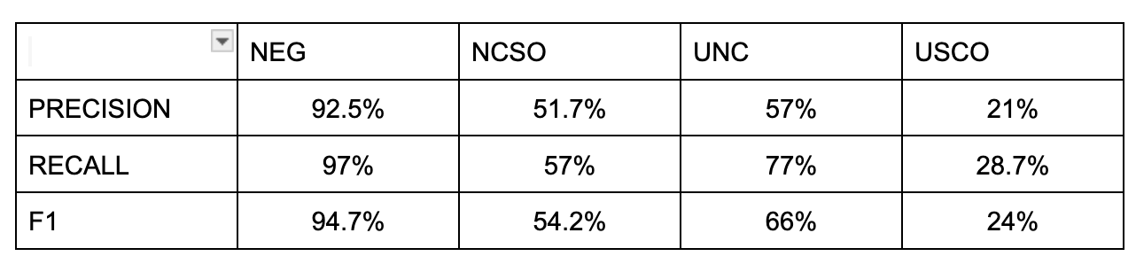
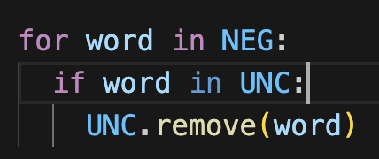
APPROACH 3: BASELINE + CUTEXT
Expanding the coverage of the model by combining the 2 vocabularies
Removing intersected words

Slide 13
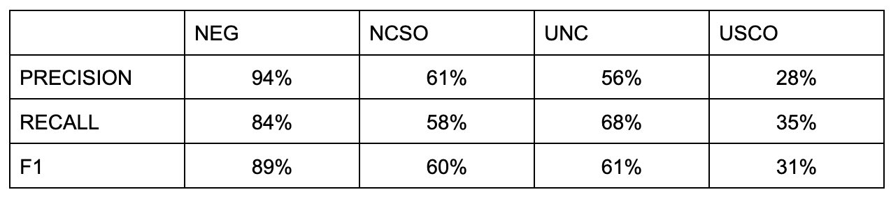
APPROACH 4: HONORABLE MENTIONS
Extending the scopes until the end of the sentence
Best ever performance on NSCO and USCO
Worse performance on NEG and UNC

Slide 14
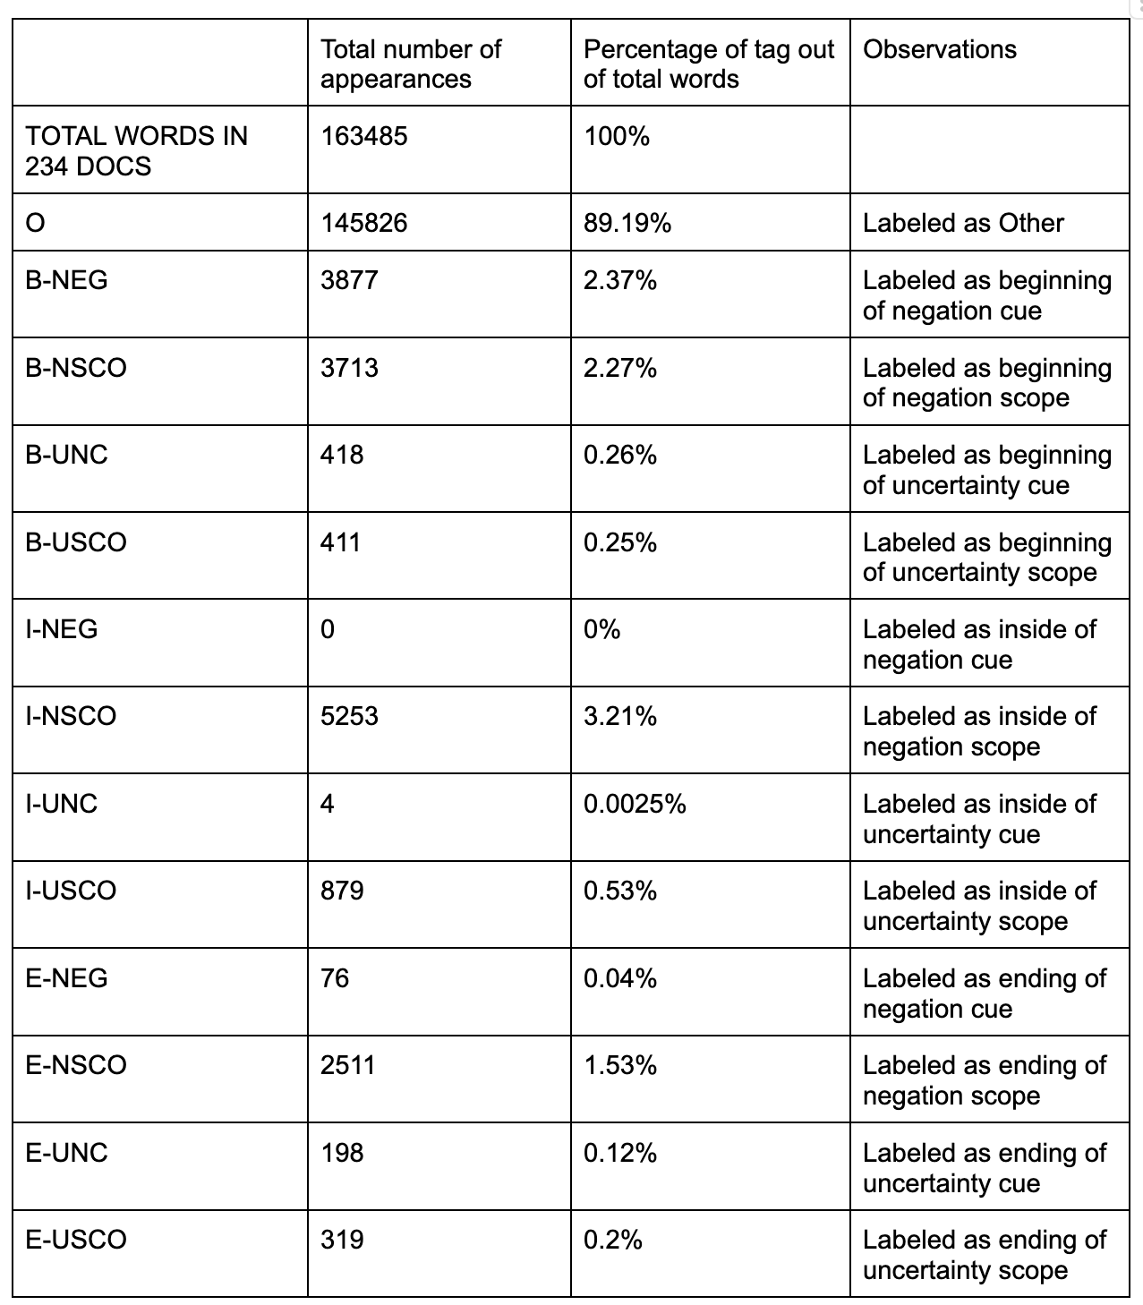
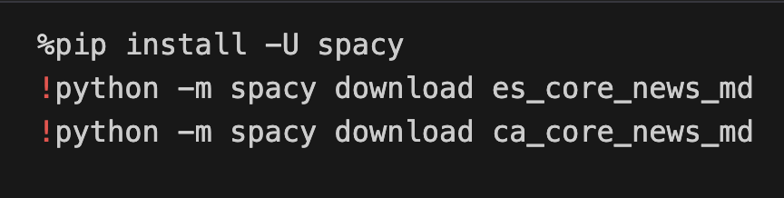
Machine Learning Model
Preprocessing
Uploading a language model for Spanish and Catalan
Removes non alphanumeric characters
Splits the documents into sentences
Extracts the lemma, PoS, suffix and prefix for each word
2. BIOE Tagging

Slide 15
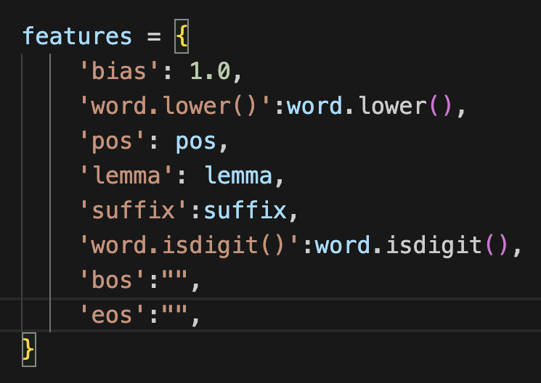
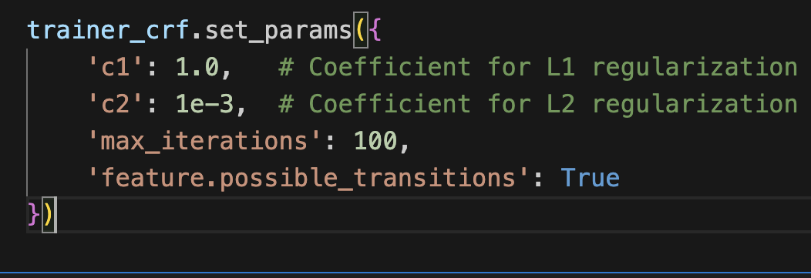
3. Training the CRF
Lowercase token, PoS, lemma, suffix
Specifying the position of the word in the sentence
Giving the model the ability to understand context by adding features of the nearby words with a window size of 3
{'bias': 1.0, 'word.lower()': 'no', 'pos': 'ADV', 'lemma': 'no', 'suffix': 'no', 'word.isdigit()': False, '+1:word.lower()': 'habitos', '+1:pos': 'NOUN', '+1:lemma': 'habito', '+1:suffix': 'tos', '+1:word.isdigit()': False, '+2:word.lower()': 'toxicos', '+2:pos': 'ADJ', '+2:lemma': 'toxico', '+2:suffix': 'cos', '+2:word.isdigit()': False, 'bos': True, 'eos': False}

Slide 16
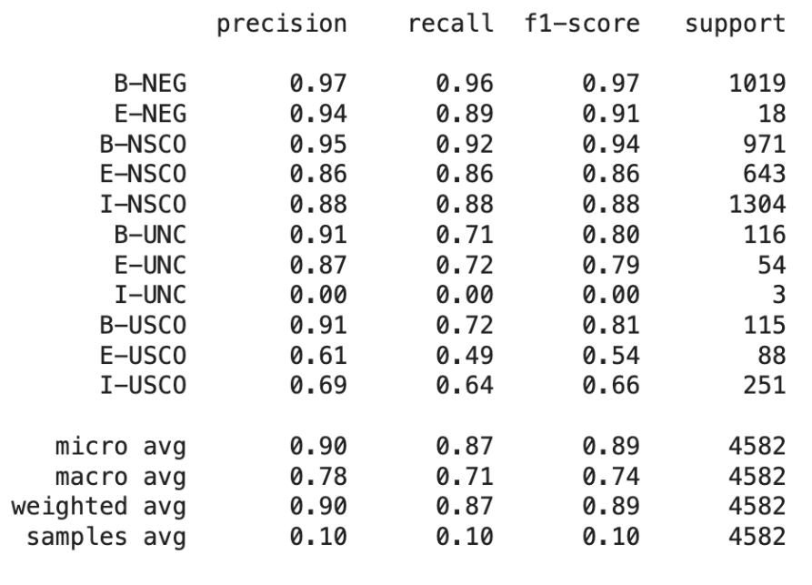
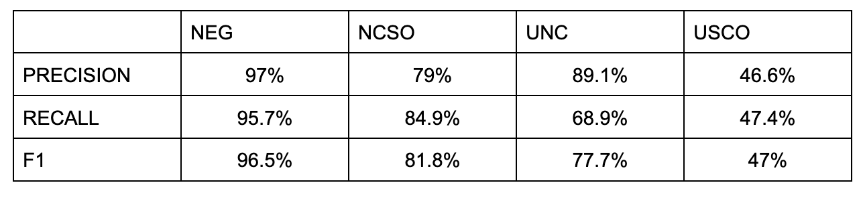
4. Labelling words from Test Set
→
→
Mapping BIOE tags to
NEG,UNC,NSCO,USCO

Slide 17
Deep Learning Model
Sentence Tagging and processing
The ground truth that the model tries to predict is the sentence tagged with the followings tags that we later index:
B-NEG: Beginning of Negation
E-NEG: End of Negation
B-NSCO: Beginning of Negation Scope
I-NSCO: Inside of Negation Scope
E-NSCO: End of Negation Scope
B-UNC: Beginning of Uncertainty
E-UNC: End of Uncertainty
I-UNC: Inside of Uncertainty
B-USCO: Beginning of Uncertainty Scope
I-USCO: Beginning of Uncertainty Scope
E-USCO: End of Uncertainty Scope
O: Other
Before giving it to the training set as ground truth, we marked the start and end of every sentence with indexes and added padding to give every sentence the same length to prepare
it for the data loader.

Slide 18
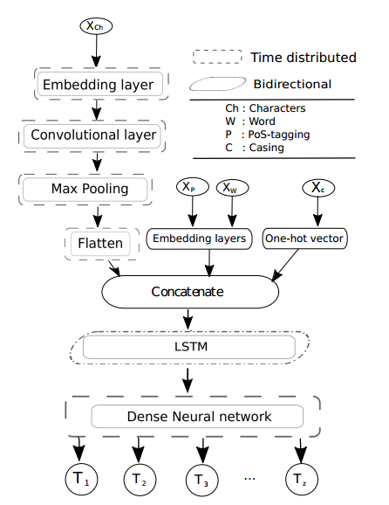
Architecture
The architecture of the model is the following:
– Word Embedding dimension: 300
– Embeddings dimension (Characters / PoS-tagging): 50 / 50
– One-hot dimension (Casing): 8
– Bi-LSTM output dimension: 128 (per each LSTM)
– 2 Dense layers after Bi-LSTM layer: 128 respectively 16 (tag size) for predictions
– Conv2D (kernel size / filter): 3 / 28
– Batch size / Model optimizer: 64 / Adam optimizer [12]

Slide 19
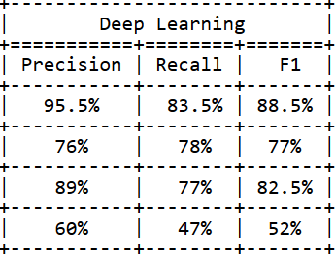
Results
We think that the Deep Learning model didn’t achieve the best results in all categories as expected, because we did not have enough data to train the model.

Slide 20
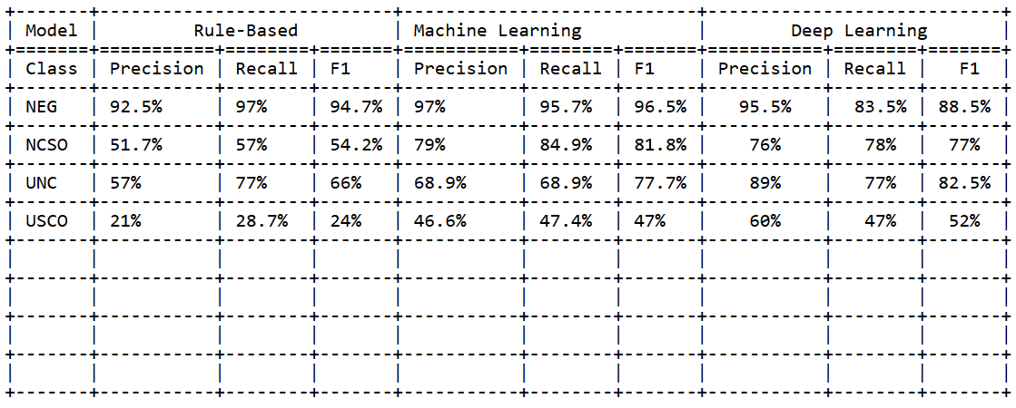
Comparison between models

Slide 21
Comparison between models
Deep Learning: High performance, especially in precision for NEG and UNC classes. Best choice for accurate negation and uncertainty detection.
Machine Learning: Strong performance, particularly in NCSO class. Balanced and reliable across all metrics.
Rule-Based: Least effective, with lower precision, recall, and F1 scores across all classes. Suitable for simpler scenarios.

Slide 22
Conclusions
This study explored various models for detecting negation and uncertainty cues in medical documents. We compared Rule-Based, Machine Learning, and Deep Learning models, highlighting their effectiveness across different classes of negation and uncertainty.

Slide 23
Conclusions
This study explored various models for detecting negation and uncertainty cues in medical documents. We compared Rule-Based, Machine Learning, and Deep Learning models, highlighting their effectiveness across different classes of negation and uncertainty.
While the Machine Learning model proved to be the most effective overall, the Deep Learning model shows significant potential, especially with more training data. The Rule-Based model, although less effective, provides a baseline for simpler scenarios.

Slide 24
Bibliography
Rule-based Methods
Universidad Politécnica de Madrid
An Approach to Detect Negation on Medical Documents in Spanish
Integrating Speculation Detection (2021)
University of Pittsburgh
A Simple Algorithm for Identifying Negated Findings and Diseases (2002)

Slide 25
Bibliography
Machine Learning Methods
Universitat de Barcelona, Spain
Detection of Negation Cues in Spanish: TheCLiC-Neg System (2019)
University of Antwerp
A metalearning approach to processing the scope of negation (2009)
Universitat Politècnica de Catalunya
Negation Cues Detection Using CRF on Spanish Product Review Texts (2018)
University of Oslo, Department of Informatics
An open-source tool for negation detection: a maximum-margin approach (2017)

Slide 26
Bibliography
Deep Learning Methods
Universidad Nacional de Educación a Distancia (UNED)
University of Oslo, Department of Informatics (2018)
H. Fabregat, A. Duque, L. Araujo
Extending a Deep Learning Approach for Negation Cues Detection in Spanish (2019)
University of Edinburgh
Neural Networks For Negation Scope Detection (2016)

Slide 27
Questions?

