Slide 1
AI in Education
Empowering Teachers with Artificial Intelligence

Slide 2



REALITY CHECK
Today we're not here to replace teachers.
We're here to make teachers more powerful.
How many teachers spend more than 2 hours making notes?
How many spend Sunday checking assignments?
If AI can save 60–70% of that time, would you like to learn it?
AI should act as an academic assistant rather than replacing educators.

Slide 3
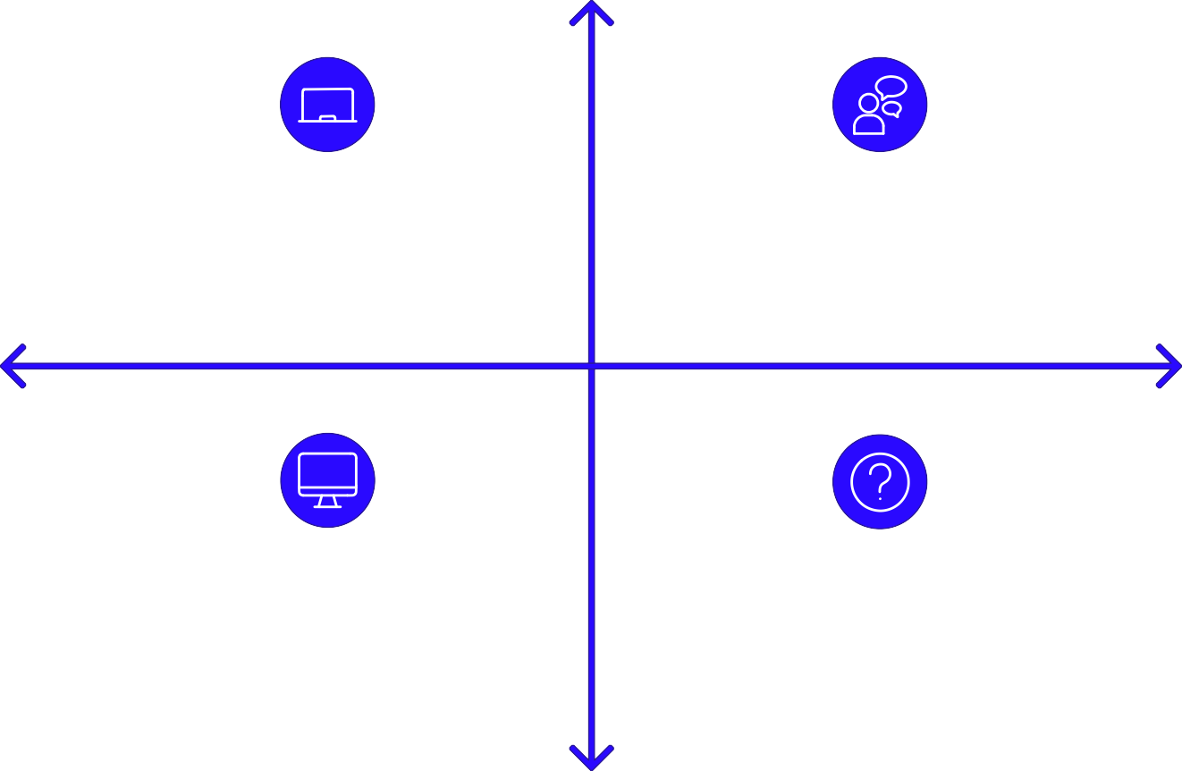
What is AI?
The Teacher Process: Teacher Explains → Student asks doubts → Teacher answers The AI Concept: If a computer can also answer... is it intelligent?
Definition: Artificial Intelligence = Machines performing tasks that usually require human intelligence.
Human-Led Explanation
Teacher explains, student asks
Teacher answers student doubts
Inquiry About Intelligence
Direct Answering
Computer provides direct answers
Question: Does this imply intelligence?
Automated Response

Slide 4


Where is AI Already?
Some real-world examples of AI that we use daily:
YouTube
AI recommends videos
Google Maps
AI predicts traffic
Instagram
AI recommends reels
Amazon
AI recommends products
Gmail
AI filters spam

Slide 5
The Evolution of AI
Traditional Software
1
2
Machine Learning
Deep Learning
3
4
Generative AI
Agentic AI (Future)
5
This timeline illustrates the progression of Artificial Intelligence, from foundational rule-based systems to the advanced, autonomous capabilities envisioned for future agentic AI.

Slide 6

How AI Works (Simplified)
The Process: Question → AI reads words → Finds patterns → Predicts best answer → Generates response
Finds patterns
Predicts answer
User asks
Reads words
This diagram illustrates the sequential steps an AI system takes from receiving a query to formulating a reply.
Core Concept: AI doesn't "think" — AI predicts exactly like Google predicts search Tokens: AI doesn't read full sentences; it reads small pieces called Tokens
Context Window: AI has memory limits for how much information it can remember at once, similar to a teacher trying to remember 1000 student questions

Slide 7
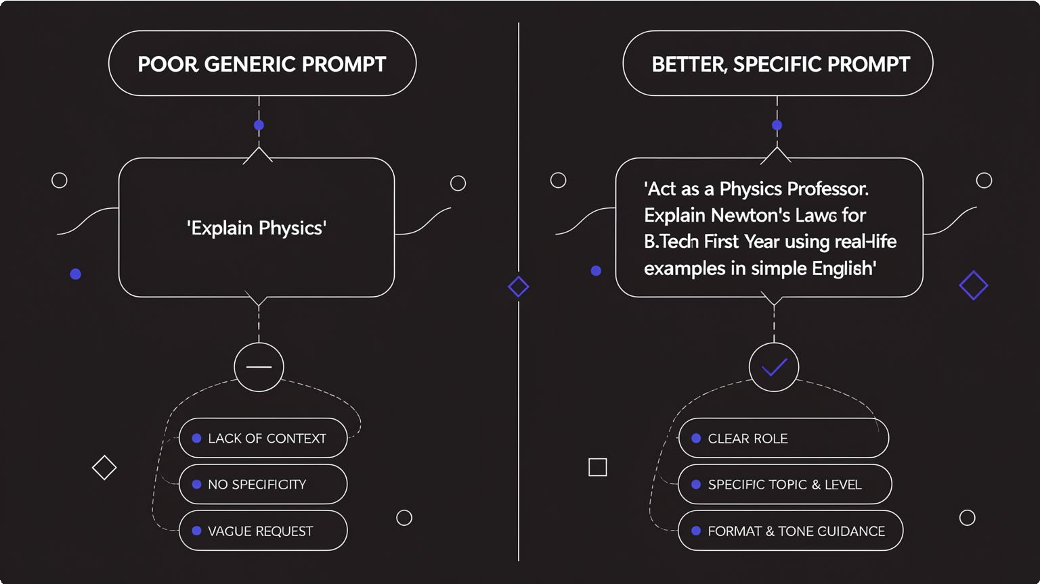
Prompt Engineering
Understanding the difference between an unrefined query and a well-crafted instruction is key to unlocking AI's full potential.
The Prompt Formula
An effective prompt guides the AI with clear components:
Role
Define the AI's persona.
Task
Specify what needs to be done.
Audience
Who is the target recipient?
Output Format
How should the response be structured?
Tone
What is the desired emotional quality?

Slide 8







Live AI Demonstrations
Some practical examples of AI tools educators can use:
ChatGPT
Generate 10 MCQs based on Bloom Taxonomy with answers, or generate a UGC-style question paper
AI Lesson Plan Creator
Create a 45-Minute Lesson Plan for 10th Class on Acids and Bases
AI for Excel
Ask ChatGPT to write an Excel formula to calculate attendance above 75%
Canva AI
Create a Science Exhibition poster in 30 seconds
Gamma
Make a 15-slide presentation on Artificial Intelligence
NotebookLM
Upload a PDF to summarize, generate questions, and create a podcast
Claude
Upload a Research Paper and ask it to find the Research Gap

Slide 9




Subject-wise Examples (STEM)
Some AI applications for STEM subjects:
Physics
Use PhET Interactive Simulations for Projectile Motion, Gravity, and Electric Circuits
Chemistry
Use PhET for Chemical Reactions, Atomic Structure, and 3D Molecular Models
Biology
Use Visible Body or BioDigital Human to view a 3D Human Heart, Brain, and Lungs
Mathematics
Use GeoGebra to show Circles, Graphs, and Derivatives in real time
Computer Science
Use ChatGPT to generate code, explain code, and debug code

Slide 10




Subject-wise Examples (Humanities s Commerce)
Some AI applications for Humanities and Commerce subjects:
Geography
Use Google Earth to show Volcanoes, the Amazon Forest, and 3D Cities
English
Generate Grammar Exercises, Vocabulary Quizzes, Story Writing, and Debate Topics
Commerce
Generate Balance Sheets, GST Questions, Financial Ratio Problems, and Case Studies
Law
Generate Case Summaries and Legal Research Questions
Agriculture
Generate Crop Disease Images, Weather Reports, and Satellite Maps

Slide 11
AI Ethics
Never copy AI blindly.
Step 2: Edit
Refine the wording, accuracy, and tone to fit your lesson.
Step 1: Always Verify
Check facts, examples, and sources before using AI output.
Step 4: Then Teach
Share the final version only after it is accurate and classroom-ready.
Step 3: Personalize
Add your own examples, context, and teaching style.

Slide 12

AI will not replace teachers.
Instead, it will elevate the teaching profession, allowing educators to focus on what truly matters.
Save Time, Teach More
Teachers who learn to use AI effectively will be able to save valuable time on administrative tasks and lesson preparation.
Enrich Learning, Mentor Students
This freed-up time will enable teachers to create better, more personalized learning experiences and focus more on mentoring students individually.

