Slide 1


Slide 2
Passport
Muhammad Umar Ahmad

Slide 3
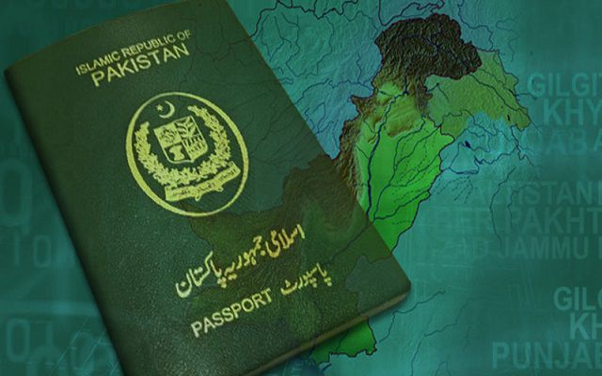
Muhammad Umar Ahmad

Slide 4
Passport.js
Passport is authentication middleware for Node.js.
Extremely flexible and modular, Passport can be unobtrusively dropped in to any Express-based web application.
A comprehensive set of strategies support authentication using a username and password, Facebook, Twitter, and more.

Slide 5
Passport.js Strategies
500+ Strategies Now!
Local (username & password)
Facebook
Twitter
Google
LinkedIn

Slide 6
Passport Configuration – Part 1
npm install express-session
npm install passport
npm install passport-local
var bodyParser = require("body-parser");
var session = require("express-session");
var passport = require("passport");
var LocalStrategy = require('passport-local').Strategy
Muhammad Umar Ahmad

Slide 7
Passport Configuration – Part 2
app.use(express.static(“./frontend"));
app.use(bodyParser.urlencoded());
app.use(bodyParser.json());
app.use(session({ secret: “secret-word" }));
app.use(passport.initialize());
app.use(passport.session());
Define Routes after Middle Configuration Configuration
Muhammad Umar Ahmad

Slide 8
Passport Local Configuration
A form is placed on a web page, allowing the user to enter their credentials and log in.
Configure Local Strategy
Configure Login Route
Muhammad Umar Ahmad

Slide 9
Thank you
Muhammad Umar Ahmad

