Slide 1


First-Order DE Applications in
Computer Engineering
Differential Equations - Assignment
Presented by:
Malik ALHASAN | *****t ****n ***N | ***r ****n ******Ş | ***a ***a ***K | ****h ****N
Instructor: Assist. Prof. Dr. Semra ZEREN
25/12/2025

Slide 2
Contents
01
02
First Problem
Second Problem
Analysis of Motherboard BIOS Battery lifespan using the Exponential Decay Model to determine critical failure thresholds.
Modeling the spread of the Code Red Worm across internet servers using the Logistic Growth Equation under limited capacity.
03
04
Third Problem
References
Investigating the MacBook Pro Thermal Throttling issue using Newton’s Law of Cooling to calculate recovery time.
Citation of real-world data sources (Panasonic Datasheets, CAIDA Report, & Tech Reviews).

Slide 3

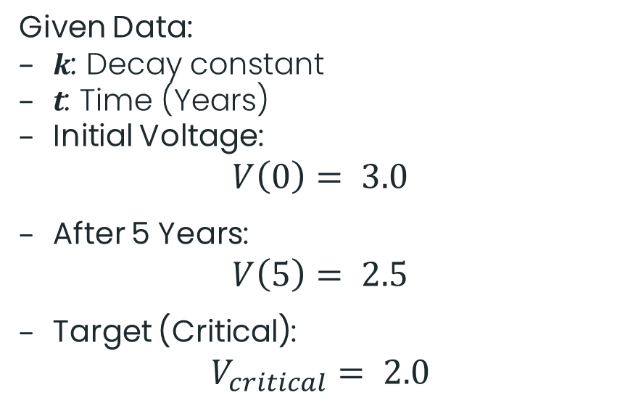
First Problem: Growth & Decay
Motherboard BIOS Battery Analysis (CR2032)
The Scenario
Mathematical Model
Context: Computer motherboards rely on CR2032 batteries to retain BIOS settings when unplugged.
Issue: Battery voltage decays naturally over time due to chemical structure.
Goal: Determine the service life before voltage drops below the critical threshold (2.0V).
Equation: Exponential Decay Model
$$V^{′}= −kV$$
Given Data:
$k$: Decay constant
$t$: Time (Years)
Initial Voltage:
$$V\left(0\right)= 3.0$$
After 5 Years:
$$V\left(5\right)= 2.5$$
Target (Critical):
$$V_{critical}= 2.0$$

Slide 4
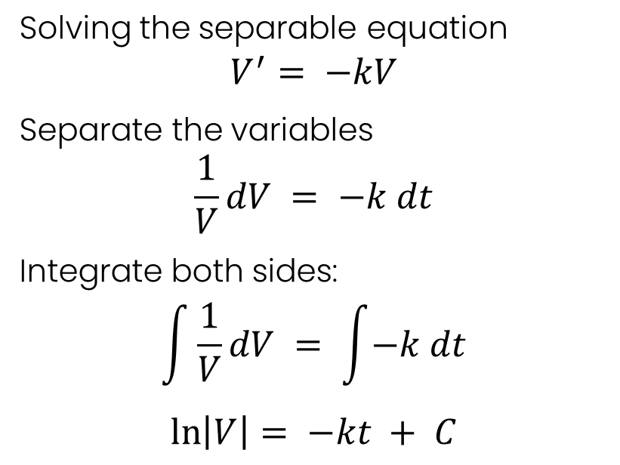
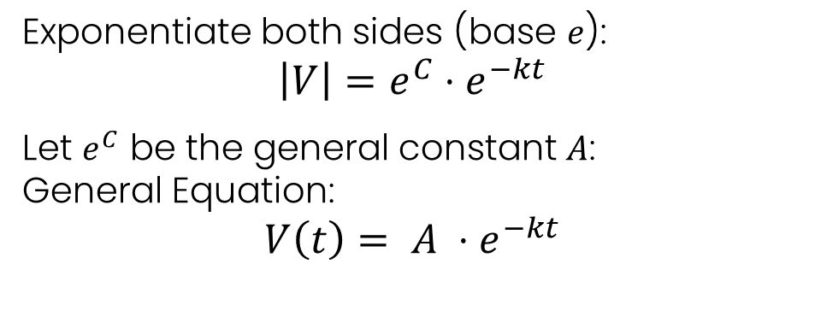
First Problem: Growth & Decay
Motherboard BIOS Battery Analysis (CR2032)
Solution:
Step 1: General Solution
Solving the separable equation
$$V^{′}= −kV$$
Separate the variables
$$\frac{1}{V}dV = −k dt$$
Integrate both sides:
$$\int{\frac{1}{V}dV} = \int{−k dt}$$
$$\ln\left|V\right|= −kt + C$$
Exponentiate both sides (base $e$):
$$\left|V\right|=e^{C}⋅e^{−kt}$$
Let $e^{C}$ be the general constant $A$:
General Equation:
$$V\left(t\right)= A ⋅e^{−kt}$$

Slide 5
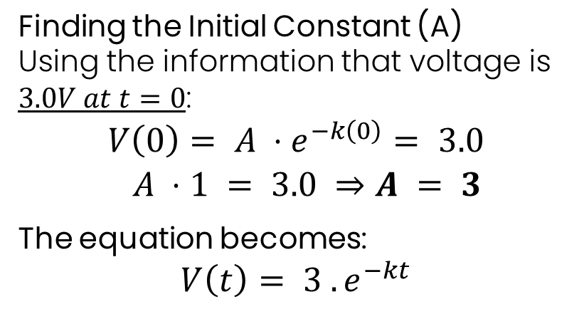
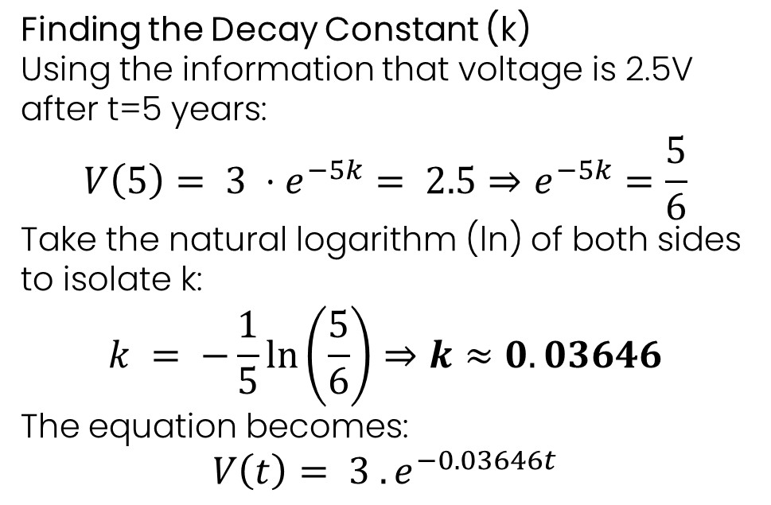
First Problem: Growth & Decay
Motherboard BIOS Battery Analysis (CR2032)
Solution:
Step 2: Finding Constants
Finding the Initial Constant (A)
Using the information that voltage is $3.0V at t=0$:
$$V\left(0\right)= A ⋅e^{−k\left(0\right)}= 3.0$$
$$A ⋅1 = 3.0 ⇒A = 3$$
The equation becomes:
$$V\left(t\right)= 3 . e^{−kt}$$
Finding the Decay Constant (k)
Using the information that voltage is 2.5V
after t=5 years:
$$V\left(5\right)= 3 ⋅e^{−5k}= 2.5⇒e^{−5k}=\frac{5}{6}$$
Take the natural logarithm (ln) of both sides to isolate k:
$$k = −\frac{1}{5}\ln\left(\frac{5}{6}\right)⇒k≈0.03646$$
The equation becomes:
$$V\left(t\right)= 3 . e^{−0.03646t}$$

Slide 6
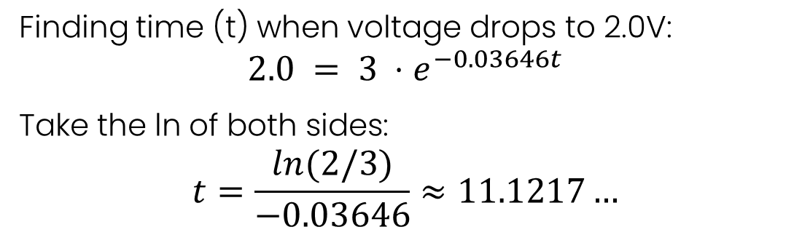
First Problem: Growth & Decay
Motherboard BIOS Battery Analysis (CR2032)
The Result:
Step 3: Critical Threshold Calculation
Finding time (t) when voltage drops to 2.0V:
$$2.0 = 3 ⋅e^{−0.03646t}$$
Take the ln of both sides:
$$t=\frac{\ln{(2/3)}}{−0.03646}≈11.1217…$$
The total service life is approximately 11.12 Years

Slide 7
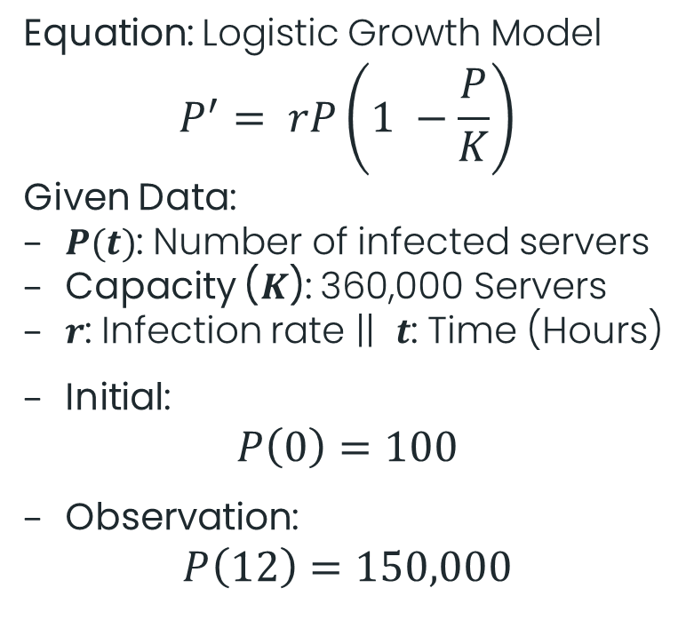
Second Problem: Population Models
Code Red Worm Spread (Logistic Growth)
The Scenario
Mathematical Model
Event: In 2001, Code Red worm attacked Microsoft IIS servers.
Constraint: The number of weak servers is finite (Limited Capacity).
Goal: Calculate time to infect 99% of the internet infrastructure.
Why 99%: Mathematically, the Logistic Growth model never reaches 100% in finite time.
Equation: Logistic Growth Model
$$P^{′}= rP\left(1 −\frac{P}{K}\right)$$
Given Data:
$P(t)$: Number of infected servers
Capacity ($K$): 360,000 Servers
$r$: Infection rate || $t$: Time (Hours)
Initial:
$$P\left(0\right)=100$$
Observation:
$$P\left(12\right)=150,000$$

Slide 8
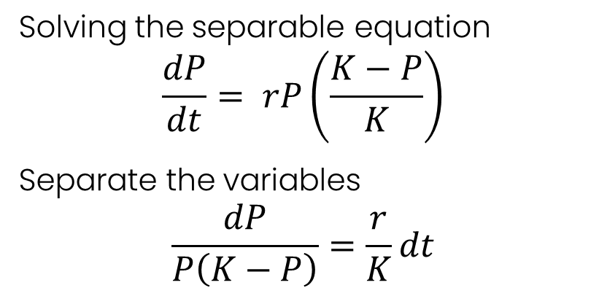
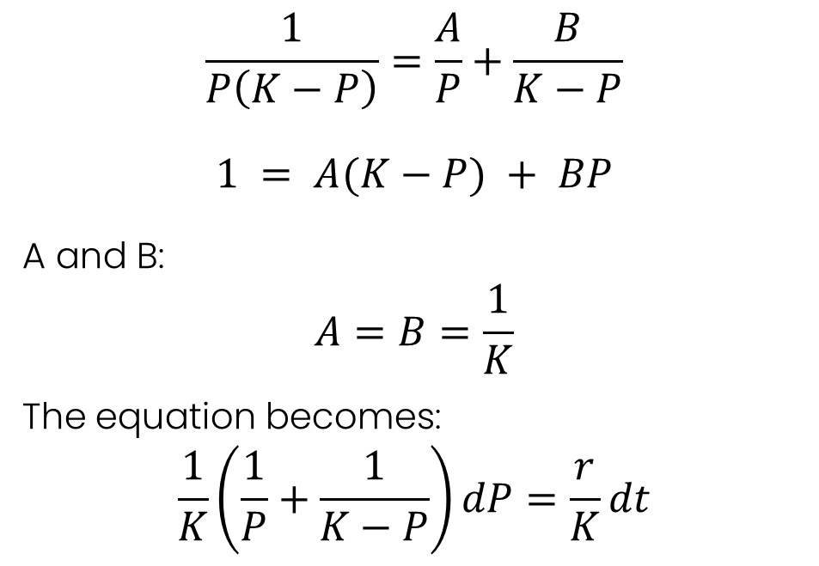
Second Problem: Population Models
Code Red Worm Spread (Logistic Growth)
Solution:
Step 1: Separation of Variables
Step 2: Partial Fraction Decomposition
Solving the separable equation
$$\frac{dP}{dt}= rP\left(\frac{K−P}{K}\right)$$
Separate the variables
$$\frac{dP}{P\left(K−P\right)}=\frac{r}{K}dt$$
$$\frac{1}{P\left(K−P\right)}=\frac{A}{P}+\frac{B}{K−P}$$
$$1 = A(K−P) + BP$$
A and B:
$$A=B=\frac{1}{K}$$
The equation becomes:
$$\frac{1}{K}\left(\frac{1}{P}+\frac{1}{K−P}\right)dP=\frac{r}{K}dt$$

Slide 9
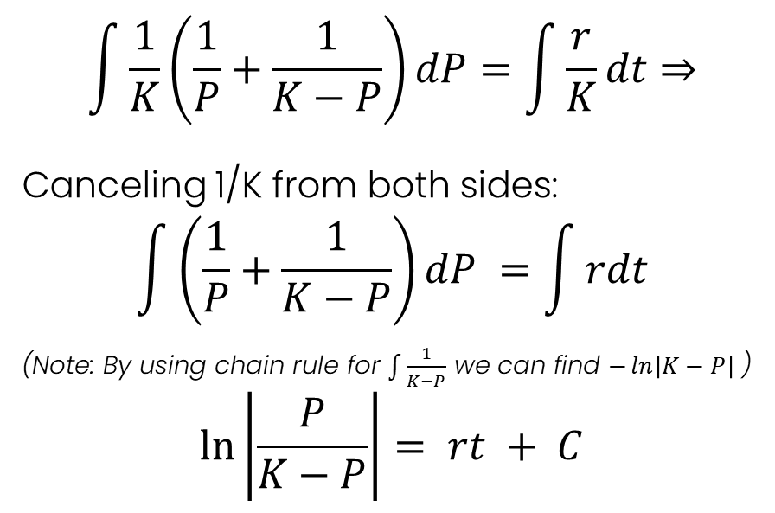
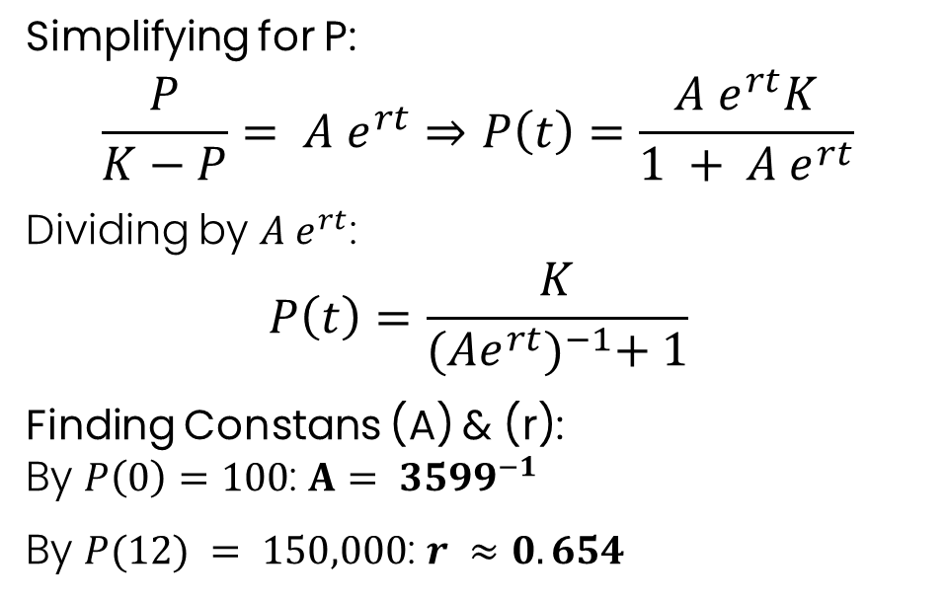
Second Problem: Population Models
Code Red Worm Spread (Logistic Growth)
Solution:
Step 3: Integration
Step 4: General Solution
$$\int{\frac{1}{K}\left(\frac{1}{P}+\frac{1}{K−P}\right)dP=\int{\frac{r}{K}dt⇒}}$$
Canceling 1/K from both sides:
$$\int{\left(\frac{1}{P}+\frac{1}{K−P}\right)dP} =\int{rdt}$$
(Note: By using chain rule for $\int{\frac{1}{K−P}}$ we can find $−\ln\left|K−P\right|$ )
$$\ln\left|\frac{P}{K−P}\right|= rt + C$$
Simplifying for P:
$$\frac{P}{K−P}= A e^{rt}⇒P\left(t\right)=\frac{A e^{rt}K}{1 + A e^{rt}}$$
Dividing by $A e^{rt}$:
$$P\left(t\right)=\frac{K}{{(Ae^{rt})}^{−1}+ 1}$$
Finding Constans (A) & (r): By $P\left(0\right)=100$: $A= {3599}^{−1}$
By $P(12) = 150,000$: $r ≈0.654$

Slide 10
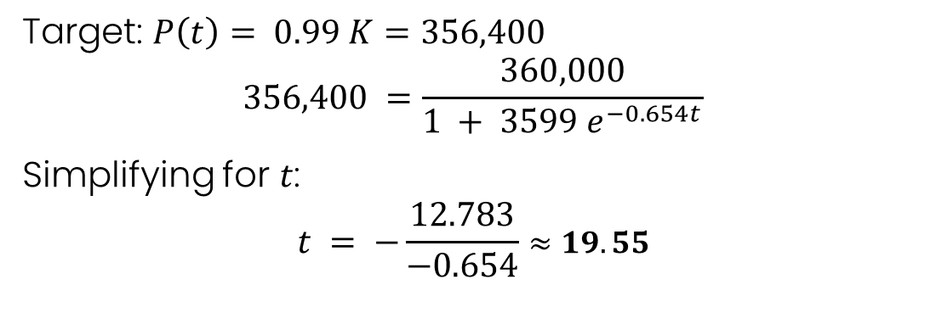
Second Problem: Population Models
Code Red Worm Spread (Logistic Growth)
The Result:
Step 5: Finding Time for 99% Infection
Target: $P\left(t\right)= 0.99 K=356,400$
$$356,400 =\frac{360,000}{1 + 3599 e^{−0.654t}}$$
Simplifying for $t$:
$$t = −\frac{12.783}{−0.654}≈19.55$$
Total time to infect 99% of the internet: Approximately 19 and a half hours.

Slide 11
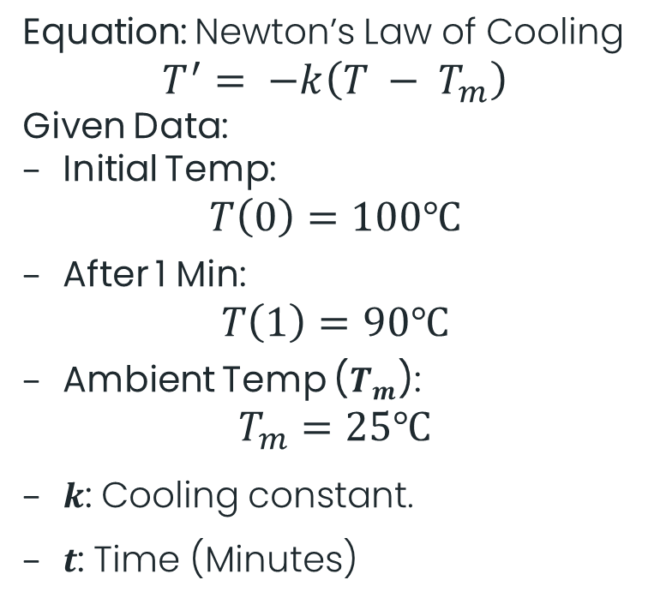
Third Problem: Cooling Problems
MacBook Pro Thermal Throttling (Newton's Law of Cooling)
The Scenario
Mathematical Model
Context: Apple's 2018 MacBook Pro (i9) suffered from severe overheating due to a faulty fan curve (Throttling Scandal).
Issue: The processor instantly hits 100°C under load. When stopped, fans are too slow to cool it down quickly.
Goal: Calculate the waiting time required for the CPU to cool down to a safe 50°C to regain Turbo Boost performance.
Equation: Newton’s Law of Cooling
$$T^{′}= −k\left(T − T_{m}\right)$$
Given Data:
Initial Temp:
$$T\left(0\right)=100℃$$
After 1 Min:
$$T\left(1\right)=90℃$$
Ambient Temp ($T_{m}$):
$$T_{m}=25℃$$
$k$: Cooling constant.
$t$: Time (Minutes)

Slide 12
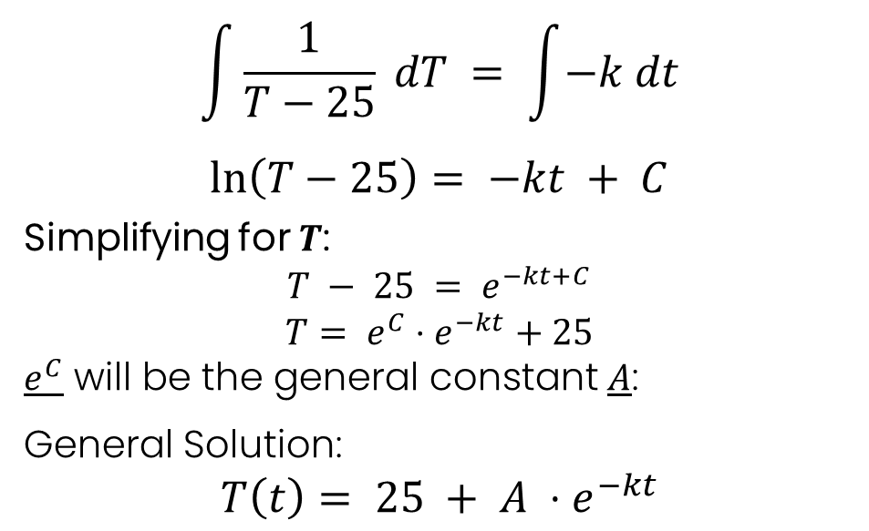
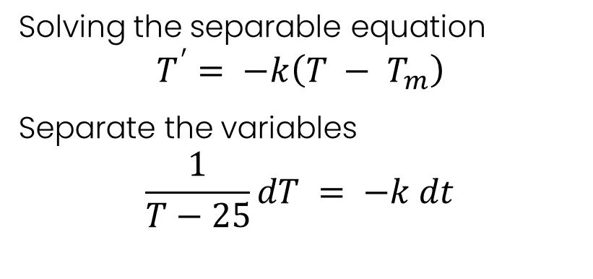
Third Problem: Cooling Problems
MacBook Pro Thermal Throttling (Newton's Law of Cooling)
Solution:
Step 1: Separation of Variables
Step 2: Integration both sides:
Solving the separable equation
$$T^{′}= −k\left(T − T_{m}\right)$$
Separate the variables
$$\frac{1}{T−25}dT = −k dt$$
$$\int{\frac{1}{T−25}} dT = \int{−k dt}$$
$$\ln\left(T−25\right)= −kt + C$$
Simplifying for $T$:
$$T − 25 = e^{−kt+C}$$
$$T= e^{C}⋅e^{−kt}+25$$
$e^{C}$ will be the general constant $A$:
General Solution:
$$T\left(t\right)= 25 + A ⋅e^{−kt}$$

Slide 13
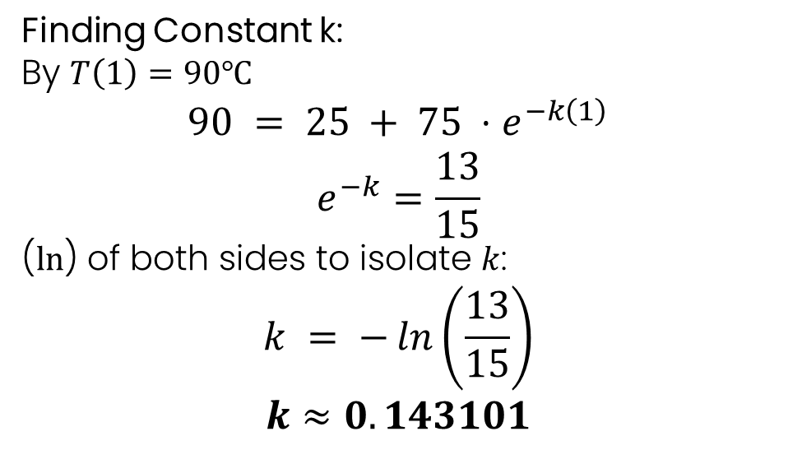
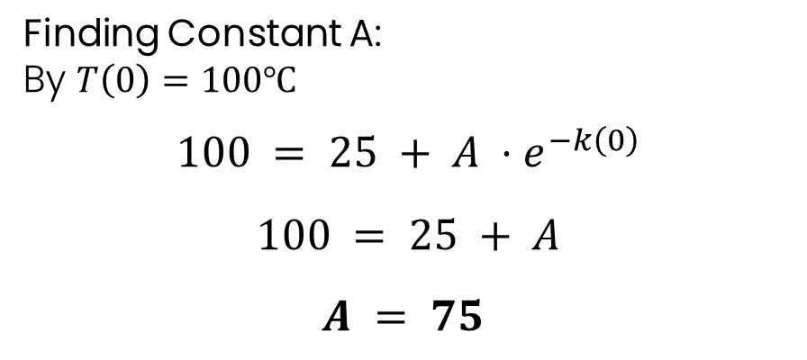
Third Problem: Cooling Problems
MacBook Pro Thermal Throttling (Newton's Law of Cooling)
Solution:
Step 3: Finding Constants
Finding Constant A:
By $T\left(0\right)=100℃$
$$100 = 25 + A ⋅e^{−k\left(0\right)}$$
$$100 = 25 + A$$
$$A = 75$$
Finding Constant k:
By $T\left(1\right)=90℃$
$$90 = 25 + 75 ⋅e^{−k\left(1\right)}$$
$$e^{−k}=\frac{13}{15}$$
($ln$) of both sides to isolate $k$:
$$k = −\ln\left(\frac{13}{15}\right)$$
$$k≈0.143101$$

Slide 14
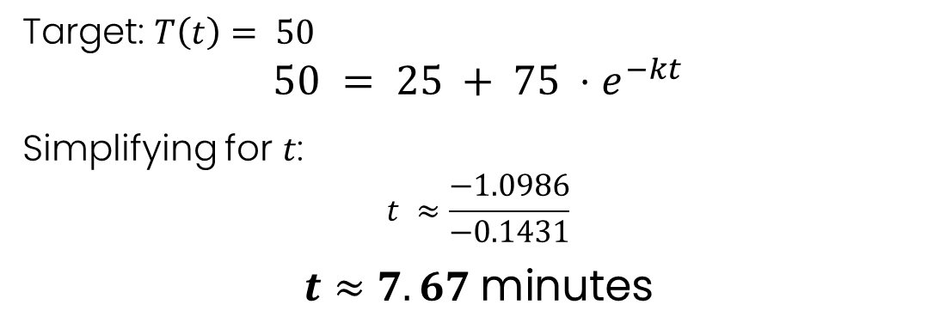
Third Problem: Cooling Problems
MacBook Pro Thermal Throttling (Newton's Law of Cooling)
The Result:
Step 4: Required time $t$ to reach 50°C.
Target: $T\left(t\right)= 50$
$$50 = 25 + 75 ⋅e^{−kt}$$
Simplifying for $t$:
$$t ≈\frac{−1.0986}{−0.1431}$$
$$t≈7.67 \text{minutes}$$
The user needs to wait approximately 7 minutes and 40 seconds to cool down

Slide 15
References
Problem I: BIOS Battery (Datasheet)
Panasonic Corporation (2021): Coin Type Lithium Manganese Dioxide Battery (CR2032) Data Sheet. Industrial Solutions Company.
Link: Panasonic CR2032 Datasheet (PDF)
Problem II: Code Red Worm (Research)
CAIDA Analysis (2002): Moore, D., et al. "Code-Red: A case study on the spread and victims of an Internet worm." The Center for Applied Internet Data Analysis.
Link: CAIDA Analysis of Code-Red
Problem III: Thermal Throttling (Tech Review)
Dave2D (2018): Technical Review: "MacBook Pro 15 (2018) - Beware the Core i9".
Link: Dave2D Original Review
The Verge (2018): Warren, T. "Apple apologizes for MacBook Pro throttling bug and releases fix."
Link: Apple apologizes for throttling Intel CPUs inside MacBook Pros

Slide 16
Thanks !
Presented by:
Malik ALHASAN | : | 123456789
--------------------- | : | 123456789
---------------------- | : | 123456789
------------------------ | : | 123456789
---------------------- | : | 123456789
Instructor: Assist. Prof. Dr. Semra ZEREN
25/12/2025

