Slide 1
Majeed Foods Desktop Management Application
Presented By: Umais, Asad, Aitzaz
Instructor: Mudassar Azam Sindhu
Fall 2025

Slide 2
Introduction
This system is design to automate:
Menu
Stock
Shifts
Balance
Designed using Java, SQL Server, MVC architecture.

Slide 3
Motivation
Restaurant operations are manual, time-consuming lack accuracy as well as:
No real time inventory check
Manual Shift Planning
No digital balance tracking

Slide 4
Goals
Our goals were to:
Reduce manager load
Automate routine operations
Improve record accuracy

Slide 5
System Scope
Desktop Application
Local Database
Manager + Waiter Dashboard
Real time CRUD operations

Slide 6
Tools Used
Frontend: Java Swing(latest Version)
Backend: Controllers+ JDBC
Database: SQL Server
Architecture: MVC

Slide 7
SRS Overview
Functional Areas:
Menu Management
Stock Management
Shift Management
Balance Management
Non-Functional Areas:
UI consistency
Response Speed
Modularity

Slide 8
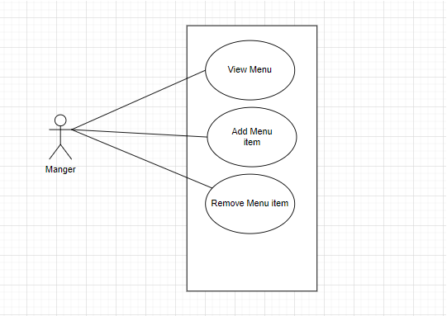
Use Case - Menu

Slide 9
Use Case - Shift

Slide 10
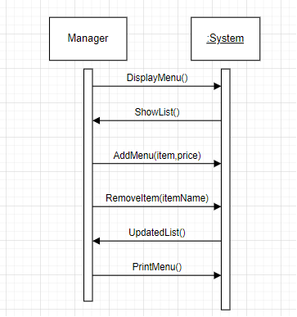
System Sequence Diagram

Slide 11
System Sequence Diagram

Slide 12
System Sequence Diagram

Slide 13
System Sequence Diagram

Slide 14
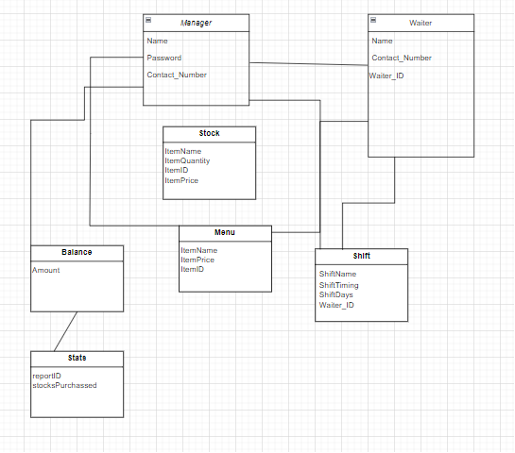
Domain Model

Slide 15
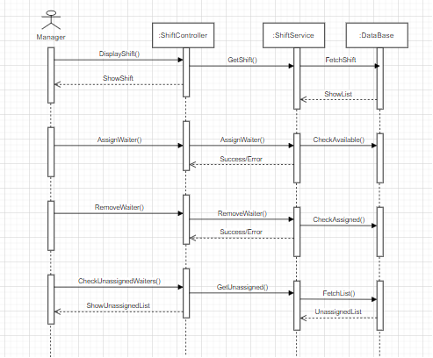
Sequence Diagram

Slide 16
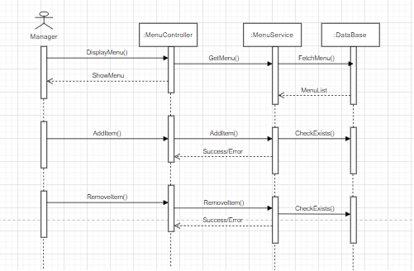
Sequence Diagram

Slide 17
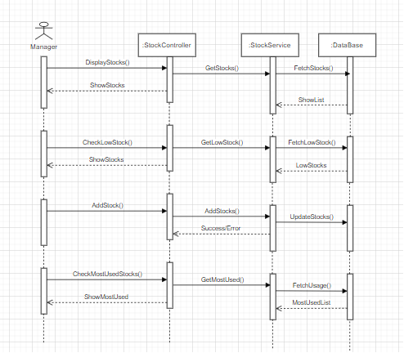
Sequence Diagram

Slide 18
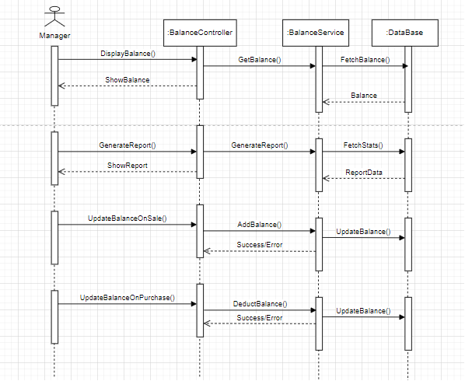
Sequence Diagram

Slide 19
Design Class Diagram

Slide 20
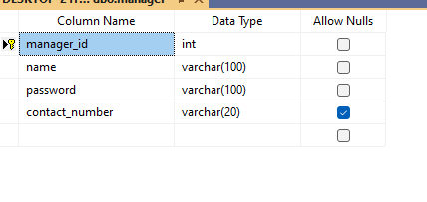
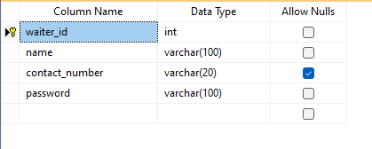
DB Schema
Manager
Waiter

Slide 21
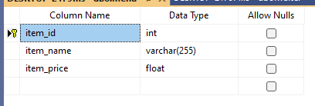
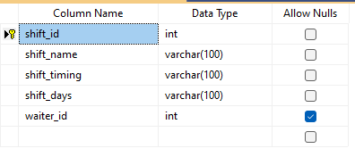
DB Schema
Menu
Shift

Slide 22
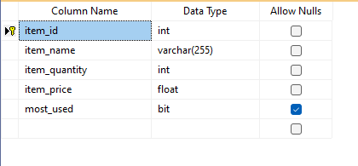
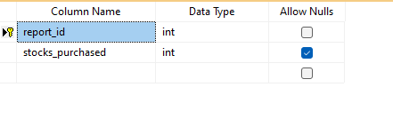
DB Schema
Stock
Stats

Slide 23
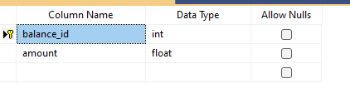
DB Schema
Balance

Slide 24
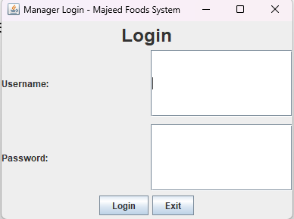
Screenshots - Login
User login screen.

Slide 25
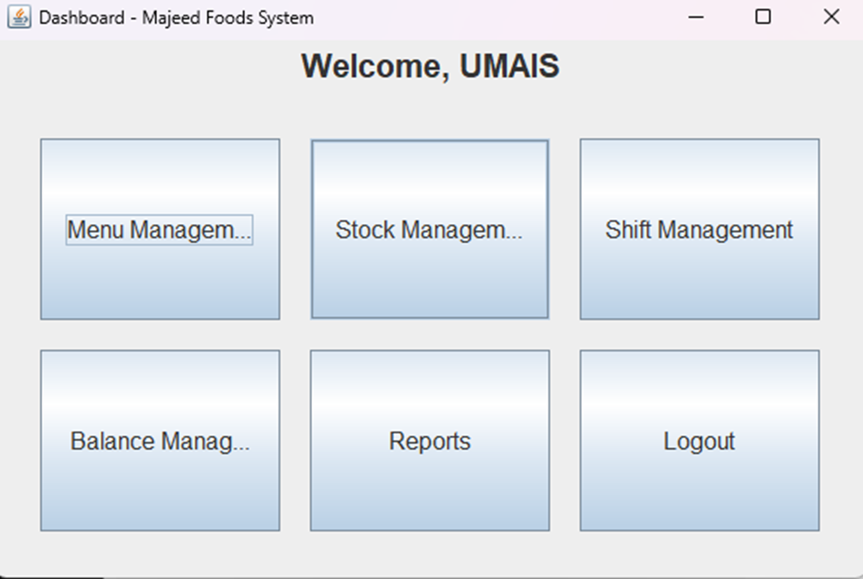
Screenshots - Manager Dashboard

Slide 26
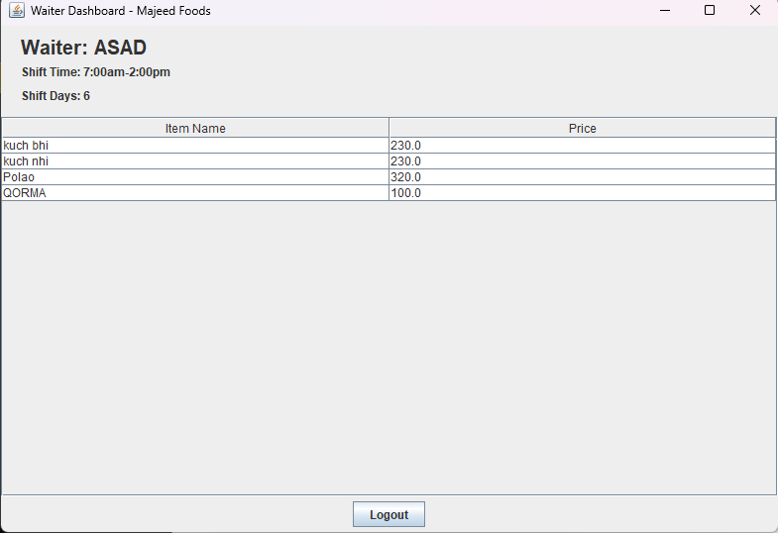
Screenshots - Waiter Dashboard

Slide 27
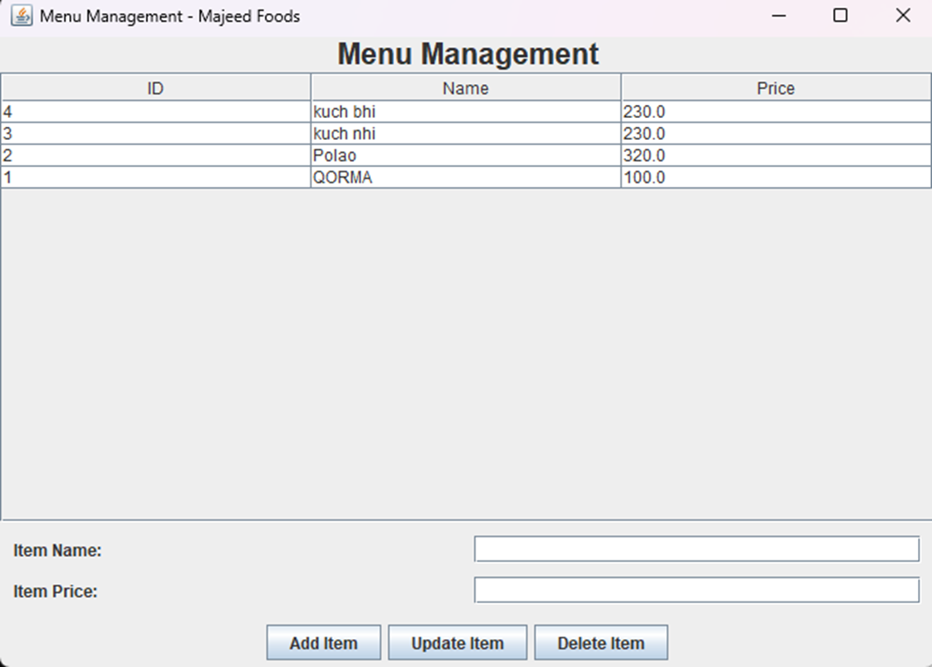
Screenshots - Menu UI

Slide 28
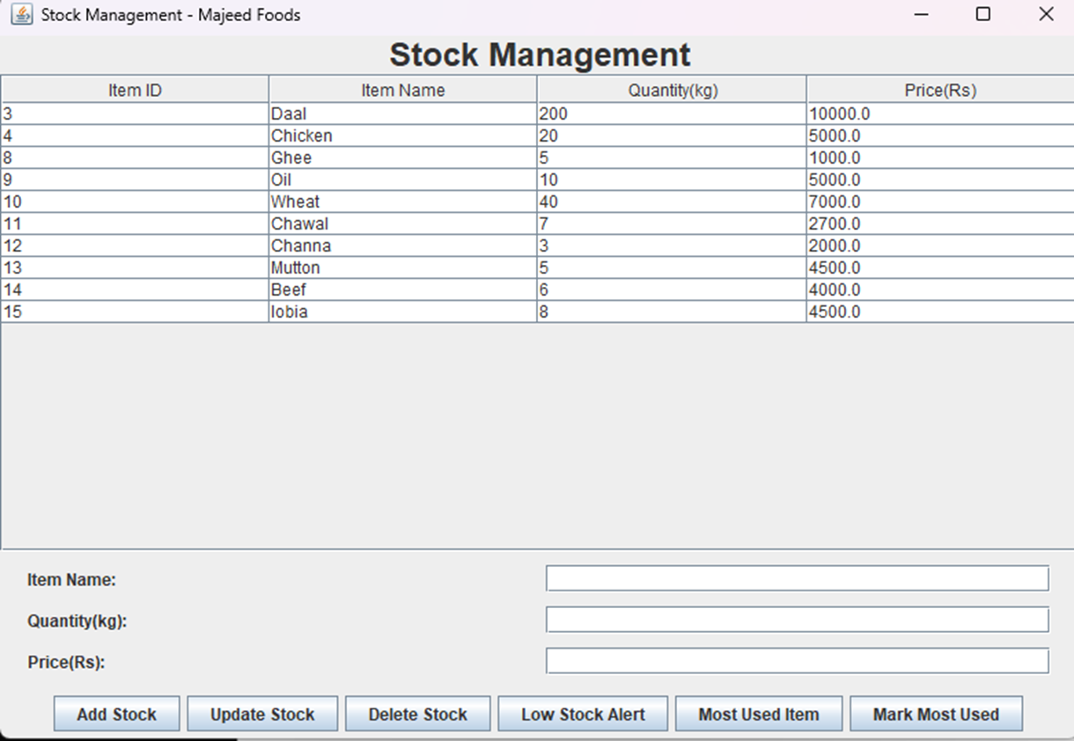
Screenshots - Stock UI

Slide 29
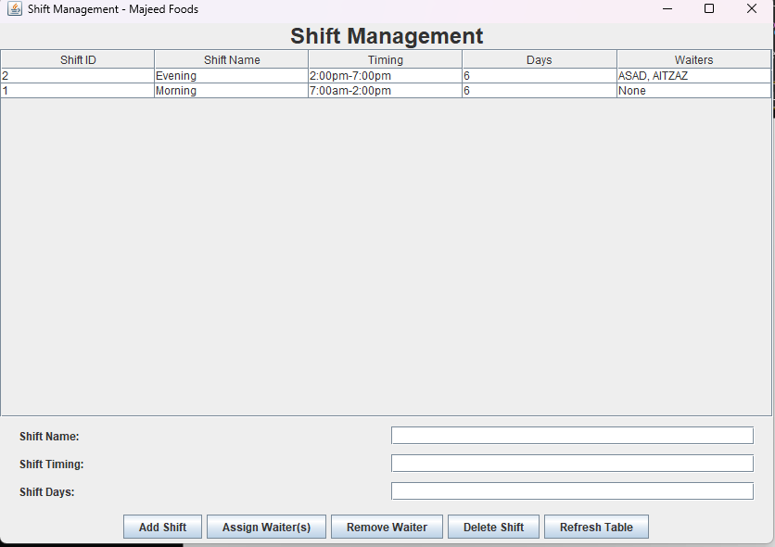
Screenshots - Shift UI

Slide 30
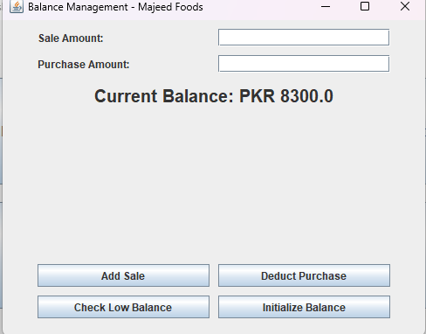
Screenshots - Balance UI

Slide 31
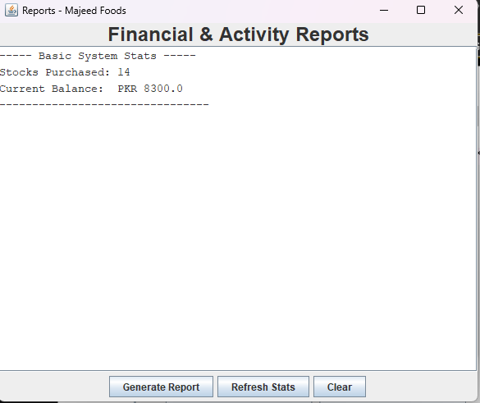
Screenshots - Report UI

Slide 32
Working Demo

Slide 33
Acceptance Test – Add Menu Item
Feature: Add Menu Item
Objective: Verify menu addition.
Step | Action | Result
1 | Enter name + price | Fields accept input
2 | Click “Add Item” | Item stored + table refreshes
3 | Check DB | New record exists
Result: Pass

Slide 34
Acceptance Test – Add Stock Item
Feature: Stock Creation
Objective: Verify stock addition.
Step | Action | Result
1 | Enter name, qty, price | Fields accept input
2 | Click “Add Stock” | Stock stored + table refreshes
3 | Check DB | New record exists
Result: Pass

Slide 35
Acceptance Test – Assign Waiter to Shift
Feature: Shift Assignment
Objective: Verify waiter assignment.
Step | Action | Result
1 | Select shift row | Highlighted
2 | Click “Assign Waiters” | Waiters Dialogue Box opens
3 | Select Waiter | Waiter assigned to shift
4 | Check DB | New record exists
Result: Pass

Slide 36
Acceptance Test – Deduct Purchase
Feature: Balance Deduction
Objective: Update balance after purchase.
Step | Action | Result
1 | Enter purchase value | Accepted
2 | Click “Deduct Purchase” | Success message
3 | Current Balance | Amount decreases
4 | Check DB | New record exists
Result: Pass

Slide 37
Challenges
Project Structuring (MVC)
Consistency
Data access and retrieval issues from DB

Slide 38
Requirements Coverage
Functional requirements achieved
Non-functional achieved
Design alignment matched with SRS

Slide 39
Conclusion
The project successfully achieved:
Automated daily tasks
Enhanced manager productivity
Improved data reliability

Slide 40
Future Enhancements
POS(Point of Sale) system integration.
Mobile application

Slide 41
Q/A
Thank you.

