Slide 1
Capstone Project-2
Yes Bank Stock Closing Price Prediction
Team Members
Mohd Danish Huzaifa Khan Arbaaz Malik Abdul Rahman Talha

Slide 2
Let’s Predict!
Overview & Objective
Data Pipeline
EDA
Regression Analysis
a) Linear Regression
b) Ridge Regression
c) Lasso Regression
d) ElasticNet Regression
5. Conclusion

Slide 3
Overview & Objective
Overview
Yes Bank is a well-known bank in the Indian financial domain. Since 2018, it has been in the news because of the fraud case involving Rana Kapoor. Owing to this fact, it was interesting to see how that impacted the stock prices of the company and whether Time series models or any other predictive models can do justice to such situations..
Objective
This dataset has monthly stock prices of the bank since its inception and includes closing, starting, highest, and lowest stock prices of every month. The main objective is to predict the stock’s closing price of the month.

Slide 4
Data Pipeline
- Data Preprocessing: At this stage, we check for duplicate
values and missing values and treat them if any.
Furthermore, we check the datatype of the features present
in our dataset and transform them if necessary
- Exploratory Data Analysis (EDA): At this stage, we conduct
an EDA on the selected features in order to better understand
their spread, pattern and relationship with the other features.
It gives us an intuition as to what is going on in the dataset.
- Model Building: At this stage, we apply various models to
understand which one will give us the best result.

Slide 5
Data Summary
We have Yes Bank monthly stock price dataset. It has following features (Columns):
1) Open : Opening price of the stock of particular day
2) High : It's the highest price at which a stock traded during a period
3) Low : It’s the lowest price at which stock traded during a period
4) Close : Closing price of a stock at the end of a Trading Day
5) Date : We will use it as a index
Note: ‘Close’ will be our Dependent variable & Others will be independent.

Slide 6
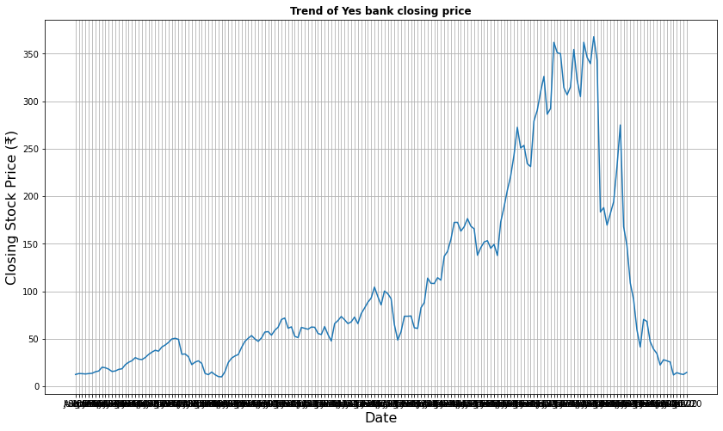
Exploratory Data Analysis(EDA)
Let’s Visualize Independent variable

Slide 7
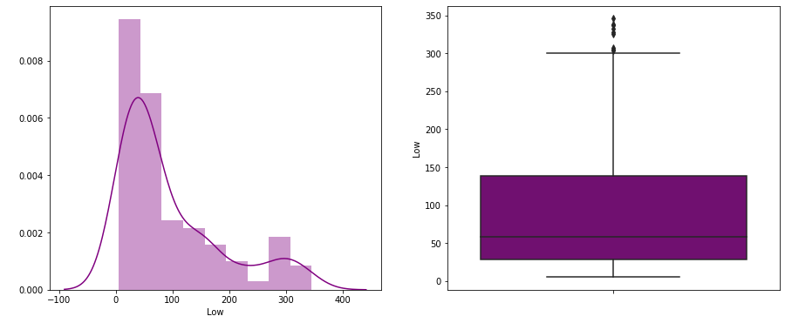
Distribution of ‘Low’

Slide 8
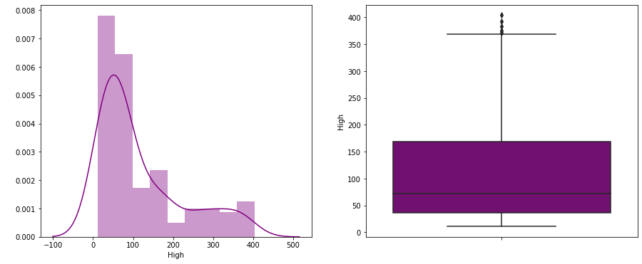
Distribution of ‘High’

Slide 9

Distribution of ‘Open’

Slide 10
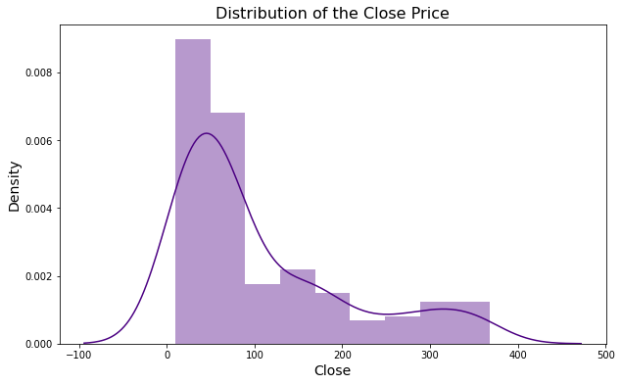
Distribution of ‘Close’ (Dependent)

Slide 11
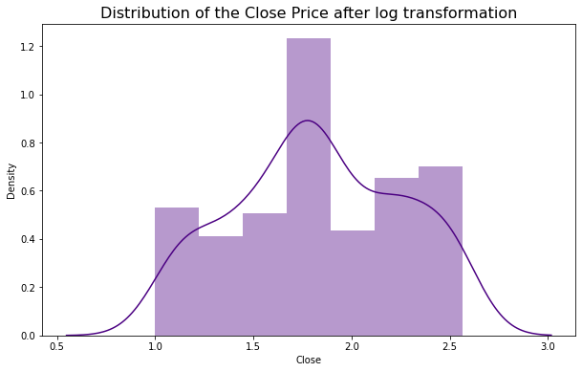
Transformation of Data
Data Transformation
As observed in the preceding slides, the observed data was found to be
skewed. We will transform the data to make it uniform before passing it
into our machine learning models. Let’s have a look at how they will look
once the transformation is applied to them.
The image on the right shows
how the distribution of our close price would look after a log transformation
is applied to it.

Slide 12
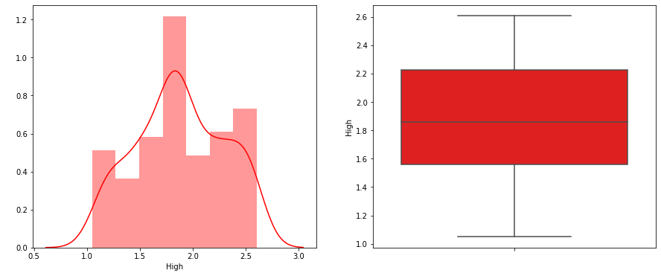
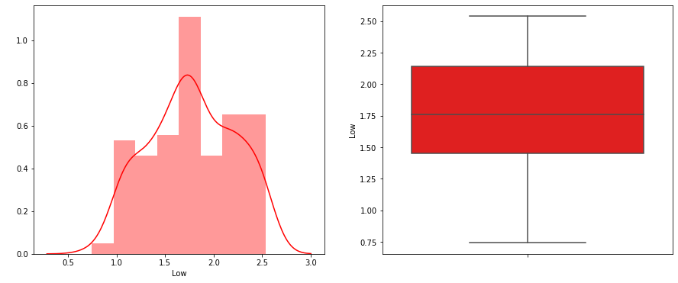
(Cont..)

Slide 13
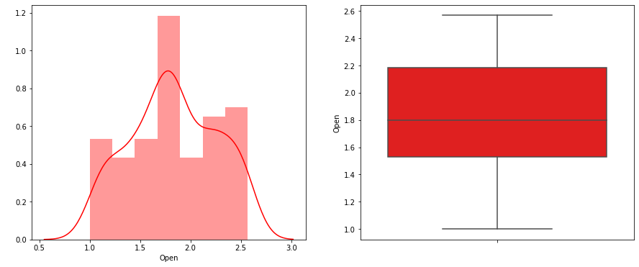
(Cont..)

Slide 14
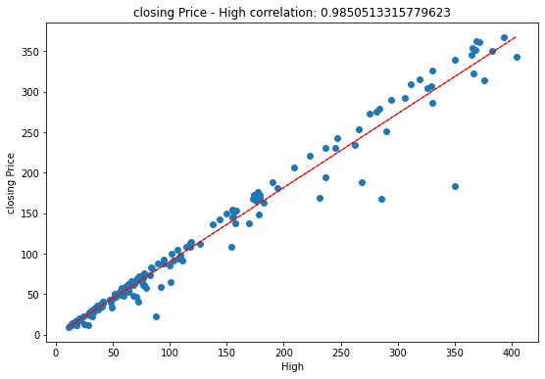
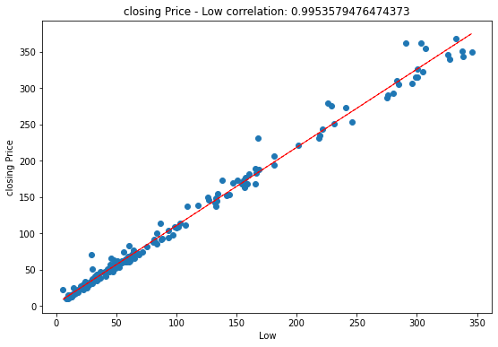
Correlation of ‘Closing Price’ with Independent Features:

Slide 15
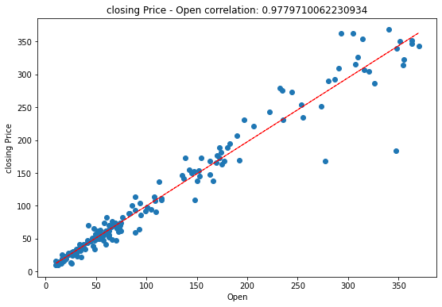
(Cont..)
As we can see that there is linear relation and high correlation between each independent variables and dependent variable.
The correlation is 0.985, 0.995, 0.978 This suggests a high level of correlation, e.g. a value above 0.5 and close to 1.0.

Slide 16
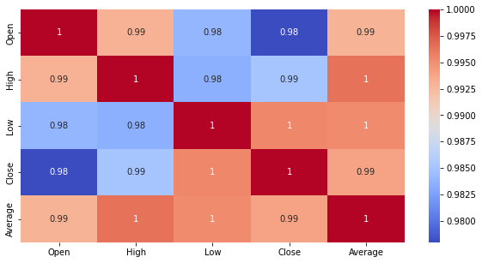
Correlation Matrix
● The correlation matrix helps us
visualize the correlation of each
parameter with respect to every
other parameter.
● The shades changes from the
highest to lowest (or vice versa)
correlations.
● We can see in the matrix on this
slide that our dependent variable
(close price) is highly correlated
with all the other independent
variables

Slide 17
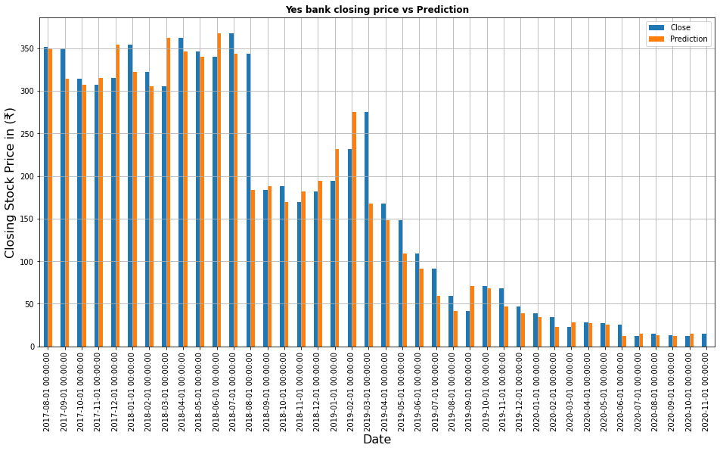
Bar Graph Comparison between Actual and predicted Price (price predicted by Shifht() function

Slide 18
Model Selection
● We passed the data into:
Linear Regression Model
Lasso Regression
Ridge Regression
ElasticNet
● We checked the performance of the model across various parameters.
●Then we decided our best models on the basis of following metrics
R2
Adjusted R2
Training Accuracy
Mean squared error and Root mean squared error.

Slide 19
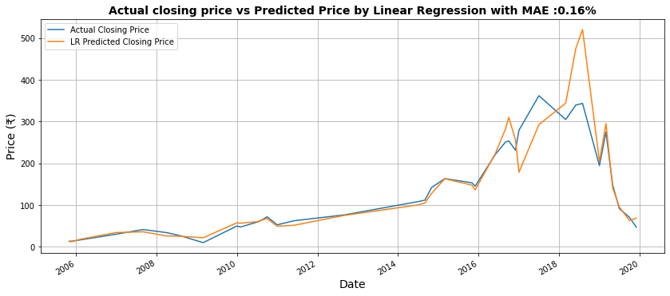
Linear Regression
Explanations:
Our Linear Model predicted the close price with 0.16% Mean Absolute error. Having training accuracy 94.03%.
R2 tells us that our independent is able to describe 95% of our dependent variable.
Adjusted R2 is about 91.44%, just because we consider 17 independent features adjusted R2 would be the best matrix to consider.

Slide 20
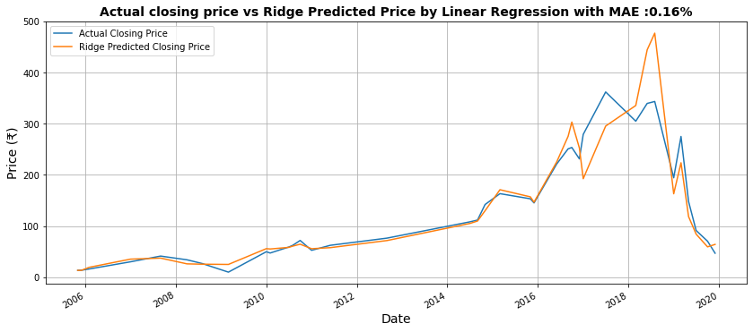
Ridge Regression
Explanations:
Our Ridge predicted the close price with 0.16% Mean Absolute error. Having training accuracy 74.07%.
Here, R2 is about 95.25% which means model’s independent features is able to describe 95.25% of our dependent variable.
Adjusted R2 is about 91%. We’ll consider adjusted R2 because we have too many independent features

Slide 21
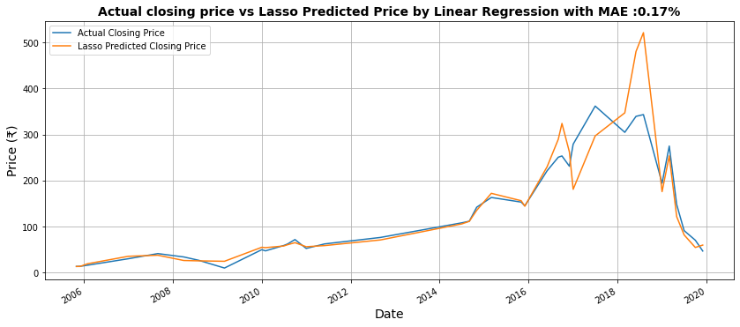
Lasso Regression
Explanations:
Lasso predicted the close price with 0.17% Mean Absolute error. Having training accuracy 94.57%.
Here, R2 is about 94.96% which means models’ independent features is able to describe 94.96% of our dependent variable.
Adjusted R2 is about 90.46%. We’ll consider adjusted R2 because we have too many independent features.

Slide 22
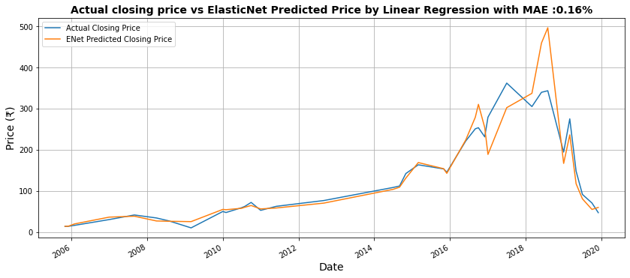
Elastic Net Regression Before Cross Validation:
Explanations:
Our Linear Model predicted the close price with 0.16% Mean Absolute error. Having training accuracy 82.64%.
R2 tells us that our independent is able to describe 95.11% of our dependent variable.
Adjusted R2 is about 90.74%, just because we consider 17 independent features adjusted R2 would be the best matrix to consider.

Slide 23
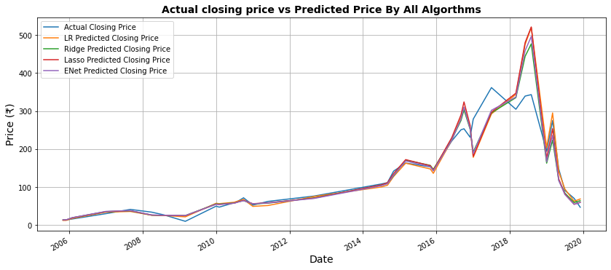
Comparispn among all Model predictions in one graph:
Final Explanation: In this combined comparison graph among actual closing price and Predicted closing price predicted by all four models, Linear Regression and Lasso are predicting closing price of next month better than Ridge and ElasticNet.
All four models have good R2 and Adjusted R2.

Slide 24
Final Matrix:
 | Linear Regression | Ridge | Lasso | Elastic Net
MSE | 0.008368 | 0.008848 | 0.009377 | 0.009096
RMSE | 0.091477 | 0.094061 | 0.096833 | 0.095375
R2 | 0.955079 | 0.952505 | 0.949664 | 0.951169
Adjusted_R2 | 0.914887 | 0.910009 | 0.904627 | 0.907478
Training Accuracy | 0.940359 | 0.740745 | 0.945777 | 0.826402

Slide 25
Conclusion
Target Variable is strongly dependent on Independent Variables.
By Introducing Dummy variables makes our data free of overfitting problem and improve our training accuracy from 82% to 94%
Linear Regression and Lasso are performing better than other models with training accuracy 94.0359% and 94.7881% respectively.
Apart from Linear Regression and Lasso, Ridge and Elastic Net is also performing better but they have less training accuracy.
Ridge and ElasticNet is performing far much better after Applying Hyperparameter Tuning
and Cross validation, it is because we have small set of datasets.
R2 and Adjusted R2 are around 95% and 91% in each model.

