Slide 1
Bringing data science and AI/ML tools to infectious disease research
Day 1 Skills Workshop
Computational Environment

Slide 2
Outline
Intro to Python / Notebooks / Google Colab
Intro to Chemical Databases (ChEMBL)
Visualise Data Distribution
Activity

Slide 3


Programming Languages
This?
Maybe this?
https://www.istockphoto.com/photo/binary-code-background-gm1046046242-279903080
https://techcrunch.com/2019/03/18/how-to-build-the-matrix/

Slide 4
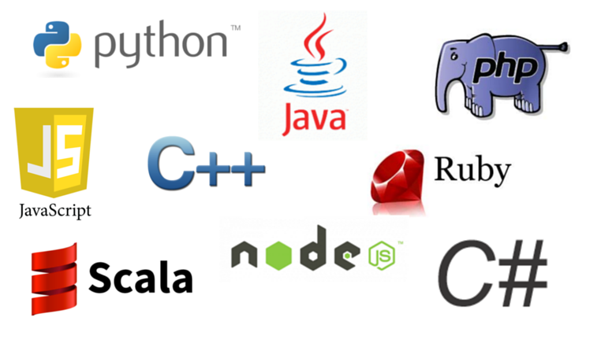
Programming Languages
A set of rules that converts human-readable text to machine code.
Why not just use English?
E.g. “I saw the man in the park with the telescope.”
Ambiguous and imprecise.
Programming language instructions are precise and only have a single meaning.

Slide 5
Software Building Blocks
Input
Process
Output
Input
Process
Output
Input
Process
Output
Input
Process
Output
Code can be written in modular building blocks and used together to build sophisticated pipelines.

Slide 6
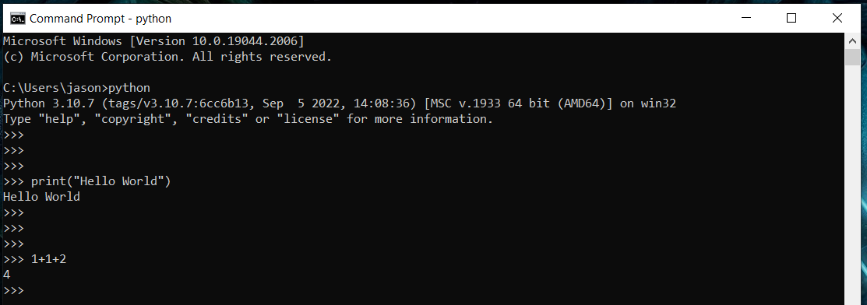
Python Concepts
Python is extremely popular because of its flexibility and emphasis on code readability.
It can be run in a terminal window interactively, however, there are more useful options…

Slide 7
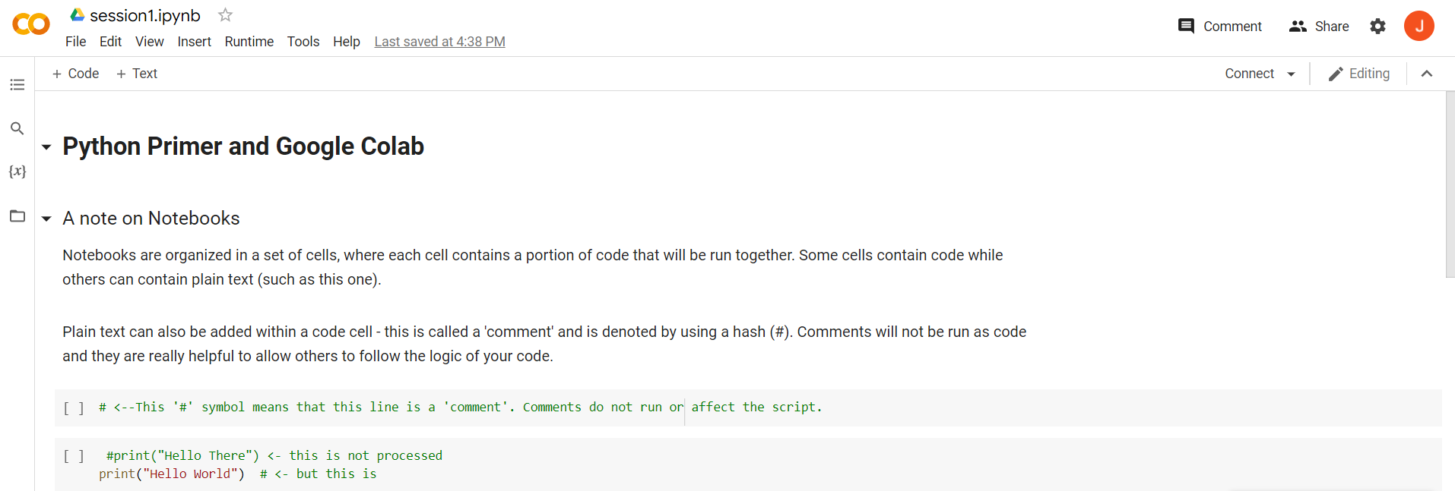
Notebooks
Notebooks allow us to run small pieces of code at a time without re-running an entire file.
We can also interleave plain text between code blocks.

Slide 8
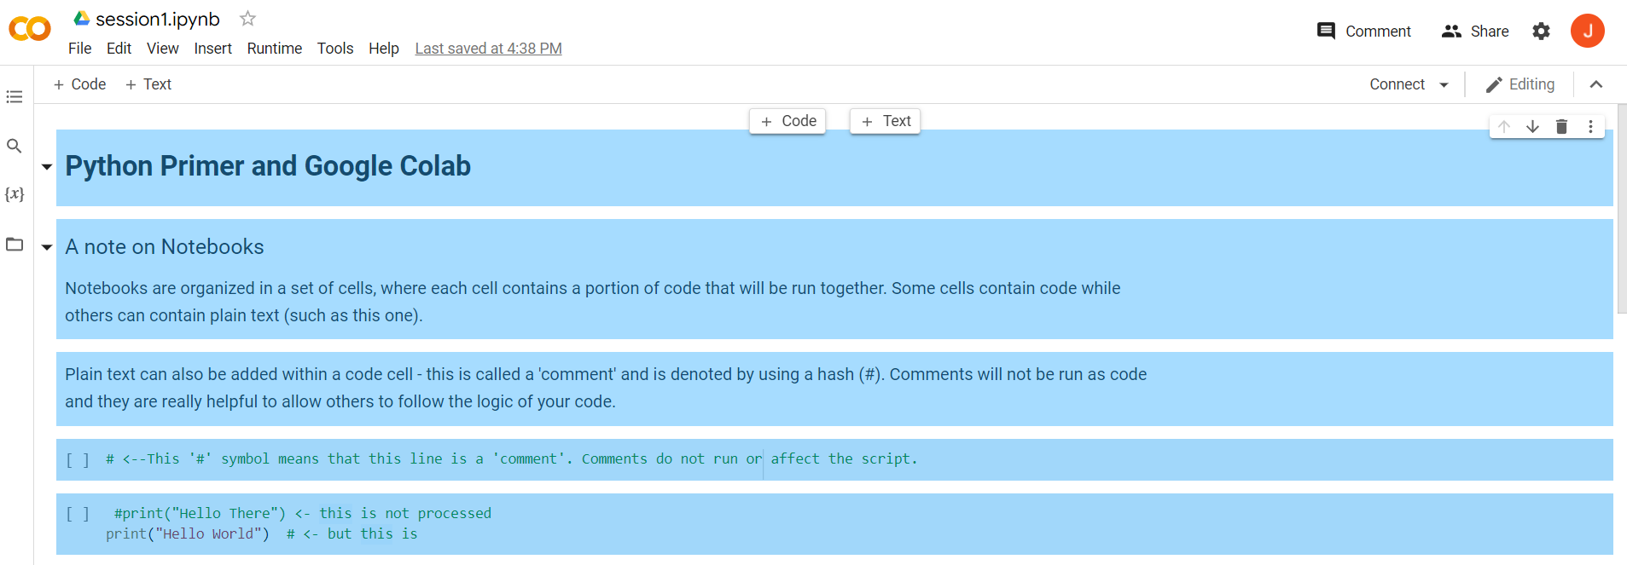
Notebooks
Notebooks consist of ‘cells’ of either code or text.
We’ll be using Google Colab notebooks for this workshop.

Slide 9
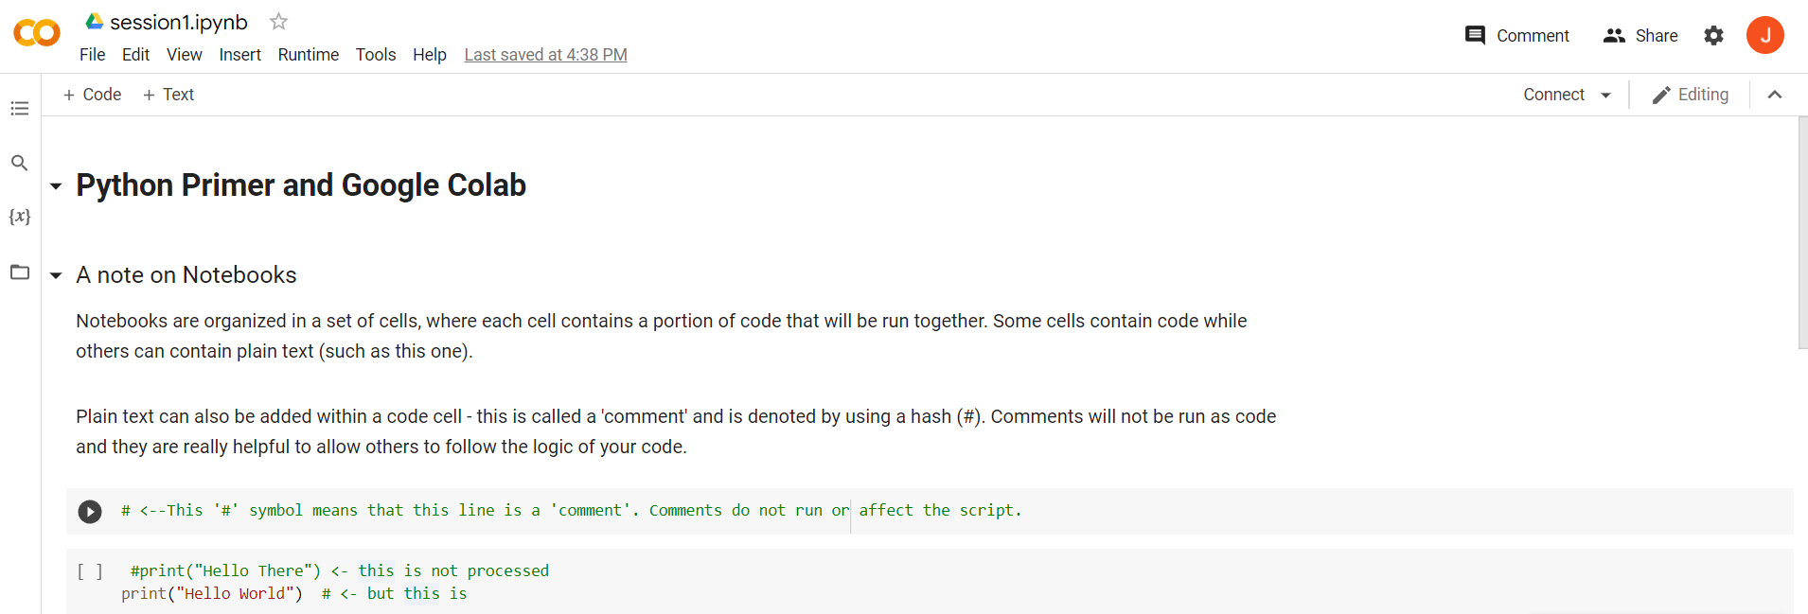





Notebooks
Once the first code block is run, Google will allocate some computing resources for us on the cloud.

Slide 10
Notebooks
Find this notebook on:
https://ersilia.gitbook.io/event-fund/

Slide 11
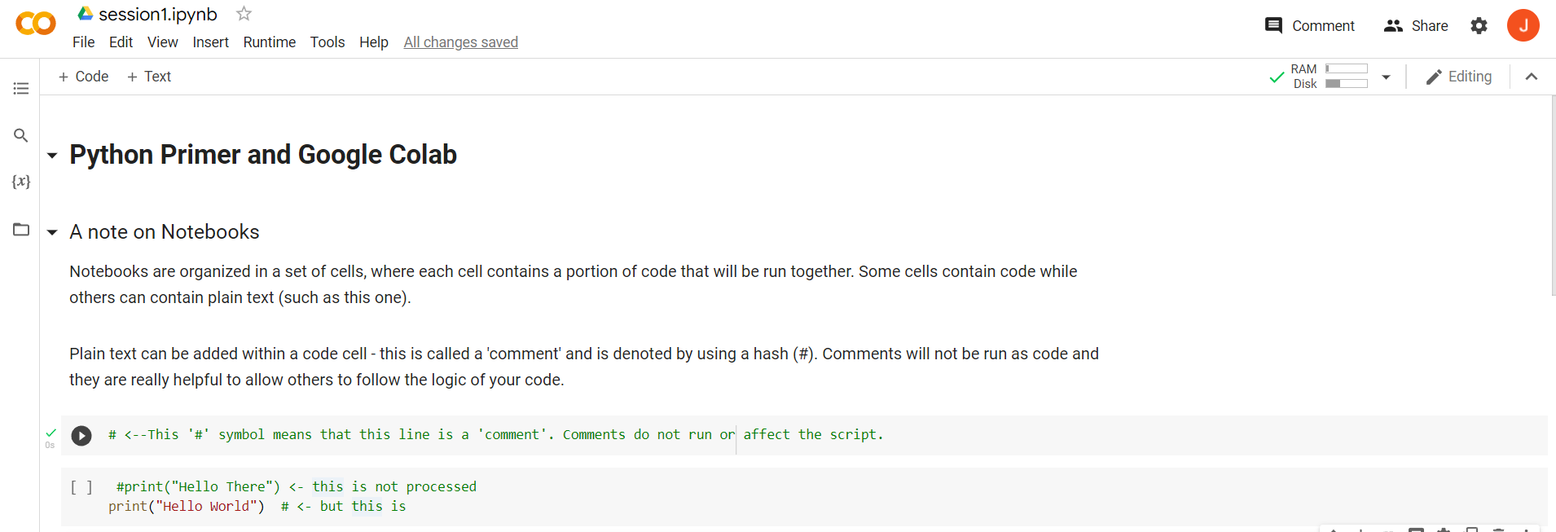
Notebooks
Run the first code block.

Slide 12
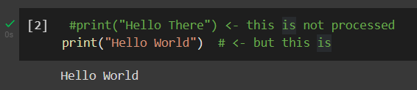

First Python Commands
Comments are plain text that aid code-readability.
Python commands in a cell are all executed after pressing the ‘run’ button.

Slide 13
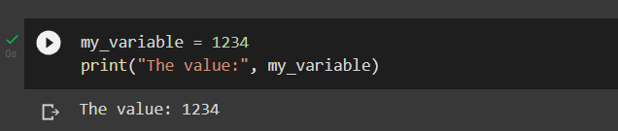
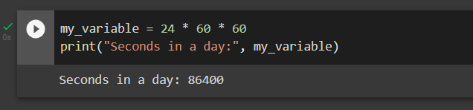
Variables
Variables store data to be referenced later using the variable’s name.
Variables are assigned or reassigned with the ‘=‘ operator.

Slide 14
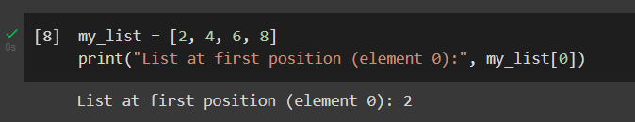
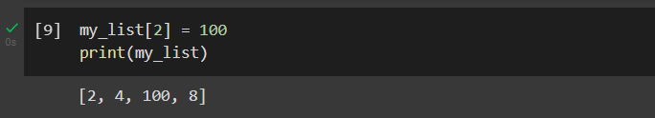
Data Types (Lists)
All data has an associated ‘type’.
Lists are useful type for storing collections of data in a single variable.
Lists are denoted with ‘[ ]’ and are zero-indexed.

Slide 15
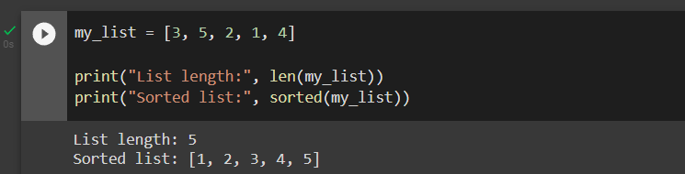
Functions
A ‘function’ is a reusable block of code that performs a specific task and avoids code duplication.
Functions are called with their name and additional data in ‘( )’.
There are many built-in Python functions.
Notes:
https://www.topleftdesign.com/kate-hampshire-topleftdesign-reflections-internship/

Slide 16
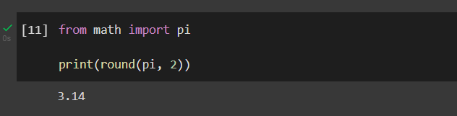

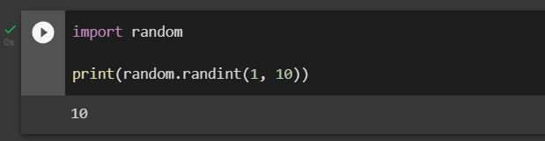
Functions
Functions can be shared between programs.
To use external packages and functions, we ‘import’ them into our workspace.
Notes:
https://abcsupplychain.com/efficient-with-excel-supply-chain/

Slide 17

The Secret…
https://twitter.com/programmersmeme/status/1243850868082053121

Slide 18

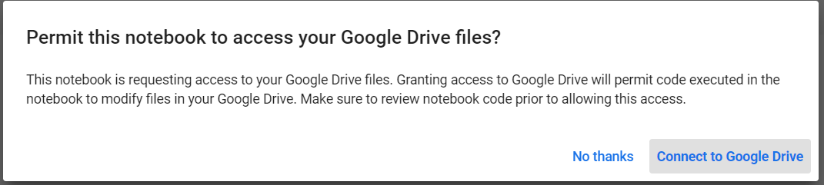
Linking to Google Drive
We can link our Colab Notebook to Google Drive to store and work on files.
Grant Google Colab access to your Google Drive.
Notes:
https://abcsupplychain.com/efficient-with-excel-supply-chain/

Slide 19


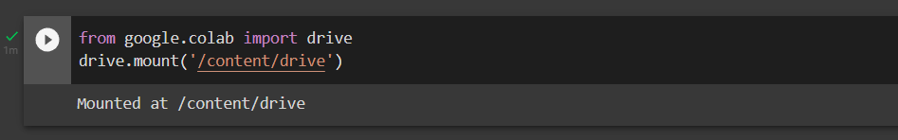
Linking to Google Drive
Notes:
https://abcsupplychain.com/efficient-with-excel-supply-chain/

Slide 20
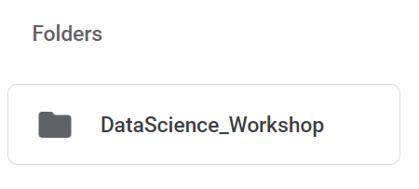
Linux Commands
Colab runs within a Linux environment.
We run Linux commands with a preceding ‘!’.
Notes:
https://abcsupplychain.com/efficient-with-excel-supply-chain/

Slide 21
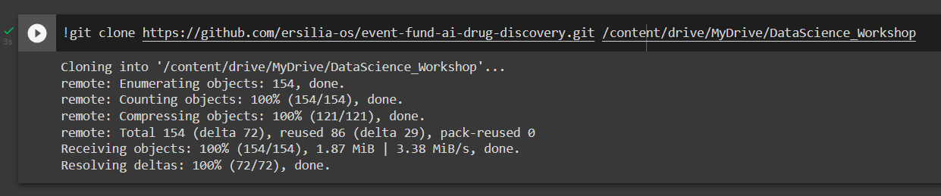
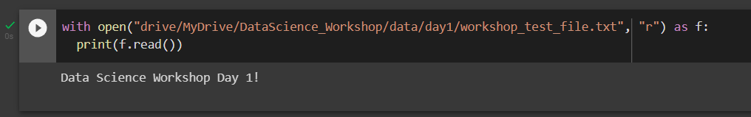
Linux Commands
Now we’ll make a copy of the workshop resources into the new folder.
Let’s check if we can read the test file in the folder.
Notes:
https://abcsupplychain.com/efficient-with-excel-supply-chain/

Slide 22
Bringing data science and AI/ML tools to infectious disease research
Day 1 Skills Workshop
Chemical Databases

Slide 23
How many chemicals are there?
Just for small organic drug-like molecules: 10⁶⁰
That’s:
1 000 000 000 000 000 000 000 000 000 000 000 000 000 000 000 000 000 000 000 000
Meanwhile, the largest databases list less than: ~10⁹
That’s only:
1 000 000 000
Therefore, much to gain from computational tools.

Slide 24





Open Access Chemical Databases
PubChem
Largest database of chemical bioactivity against their assays.
ChEMBL
Manually curated bioactivity database for drug-like molecules.
Therapeutic Data Commons (TDC)
Platform for AI-ready datasets for drug discovery.
Community for Open-Antimicrobial Drug Discovery
Community driven screening for antibiotics.
ZINC
Collection of commercially available compounds for screening.

Slide 25
ChEMBL
Chemical database of the European Molecular Biology Laboratory
Database of structured bioactivity data for small organic molecules.
2.3 million compounds
Includes binding, whole-cell phenotypes, ADMET
Manually curated from:
Medicinal chemistry journals
PubChem BioAssay
Other free databases, e.g. DrugMatrix
Deposited datasets. e.g. GSK, MMV

Slide 26
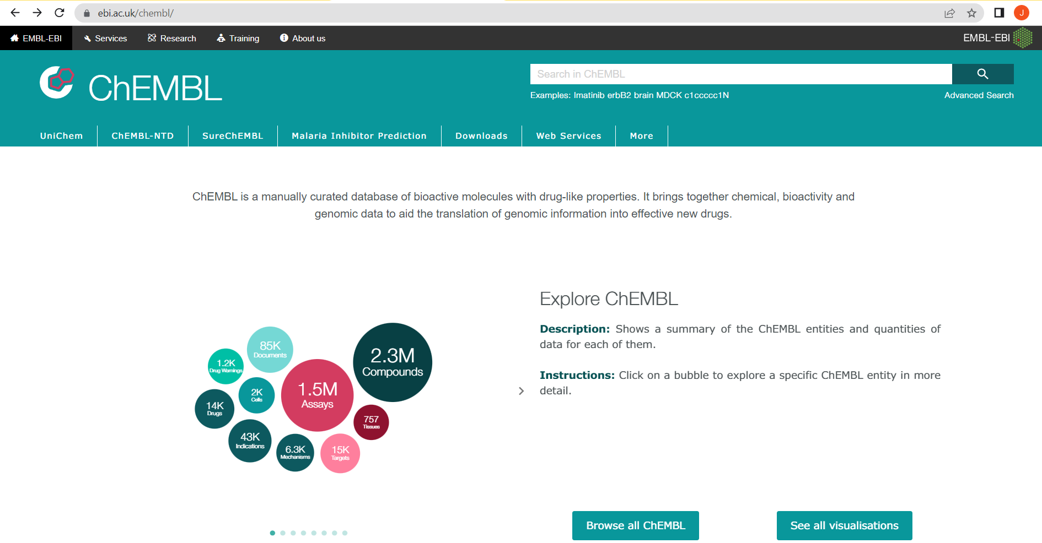
ChEMBL

Slide 27
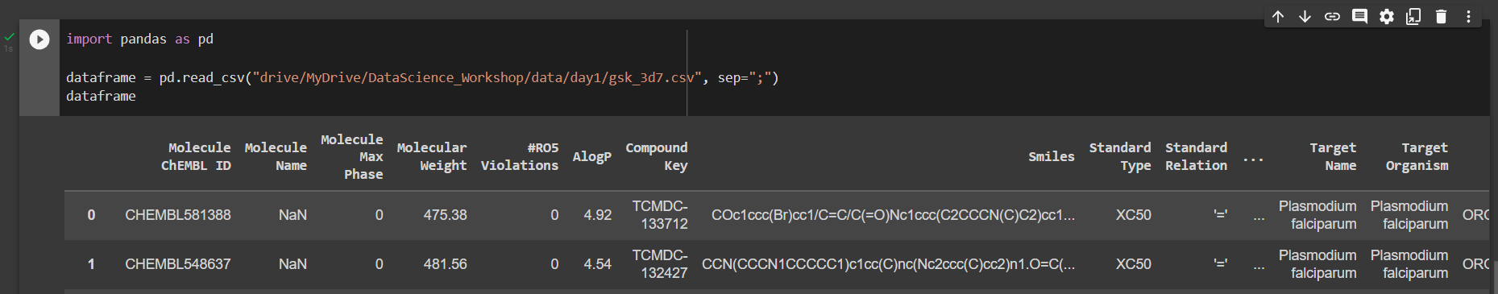

Pandas
Pandas is a data analysis Python package and particularly popular in data science.
We’ll use Pandas to load an example malaria screening dataset from ChEMBL.
Notes:
https://abcsupplychain.com/efficient-with-excel-supply-chain/

Slide 28
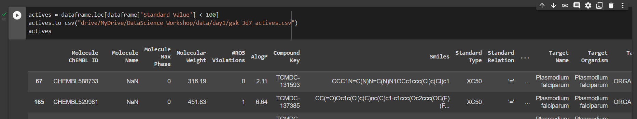

Pandas
ChEMBL datasets have a “Standard Value” column that we’ll use to select compounds with < 100 nM activity.
You’ll be seeing a lot more Pandas usage in the next days.
Notes:
https://abcsupplychain.com/efficient-with-excel-supply-chain/

Slide 29
Bringing data science and AI/ML tools to infectious disease research
Day 1 Skills Workshop
Visualising Chemical Distribution

Slide 30
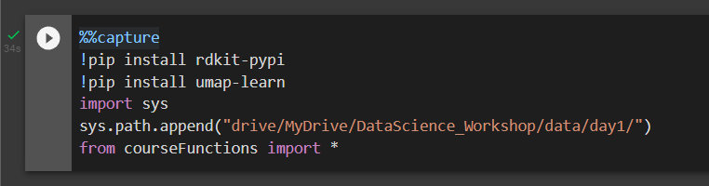
More Python Tools
Let’s install some additional packages – this may take a minute.
RDKit is a toolkit to support various cheminformatics and ML workflows.
The remaining packages will aid us in plotting data.
Notes:
https://abcsupplychain.com/efficient-with-excel-supply-chain/

Slide 31
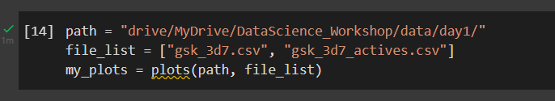
Dimensionality Reduction
We can describe our molecules with 1000s of descriptors.
However, to visualise our chemical distribution, we need to reduce this data to two dimensions.
Let’s plot the GSK screening data with two popular dimensionality reduction methods: PCA and UMA
Notes:
https://abcsupplychain.com/efficient-with-excel-supply-chain/

Slide 32
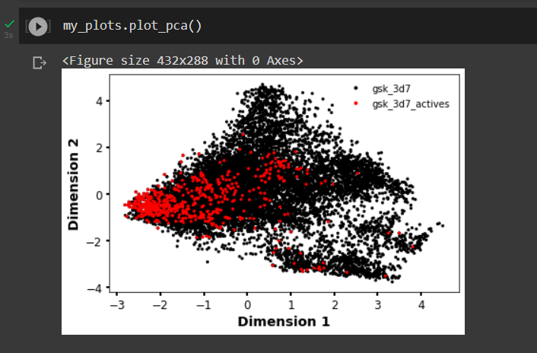
Principal Component Analysis
A PCA is a linear data transformation that maximises the variance of the data.
Not all chemical space is equally active.
Notes:
https://abcsupplychain.com/efficient-with-excel-supply-chain/

Slide 33
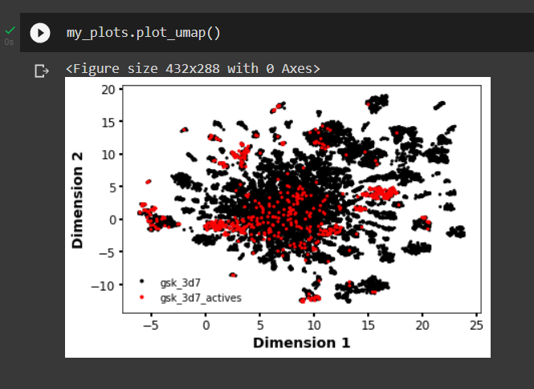
UMAP
A UMAP is a non-linear data transformation that preserves clustering of datapoints.
UMAPs are more qualitative in nature but very useful.
Can vary slightly between runs.
Notes:
https://abcsupplychain.com/efficient-with-excel-supply-chain/

Slide 34
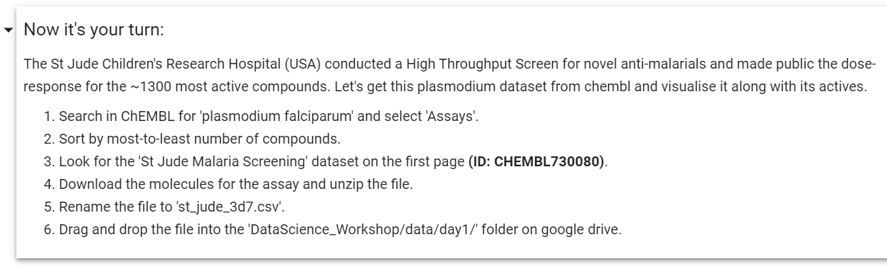
Hands-on ChEMBL
Now to fetch your own dataset from ChEMBL:
Notes:
https://abcsupplychain.com/efficient-with-excel-supply-chain/

Slide 35
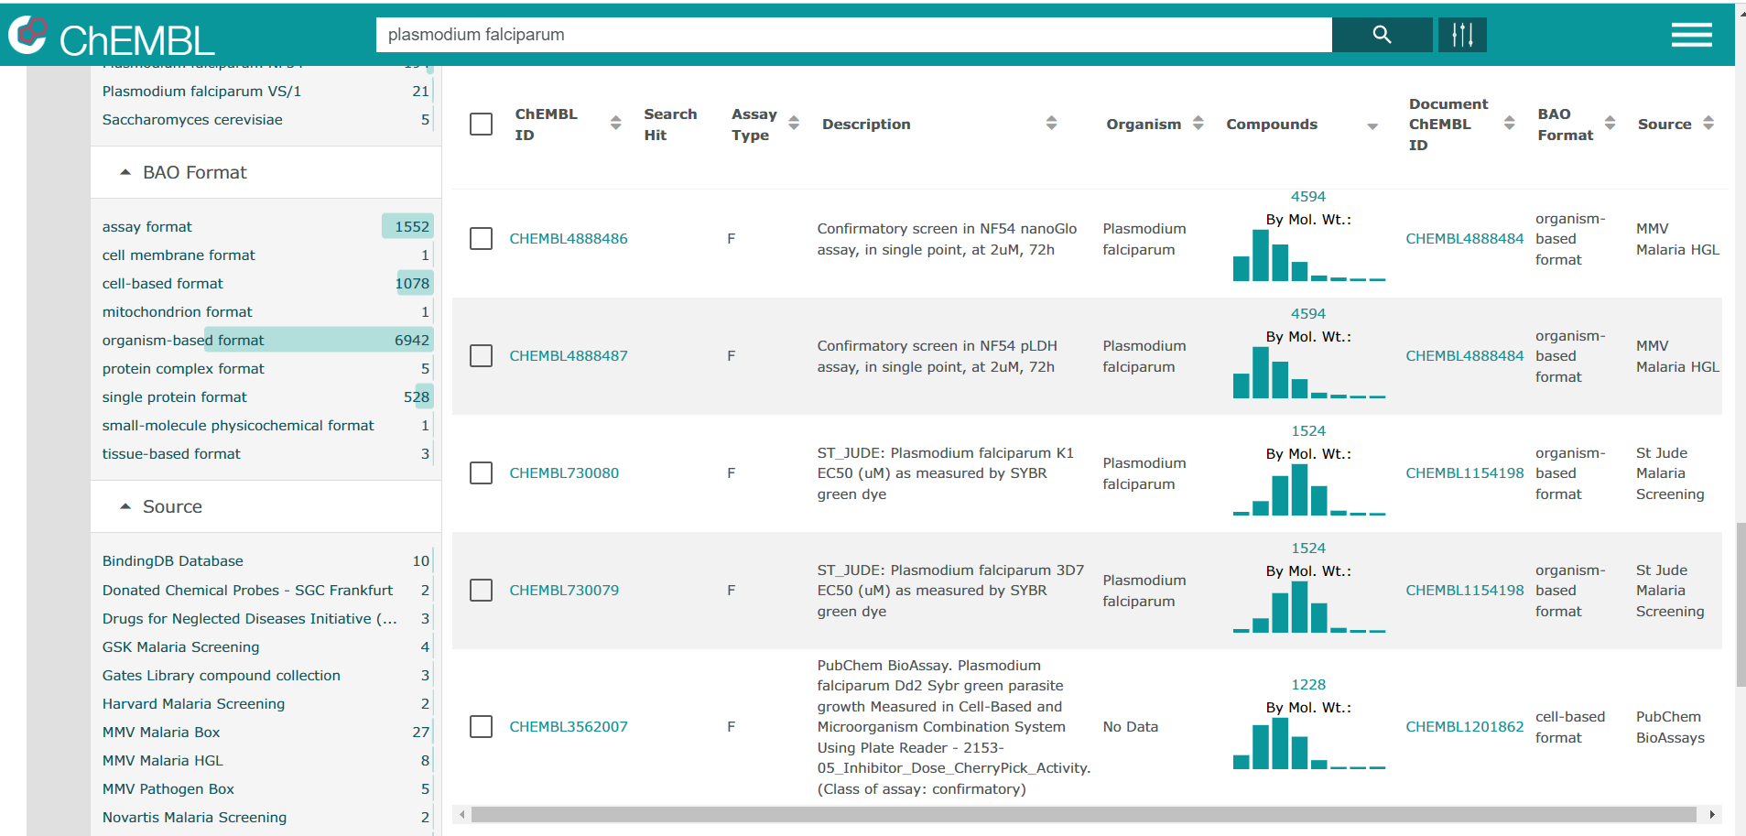
Hands-on ChEMBL
Now to fetch your own dataset from ChEMBL:
(not this one)
Notes:
https://abcsupplychain.com/efficient-with-excel-supply-chain/

Slide 36
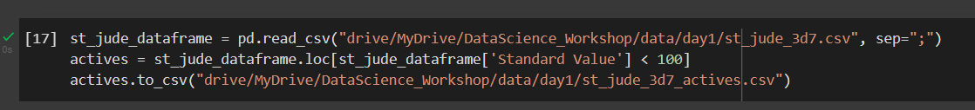
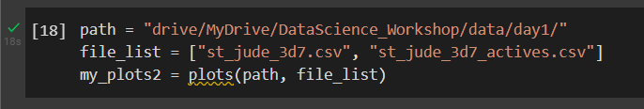
Hands-on ChEMBL
As we did with the GSK dataset, let’s save the compounds with < 100 nM activity separately:
And then plot the datasets.
Notes:
https://abcsupplychain.com/efficient-with-excel-supply-chain/

Slide 37
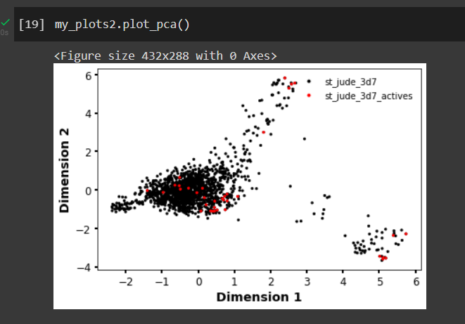
Hands-on ChEMBL PCA
This dataset appears less structurally diverse and less potent overall.
We still observe regions of activity.
Notes:
https://abcsupplychain.com/efficient-with-excel-supply-chain/

Slide 38
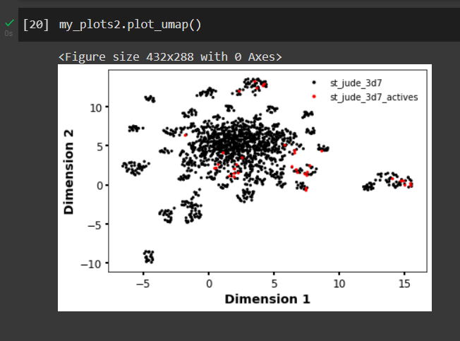
Hands-on ChEMBL UMAP
This dataset appears less structurally diverse and less potent overall.
We still observe regions of activity.
Notes:
https://abcsupplychain.com/efficient-with-excel-supply-chain/

