Slide 1
Bringing data science and AI/ML tools to infectious disease research
Day 1 Breakout Session

Slide 2
Breakout Session
This breakout session will have 3 sections as listed in the ‘session1_breakout.ipynb’ notebook:
Group Introductions & Data Science Challenges
Chemical Space Discussion
Data Cleaning
Today will be discussion-focused in your assigned groups.
At the end of the day, we’ll have a combined feedback session based on your group discussions.

Slide 3
Breakout Groups
Group 1 | Group 2 | Group 3 | Group 4 | Group 5
Dirkie Myburgh | Jessica Thibaud | Mohamed Maiga | Godfrey Mayoka | Donald Seanego
Jonathan Bvunzawabaya | Mariscal Brice Tchatat Tali | CJ Borstlap | Carene Ndong Sima | Dickson Mambwe
Frank Zindo | Sumit Kumar | Chris Jurisch | Ngonidzashe Ruwizhi | Ngceboyakwethu Primrose Zinyama
Sizwe Ndlovu | Lutete Peguy Khonde | Chinenyenwa Fortune Chukwuneme | Petrus Shanika | Henry Onyame
Ashleigh van Heerden | Phanankosi Moyo | Samuel Egieyeh | Sauvik Samanta | Michelle
Natalia Shakela | Moola Nyambe | Rudy Cozett

Slide 4
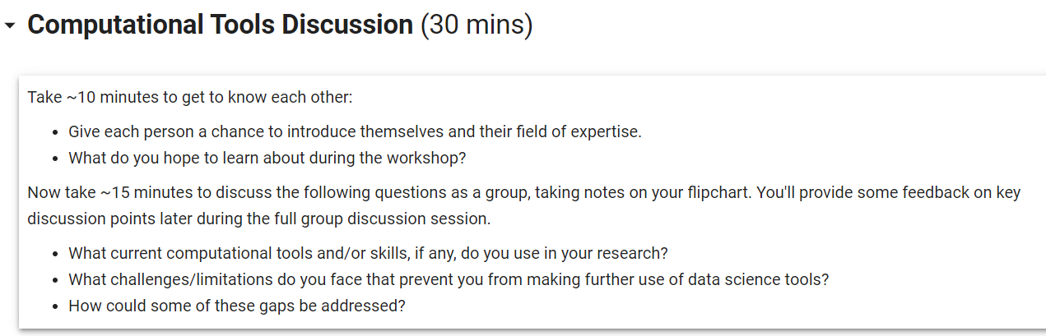
Breakout 1: Data Science Challenges

Slide 5
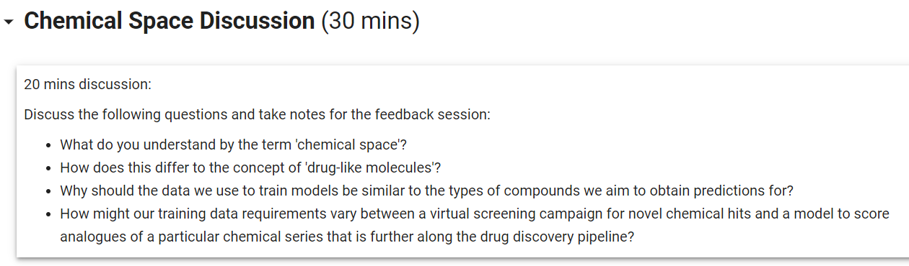
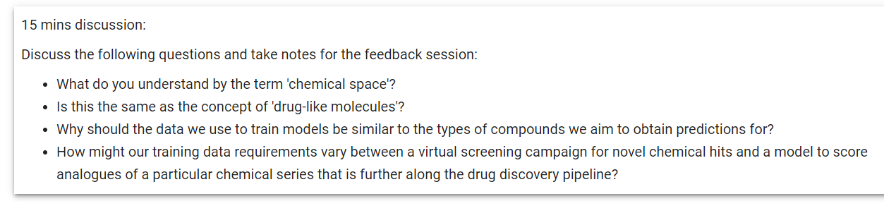
Breakout 2: Chemical Space Discussion

Slide 6
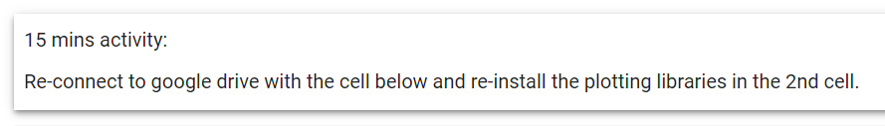
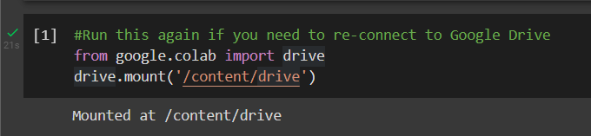
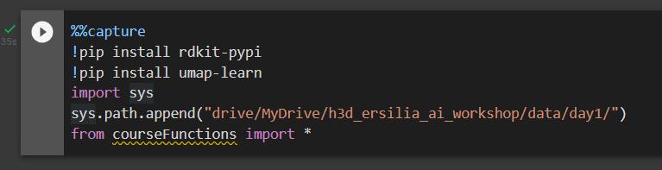
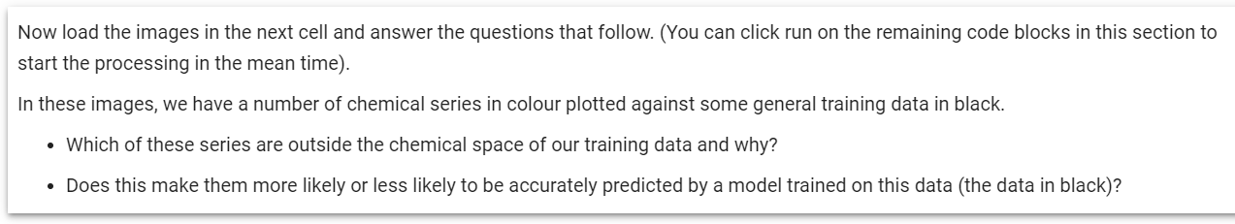
Breakout 2: Chemical Space Activities

Slide 7
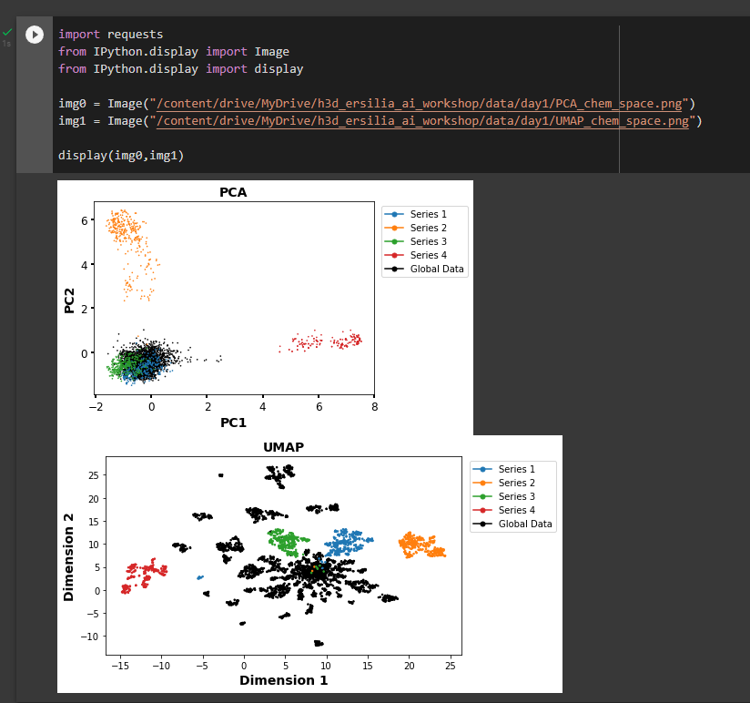
Chemical Space Activity 1

Slide 8
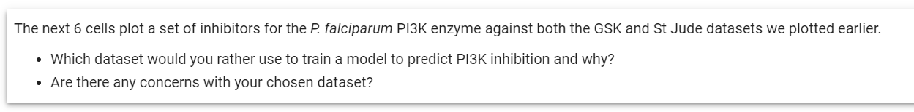
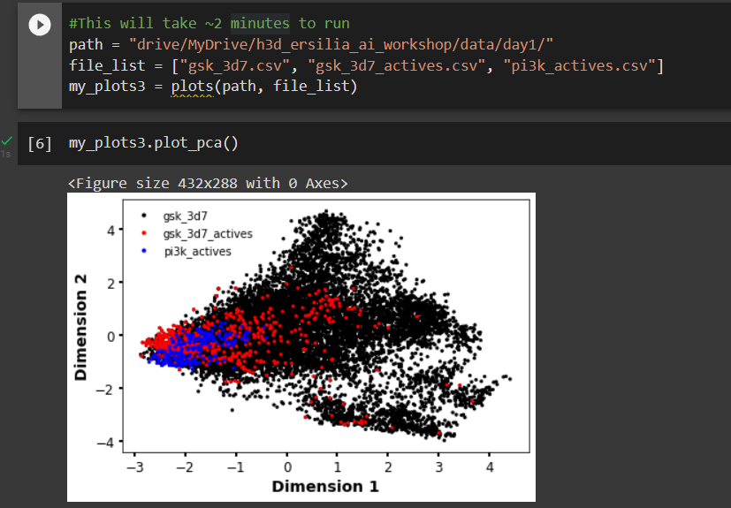
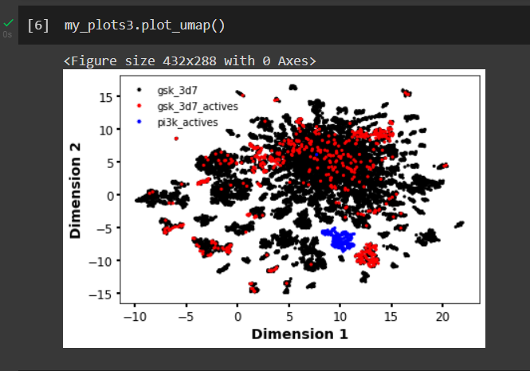
Chemical Space Activity 2

Slide 9
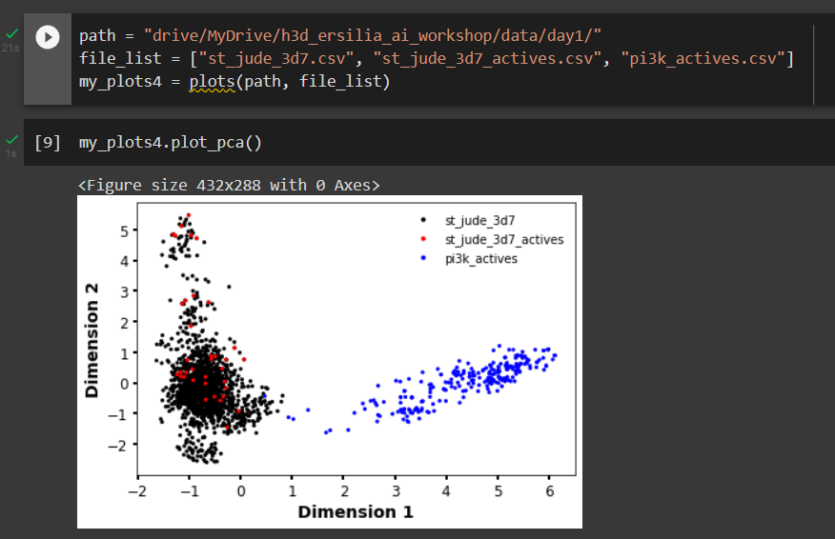
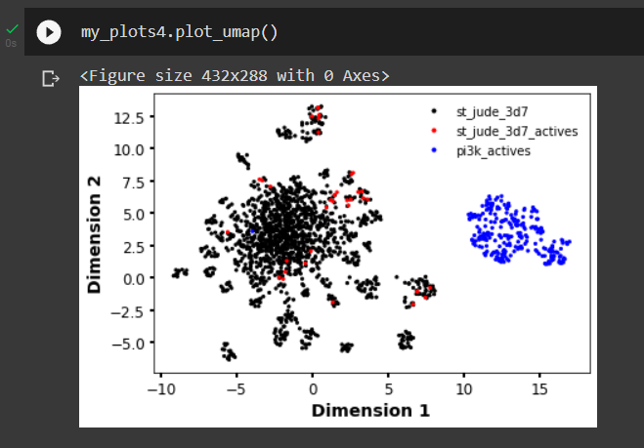
Chemical Space Activity 2

Slide 10
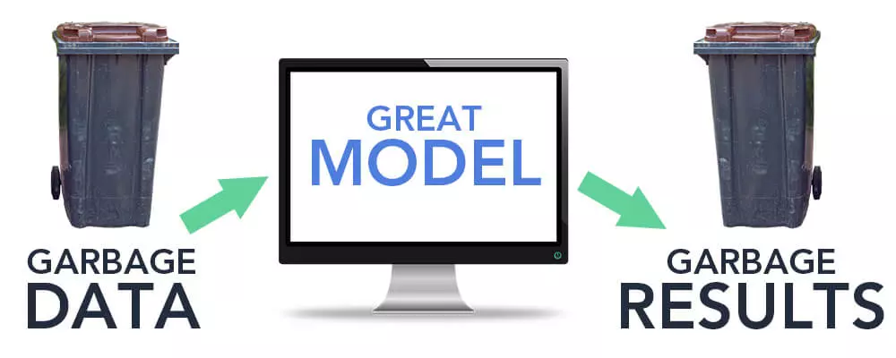
Roadmap to a Model
Data Curation
Data Cleaning
Pre-processing
Model Training
Model Validation
Predictions
Everything we do is driven by the data!
Datasets should be:
Complete
Consistent
Accurate
Relevant
Notes:
https://www.r-bloggers.com/2019/08/new-course-learn-advanced-data-cleaning-in-r/

Slide 11
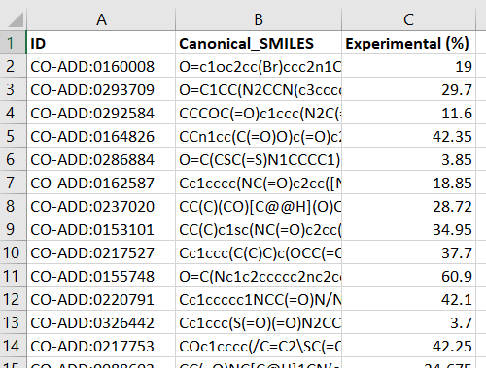
Roadmap to a Model
Data Curation
Data Cleaning
Pre-processing
Model Training
Model Validation
Predictions
Datasets should be:
Complete
Consistent
Accurate
Relevant

Slide 12
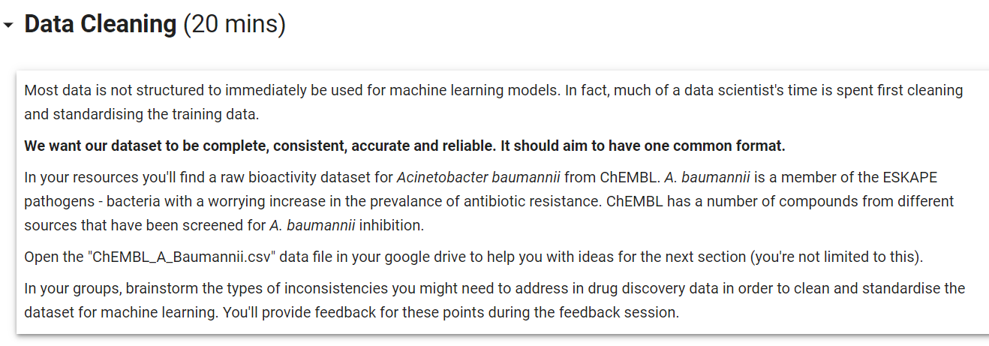
Breakout 3: Data Cleaning

