Slide 1

Enhancing User Experience: Building a Movie Recommendation System
Team 666
Songbo Hu, Robert Ngabo Mugisha Sr., Maliki Uwase, Kedi Lin
START
Notes:
https://pixabay.com/en/macbook-apple-imac-computer-screen-606763/

Slide 2
Data Mining Process
The Mining Workflow
Business Understanding
Data Understanding
Data Preparation
Deployment
Evluation
Modeling

Slide 3

Business Understanding
What is a Movie Recommendation System?
A filtering system that suggests movies to users based different algorithms
Increase engagement & retention
Maximizing Content Value
Personalized User Experience:
Boosting revenue
Notes:
Business problem and what we planning to do. Fast-growing streaming industry. Competitive Netflex, disney+
Retention of users is crucial. Pick the one you like.

Slide 4
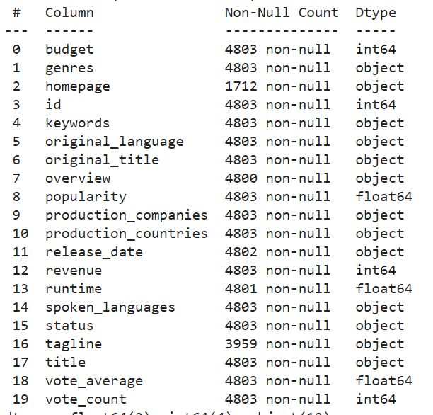
Data Understanding
Grasping the Essence of the Database
Exploring Data Set:
19 columns
4803 instances
High missing values for “homepage” and “tagline”
Notes:
Target variable is vote average which is the Rating

Slide 5
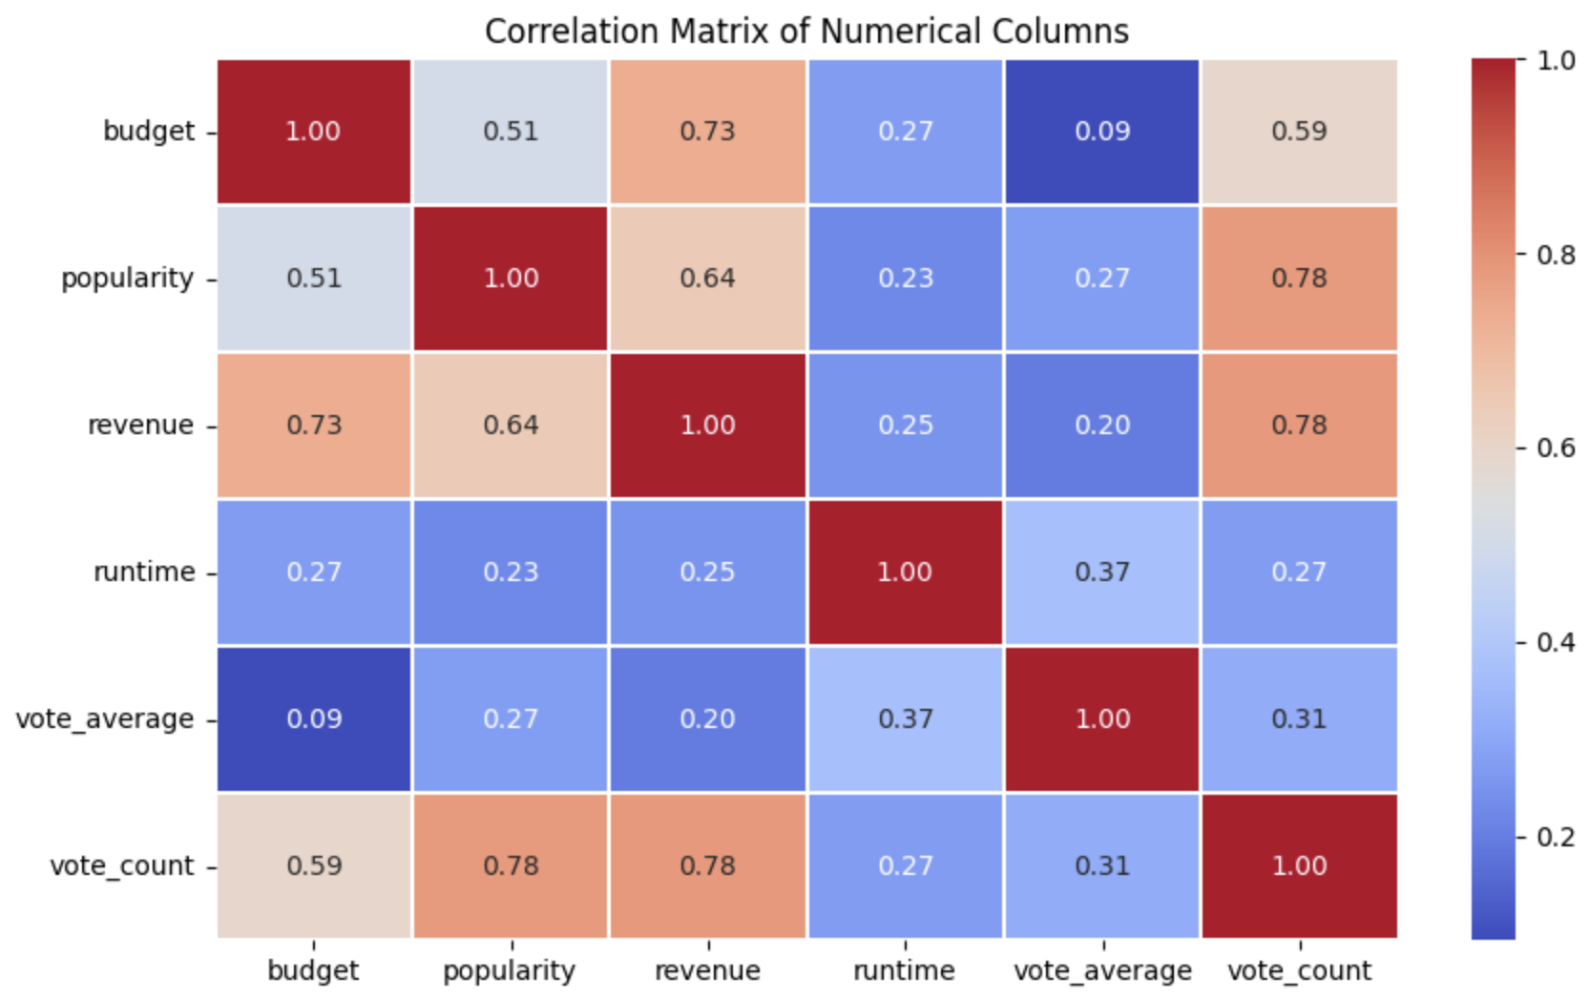
Data Understanding
Grasping the Essence of the Database
Offers insights into relationships between different movie attributes
Strong Correlations: “budget” and “revenue”; “popularity” and “vote_count”; “revenue” and “vote_count”
Higher budget is generally associated with higher revenue
Popular movies tend to get more votes
Movies with higher revenues tend to get more votes

Slide 6
Data Preparation
Ensuring Data Integrity and Usability
Handling missing values
Formatting values
Resetting indexes
Normalization
Encoding
Dividing data for training, validation, and testing
Feature transformation
Cleaning
Feature Engineering
Data Transformation
Data Split

Slide 7
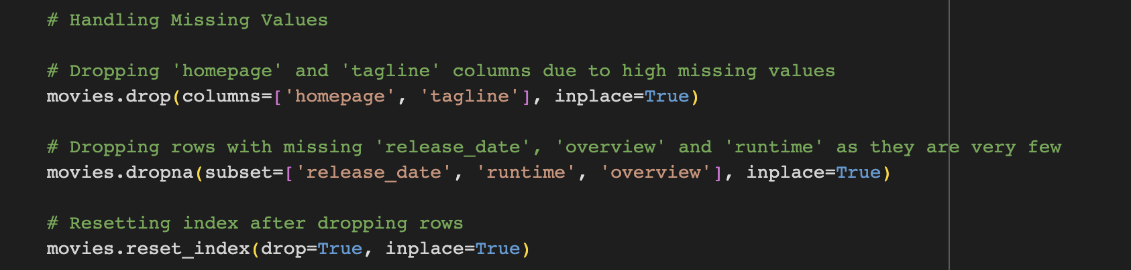
Data Preparation
Data Cleaning
Tidy dataset
Drop entire columns for “homepage” and “tagline”
Drop rows with missing value for others
Resetting index for consistency

Slide 8
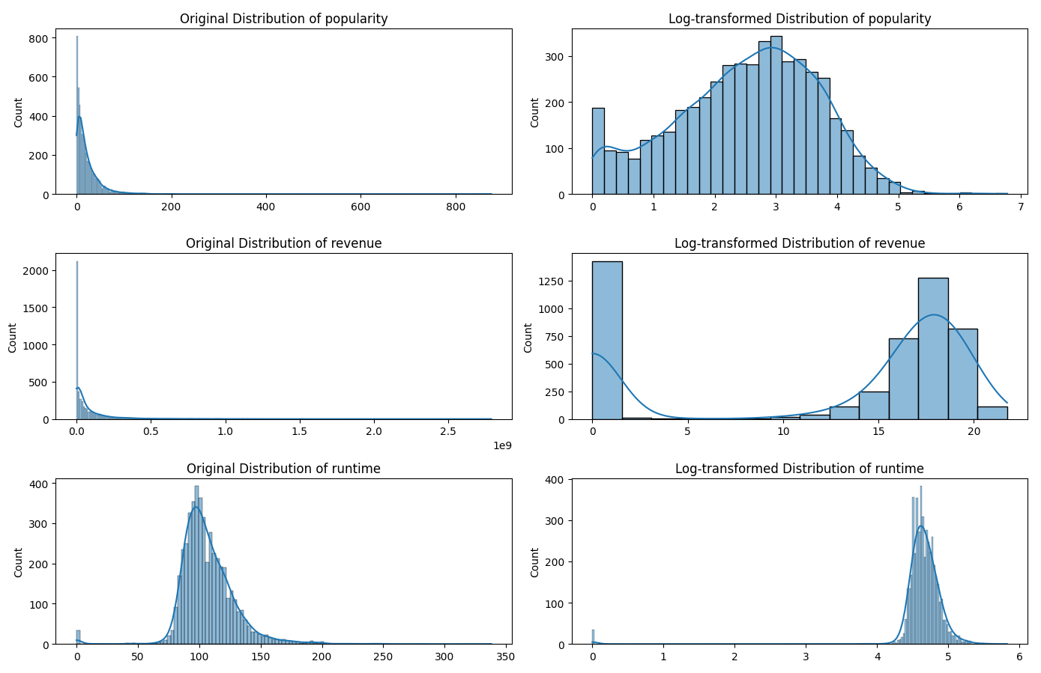
Data Preparation
Feature Engineering & Data Transformation
Perform simulated log-transforamtion on 6 features
Log-transformation: A powerful tool to manage skewed data
Right-skewed to normally distributed
Not all features benefits from log-transformation

Slide 9
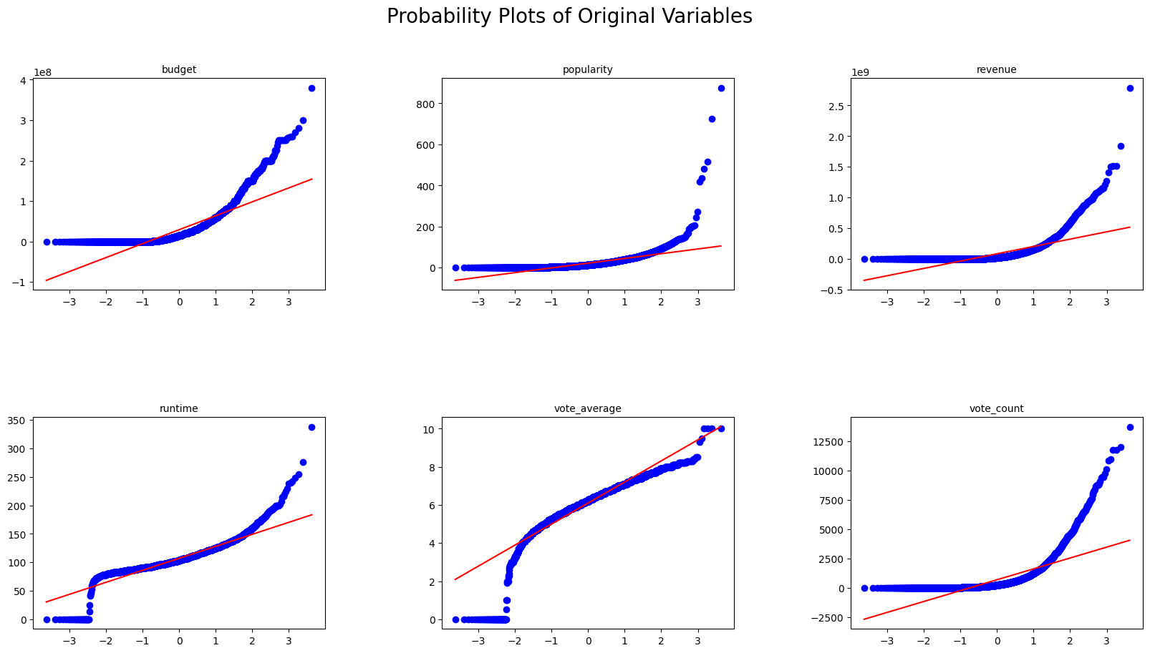
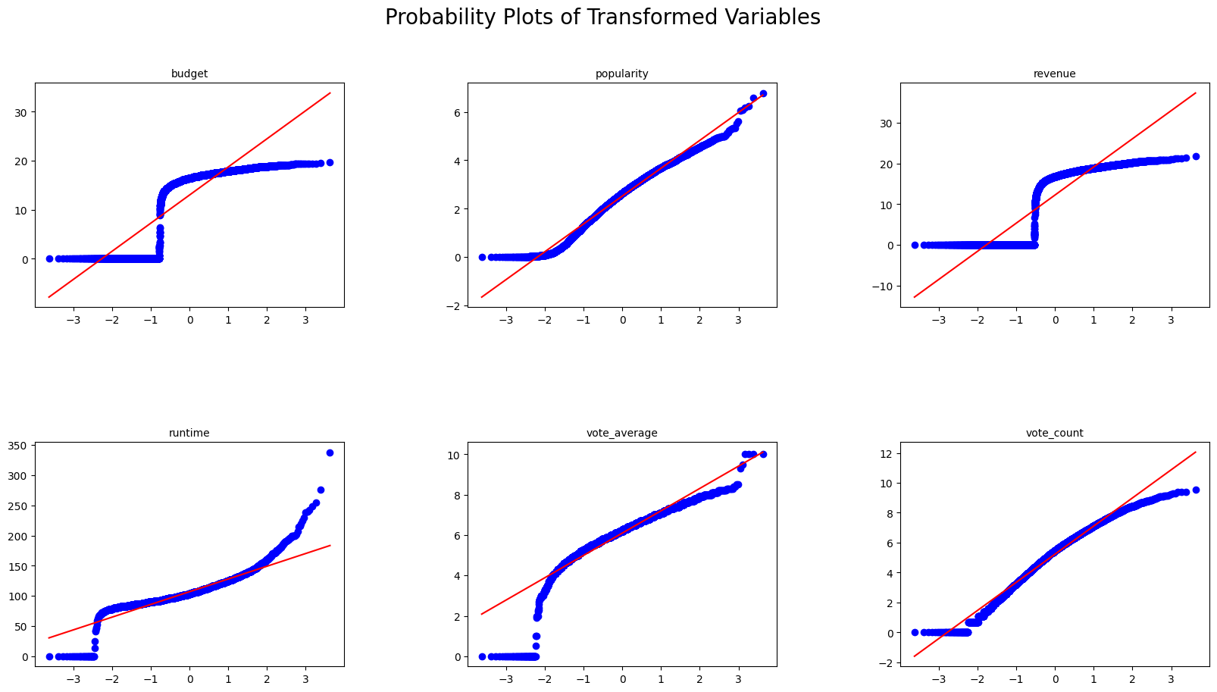
Data Preparation
Feature Engineering & Data Transformation
Normality: data points closely follow the reference line — normally distributed
Skewness: data points veer off above the reference line at the high end — right-skewed
Transformed 4 features
Transformed features became normally distributed

Slide 10
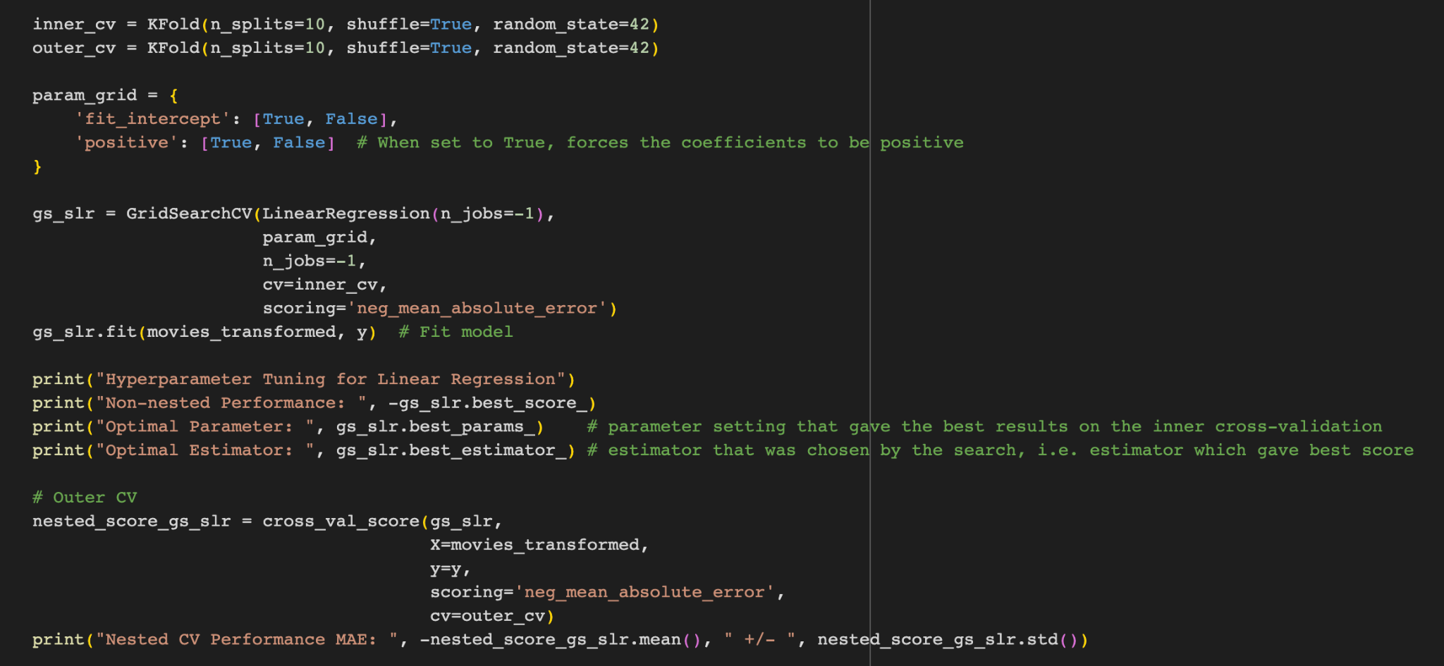
Data Preparation
Split the data to into training, validation, and testing set to perform cross-validation
Data Spliting

Slide 11

Algorithm Choices:
k-NN, Decision-Tree, and Linear Regression
Training Process:
Model training, hyperparameter tuning methods
Model Selection Criteria:
Metrics for evaluation models (Mean Absolute Error)
Notes:
https://pixabay.com/en/skyscraper-glass-facade-offices-418189

Slide 12
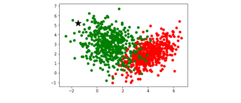
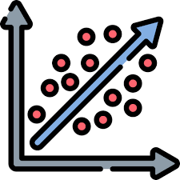
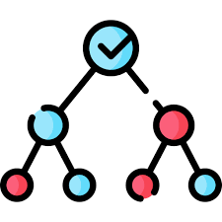
Modeling
k-NN
Linear Regression
Desision Tree
We used three regression modeling algorithms: KNN, Linear Regression, and Regressor Tree. We conducted three rounds of model evaluations. We began by creating the baseline models, then conducted hyperparameter tuning using nested cross-validation, and finally combined feature transformation with hyperparameter tuning. At every stage, we observed how the model's performance changed in response to different optimization techniques. We used the mean absolute error as our performance metric.

Slide 13
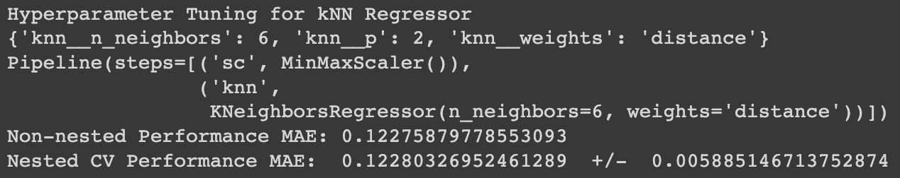
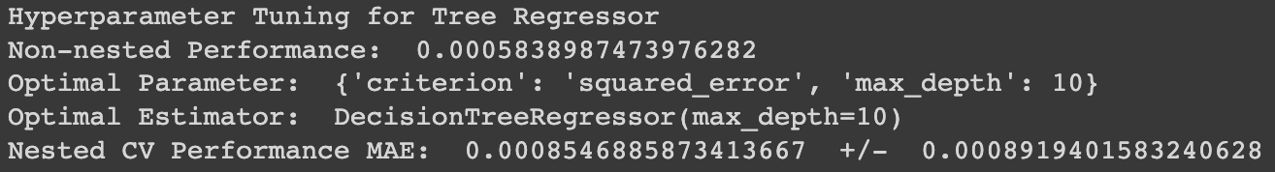
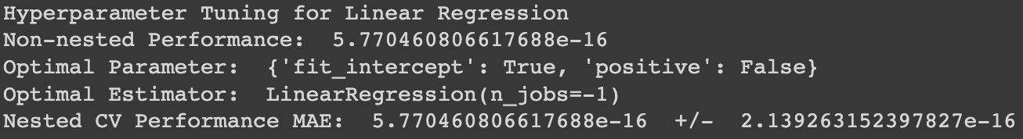
Evaluation
kNN Regressor:
Non-nested Performance: 0.1228
Nested CV Performance: 0.1228
Linear Regression:
Non-nested Performance: 5.77e-16
Nested CV Performance: 5.77e-16
Tree Regressor:
Non-nested Performance: 0.00058
Nested CV Performance: 0.00085

Slide 14

Evaluation
Overall, the Regressor Tree performed the best, achieving the lowest MAE on both the train and test sets. KNN ranked second. The learning curve revealed that KNN did not perform well with fewer examples, but its performance approached zero as the number of examples increased. This suggests that KNN might yield better results with more data. However, given our business context of developing a movie recommender system, KNN seems more suitable. This is because it operates faster compared to the Regressor Tree, and the difference in their MAE is not significant.

Slide 15
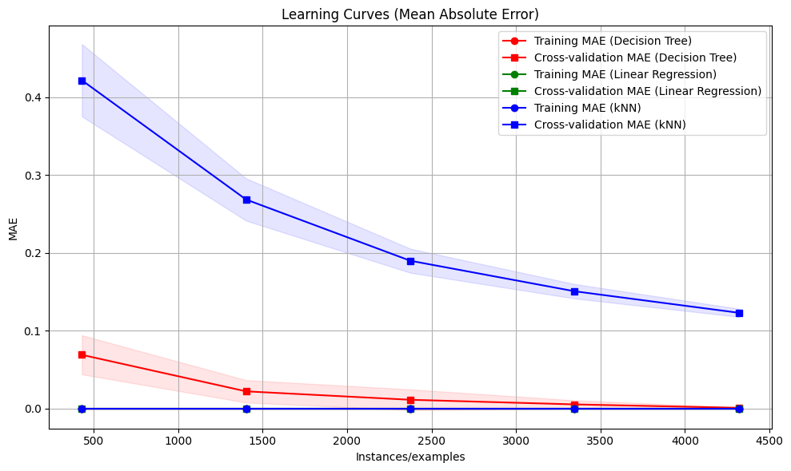
Evaluation

Slide 16


Recommendations & Conclusion
Implement the Regressor Tree for post-viewing recommendations.
Source: Netflix
Integrate KNN into the movie search engine.
Notes:
KNN and decision tree are the best models to fit our business content, however codindering from different scenial during the search time, user are expecting a fast response and in that case, KNN would be the best fit. but if the user is watching the a movie until the end, then we would have mote time to load then decision tree would be a better fit because it is take longer but have a better performance.

Slide 17
ThanK you!

