Slide 1
FINAL REVIEW
TalentFlow AI
Enterprise Candidate Relationship Management and Predictive Intelligence Ecosystem
Final project presentation covering the implemented portal, PostgreSQL schema, Azure lakehouse, ML insights, validation, and NLP-based conversational analytics agent.
2024DA04133
Final Submission
Altimetrik
BITS ID
WILP dissertation stage
Host organization
Malikulashtar K Malampatiwalla
Slide 1
Notes:
[Sources]
Local source deck used for styling: TalentFlow_AI_Professional_Mid_Term_With_Screenshots_2024DA04133.pptx
Final report: TalentFlow_AI_Final_Project_Report_2024DA04133.pdf

Slide 2
NARRATIVE
Final Presentation Roadmap
The final review is structured to help the examiner see the problem, the implemented system, the intelligence layer, and the project evidence.
1
Why TalentFlow AI?
2
What was built
Recruitment data fragmentation, historical profile loss, slow reporting, and privacy exposure.
Role-based portal, PostgreSQL schema, medallion ELT, Gold analytics, ML, and Ask Data.
3
What is new after mid-term
4
How it is validated
NLP semantic matcher, downloaded Hugging Face LLM mode, feedback memory, and SQL repair.
Gold reconciliation, contract tests, agent tests, ML metrics, and security controls.
Slide 2
Notes:
[Sources]
Final report sections 1, 4, 8, 9 and 10.

Slide 3
CONTEXT
The problem is not only hiring workflow, it is analytical trust
TalentFlow AI converts operational recruitment events into secured, versioned, and explainable decision-support data.
Operational fragmentation
History loss
Analytics bottleneck
Candidate profile, interview schedule, feedback, login, and education data often live in separate screens or spreadsheets.
Profile updates overwrite previous state unless audit and SCD2 logic capture change over time.
Hiring managers need KPIs and natural-language answers without waiting for manual SQL or exported reports.
Design implication: the project is a governed recruitment data product, not only a CRUD application.
Slide 3
Notes:
[Sources]
Final report section 1: problem statement and objectives.

Slide 4
OBJECTIVES
All core project objectives were completed
The final build covers operational capture, engineering, analytics, intelligence, security, and validation.
Role-aware portal
Candidate, admin, interviewer workflows
Implemented
Normalized database
Recruitment entities with relationships
Implemented
Medallion ELT
Bronze, Silver, Gold Parquet pipeline
Implemented
Privacy controls
Fernet encryption and SCD2 history
Implemented
Predictive layer
Random Forest models and feature insight publishing
Implemented
Conversational analytics
NLP matcher, Hugging Face LLM, SQL repair, feedback memory
Implemented
Slide 4
Notes:
[Sources]
Final report abstract, sections 3 and 8.

Slide 5
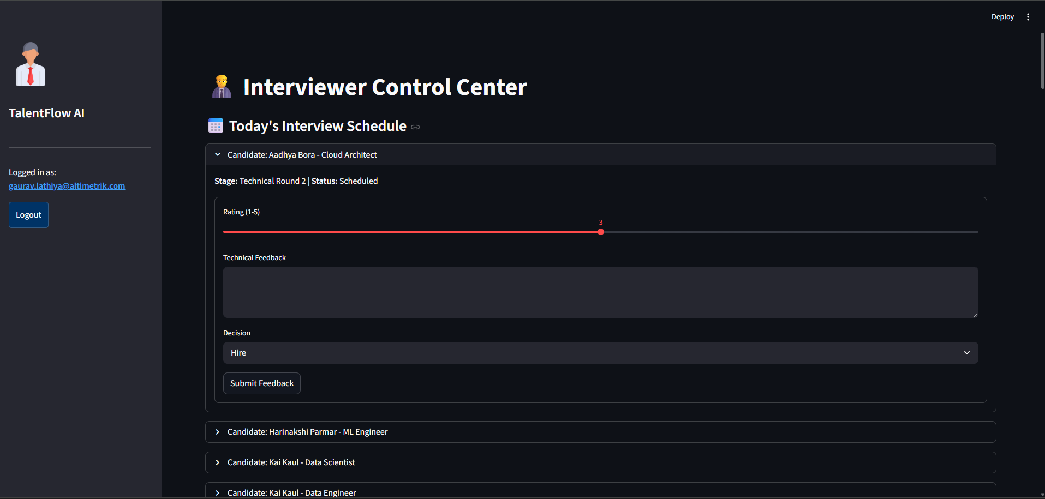
The final system separates workflow, lakehouse, analytics, and intelligence
ARCHITECTURE
The architecture keeps operational transactions in PostgreSQL and moves analytical processing through governed lakehouse layers.
Streamlit portal captures candidate, admin, and interviewer activity.
PostgreSQL stores normalized operational records.
Bronze/Silver/Gold pipelines publish versioned Parquet outputs.
DuckDB builds Gold metrics; dashboard and agent consume curated data.
ML models and the Ask Data agent add predictive and conversational intelligence.
The system is intentionally modular: transactional concerns, analytical storage, model training, and natural-language querying are separated.
Slide 5
Notes:
[Sources]
Embedded architecture image from mid-term deck; final report section 4.

Slide 6
SYSTEM MODULES
The implementation is broad but connected through one recruitment data model
Each module contributes a specific business or engineering capability.
Candidate portal
Admin center
Registration, login, profile update, education and salary details
Schedule interviews, inspect KPIs, view ML insights, run Ask Data
Interviewer center
Data lakehouse
Assigned interviews, rating, comments, hire/hold/reject decision
Bronze snapshots, Silver protection/history, Gold business datasets
ML insights
Analytics agent
Hire, decision and rating models with feature importance
Natural-language questions converted to safe read-only SQL
Slide 6
Notes:
[Sources]
Project source files: app/portal.py, pipelines, models/train_ml_insights.py, app/analytics_agent.py.

Slide 7
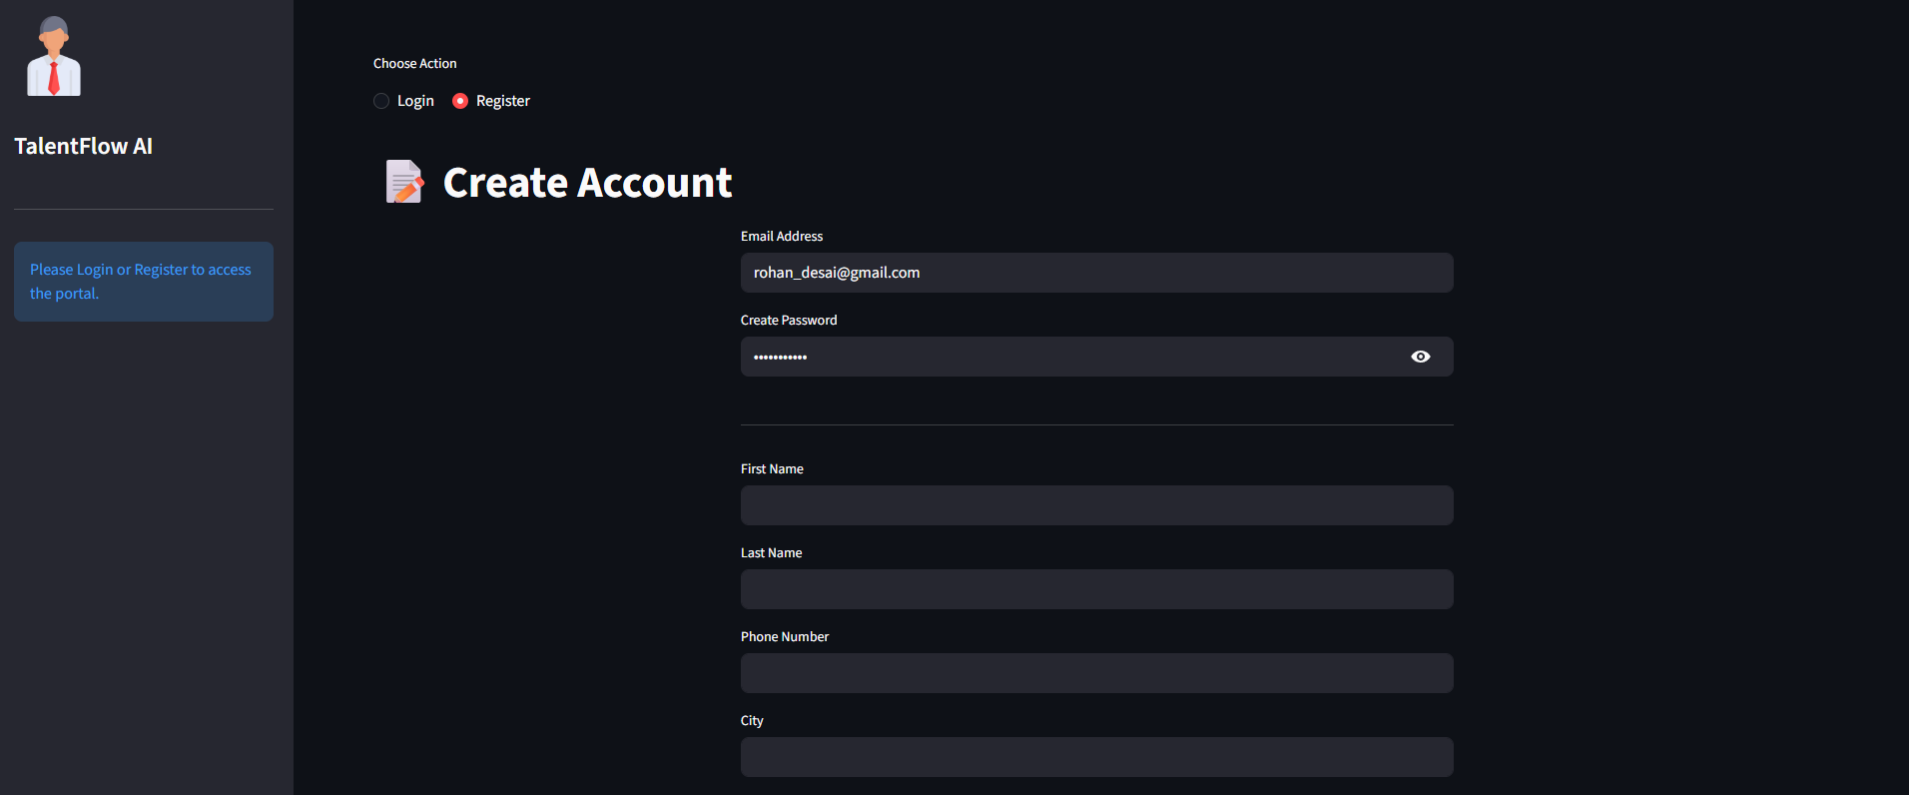
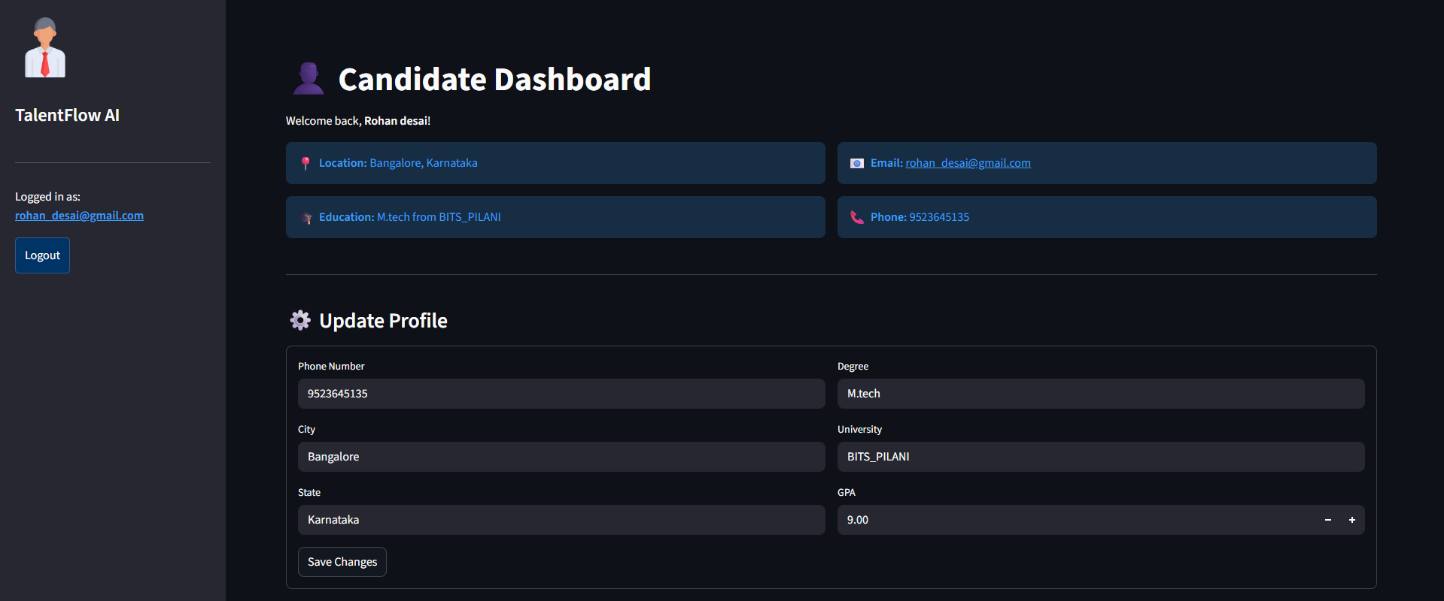
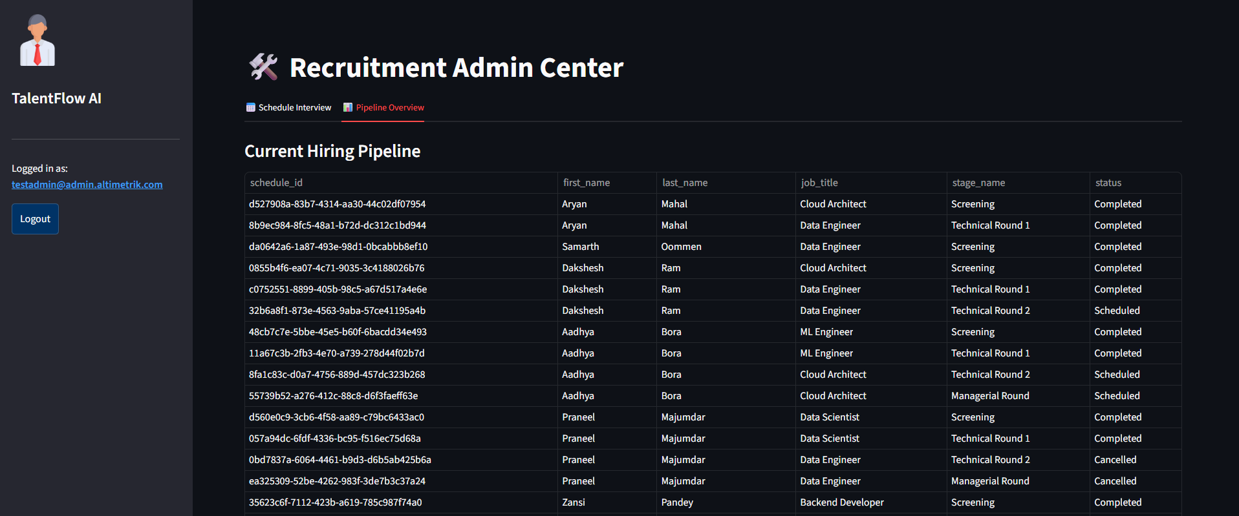
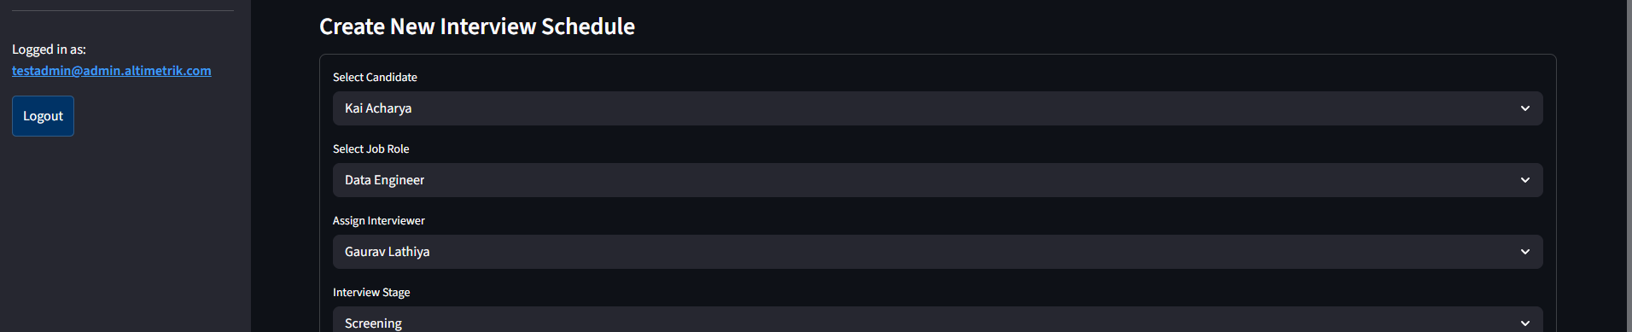
VISUAL EVIDENCE
The portal supports all three recruitment roles
Screenshots show the implemented user-facing workflows rather than only design diagrams.
Candidate profile, admin scheduling, active pipeline review, and interviewer feedback form are all implemented in the Streamlit portal.
Slide 7
Notes:
[Sources]
Embedded screenshots from mid-term deck; final project app/portal.py.

Slide 8
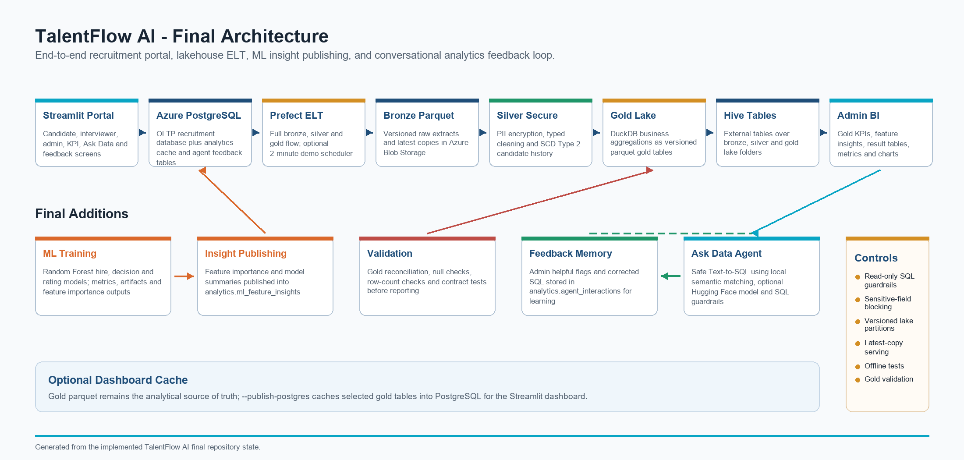
DATABASE DESIGN
The PostgreSQL schema is normalized around recruitment entities
Clear relationships make both transactional workflow and analytics joins reliable.
Candidate identity, education, login, audit, jobs, interviewers, stages, schedules and feedback are separated.
Schedules connect candidate, job, interviewer and stage.
Feedback belongs to a scheduled interview and drives KPIs and ML labels.
analytics.agent_interactions stores question, SQL, summaries, helpful flag and corrected SQL.
Slide 8
Notes:
[Sources]
Embedded ERD from mid-term deck; DDL.sql; final report section 5.

Slide 9
DATA ENGINEERING
The medallion pipeline turns raw operations into governed analytics
Bronze preserves snapshots, Silver protects and versions records, and Gold publishes business-ready KPIs.
PostgreSQL
Bronze
Silver
Gold
Dashboard
ML + Agent
Bronze
Silver
Gold
Raw snapshots with run_datetime lineage and latest copies.
PII encryption plus candidate history using SCD Type 2 logic.
DuckDB aggregates city, salary, engagement, funnel and hire-rate datasets.
Slide 9
Notes:
[Sources]
Final report section 7; pipelines/elt_bronze.py, pipelines/elt_silver.py, pipelines/elt_gold.py.

Slide 10
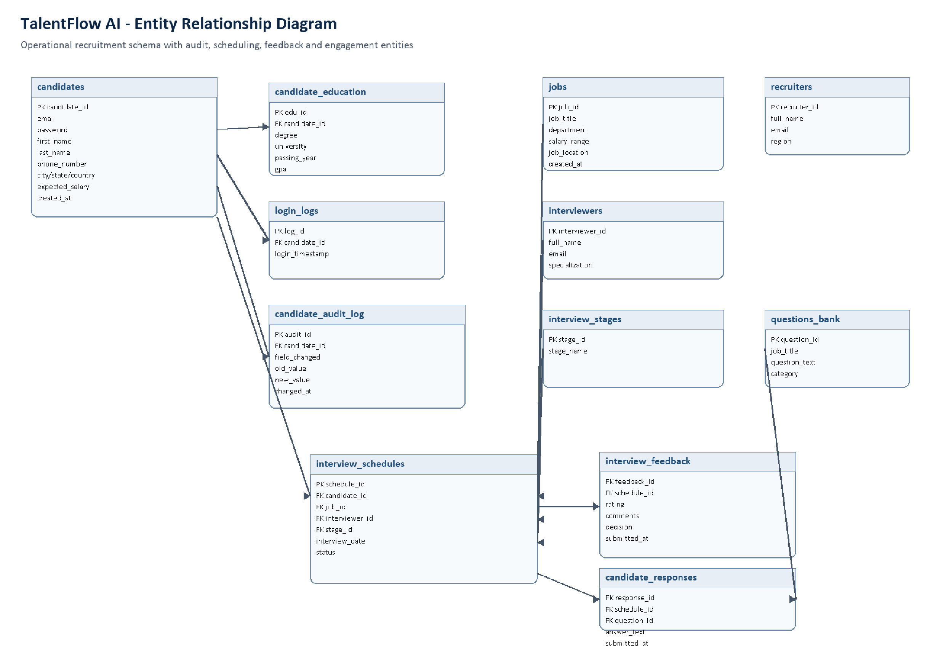
Entity-Relationship Diagram between the tables.
LAKEHOUSE EVIDENCE
Slide 10
Evidence point: each layer has both run-level lineage and current analytical consumption paths.
Notes:
[Sources]
Embedded Azure screenshots from mid-term deck; final report section 7.

Slide 11
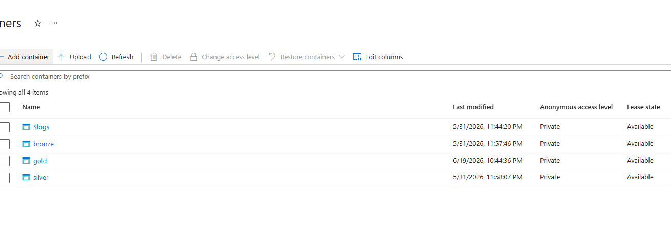
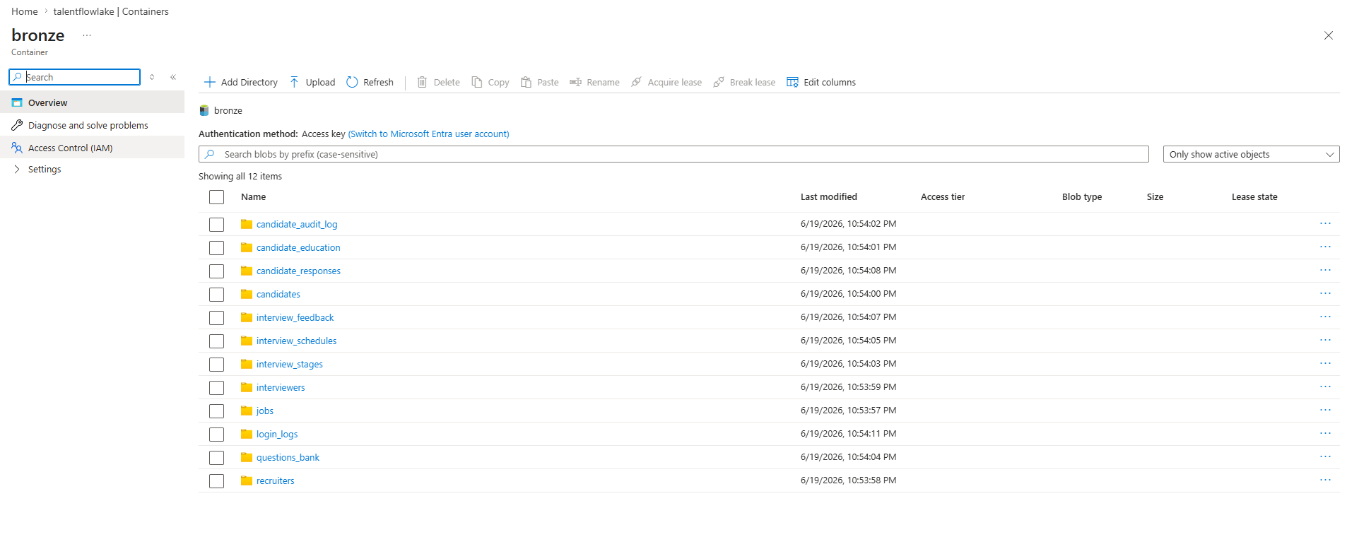
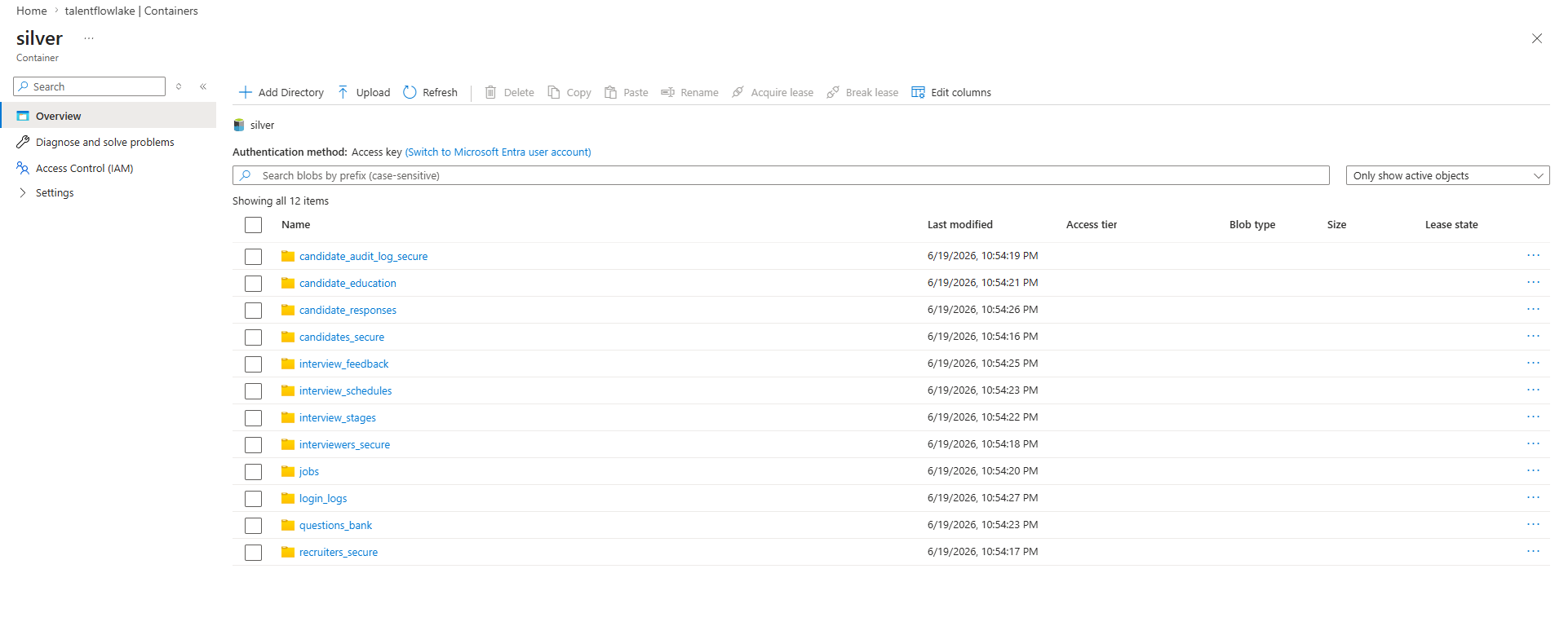
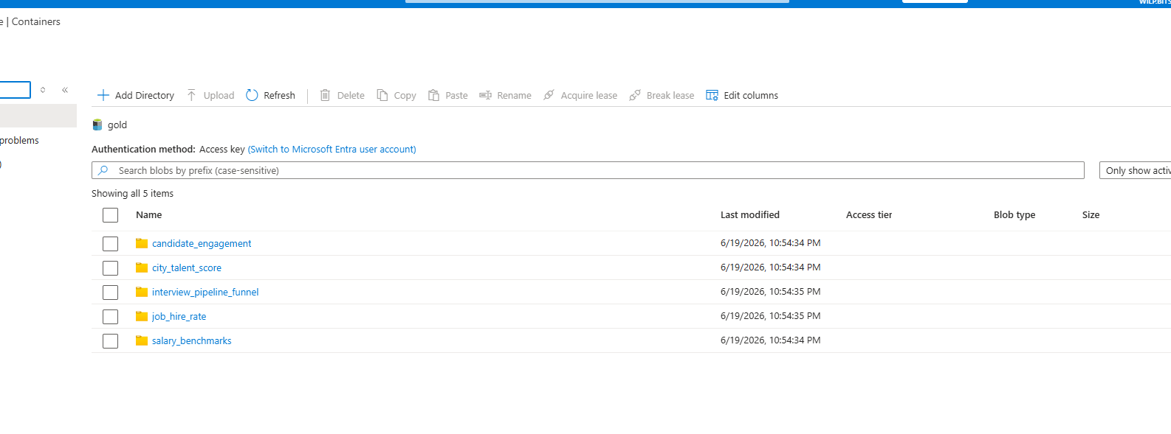
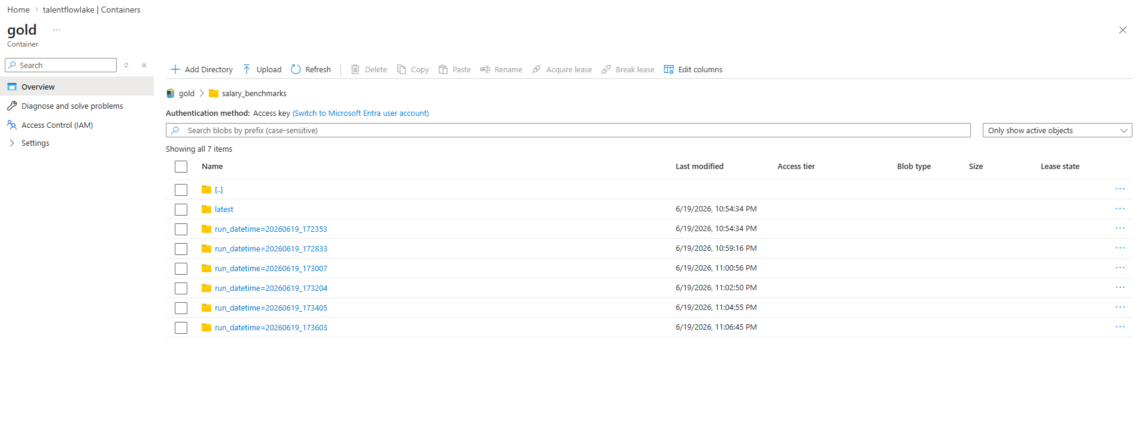
LAKEHOUSE EVIDENCE
Azure Blob containers store versioned Parquet outputs
The screenshots show Bronze, Silver, and Gold folders produced by the pipeline.
Slide 10
Evidence point: each layer has both run-level lineage and current analytical consumption paths.
Notes:
[Sources]
Embedded Azure screenshots from mid-term deck; final report section 7.

Slide 12
GOLD ANALYTICS
Gold datasets convert recruitment activity into business questions
The dashboard consumes curated tables instead of forcing managers to inspect raw transactional rows.
city_talent_score
Which cities have stronger candidate pipelines?
salary_benchmarks
How do expected salaries vary by education?
candidate_engagement
Which candidates are active or inactive?
interview_pipeline_funnel
Where is the interview process slowing down?
job_hire_rate
Which jobs have better hire recommendation rates?
Slide 11
Notes:
[Sources]
Final report section 7.3; pipelines/elt_gold.py; scripts/validate_gold_analytics.py.

Slide 13
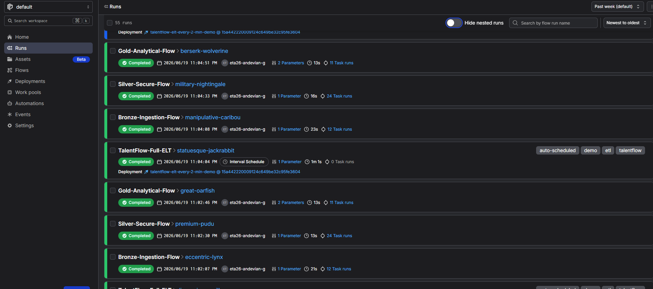
DASHBOARD EVIDENCE
Admins can view KPIs and ML feature insights in one place
The dashboard joins lakehouse outputs, PostgreSQL cache tables, and model artifacts for business-facing consumption.
What it proves
The final product is not limited to backend pipelines. It exposes analytics through a usable admin interface.
Decision support
Feature insight tables help explain model behavior without replacing human judgement.
Slide 12
Notes:
[Sources]
Embedded dashboard screenshot from mid-term deck; final report section 8.1.

Slide 14
PREDICTIVE INTELLIGENCE
The ML layer creates three decision-support models
The models are treated as prototypes for insight and explanation, not automatic hiring decision makers.
hire_prediction
decision_prediction
rating_prediction
Accuracy 0.7552
F1 0.8427
ROC-AUC 0.8262
Support 241
Accuracy 0.7884
Weighted F1 0.8165
Classes: Hire, Hold, Reject
Support 241
MAE 0.3017
R2 0.5309
Support 241
Mean rating 4.4995
Pipeline: joined recruitment features -> preprocessing -> Random Forest training -> artifacts -> analytics.ml_feature_insights -> dashboard.
Slide 13
Notes:
[Sources]
models/artifacts/20260708_065754/metrics.json; final report section 8.1.

Slide 15
MODEL INTERPRETATION
Random Forest was chosen as a strong tabular baseline
It supports mixed recruitment features and produces feature-importance signals that are easy to present to admins.
Handles numeric and categorical recruitment variables after preprocessing.
Feature examples
Works well as a practical baseline for tabular decision-support problems.
city, state, country, degree, university, expected salary, passing year, GPA, login count, job title, department, stage
Publishes feature importance so admins can see influential signals.
Limitations are acknowledged: demo data size, bias risk, and the need for fairness/drift checks before production.
Human review remains mandatory
Model outputs are advisory. Final hiring decisions must remain transparent, policy-compliant, and reviewed by people.
Slide 14
Notes:
[Sources]
Final report sections 8.1 and Appendix C; scikit-learn Random Forest documentation cited in the report.

Slide 16
NEW FINAL ASPECT
The Ask Data module adds a conversational analytics layer
Admins can ask recruitment questions in natural language and receive safe SQL-backed answers with tables or charts.
Natural-language input
Agent plan
Safe execution
Learning loop
Example: Which candidates have high ratings but were not hired?
The router chooses fast local NLP, Hugging Face local LLM, optional cloud AI, or fallback SQL.
SQL is sanitized, limited, executed read-only, and optionally repaired once in Hugging Face mode.
Question, SQL, summary, helpful flag, and corrected SQL are stored for future reuse.
This is a major improvement over the mid-term plan: Text-to-SQL is now implemented with local NLP and downloaded LLM support.
Slide 15
Notes:
[Sources]
app/analytics_agent.py, app/local_sql_model.py, app/huggingface_sql_agent.py, app/portal.py; final report section 8.2.

Slide 17
NLP + HUGGING FACE
Fast local matching keeps demos responsive, while local LLM mode handles harder questions
The system avoids depending only on paid cloud AI or slow model generation.
Fast local NLP matcher
Admin question
Schema + learned examples
Sanitized PostgreSQL SELECT
Answer + visualization
Downloaded Hugging Face LLM
LOCAL_AGENT_SPEED_MODE defaults to fast local SQL before slow LLM generation.
LOCAL_ALLOW_SLOW_LLM enables slower Hugging Face fallback when local confidence is low.
Default local model: Qwen/Qwen2.5-Coder-1.5B-Instruct through Transformers text-generation pipeline.
Slide 16
Notes:
[Sources]
app/analytics_agent.py and app/huggingface_sql_agent.py; Hugging Face Transformers/Qwen references cited in final report.

Slide 18
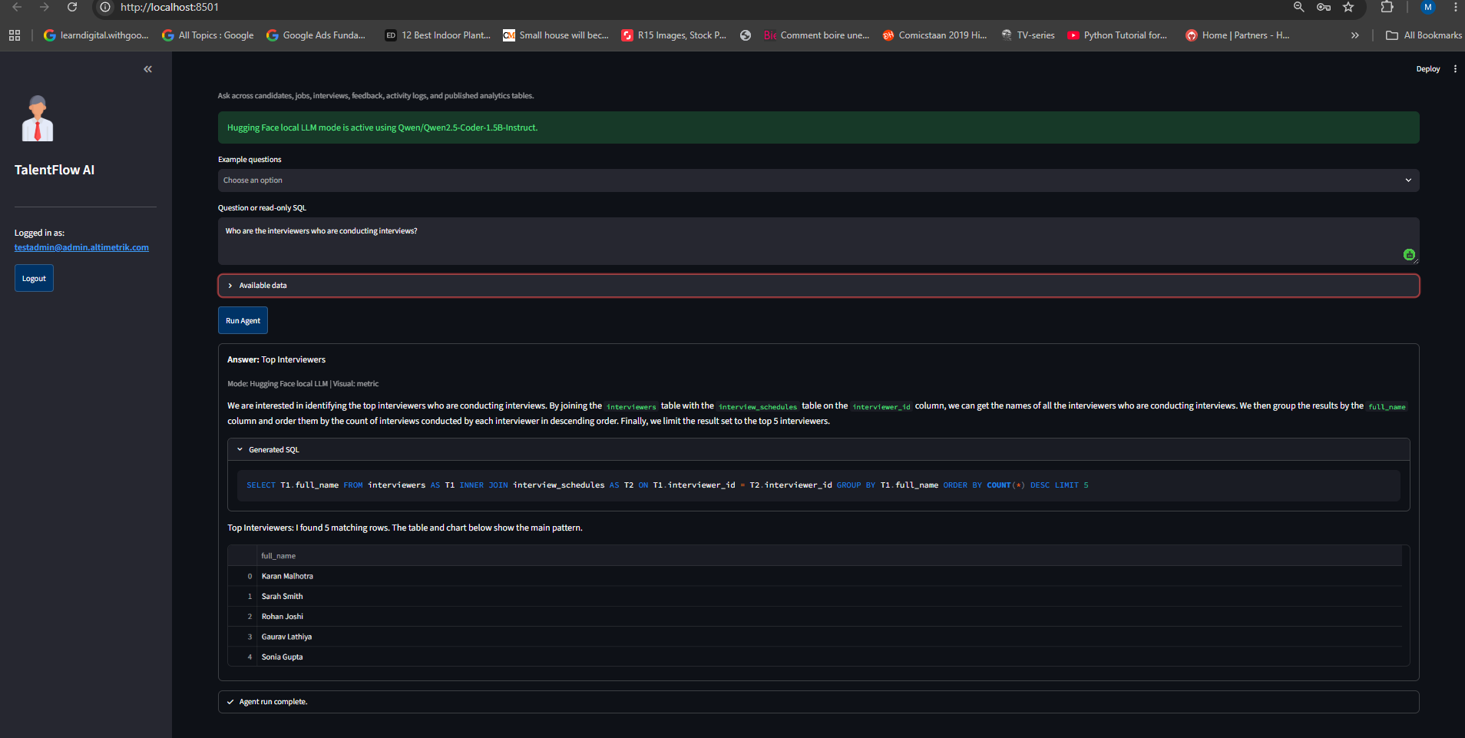
AGENT SAFETY
The assistant is designed to be useful without being dangerous
Generated SQL is never trusted directly; the same sanitizer protects pasted SQL, local NLP SQL, cloud SQL, and Hugging Face SQL.
Read-only
Single statement
Only SELECT or WITH queries are allowed.
Multiple semicolon-separated statements are rejected.
Sensitive fields
Bounded output
Password and secret fields are not allowed in assistant output.
A LIMIT is added when missing to reduce accidental large scans.
Blocked mutations
Feedback memory
INSERT, UPDATE, DELETE, DROP, ALTER, CREATE, TRUNCATE, COPY, GRANT and REVOKE are blocked.
Useful answers and corrected SQL teach future examples.
Slide 17
Notes:
[Sources]
app/analytics_assistant.py, app/analytics_agent.py; final report section 8.2.4.

Slide 19
AGENT DEMONSTRATION
The question bank is aligned with real recruitment decisions
These questions are ready to use during viva or project demonstration.
Give me a hiring summary with the main KPIs.
Which cities have the strongest candidate pipeline?
Which candidates have high ratings but were not hired?
Which jobs have the best hire rate and enough feedback?
Which interviewers have the highest pending feedback workload?
Which degrees are associated with better ratings?
Which active candidates have not logged in recently?
What are the top ML feature insights and what should I do next?
Slide 18
Notes:
[Sources]
app/portal.py example_questions; outputs/TalentFlow_AI_Agent_Question_Bank.md.

Slide 20
TESTING
Validation covers schema, data quality, contracts, and the new agent
The final project includes tests for both the data product and the conversational analytics layer.
Gold validation
Project contracts
Row counts, nulls, duplicates, ranges, formulas, reconciliation
SCD2, versioned lake paths, Hive tables, dashboard exposure
Agent tests
Latest result
Local matching, Hugging Face prompt parsing, response extraction, fallback narration
10 targeted agent tests passed after the final update
Verification command result: 10 passed across huggingface_sql_agent, analytics_agent, and local_sql_model tests.
Slide 19
Notes:
[Sources]
tests/test_huggingface_sql_agent.py, tests/test_analytics_agent.py, tests/test_local_sql_model.py; local verification run on 2026-07-27.

Slide 21
SECURITY
Privacy and governance are built into the pipeline and assistant
The project handles sensitive data carefully at the analytics boundary and prevents unsafe assistant operations.
Fernet encryption protects selected PII before Silver publication.
SCD Type 2 candidate history preserves changes instead of overwriting analytical memory.
Read-only SQL guardrails reduce risk in the conversational agent.
run_datetime lake paths provide lineage and reproducibility.
Production recommendations include Key Vault, formal RBAC, password hashing, CI, monitoring, model cards, fairness checks, and drift monitoring.
Slide 20
Notes:
[Sources]
utils/crypto_utils.py, pipelines/elt_silver.py, app/analytics_assistant.py; final report section 10.

Slide 22
RESULTS
The final outcome is a working recruitment intelligence foundation
The project demonstrates end-to-end data engineering plus data science, not isolated scripts.
Operational workflows
Lakehouse pipeline
Analytics products
Registration, profile update, scheduling, feedback
Bronze, Silver, Gold, Azure Parquet, external table readiness
Gold KPIs, dashboard, validation, reconciliation
Predictive intelligence
Conversational analytics
ML models, feature importance, decision-support framing
NLP matcher, Hugging Face LLM, SQL safety, feedback memory
Slide 21
Notes:
[Sources]
Final report conclusion and appendices; local project implementation.

Slide 23
LIMITATIONS
The project is strong as a prototype, with clear production next steps
Acknowledging limits improves credibility and shows engineering maturity.
Current limitations
Recommended hardening
Demo-oriented data size
Email-domain role checks
Prototype ML evaluation
Local LLM can be slow on CPU
No production CI/CD yet
Identity provider and RBAC
Azure Key Vault
Deployment automation
Monitoring, fairness and drift checks
Positioning: the submitted system is a complete academic project and a realistic foundation for productionization.
Slide 22
Notes:
[Sources]
Final report sections 10 and 11.

Slide 24
VIVA TALKING POINTS
Use these points to explain the project confidently
The answers connect implementation choices to business and engineering value.
Why medallion?
Why DuckDB?
Why Random Forest?
It separates raw capture, protected history, and trusted business metrics.
It can query Parquet directly and works well for lake-first Gold aggregation.
It is a strong tabular baseline and gives feature-importance outputs.
Why local NLP + LLM?
What is the main contribution?
The local matcher keeps common questions fast; Hugging Face mode handles harder Text-to-SQL without paid cloud AI.
An integrated recruitment data product combining OLTP workflows, lakehouse engineering, privacy, ML, and conversational analytics.
Slide 23
Notes:
[Sources]
Final report sections 4, 7, 8, 9 and 11.

Slide 25
CLOSING
Conclusion
TalentFlow AI successfully demonstrates a complete recruitment intelligence data product: operational workflows, governed lakehouse pipelines, validated analytics, machine-learning insights, and an NLP-based analytics agent.
Best examiner takeaway
Thank you
This project combines data engineering, data science, privacy, validation, and practical business usability in one coherent system.
Questions and discussion
Malikulashtar K Malampatiwalla | 2024DA04133
Slide 24
Notes:
[Sources]
Final report conclusion.

