Slide 1
TalentFlow AI
Mid-term focus
Enterprise Candidate Relationship Management & Predictive Intelligence Ecosystem
From recruitment records to governed lakehouse analytics and ML-ready insights.
Mid Term Dissertation Presentation
Malikulashtar K MALAMPATIWALLA
BITS ID: 2024DA04133
M.Tech. Data Science and Data Engineering
Altimetrik Pvt Ltd, Bangalore
Supervisor: Gaurav Lathiya
Additional Examiner: Vignesh N
2024DA04133 | Malikulashtar K M
01

Slide 2
TALENTFLOW AI MID TERM
What I will present
01
Submitted report snapshot
The goal is to prove a working data product: operational portal + governed ETL + lakehouse analytics + ML insight publishing.
02
Problem and objective
03
System architecture
04
Database and ER design
05
Bronze-Silver-Gold ETL
06
Demo, validation and roadmap
2024DA04133 | Malikulashtar K M
02

Slide 3
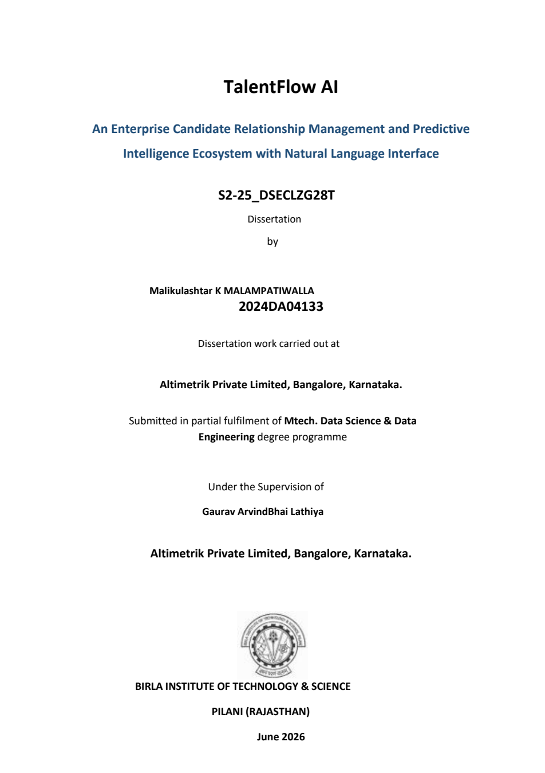
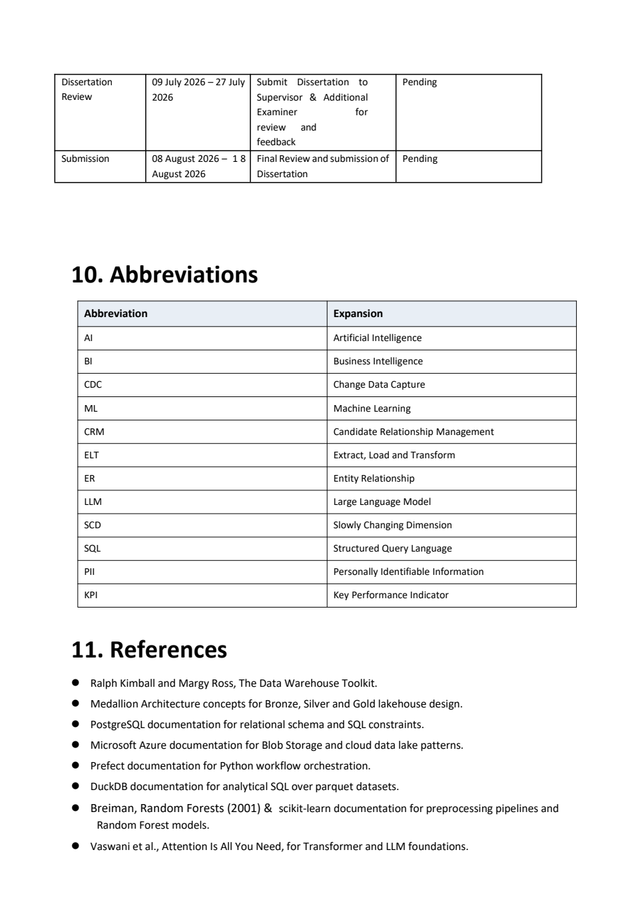
TALENTFLOW AI MID TERM
Submitted mid-term report: what this deck represents
Presentation scope
▪
Based on the submitted report dated June 2026.
▪
Focuses on completed portal, ETL and testing phase 1.
▪
Shows pending Text-to-SQL and final validation work clearly.
2024DA04133 | Malikulashtar K M
03

Slide 4
TALENTFLOW AI MID TERM
Business problem and dissertation objective
3
620+
5
2 min
core recruitment gaps
demo candidates generated
gold analytics datasets
scheduled ETL demo interval
▪
Candidate data is often fragmented across operational screens and reports.
▪
Profile updates overwrite history, limiting salary trend and engagement analysis.
▪
Business users need KPI access without writing SQL against raw operational tables.
2024DA04133 | Malikulashtar K M
04

Slide 5
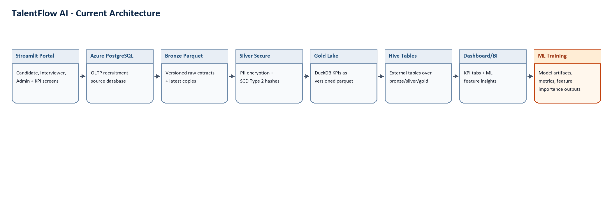
TALENTFLOW AI MID TERM
Current architecture: operational portal to lakehouse insights
▪
Streamlit captures candidate, interviewer and admin events.
▪
PostgreSQL remains the OLTP source; Azure Blob stores versioned lake layers.
▪
Gold parquet is the analytical source of truth; PostgreSQL publish supports dashboard cache.
▪
ML Training is downstream of the dashboard/feature insight path for demo clarity.
2024DA04133 | Malikulashtar K M
05

Slide 6
TALENTFLOW AI MID TERM
Portal workflows implemented
Candidate
Interviewer
Admin
Register, login, view profile, update contact/education fields and generate login engagement events.
View assigned interviews, record rating, comments and Hire/Hold/Reject decision.
Schedule interviews, monitor pipeline, view Gold KPIs and ML feature-importance outputs.
Admin page is reached by email pattern: @admin.altimetrik.com
2024DA04133 | Malikulashtar K M
06

Slide 7
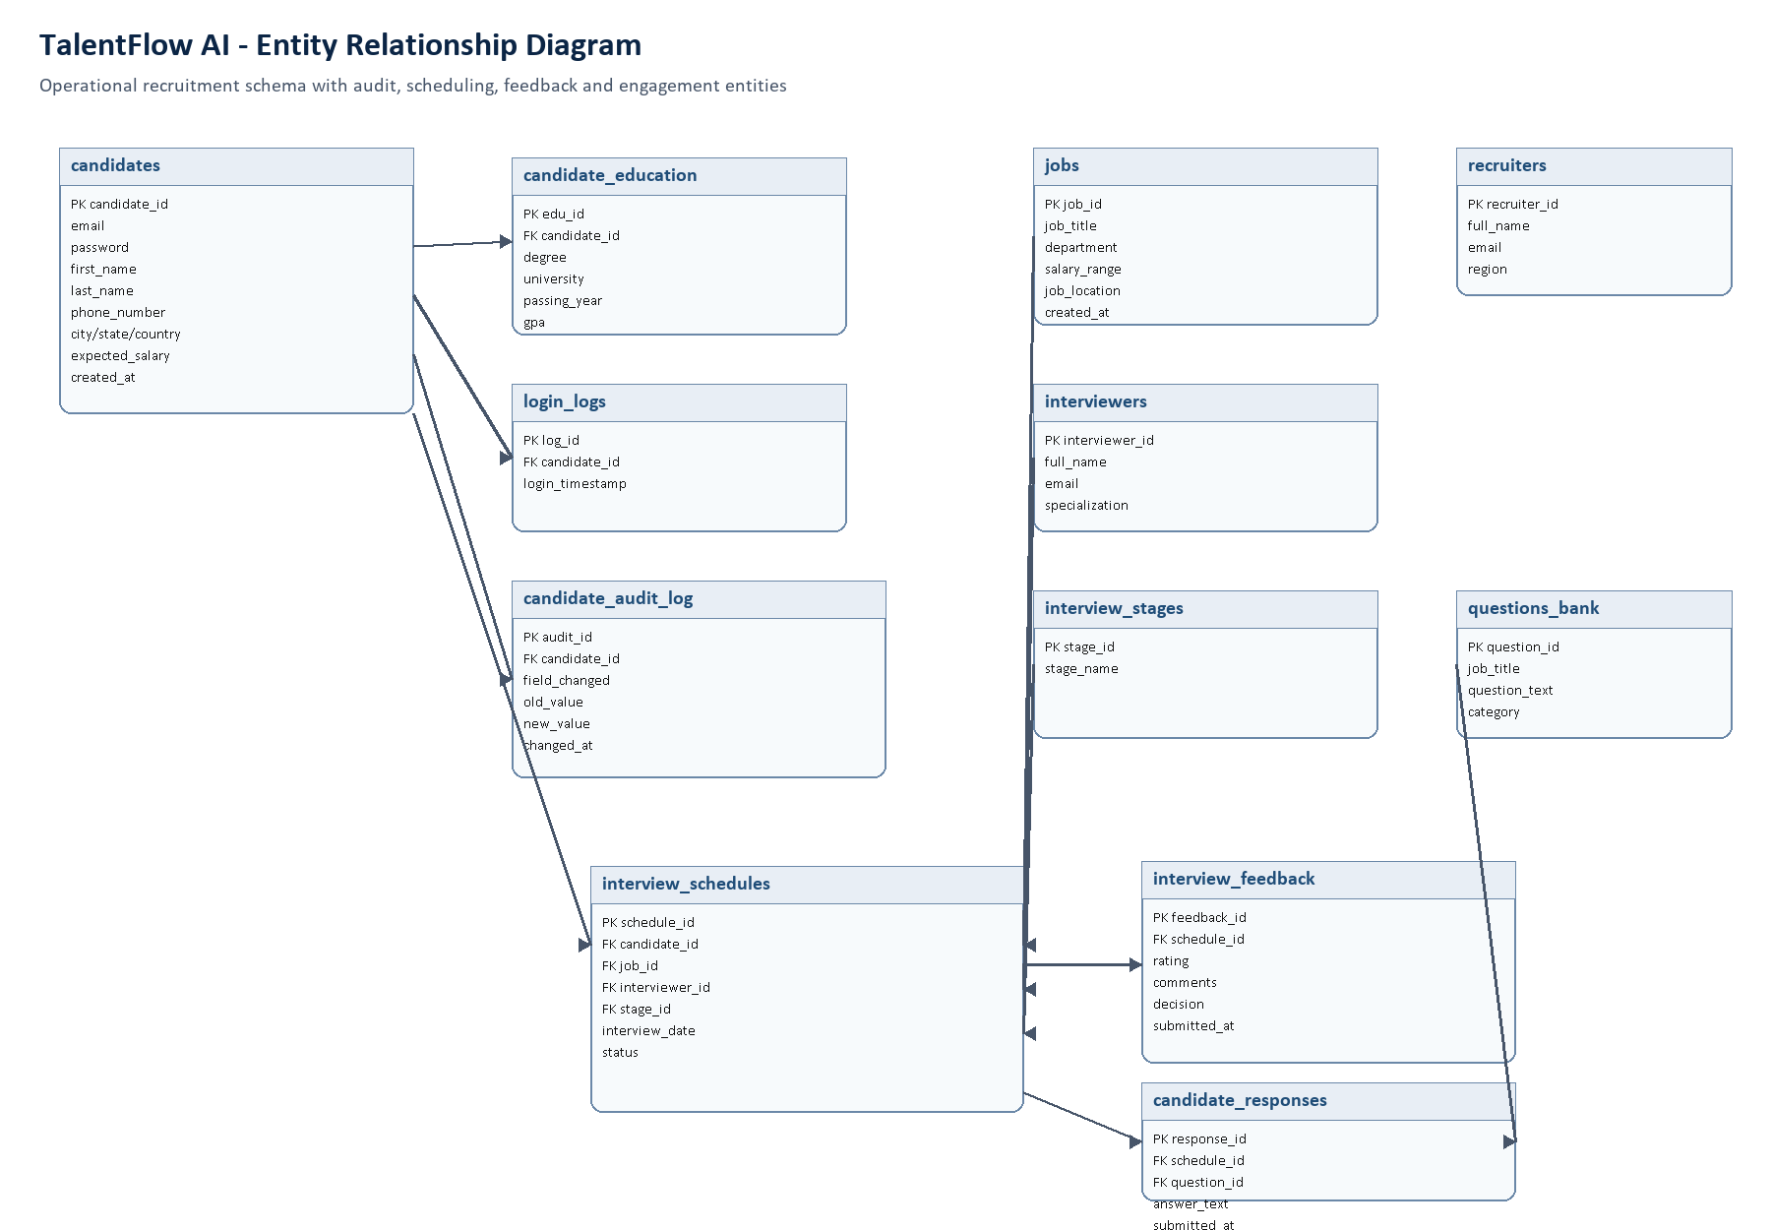
TALENTFLOW AI MID TERM
Database design: normalized recruitment schema
Why this matters
▪
Candidate profile separated from education, logins and audit history.
▪
Interview schedules link candidates, jobs, interviewers and stages.
▪
Feedback and responses become analytical signals for funnel and ML insights.
2024DA04133 | Malikulashtar K M
07

Slide 8
TALENTFLOW AI MID TERM
ELT pipeline: Bronze → Silver → Gold
Bronze
Silver
Gold
Raw PostgreSQL tables extracted to versioned parquet plus latest copies.
→
PII encrypted, candidate snapshots tracked with row_hash, start_date, end_date and is_current.
→
DuckDB creates KPI parquet datasets: city score, salary benchmarks, engagement, funnel, hire rate.
run_elt.py
run_datetime = run_datetime or make_run_datetime()
bronze_flow(run_datetime)
silver_flow(run_datetime)
gold_flow(run_datetime, publish_postgres=True)
2024DA04133 | Malikulashtar K M
08

Slide 9
TALENTFLOW AI MID TERM
Security and history tracking in Silver
elt_silver.py - key logic
df["row_hash"] = df.apply(lambda row: _row_hash(row, tracked_columns), axis=1)
df["start_date"] = now
df["end_date"] = pd.NaT
df["is_current"] = True
# Fernet ciphertext is text, so numeric PII columns are cast safely
df[col] = df[col].astype("object")
df.loc[mask, col] = df.loc[mask, col].apply(odin_encrypt)
Mid-term improvement
▪
Sensitive attributes are encrypted before analytical storage.
▪
SCD2-style snapshots keep candidate history for point-in-time analysis.
▪
Recent fixes made repeated scheduled runs stable for demo data.
2024DA04133 | Malikulashtar K M
09

Slide 10
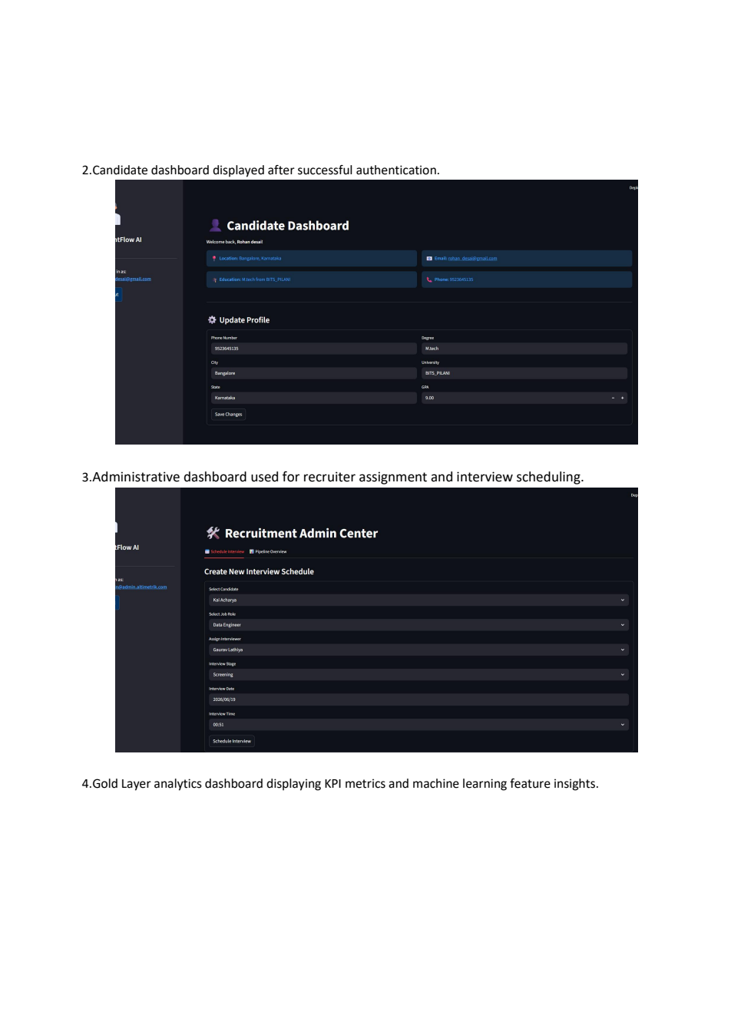
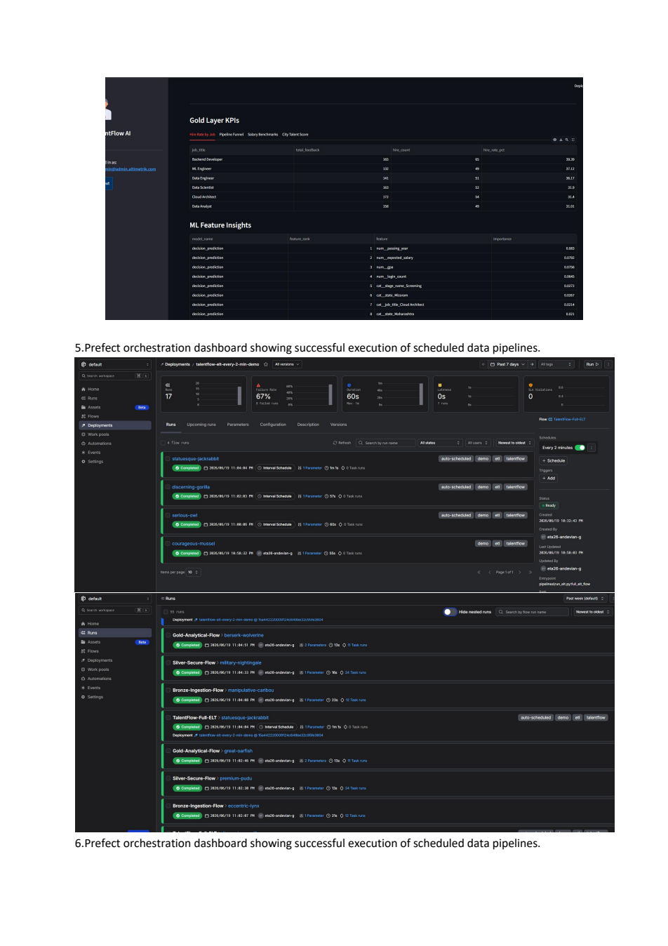
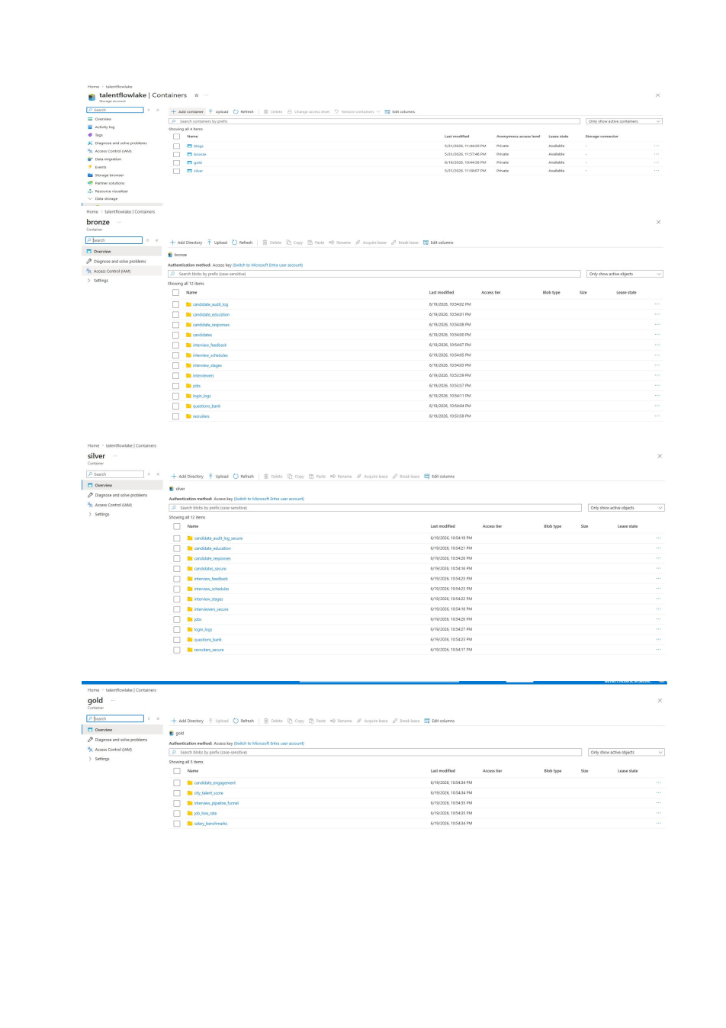
TALENTFLOW AI MID TERM
Visual evidence from submitted report
These screenshots prove UI progress, Gold analytics visibility, and Prefect scheduled execution evidence.
2024DA04133 | Malikulashtar K M
10

Slide 11
TALENTFLOW AI MID TERM
Prefect Cloud demo: scheduled every 2 minutes
Command used for the live demo
What examiner should see
cd D:\TalentFlow_AI
prefect cloud login
python scripts\serve_elt_prefect_cloud.py
▪
Deployment: TalentFlow-Full-ELT / talentflow-elt-every-2-min-demo
▪
New flow run appears every 2 minutes
▪
Subflows show Bronze, Silver and Gold execution
▪
Completed runs confirm scheduled ETL is working
If the lake is reset, delete bronze/silver/gold files only; keep PostgreSQL source data intact.
2024DA04133 | Malikulashtar K M
11

Slide 12
TALENTFLOW AI MID TERM
Gold analytics and ML baseline results
0.502
0.343
1.23
45
hire prediction accuracy
decision model accuracy
rating MAE baseline
feature rows shown in admin
Gold datasets surfaced
Interpretation
▪
city_talent_score
▪
Models are baseline evidence that the ML pipeline works end-to-end.
▪
salary_benchmarks
candidate_engagement
▪
Final phase should improve feature quality, class balance and model evaluation.
▪
▪
interview_pipeline_funnel
▪
Feature importance is published to analytics.ml_feature_insights for business visibility.
▪
job_hire_rate
2024DA04133 | Malikulashtar K M
12

Slide 13
TALENTFLOW AI MID TERM
Validation and quality checks
01
Demo safety
Data reset guarded by ALLOW_DEMO_DATA_RESET.
02
Gold checks
Schema, row counts, null/range checks, reconciliation and formulas.
03
Contract tests
SCD2 hashes, lake versioning, optional PostgreSQL publish and Hive definitions.
04
Dashboard
Admin page exposes Gold KPIs and ML feature insights.
Validation command
python scripts\validate_gold_analytics.py
python -m pytest
2024DA04133 | Malikulashtar K M
13

Slide 14
TALENTFLOW AI MID TERM
Plan from mid-term to final submission
1
2
3
4
Harden pipeline
Improve models
Natural language layer
Final polish
CDC/incremental loads, partition repair, robust SCD2 testing.
Richer behavioral features, model cards, drift checks and clearer evaluation.
Guarded Text-to-SQL over Gold analytics schema.
Screenshots, dashboards, result analysis and production readiness write-up.
2024DA04133 | Malikulashtar K M
14

Slide 15
What has been proven at mid-term
▪
A working recruitment portal exists for candidate, interviewer and admin roles.
▪
Operational PostgreSQL data flows into Bronze, Silver and Gold lake layers.
▪
PII protection, SCD2-style history and versioned parquet partitions are implemented.
▪
Prefect Cloud can show scheduled ELT execution every 2 minutes.
▪
Gold KPIs and ML feature insights are ready for examiner demo.
Thank you
2024DA04133 | Malikulashtar K M
15

