Slide 1
TALENTFLOW AI | MID-TERM REVIEW
TalentFlow AI
Enterprise Candidate Relationship Management and Predictive Intelligence Ecosystem
A detailed mid-term presentation covering system design, lakehouse engineering, validation, ML workflow, and future Text-to-SQL direction.
2024DA04133
Mid-Term
Altimetrik
BITS ID
Project evaluation stage
Host organization
Malikulashtar K Malampatiwalla

Slide 2
NARRATIVE
Presentation Roadmap
How the review is structured for the examiner: problem, architecture, implementation evidence, validation, and next work.
1
Why TalentFlow AI?
2
How the system is built
Recruitment data fragmentation, loss of candidate history, and manual reporting bottlenecks.
Streamlit portals, PostgreSQL operational schema, Azure lakehouse, Prefect flows, DuckDB Gold analytics.
3
What has been completed
4
What remains
Frontend workflows, Bronze/Silver/Gold ELT, Gold KPI datasets, ML artifacts, validation scripts.
Text-to-SQL conversational interface, stronger model validation, production hardening and final dissertation polish.

Slide 3
CONTEXT
Problem Definition and Motivation
TalentFlow AI was designed around a practical recruitment-data problem: operational tools capture activity, but do not automatically create reliable analytical memory.
OPERATIONAL FRAGMENTATION
ANALYTICS BOTTLENECK
PROJECT RESPONSE
•
Candidate profile, interview schedule, feedback and engagement data are spread across workflow screens.
•
Hiring-funnel, salary, engagement and city-level questions require manual SQL or exported reports.
•
Separate OLTP work from lakehouse analytics.
•
Simple update-in-place systems overwrite the earlier state of a candidate.
•
Operational databases are not designed as business-facing reporting products.
•
Preserve historical candidate versions through Silver SCD2 logic.
•
Recruiters need timeline-aware information, not just the current profile row.
•
Data quality and privacy must be handled before analytics are trusted.
•
Serve Gold KPIs and ML features to admin dashboards and future conversational analytics.
Design implication: the project is not only a recruitment portal; it is a governed recruitment-data product.

Slide 4
OBJECTIVES
Project Objectives and Scope
The scope combines application workflows with data engineering and AI readiness, so the system demonstrates end-to-end recruitment intelligence.
Area
Objective
Implementation Evidence
Operational CRM
Candidate, interviewer and admin workflows
Streamlit portal, profile updates, schedules, feedback
Relational core
Normalized recruitment source schema
13 PostgreSQL tables with PK/FK/CHECK/UNIQUE constraints
Lakehouse
Bronze raw, Silver secure, Gold analytics
Versioned Parquet outputs with latest copies
Orchestration
Repeatable ELT with observability
Prefect full flow and 2-minute demo deployment
Analytics
Recruitment KPI datasets
city_talent_score, salary_benchmarks, engagement, funnel, hire_rate
Predictive AI
ML-ready features and model artifacts
Random Forest pipelines, metrics JSON, feature importance CSVs

Slide 5
SYSTEM MODULES
Current Implementation Modules
The implementation is modular: user-facing actions are separated from storage, transformation, analytics, metadata and validation.
Candidate Portal
Registration, login, profile display/update, engagement logging
Interviewer Portal
Assigned interview view, structured rating, comments and decision
Admin Portal
Recruiter assignment, schedule control, KPI tabs and ML feature insights
Operational DB
PostgreSQL recruitment entities, constraints, audit and login logs
Bronze Layer
Raw source extraction to versioned Parquet paths and latest copies
Silver Layer
PII encryption, SCD2 candidate tracking, secure Parquet outputs
Gold Layer
DuckDB KPI aggregation and optional analytics schema publishing
ML Layer
Random Forest artifacts, metrics, feature importance and dashboard output

Slide 6
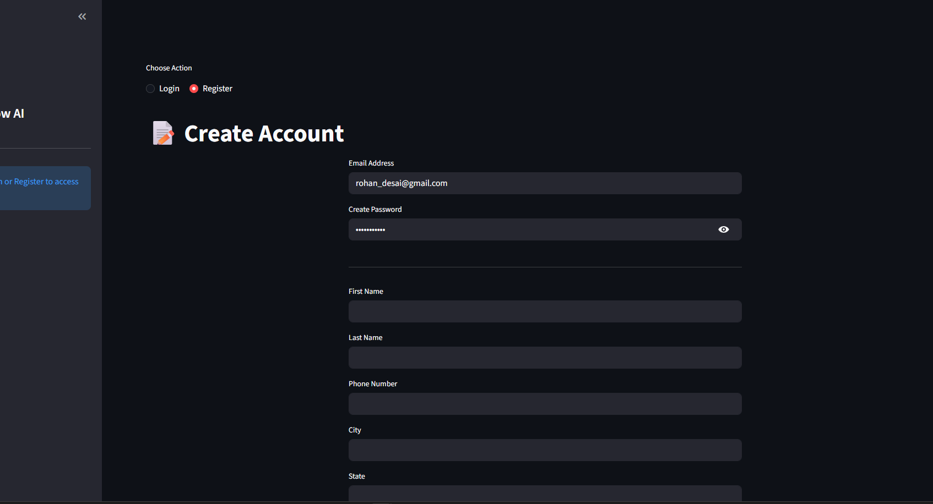
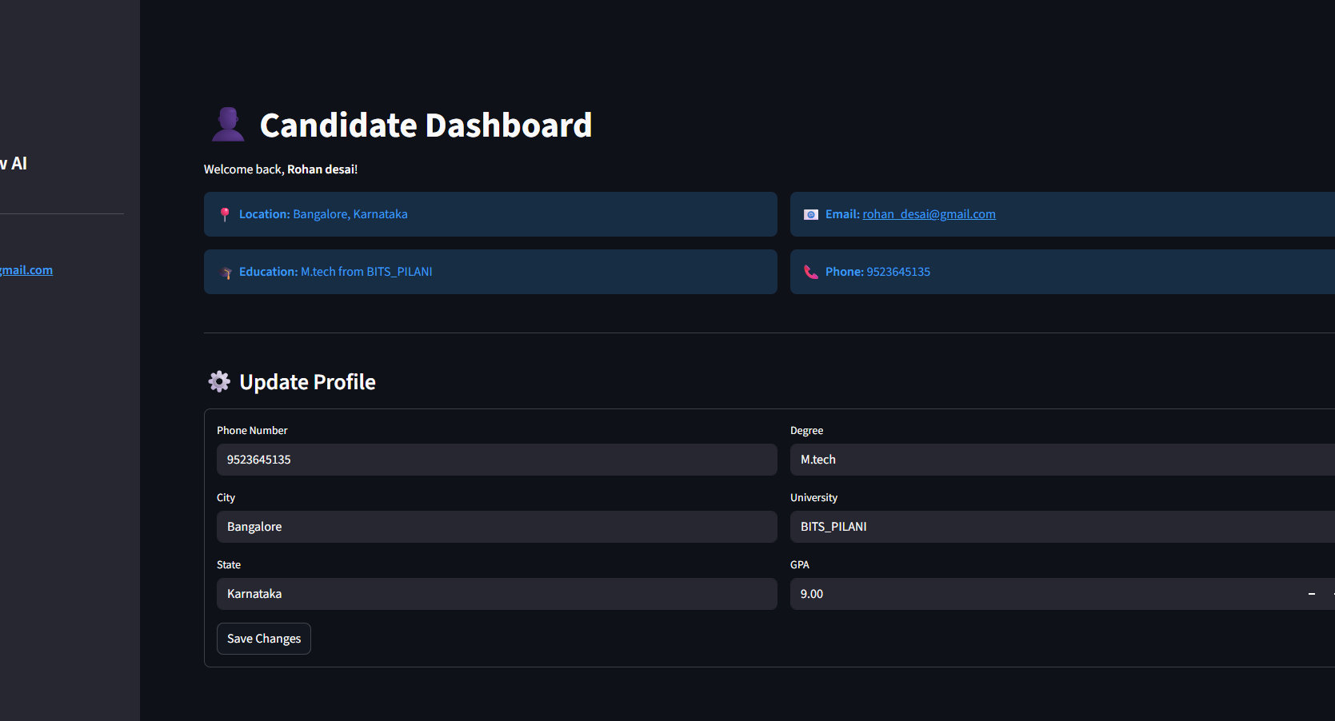
APPLICATION EVIDENCE
Visual Evidence: Candidate and Admin Workflows
These screens show the user-facing Streamlit application that feeds the operational PostgreSQL source database.
Candidate registration screen captures profile data and login credentials.
Candidate dashboard shows the profile fields that become operational source records.
Why this matters
The portal is not separate from the data platform: candidate registration, profile updates and login activity create the records later extracted into Bronze and transformed into engagement, salary and profile-history analytics.

Slide 7
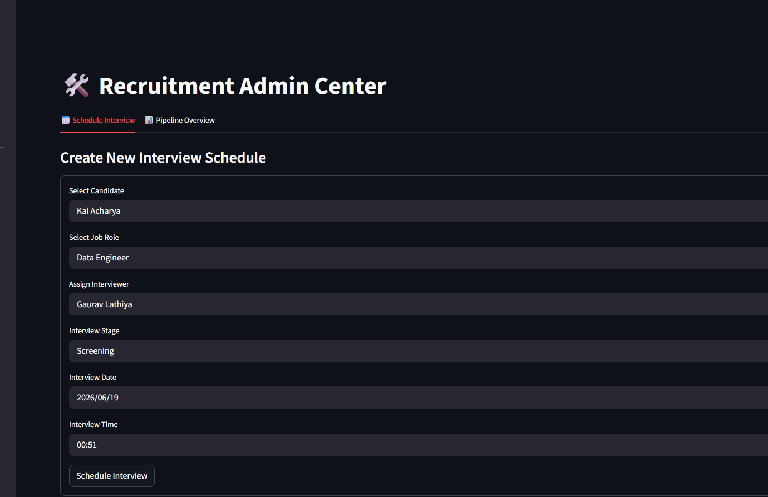
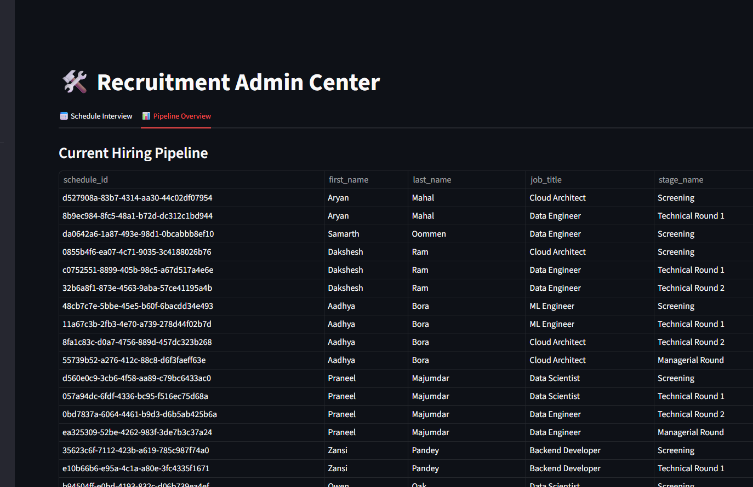
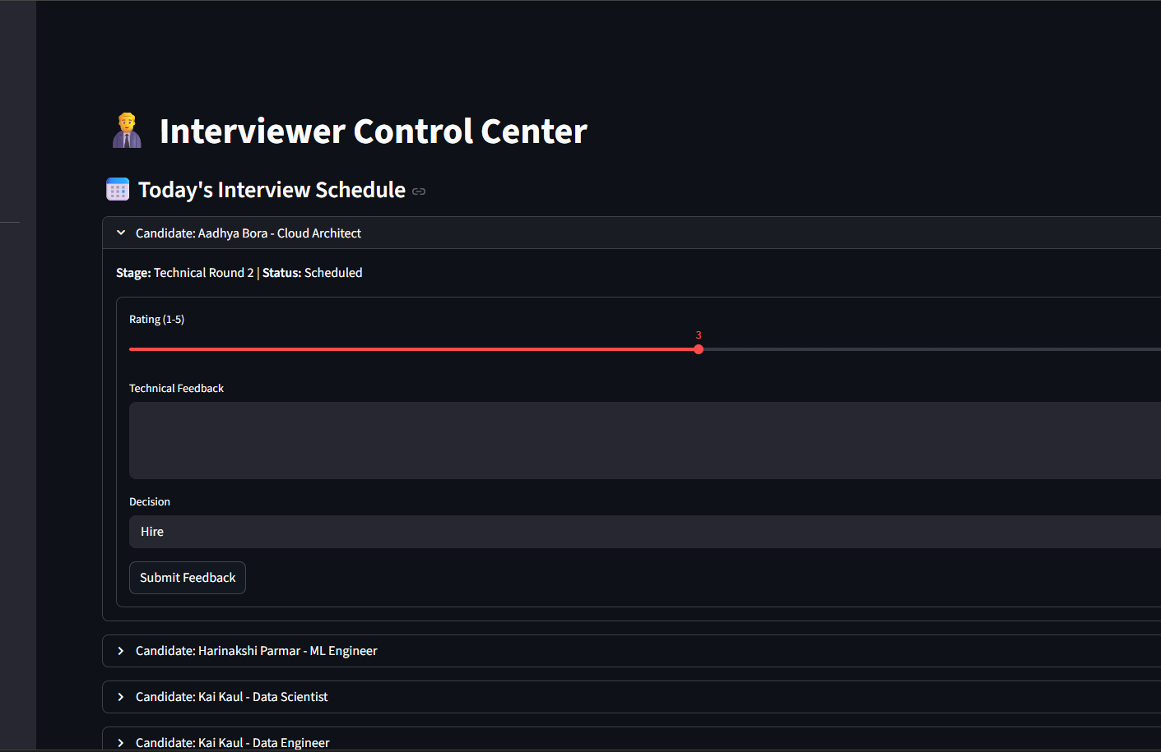
APPLICATION EVIDENCE
Visual Evidence: Interviewer and Admin Workflows
The recruitment workflow is role based: admins schedule interviews and interviewers submit feedback that later becomes Gold and ML input.
Admin scheduling creates interview_schedules records.
Admin pipeline overview shows scheduled/completed stages.
Interviewer feedback captures rating and hire/hold/reject decisions.
DATA GENERATED BY THESE SCREENS
•
interview_schedules links candidate_id, job_id, interviewer_id, stage_id, interview_date and status.
•
interview_feedback stores rating, comments, decision and submitted_at.
•
These records drive interview_pipeline_funnel, job_hire_rate and Random Forest model targets.

Slide 8
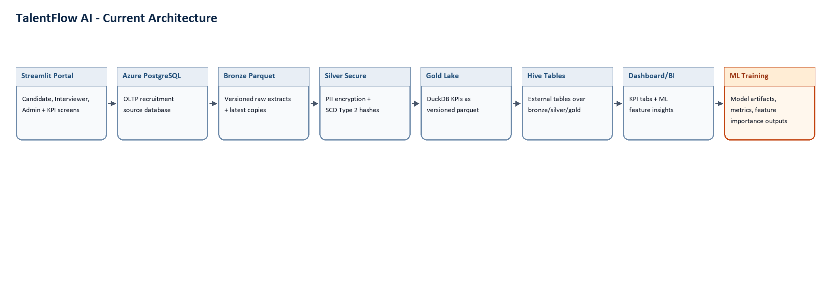
ARCHITECTURE
End-to-End Functional Architecture
The implementation follows the flow captured in your mid-term report: operational capture, medallion ELT, Gold analytics, and ML outputs.
Streamlit
PostgreSQL
Bronze
Silver
Gold
ML
Candidate, Interviewer, Admin and KPI screens
→
Normalized OLTP source and audit logs
→
Raw extracts with versioned run folders
→
PII encryption and SCD2 history
→
DuckDB KPIs as Parquet
→
Training artifacts and feature insights
Reference alignment: medallion architecture improves quality progressively from raw to validated to business-ready data; Gold is optimized for analytics and ML consumption.

Slide 9
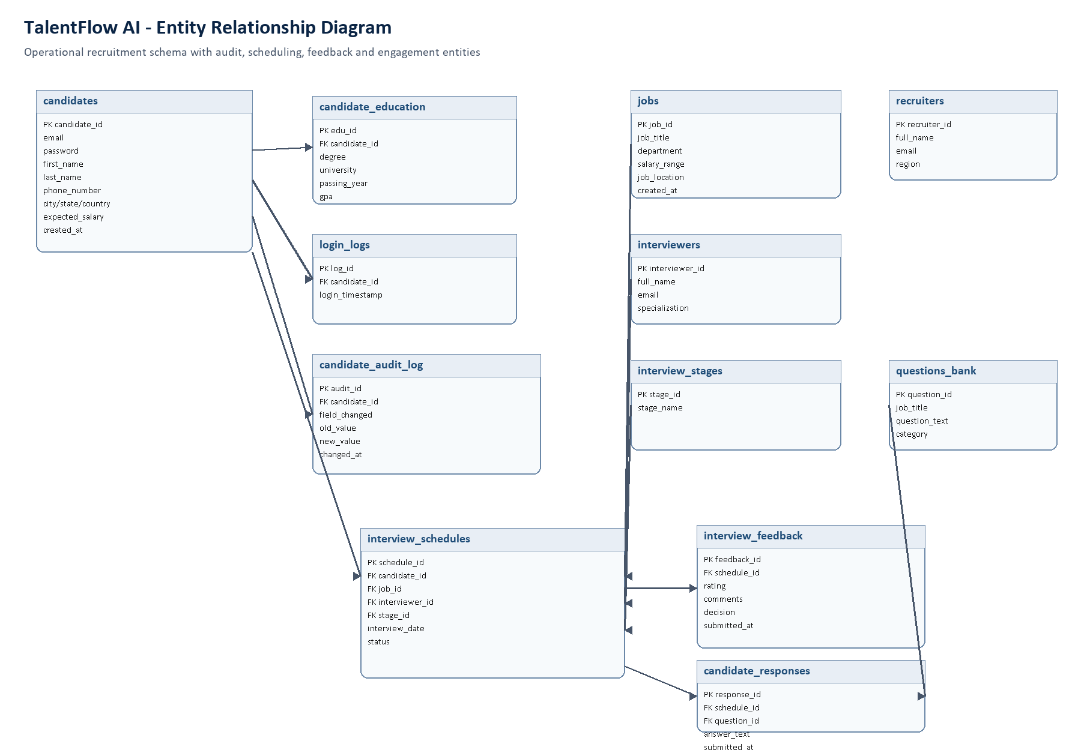
DATABASE DESIGN
ER Diagram and Relational Design
The OLTP database is normalized to protect operational integrity before data enters the lakehouse.
SCHEMA GROUPS
•
Candidate core: candidates, education, login logs, audit log.
•
Hiring and evaluation: jobs, stages, interviewers, schedules, feedback, responses.
•
Administration: recruiters and reference tables.
•
Integrity: UUID primary keys, foreign keys, unique emails and rating CHECK constraint.
•
Analytical seed: login logs and feedback become ML features and Gold KPIs.

Slide 10
OLTP LAYER
PostgreSQL Operational Layer
PostgreSQL is used as the transactional source of truth; the lakehouse is not a replacement for the normalized application database.
WHY POSTGRESQL HERE?
REPRESENTATIVE SCHEMA CHOICES
•
Recruitment workflow needs row-level consistency and relational integrity.
candidates(candidate_id UUID PRIMARY KEY, email TEXT UNIQUE NOT NULL, expected_salary NUMERIC)
interview_schedules(schedule_id UUID PRIMARY KEY, candidate_id FK, job_id FK, interviewer_id FK, stage_id FK)
interview_feedback(feedback_id SERIAL PRIMARY KEY, schedule_id FK, rating INTEGER CHECK rating between 1 and 5)
login_logs(log_id SERIAL PRIMARY KEY, candidate_id FK, login_timestamp)
•
Foreign keys connect candidate, schedule, job, interviewer and feedback records.
•
Constraints prevent invalid operational values before they reach analytics.
•
The schema remains understandable for application queries and migrations.
Reference used: PostgreSQL constraints documentation confirms CHECK, NOT NULL, UNIQUE, PRIMARY KEY and FOREIGN KEY controls for table integrity.

Slide 11
LAKEHOUSE RATIONALE
Why Medallion Architecture?
The project uses Bronze, Silver and Gold layers because each stage has a different responsibility and audience.
Layer
TalentFlow implementation
Reference-backed purpose
Bronze
Extract each PostgreSQL table to raw versioned Parquet plus latest copy
Preserve source fidelity, enable reprocessing and audit
Silver
Encrypt PII, normalize UUIDs, apply row_hash and SCD2 current flag
Clean, validate, deduplicate and enrich detailed data
Gold
Build business KPIs and ML feature tables using DuckDB
Serve domain-specific analytics, dashboards and ML-ready datasets
Design comparison: direct OLTP reporting is simpler, but it mixes operational load with analytics, loses historical versions, and makes privacy controls harder to isolate.

Slide 12
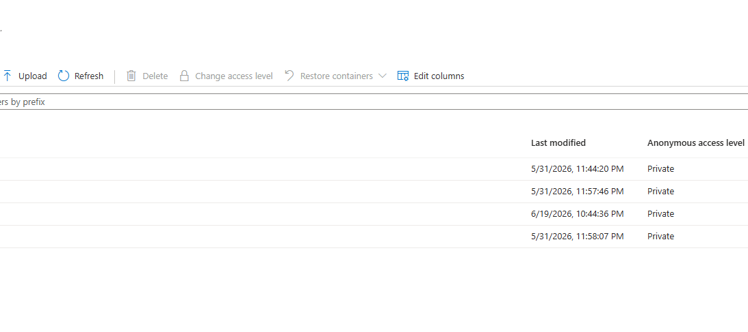
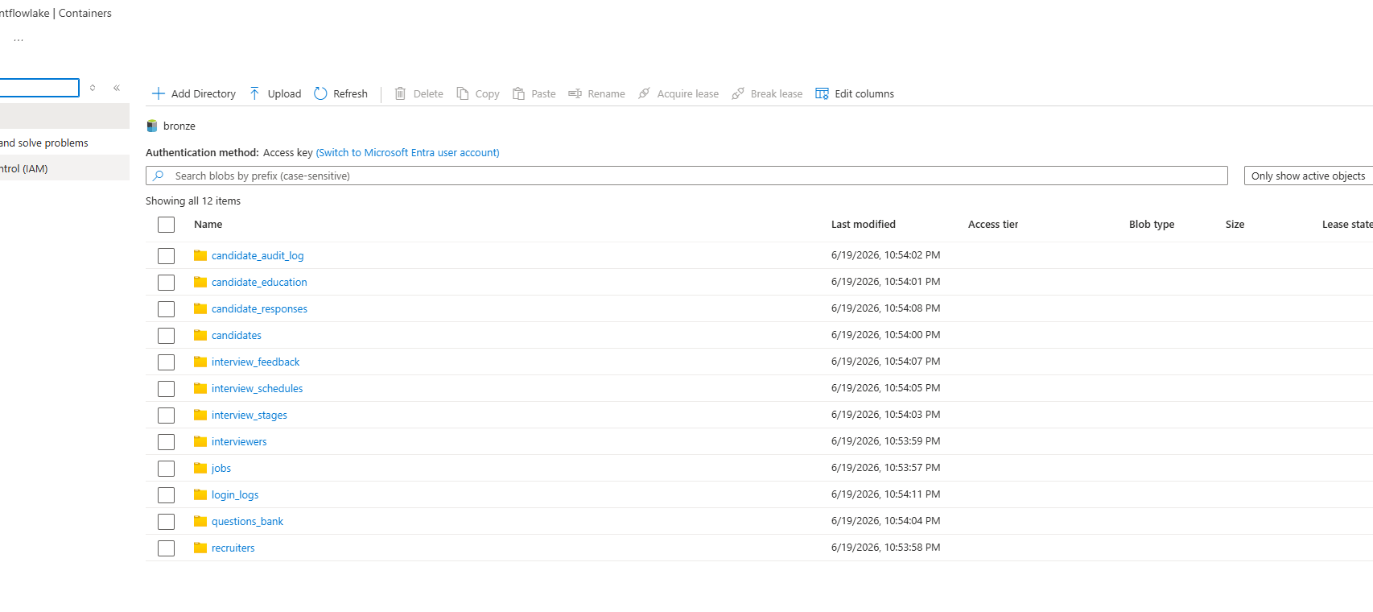
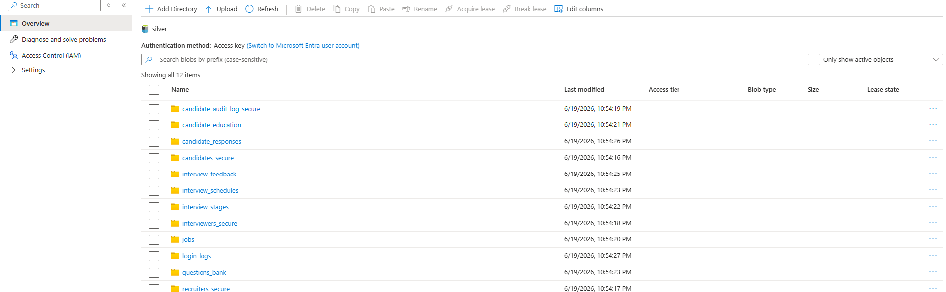
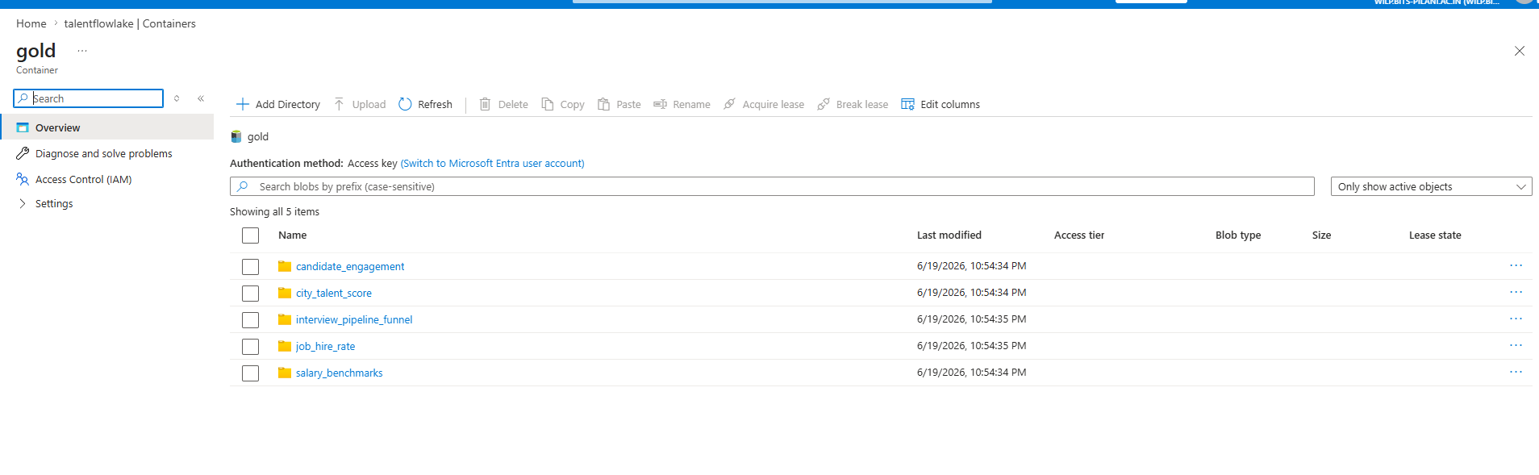
AZURE EVIDENCE
Visual Evidence: Azure Lakehouse Containers
The Azure storage account shows the medallion layout implemented as separate private containers for Bronze, Silver and Gold.
Storage account containers: bronze, silver and gold.
Bronze container stores raw table folders from PostgreSQL extraction.
Silver container stores secure/transformed table folders, including *_secure outputs.
Gold container stores business-facing KPI dataset folders.

Slide 13
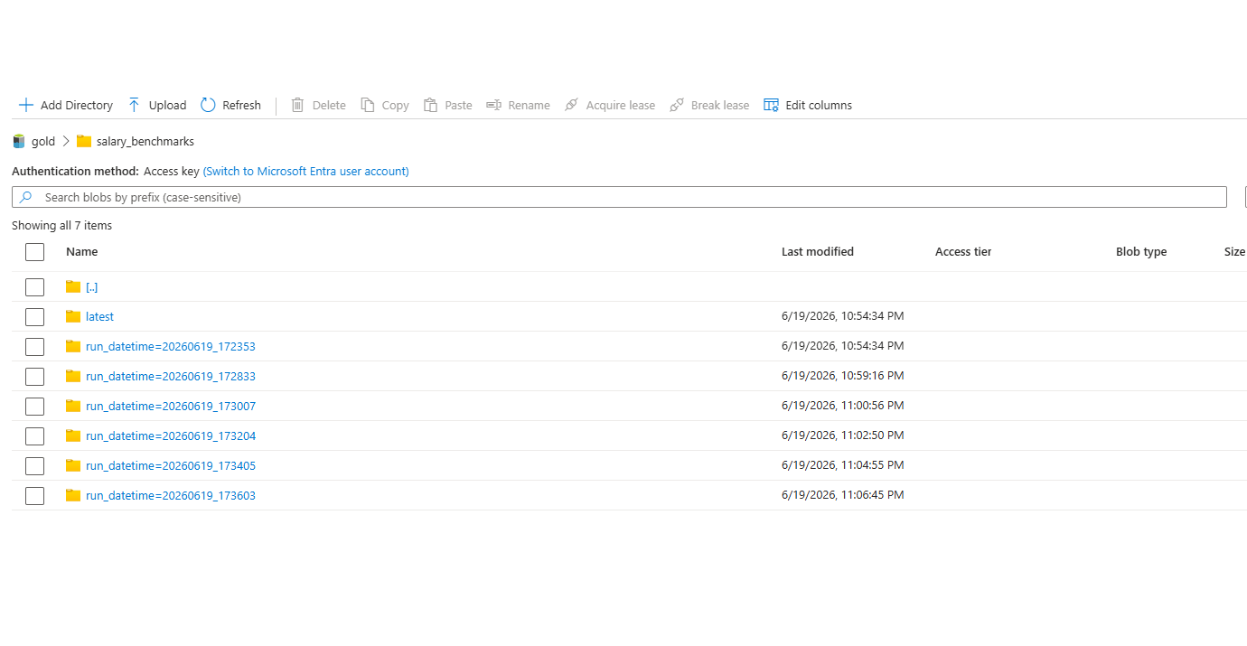
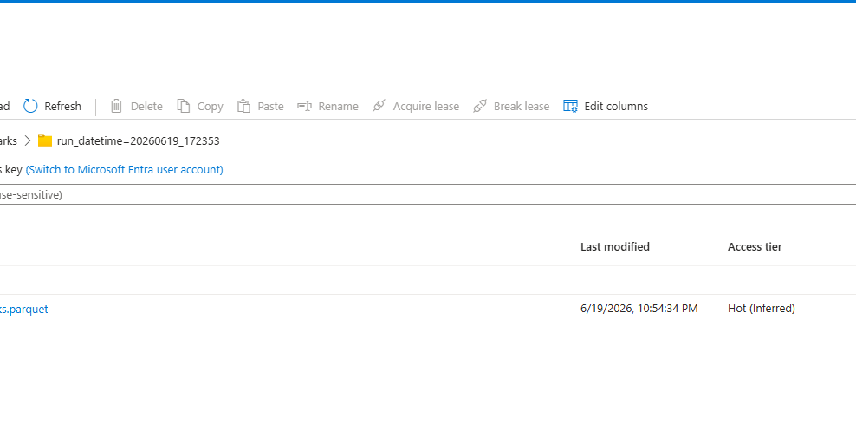
GOLD EVIDENCE
Visual Evidence: Gold Versioned Parquet Outputs
Gold outputs are written as versioned Parquet snapshots and latest copies, which supports repeated demo runs and reproducibility.
salary_benchmarks has multiple run_datetime folders plus latest.
Inside a run folder, the Gold parquet file is stored as a block blob.
Presentation talking point
This proves that the Gold layer is lake-first: each KPI dataset is materialized to Azure storage with traceable runtime partitions, and PostgreSQL publishing is only an optional dashboard cache.

Slide 14
BRONZE
Bronze Layer: Raw Ingestion and Runtime Lineage
Bronze is intentionally close to the source. It captures raw extracts and ties every table to the same run identifier.
IMPLEMENTATION
PATH CONTRACT
•
Prefect task reads each configured PostgreSQL table with pandas SQL extraction.
bronze/<table_name>/run_datetime=YYYYMMDD_HHMMSS/*.parquet
bronze/<table_name>/latest/<table_name>.parquet
The same run_datetime is passed into Silver and Gold, giving traceability when demo runs execute every 2 minutes.
•
Each table is written to Azure Blob Storage as Parquet.
•
Every run writes a versioned path and a latest copy.
•
Shared run_datetime links Bronze, Silver and Gold outputs from the same execution.
Azure Data Lake Storage is built on Blob Storage and supports hierarchical directory organization for data lake workloads.

Slide 15
SILVER
Silver Layer: PII Protection and SCD Type 2 History
Silver is where TalentFlow AI becomes analytically trustworthy: sensitive data is protected and changed candidate profiles are versioned.
PRIVACY CONTROLS
SCD2 MECHANISM
WHY IT MATTERS
•
PII columns are encrypted before secure Parquet output.
•
candidate_id is normalized even when Parquet returns UUID bytes.
•
Recruitment analytics need the state of the candidate at the time of decisions.
•
Numeric salary fields are cast to object/string before ciphertext assignment.
•
row_hash detects changes across tracked attributes.
•
Historical profile movement supports longitudinal analysis.
•
Changed keys close previous rows with end_date and is_current = false.
•
Gold decrypts only the salary value required for aggregate KPI calculation.
•
Kimball-style dimensional thinking values clear grain and time-variant history.
•
New versions start with current timestamp and is_current = true.
Mid-term debugging outcome: the pipeline was fixed to handle encrypted strings in numeric columns and UUID byte decoding in SCD2 comparison.

Slide 16
GOLD ANALYTICS
Gold Layer: Business-Facing Analytical Datasets
Gold converts secure Silver data into purpose-built recruitment KPIs that can be consumed by dashboards, BI tools and ML workflows.
Gold dataset
Business question answered
Implementation
city_talent_score
Where is candidate density high and what is avg salary by city?
COUNT + AVG expected salary
salary_benchmarks
How do expected salaries vary by degree?
Join candidates with education
candidate_engagement
Which candidates are active?
Count login_logs per candidate
interview_pipeline_funnel
How many interviews by role, stage and status?
Join schedules, jobs and stages
job_hire_rate
Which roles convert feedback into hires?
Hire count / total feedback percentage
Reference alignment: Kimball/Ross dimensional modeling focuses on business processes, grain, dimensions and facts. Gold tables in this project are intentionally domain-specific and query-ready.

Slide 17
ANALYTICAL COMPUTE
DuckDB Analytical SQL Over Parquet
DuckDB is used as lightweight analytical compute for Gold aggregation without making PostgreSQL do warehouse-style work.
WHY DUCKDB?
REPRESENTATIVE GOLD QUERY PATTERN
•
Reads Parquet files directly from temporary Silver downloads.
SELECT j.job_title,
COUNT(*) AS total_feedback,
SUM(CASE WHEN f.decision = 'Hire' THEN 1 ELSE 0 END) AS hire_count,
ROUND(100.0 * hire_count / COUNT(*), 2) AS hire_rate_pct
FROM feedback f
JOIN schedules s ON f.schedule_id = s.schedule_id
JOIN jobs j ON s.job_id = j.job_id
GROUP BY j.job_title;
•
Uses SQL joins and group-by logic for KPI generation.
•
Keeps Gold generation lake-first; PostgreSQL publish is optional for dashboard caching.
•
Simple to run locally during demo and easy to reason about in code.

Slide 18
ORCHESTRATION
Prefect Orchestration and 2-Minute Demo Schedule
The pipeline is orchestrated as a full Bronze -> Silver -> Gold flow, with an interval deployment for examiner demonstration.
FLOW STRUCTURE
CLOUD DEMO DEPLOYMENT
REFERENCE FIT
•
TalentFlow-Full-ELT creates or accepts a shared run_datetime.
•
Deployment name: talentflow-elt-every-2-min-demo.
•
Prefect flows are decorated Python functions.
•
bronze_flow, silver_flow and gold_flow run in order.
•
Interval: 120 seconds.
•
Flow run states are tracked for observability.
•
Tags: talentflow, demo, etl.
•
publish_postgres flag optionally caches Gold tables in analytics schema.
•
Deployments allow schedules and remote interaction.
•
Prefect Cloud shows flow runs, state, failures and logs.
Demo command used: python scripts/serve_elt_prefect_cloud.py

Slide 19
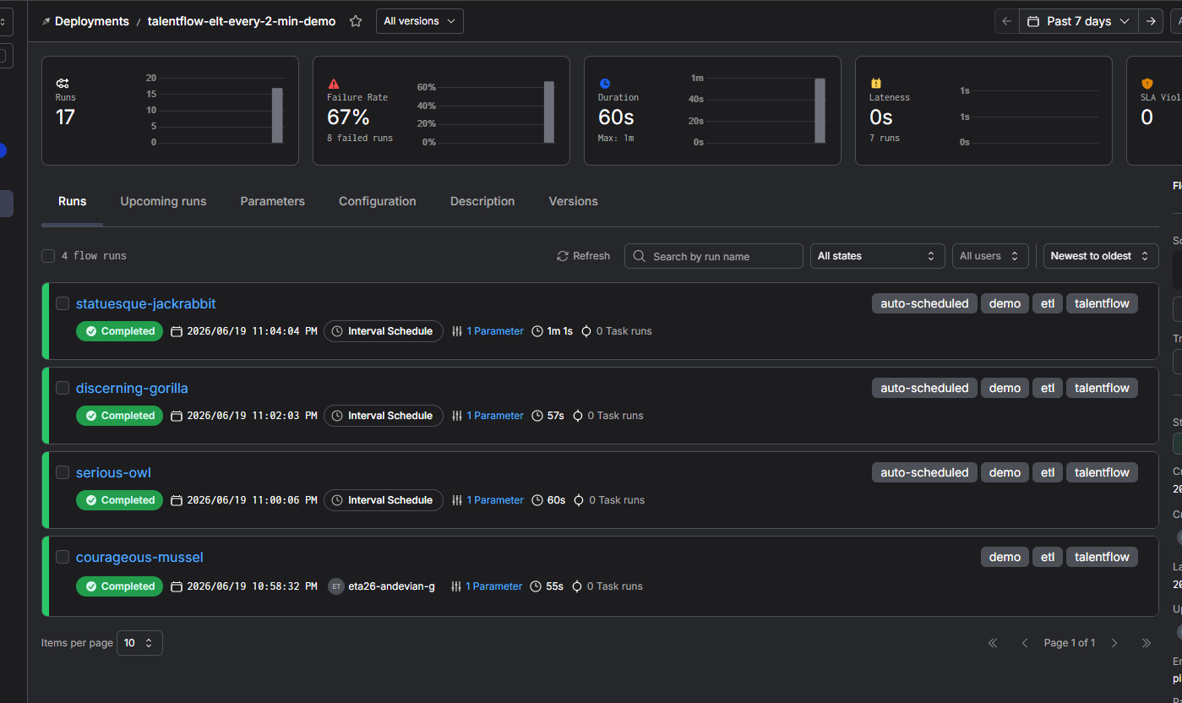
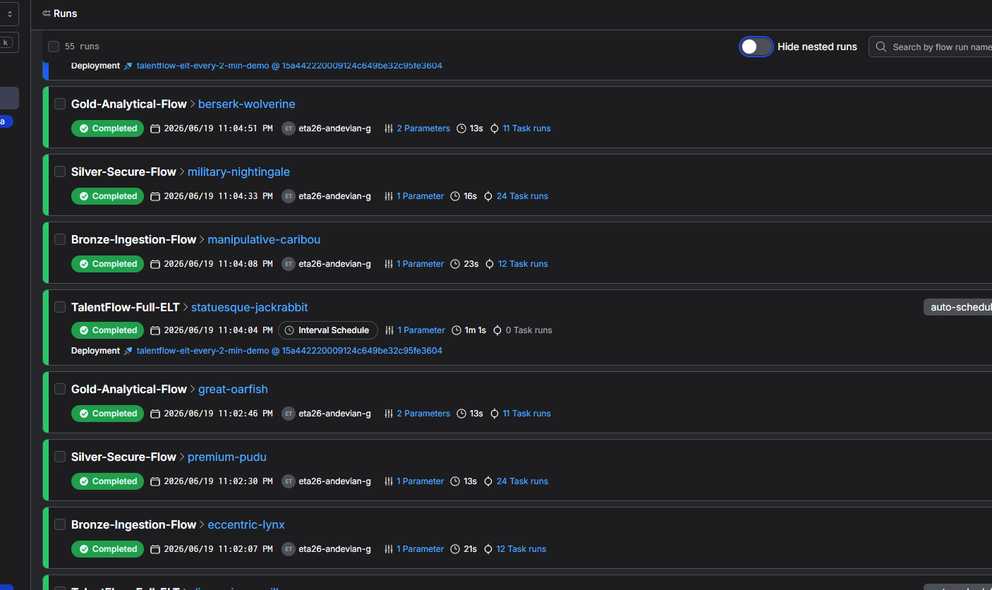
PREFECT EVIDENCE
Visual Evidence: Prefect Cloud Orchestration
The Cloud UI screenshots prove that the full ELT was deployed on an interval schedule and that nested Bronze, Silver and Gold flows completed.
Deployment view: every 2 minutes schedule, ready status and recent successful runs.
Runs view: TalentFlow-Full-ELT triggers Bronze, Silver and Gold child flows.
How to explain it
For the demo, the examiner can see recurring flow runs, completed states, duration, parameters and task-run counts instead of only trusting terminal output.

Slide 20
PREDICTIVE INTELLIGENCE
Machine Learning Workflow and Current Results
The current ML goal is not to claim a final high-performing model; it is to prove a complete, repeatable predictive-intelligence workflow.
0.5021
0.3958
0.5016
1.2278
Hire prediction accuracy
Hire prediction F1
Hire prediction ROC-AUC
Rating prediction MAE
PIPELINE DESIGN
TOP HIRE-MODEL FEATURE IMPORTANCES
•
Feature query joins feedback, schedules, candidates, jobs, stages, education and login counts.
expected_salary
0.0893
ColumnTransformer handles numeric and categorical features.
gpa
0.0871
•
0.0658
passing_year
•
Random Forest classifier/regressor artifacts are saved with joblib.
login_count
0.0579
state_Maharashtra
0.0442
•
Feature importance CSVs are published to analytics.ml_feature_insights.

Slide 21
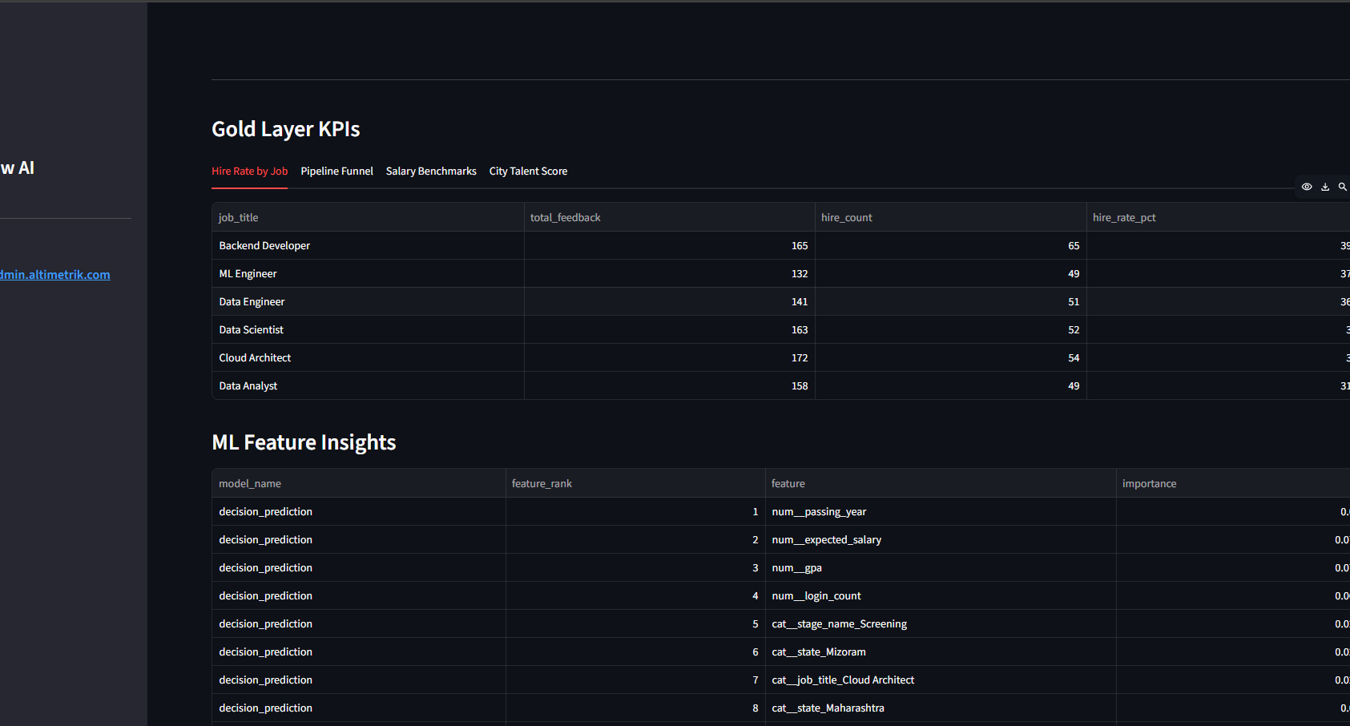
DASHBOARD EVIDENCE
Visual Evidence: Gold KPI Dashboard and ML Insights
This screen closes the loop: source data becomes Gold KPIs and model feature insights visible to the admin user.
WHAT THIS PROVES
•
Gold KPIs are available inside the product, not only in backend files.
•
Hire-rate by job is calculated from interview feedback outcomes.
•
Feature insights are published from Random Forest artifacts into analytics output.
•
The dashboard connects application, lakehouse, SQL analytics and ML into one reviewable flow.
Admin dashboard showing Gold Layer KPIs and ML Feature Insights from analytics outputs.

Slide 22
ML RATIONALE
Why Random Forest First?
For the mid-term stage, Random Forest is a sensible baseline because TalentFlow features are mostly structured/tabular recruitment signals.
BREIMAN 2001
SCIKIT-LEARN IMPLEMENTATION
INTERPRETATION
•
Random Forest combines many tree predictors.
•
Pipeline prevents leakage by applying preprocessing inside training flow.
•
Current metrics are modest and honestly reported.
•
Generalization depends on individual tree strength and correlation.
•
ColumnTransformer keeps numeric and categorical transformations explicit.
•
The achievement is an end-to-end ML path, not final model maturity.
•
Variable importance is part of the method family.
•
Class weight balancing is used for hire classification.
•
Next work: stronger features, balanced labels, model cards and drift checks.

Slide 23
CONVERSATIONAL AI
Natural-Language Analytics Roadmap
The LLM/Text-to-SQL component is planned after the data platform is stable, so natural-language answers can be grounded in trusted Gold tables.
User
Schema Context
LLM
Guardrail
Execution
Answer
Recruiter asks business question
→
Gold table names, columns and business definitions
→
Intent parsing and SQL draft
→
Validate tables, columns, filters and read-only query
→
Run against Gold/analytics layer
→
Return explanation and KPI result
WHY NOT LLM-FIRST?
REFERENCE CONNECTION
•
A language model without trusted data produces impressive but unreliable answers.
•
Vaswani et al. introduced Transformer attention foundations used by modern LLMs.
•
Gold tables give the model a governed semantic surface.
•
In this project, LLMs are an interface layer, not the system of record.
•
Read-only SQL validation reduces operational risk.
•
The trustworthy layer remains PostgreSQL + lakehouse + Gold validation.

Slide 24
VALIDATION
Testing, Validation and Quality Gates
Testing was implemented as a project safety layer, especially for Gold analytics and lakehouse contracts.
Schema
analytics schema exists; expected columns are present
Rows
Gold tables are created and row counts are non-empty unless explicitly allowed
Nulls/ranges
Candidate counts, salaries, login counts and hire rates are checked
Duplicates
Candidate, job and funnel duplicate groups are detected
Reconciliation
Gold totals are matched back to source login, schedule and feedback counts
Formula
hire_rate_pct is recalculated and compared to stored Gold output
Validation script: scripts/validate_gold_analytics.py

Slide 25
PROJECT PLAN
Current Status and Remaining Work
This slide aligns with the mid-term report timeline while making the progress easy to explain verbally.
Completed
Completed
Completed
Pending
Pending
Pending
Dissertation outline
Frontend + ETL development
Testing Phase 1
Text-to-SQL framework
Conversational AI testing
Dissertation review/submission
5 May - 10 May 2026
12 May - 5 June 2026
6 June - 20 June 2026
21 June - 30 June 2026
1 July - 7 July 2026
9 July - 18 August 2026
Mid-term position: the data platform foundation is implemented; the final phase is intelligence, usability validation and production hardening.

Slide 26
REFERENCES
Reference-Backed Design Decisions
Each major technical decision is connected to a recognized method, official documentation or foundational paper.
Decision
Reference basis
How it appears in TalentFlow AI
Dimensional/Gold thinking
Kimball & Ross, The Data Warehouse Toolkit
Gold KPIs have business grain and reporting purpose
Bronze/Silver/Gold
Databricks medallion architecture concepts
Raw -> secure/versioned -> business-ready datasets
Relational constraints
PostgreSQL documentation
PK/FK/UNIQUE/CHECK controls in DDL.sql
Cloud lake storage
Microsoft Azure Data Lake Storage docs
Blob-backed hierarchical lake folders and Parquet
Workflow orchestration
Prefect documentation
Flows, deployments, schedules and Cloud UI monitoring
Parquet analytics
DuckDB documentation
SQL joins/aggregations over Parquet-backed Silver data
Predictive model
Breiman Random Forests; scikit-learn docs
Random Forest pipelines and feature importances
Future LLM layer
Vaswani et al., Attention Is All You Need
Transformer/LLM foundation for Text-to-SQL interface

Slide 27
SOURCE LIST
Bibliography and Web Sources
These are the concrete references used to connect the implementation choices to accepted data-engineering and AI foundations.
BOOKS, PAPERS AND OFFICIAL DOCS
URLS USED FOR CROSS-CHECKING
•
Ralph Kimball and Margy Ross, The Data Warehouse Toolkit.
https://docs.databricks.com/aws/en/lakehouse/medallion
https://www.postgresql.org/docs/current/ddl-constraints.html
https://learn.microsoft.com/en-us/azure/storage/blobs/data-lake-storage-introduction
https://docs.prefect.io/v3/concepts/flows
https://duckdb.org/docs/stable/data/parquet/overview
https://link.springer.com/article/10.1023/A:1010933404324
https://scikit-learn.org/stable/modules/compose.html
https://scikit-learn.org/stable/modules/ensemble.html
https://arxiv.org/abs/1706.03762
•
Databricks Docs: What is the medallion lakehouse architecture?
•
PostgreSQL Docs: Data Definition - Constraints.
•
Microsoft Learn: Introduction to Azure Data Lake Storage.
•
Prefect Docs: Flows, deployments and schedules.
•
DuckDB Docs: Parquet data support and read_parquet usage.
•
Breiman, L. Random Forests. Machine Learning 45, 5-32 (2001).
•
scikit-learn User Guide: Pipeline, ColumnTransformer, ensemble methods.
•
Vaswani et al. Attention Is All You Need. arXiv:1706.03762.
The implementation-specific evidence is from D:/report/2024da04133.pdf and D:/TalentFlow_AI project files.

Slide 28
CONCLUSION
Conclusion and Examiner Talking Points
The project demonstrates a complete mid-term foundation: operational recruitment workflows, lakehouse ETL, validation, and AI readiness.
WHAT IS STRONG NOW
WHAT WILL MAKE IT FINAL-READY
•
End-to-end working application and ELT foundation.
•
Real UI screenshots replacing report placeholders.
•
Clear data separation: OLTP for workflow, lakehouse for analytics.
•
Text-to-SQL guardrails and conversational testing.
•
SCD2 and PII handling show data engineering maturity.
•
Better ML features, model evaluation and model-card documentation.
•
Gold validation and ML artifacts provide defensible evidence.
•
Security hardening: password hashing, stronger RBAC and alerts.
Thank you. Questions?

