Slide 1
StudyMate: An AI-Powered PDF Q&A System Enhanced with a LangGraph Validation Agent Date: August 30, 2025

Slide 2
Introduction
The Challenge: Students face significant challenges with digital documents, including information overload, passive reading, and disconnected knowledge across multiple sources. Static PDFs lack the interactivity needed for effective learning.
Our Approach: We developed StudyMate, an AI-powered academic assistant that transforms this passive process into an interactive, conversational experience, allowing students to ask direct questions and get grounded, verifiable answers from their study materials.

Slide 3
Architecture: Agentic RAG
Our solution is built on an advanced Retrieval-Augmented Generation (RAG) architecture, powered by a LangGraph agent.
Technology Stack:
UI: Streamlit
PDF Parsing: PyMuPDF
Retrieval: Sentence Transformers & FAISS
Core Logic: LangGraph
Generation: IBM Watsonx.ai
The Agentic Flow:
Retrieve: The system fetches relevant text chunks from the user's PDFs.
Grade (Decision Point): The LangGraph agent uses an AI "grader" to validate if the retrieved information is truly relevant to the question.
Generate: If the information is deemed relevant, the agent synthesizes a final, accurate answer. This self-correction loop is our key innovation.

Slide 4
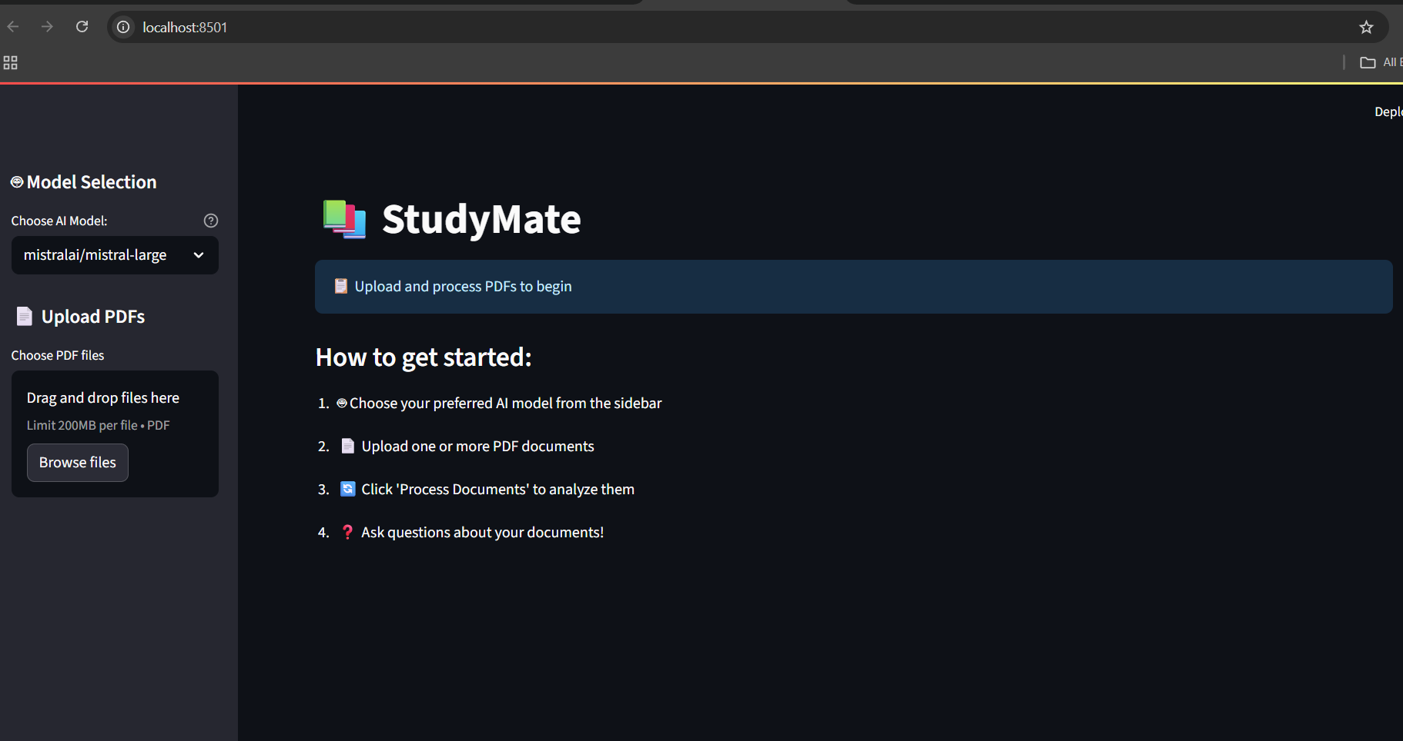

Slide 5
Future Scope
StudyMate provides a strong foundation for several exciting future enhancements that will further improve the learning experience.
Table & Diagram Parsing: Extend the system's capabilities to understand and answer questions about data presented in tables and diagrams.
OCR Integration: Incorporate Optical Character Recognition (OCR) to support image-based and scanned PDFs, broadening document compatibility.
Confidence Scoring: Display a confidence score with each answer, giving users insight into the system's certainty based on the source material.
Cloud Deployment: Deploy StudyMate as a scalable, web-based service for broader access to students and educators

Slide 6
The Solution: StudyMate
StudyMate is a dynamic and intelligent tool designed for modern learning.
Key Features:
Multi-PDF Upload: Allows users to upload and query multiple documents (textbooks, notes, papers) as a single knowledge base.
Natural Language Q&A: Users can ask questions in plain English and receive direct, concise answers.
Grounded & Verifiable: Every answer is based only on the provided documents and includes source references, ensuring academic integrity.
Intelligent Agent: A LangGraph validation agent checks the relevance of information before generating an answer, increasing reliability.

Slide 7
Conclusion
StudyMate successfully meets its objective to serve as an intelligent study assistant that makes learning more efficient, interactive, and effective.
Key Achievements:
A fully functional, interactive Q&A system for academic PDFs.
Guaranteed answer traceability and academic integrity through a strict RAG implementation.
The LangGraph Advantage: The integration of a LangGraph agent significantly increases the system's reliability and trustworthiness by actively filtering out irrelevant information and checking its own work before providing an answer.
StudyMate provides a strong foundation for several exciting future enhancements that will further improve the learning experience.
Table & Diagram Parsing: Extend the system's capabilities to understand and answer questions about data presented in tables and diagrams.
OCR Integration: Incorporate Optical Character Recognition (OCR) to support image-based and scanned PDFs, broadening document compatibility.
Confidence Scoring: Display a confidence score with each answer, giving users insight into the system's certainty based on the source material.
Cloud Deployment: Deploy StudyMate as a scalable, web-based service for broader access to students and educators

