Slide 1
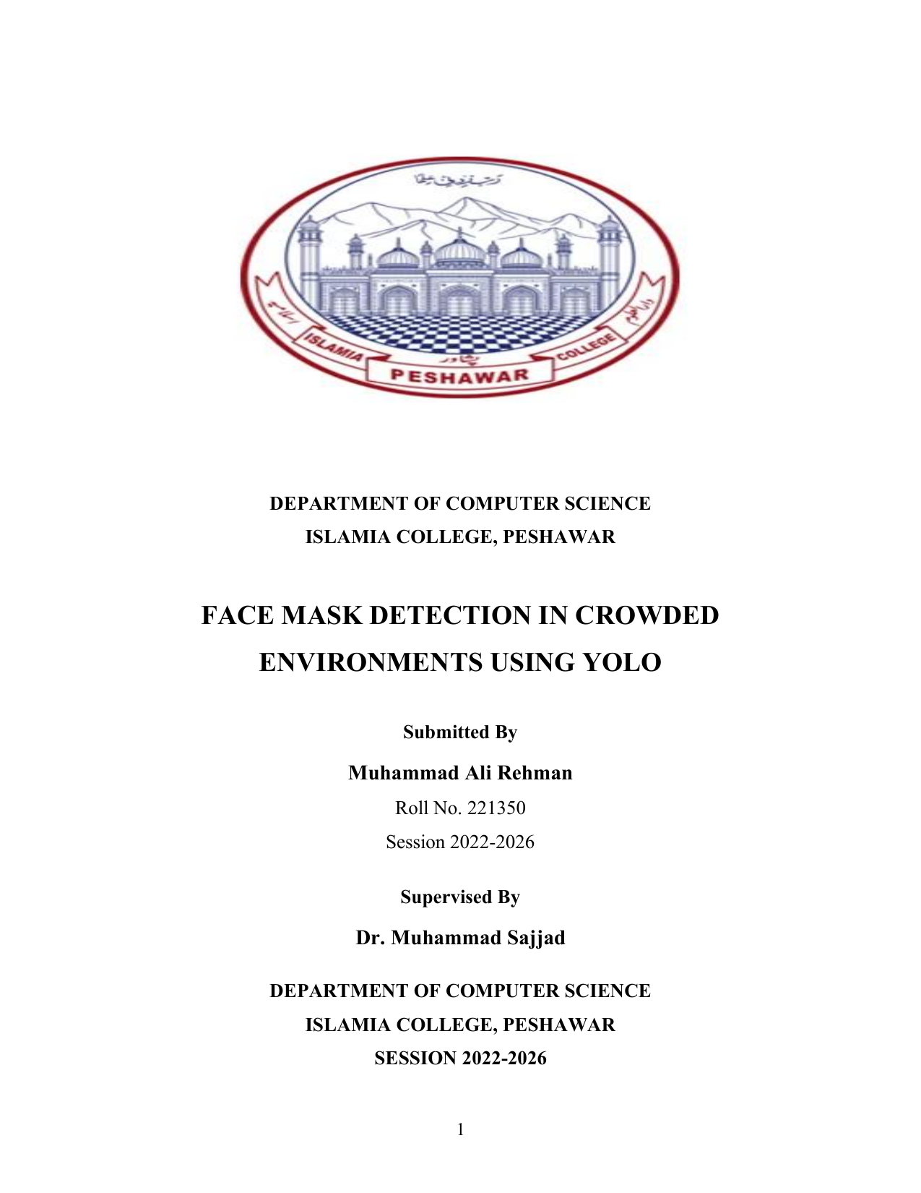
DEPARTMENT OF COMPUTER SCIENCE
ISLAMIA COLLEGE, PESHAWAR
FACE MASK DETECTION
IN CROWDED ENVIRONMENTS
USING YOLO
FYP VIVA PRESENTATION
Muhammad Ali Rehman
Roll No. 221350 • Session 2022–2026
Supervisor: Dr. Muhammad Sajjad
A simple YOLO + OpenCV pipeline for Mask / No Mask detection in images, videos and live input.

Slide 2
1. Problem & Motivation
Why this project is needed
The problem
Our motivation
Manual monitoring is slow and inconsistent when many people appear in the same frame. Crowded scenes, blur, poor lighting and partial occlusion make the task harder.
Build a practical computer-vision system that can detect multiple faces and classify each one as Mask or No Mask with clear visual output.
Project goal
Detect faces in images, videos and webcam input.
Classify each detected face as Mask or No Mask.
Show bounding boxes, labels and confidence values.
Keep the inference workflow simple enough for an FYP demo.

Slide 3
2. Objectives & Proposed Solution
What the system actually does
Detect
Classify
Visualize
Process
Locate faces in each input frame.
Assign Mask or No Mask.
Draw boxes, labels and confidence.
Support image, video and webcam streams.
Proposed solution
Use a single-stage Ultralytics YOLO detector instead of a separate face detector + classifier pipeline.
Single model → multiple detections → Mask / No Mask
Source: project thesis, Chapter 3 — objectives and system overview.

Slide 4
3. Existing Approach vs Proposed YOLO
The main technical difference
Aspect
Existing approach
Proposed system
Detection
Often two-stage
Single-stage YOLO
Crowded scenes
Limited support
Multiple faces in one pass
Processing
Separate detection + classification
Integrated detection + classification
Output
Basic labels
Boxes + class + confidence
Testing
Research / prototype focused
Notebook + video / webcam
Key idea: YOLO combines localization and classification in one integrated inference workflow.

Slide 5
4. System Workflow
From dataset to final prediction
1
2
3
4
5
Dataset
Annotation
Training
Weights
Inference
Face images
YOLO labels
(class + box)
Google Colab
best.pt
facemask.ipynb
+ OpenCV
Final output
Bounding box + class label + confidence score on each detected face.
The thesis workflow diagram on page 14 follows this same sequence: dataset → annotation → training → best.pt → inference → output.

Slide 6
5. YOLO Architecture Used
Single-stage object detection: detection + classification in one model
Input
Image / video frame
from OpenCV
Backbone
Extracts visual
features
Neck
Combines features at
different scales
Detection Head
Predicts bounding boxes
and classes
NMS + Output
Removes duplicate boxes
and keeps strong detections
Project Output
For each detected face: bounding box + class (Mask / No Mask) + confidence score.
Why YOLO for this project
It can handle multiple faces in the same frame and performs localization and classification in one inference pass.
Viva wording: “I used the Ultralytics YOLO single-stage detector. My checkpoint is saved as best.pt.”

Slide 7
6. How I Trained the Model
Custom face-mask detector trained on two classes
1. Dataset
Face images
Mask / No Mask
2. Annotation
YOLO labels:
class + box coordinates
3. Training
Google Colab
50 epochs · batch 16
4. Saved Model
best.pt
learned weights
What the model learns
It learns visual patterns that help it locate a face and classify that detected object as either Mask or No Mask.
Training data split
Training + validation + testing data
with YOLO-format labels.
Final result
The best checkpoint is stored as best.pt and reused for inference.

Slide 8
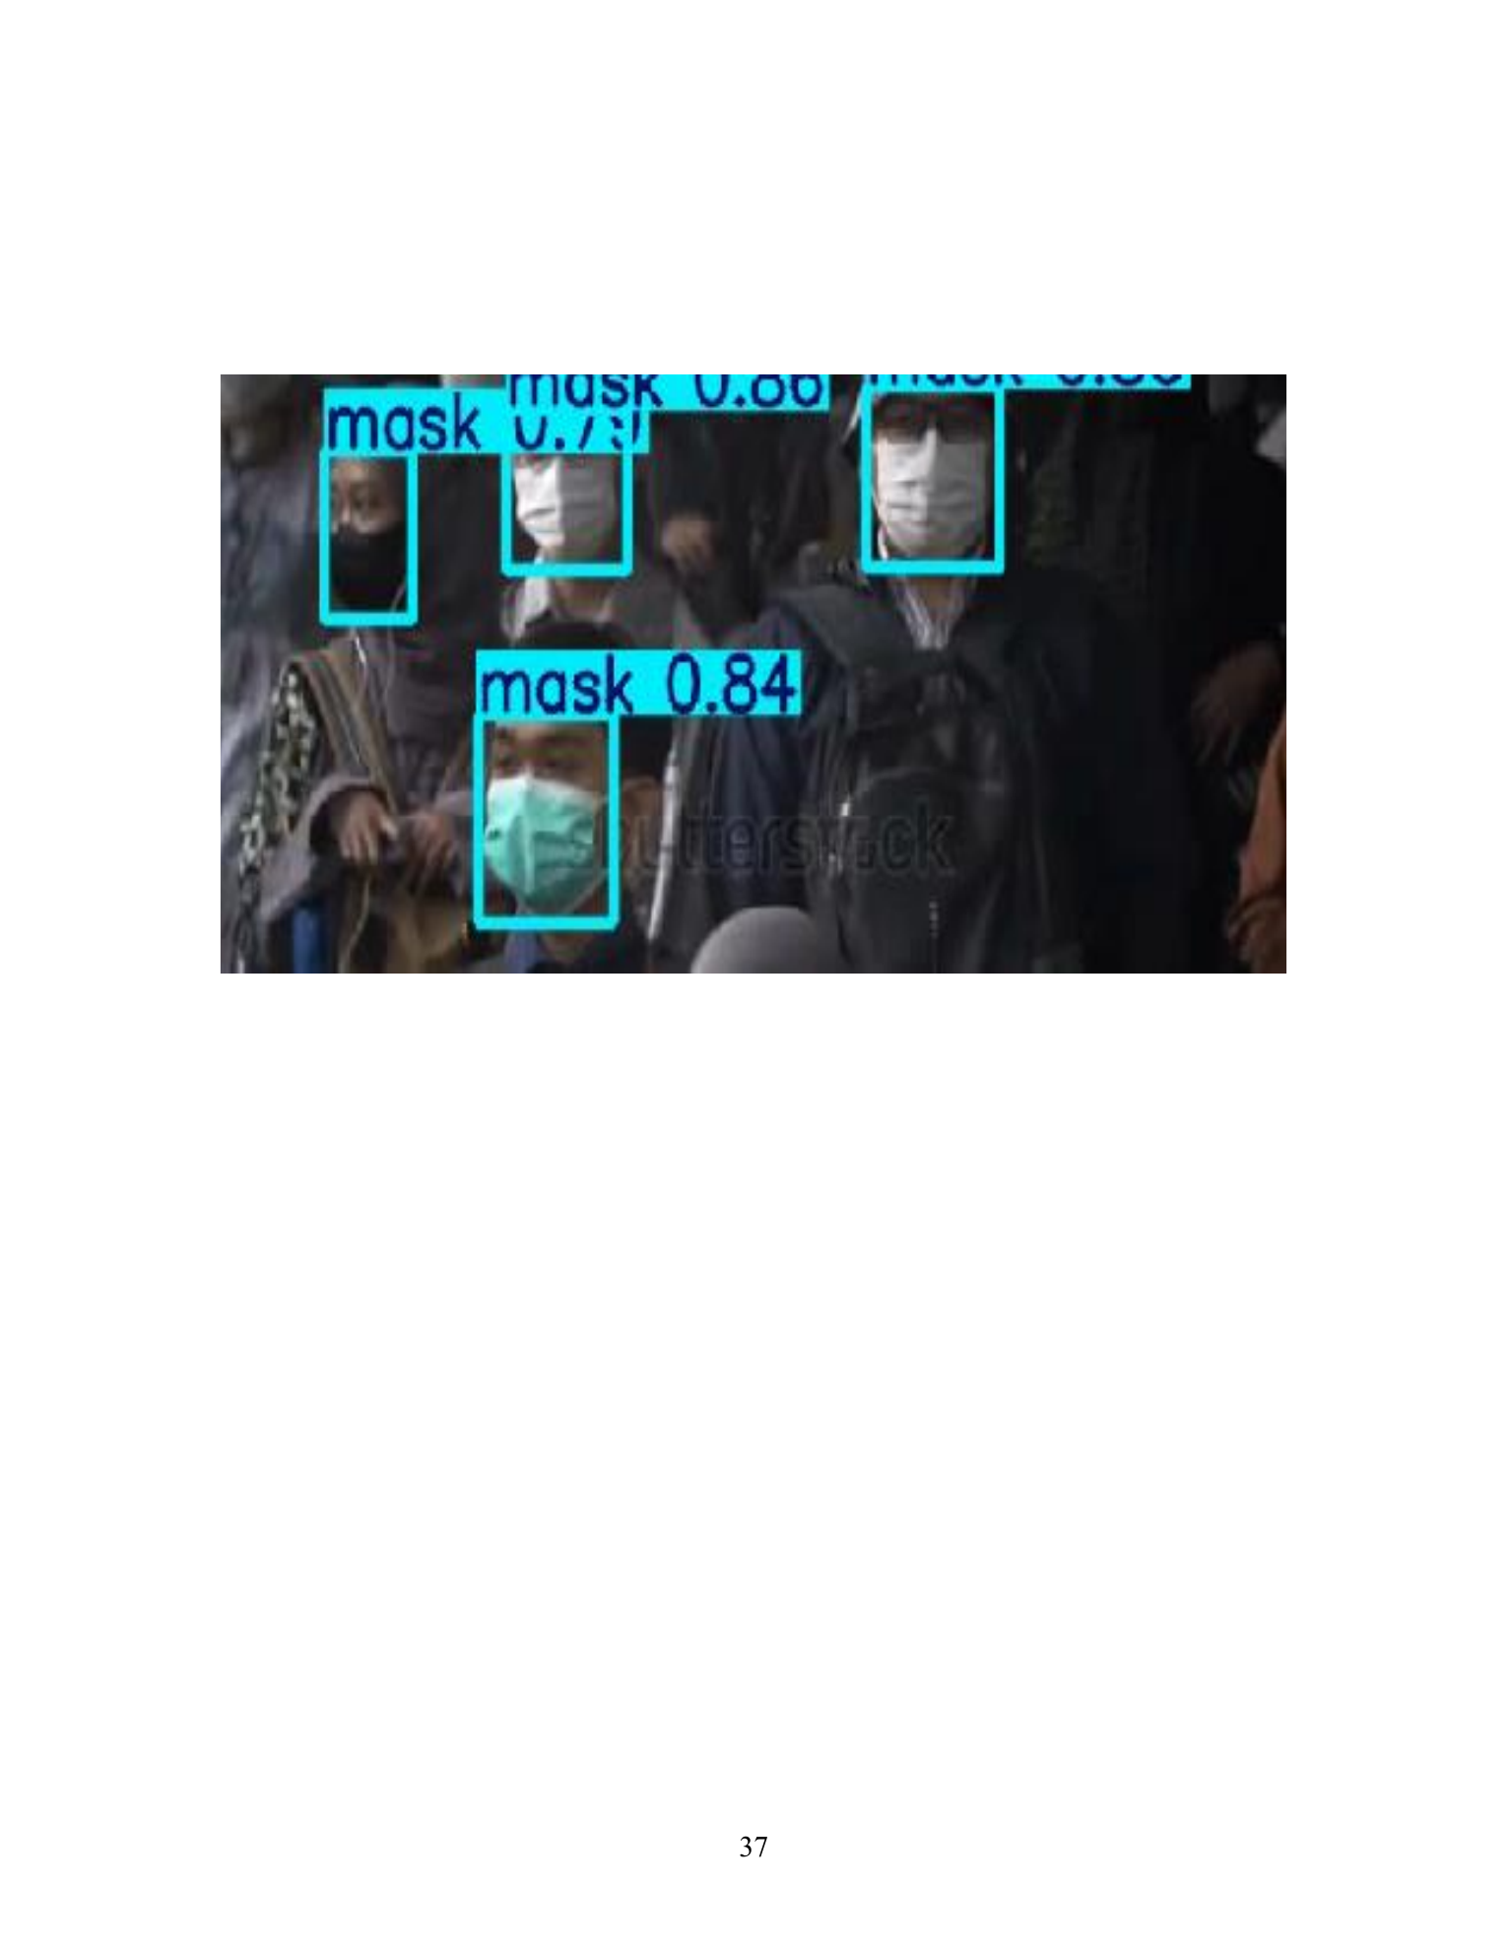
7. How the System Works During Detection
The trained model is reused on every frame
OpenCV
Capture image / video / webcam frame
YOLO
model.predict(frame, conf=0.4)
Prediction
Get box, class ID and confidence
Visualization
Draw box + label + confidence
Display
Show annotated frame
Why conf = 0.4?
The notebook keeps predictions whose confidence is at least 0.40, helping remove weak detections.
What the code does
Reads each box → gets class name → draws the bounding box → counts Mask / No Mask → displays the frame.
Viva sentence
“I trained the detector once, saved the learned weights as best.pt, and then used OpenCV to send video frames to YOLO for real-time prediction.”

Slide 9
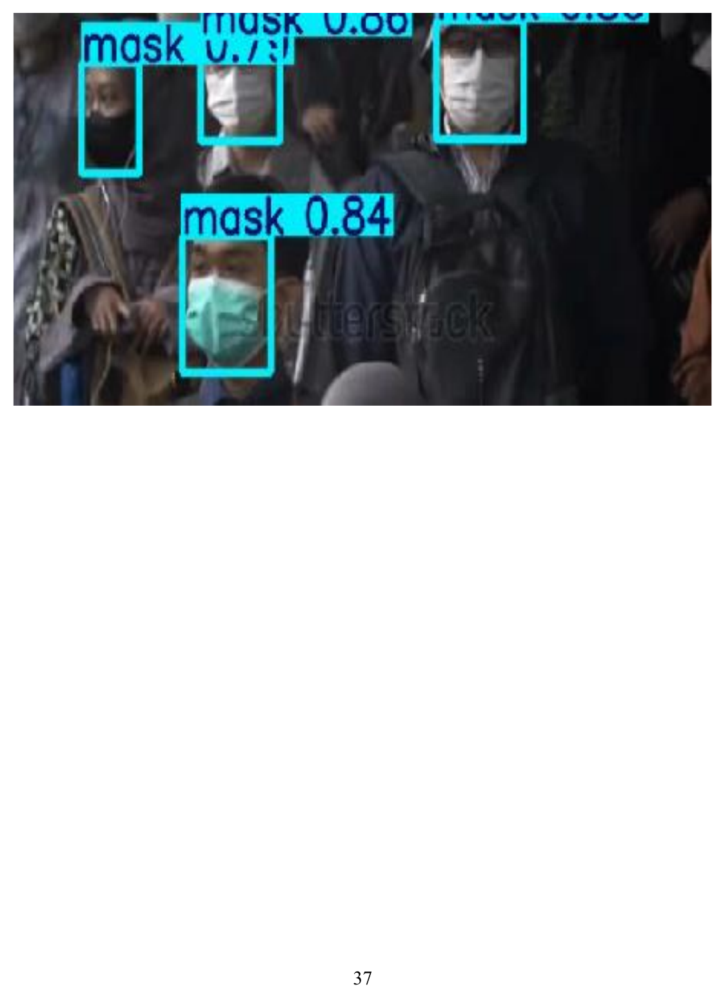
8. Detection Results
Example output from the trained face-mask detector
What the output shows
Bounding box
The model locates each detected face.
Class label
The model assigns a learned class.
Confidence
The score shows prediction confidence.
Multiple faces
Several faces can be detected in one frame.
Example detection result: boxes + class labels + confidence scores.
Face Mask Detection • FYP Viva
9

Slide 10
8. Limitations & Future Work
What can be improved next
Current limitations
Future work
• Lower reliability with severe occlusion
• Small faces, blur and poor lighting are challenging
• Only two classes: Mask / No Mask
• Mainly notebook-based deployment
• Expand dataset diversity
• Add “incorrect mask” as a class
• Compare YOLO model sizes for speed vs accuracy
• Add alerts, logging, cloud storage or a simple interface
Scope boundary
The current project focuses on detection and classification. It does not identify people or store long-term surveillance records.

Slide 11
9. Conclusion
The project demonstrates a complete YOLO-based pipeline from annotated data to real-time visual detection.
Simple: one integrated detector
Practical: image, video and webcam support
Interpretable: boxes, labels and confidence
Thank you
Questions / Viva

