Slide 1

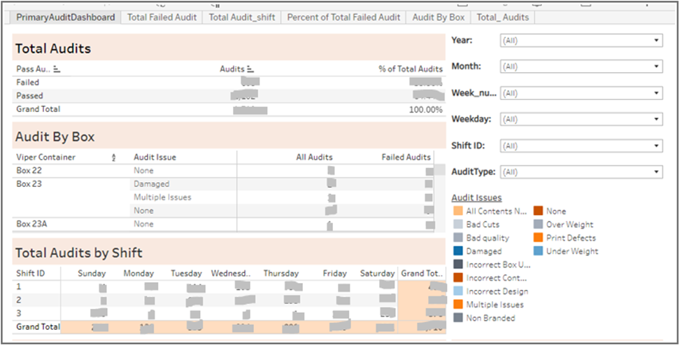
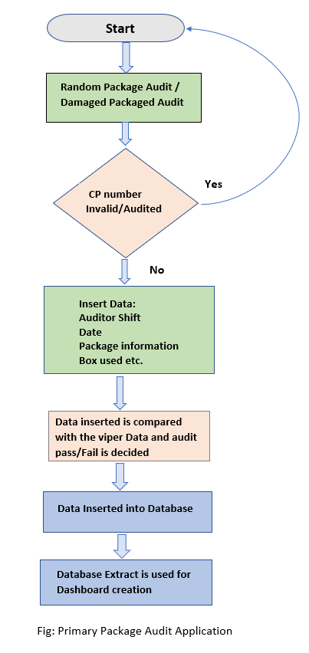
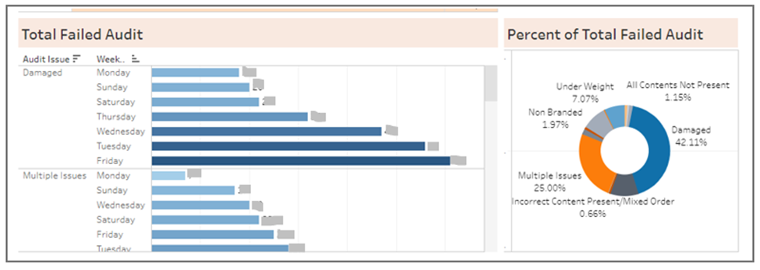
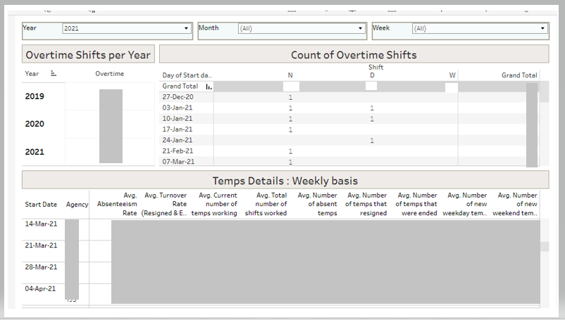
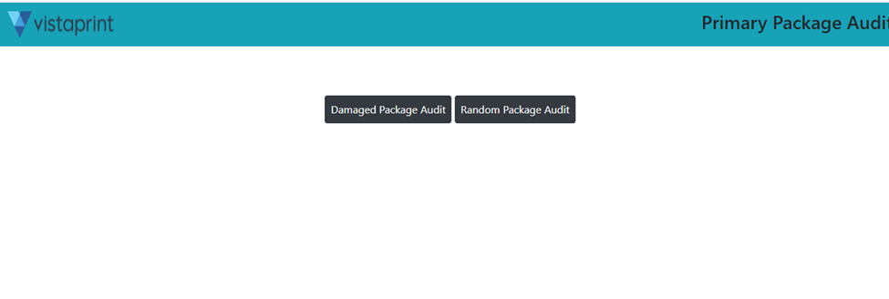
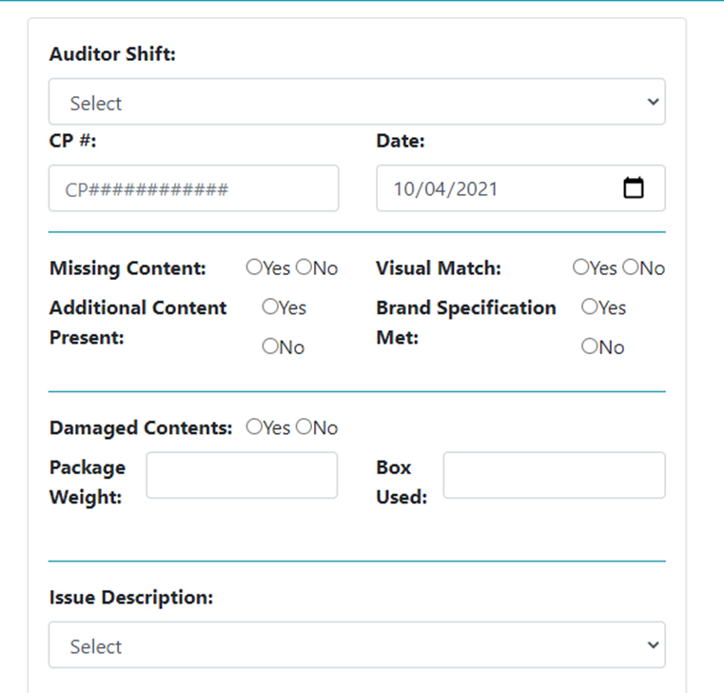
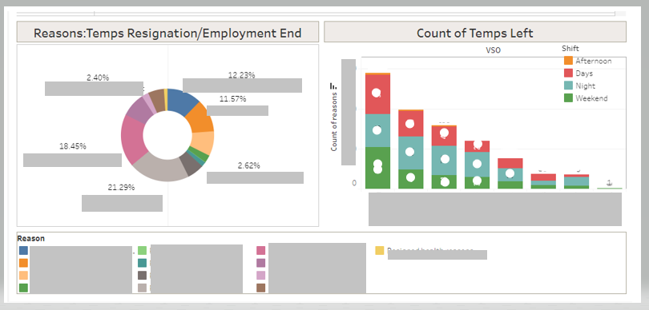
Vista - Windsor Plant
Malita Dodti
dodti@uwindsor.ca
MSc Computer Science Co-op, Summer 2021- Fall 2021 Work Term
School of Computer Science, University of Windsor
About Vista
Primary Package Application Dashboard
Accomplishments
Vista, a subsidiary of Cimpress, is a market leader in personalized physical and digital goods. It offers a wide range of small business marketing products, as well as real-time access to expert advice and ideas for those who require it, as well as a simple, easy experience for those who know exactly what they want.
Vista is aware of the many factors that must be present in order to appear knowledgeable, prepared, and connected. It focuses on providing value to customers through easy-to-use, cutting-edge technology. As a result, our customers and team members will have more chances for exploration, cooperation, innovation, and growth. Vista made $1.508 billion in revenue last year via customized print items, signage, clothes, websites, and more.
Primary Package Audit Application: Auditors use the PPAT application to audit the packages for quality inspection before being shipped out to customers. It accepts the data from the application and compares it with the viper(Vista Proprietary Software) data for that particular CP number; if the contents of the field match, the Audit is passed; else, based on the dissimilarities in data, the Audit is failed with different reasons. The Audited package data is stored in the database every time a package is audited. The Application uses PHP as the primary programming language and HTML form and CSS styling to develop the interface. jQuery and AJAX insert data into the database. Primary Package Application Dashboard: The Audit statistics for the Primary Package Audit Application are displayed on the Dynamic Dashboard. The right-hand filters allow the user to tailor their search. The data for the Tableau dashboard comes from a database that is connected to the tableau in real-time. HR Dashboard: The temporary employees data, overtime shifts worked, temp employees working each day, the number of temps who resigned/ended, and reasons for job termination are all displayed on the dashboard. It assists HR in determining the amount of overtime performed by temporary employees at each shift and the reasons for employee's termination at various times throughout the year, and drawing inferences for future overtime shift planning and scheduling. Queried database to retrieve information requested by partners who are looking into processes to improve efficiency, solve problems, and so on. Indexed over 15 tables in the database to reduce query execution time and increase overall performance. The Table indexed were pre-studied for their jobs performed, productivity and priority in the daily functions. After the indexing procedure was done, efficiency increased by an average of 15%. Created SSRS dashboard requested by customers to monitor the retail rates, such as Bin Pack rate, Fetch rate and put away rate with history option available. Modified an SSRS dashboard to add teams and related content when selected on the Dashboard.
About Analytics team
The Windsor Production Systems & Analytics Team at Vista contributes to the development and deployment of solutions for tracking and reporting on the performance of various Manufacturing streams. Streamlining the present process of creating and publishing key performance indicators on a daily, weekly, and monthly basis (KPIs). Creating mechanisms to track labour skill sets more effectively. Methods for tracking and assessing trends in efficiency, scrap, and customer-facing performance measurements are being developed. Creating a throughput-time compliance model to better understand how much time is spent on each step of the manufacturing process. Work with other departments, such as Engineering, Supply Chain, and Finance, to do exploratory data analysis in order to improve Manufacturing's performance.
HR Dashboard
Work Term Profile: Manufacturing Analyst Co-op
Primary Package Application
Conclusion
Co-op enabled an opportunity to explore my capabilities and develop skills that would be important for my professional endeavors.
Queried large databases for reporting and provided insights for business decisions using tableau dashboards showcasing a data story.
Strategized the approximate time required to complete the assigned task, keeping the supervisor in the loop with the updates, Revisiting the deadlines when faced with a hurdle. etc. are a few of many aspects I learned during my tenure with Vista.
Acknowledgements & References
Muhammad Bukhari , Manager Analytics, North America, Vista
Alexendra krasowski, Manufacturing Analyst, Vista
Devin P., Software Engineer, Vista
Romina Oulevey, Co-op Coordinator, University of Windsor
https://en.wikipedia.org/wiki/Windows_Vista
https://www.vistaprint.com/

