Slide 1
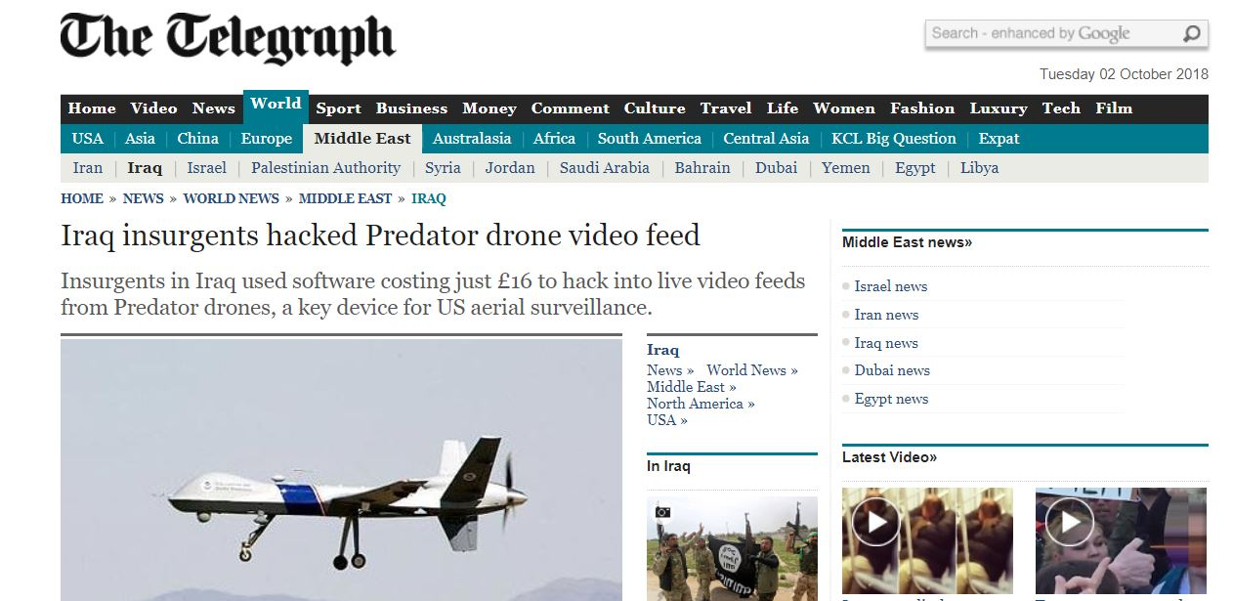
Notes:
Explain about the drone video feed hack
https://www.telegraph.co.uk/news/worldnews/middleeast/iraq/6834884/Iraq-insurgents-hacked-Predator-drone-video-feed.html
Securing streamed data feeds though encryption is mandatory
Which means stream lined data should be sent through secure channels
Cyber criminals use many techniques to hack in to cryptographic devices
Power analysis attack is one form of them
Here, we try to see if stream cipher, trivium is vulnerable against power analysis attacks
If so we plan to deliver few countermeasures as well.

Slide 2
Power Analysis Attack on Trivium Stream Cipher CO 421- Final Year Project I
GROUP 18
De Silva M.D.R.A.M. (E/13/058)
Navaratna N.M.I. (E/13/237)
Kumarasiri G.M.D. (E/13/200)
Notes:
Explain about the drone video feed hack
https://www.telegraph.co.uk/news/worldnews/middleeast/iraq/6834884/Iraq-insurgents-hacked-Predator-drone-video-feed.html
Securing streamed data feeds though encryption is mandatory
Which means stream lined data should be sent through secure channels
Cyber criminals use many techniques to hack in to cryptographic devices
Power analysis attack is one form of them
Here, we try to see if stream cipher, trivium is vulnerable against power analysis attacks
If so we plan to deliver few countermeasures as well.

Slide 3

Ciphers
Block 1
Block 2
Block 3
Encryption Function
Block 3
Block 2
Block 1
Plaintext
Block Cipher
Ciphertext
Encryption Function
Bit stream 00101110011100011
Encryption Function
Plaintext 110011100011
Ciphertext 100110011010
Stream Cipher
Notes:
Algorithms used for encryption and decryption
Modern, rotary and traditional
Most modern ciphers can be categorized in several ways:
By whether they work on blocks of symbols usually of a fixed size (block ciphers), or on a continuous stream of symbols (stream ciphers).

Slide 4
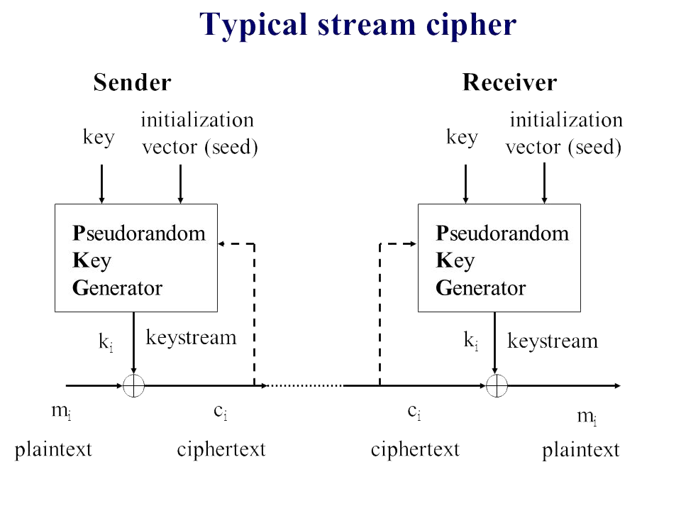
Typical Stream Cipher

Slide 5
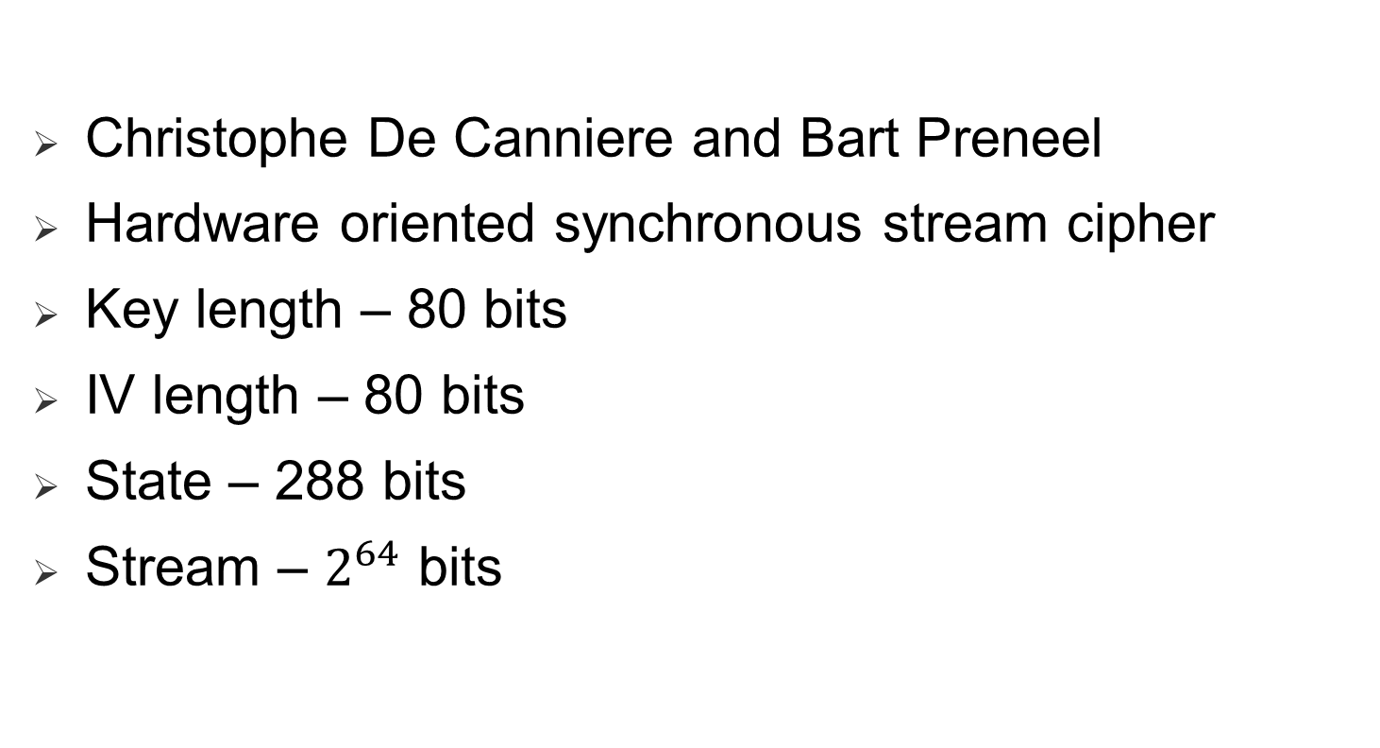
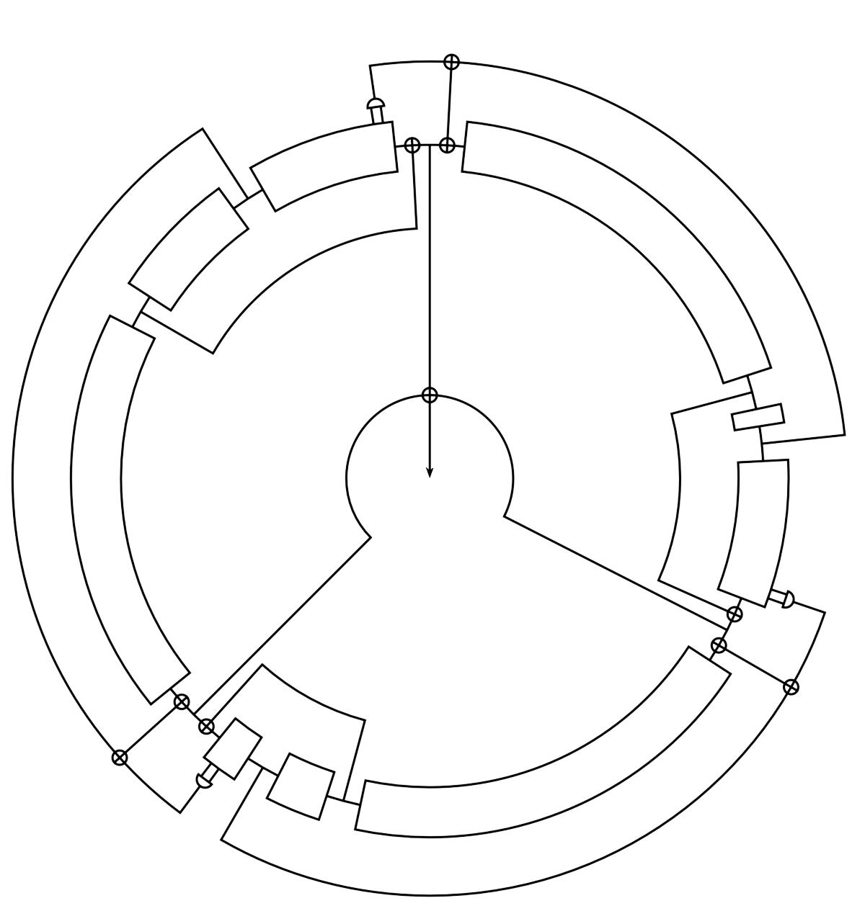
Trivium Stream Cipher
Notes:
Trivium – meaning – 3 parts 3 registers and the simple implementation
Output can be a maximum of 64 bits
Advantage – can be used in compact environments cz less number of gates are used
Use cases??
3 registers modify each other by getting specific bits

Slide 6
Trivium Security
Evolves non-linearly
Trivium is secure from both
Correlation between linear combination of keystream bits and
internal state
Correlation between keystream bits
Notes:
Trivium generates up to 2⁶⁴ bits of key stream from an 80-bit secret key and an 80-bit initial value (IV).
Internal state is 288 bits

Slide 7
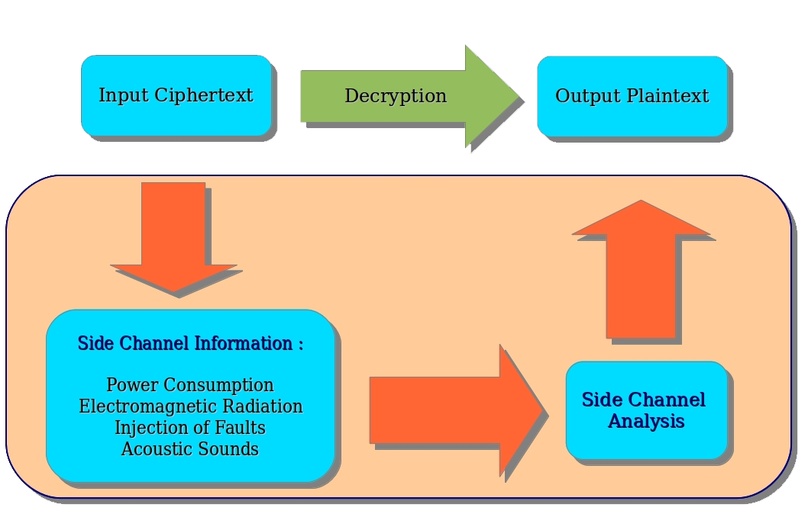
Side Channel Attacks

Slide 8
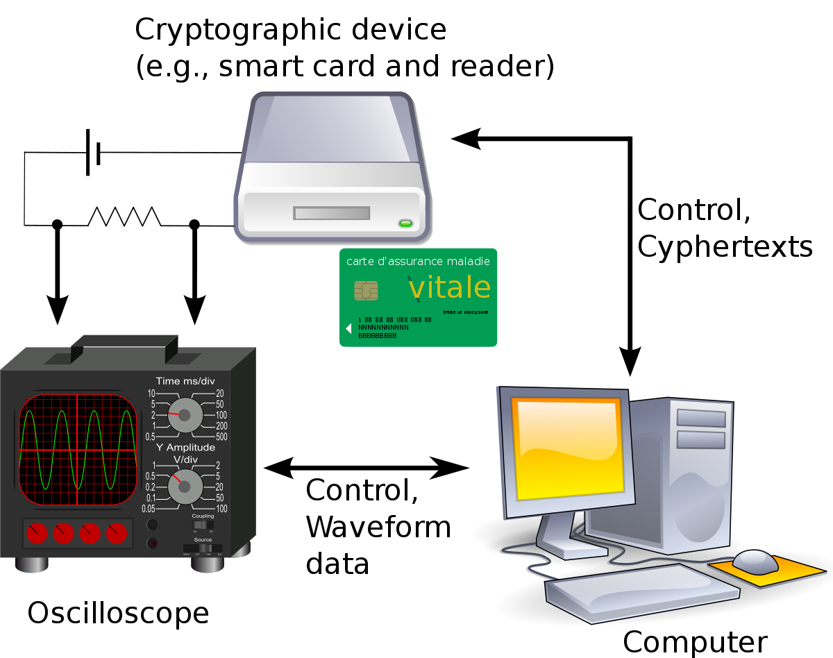
Power Analysis Attacks
Observe and study power consumption of the cryptographic system
Collect power traces and do statistical analysis to get the secret key

Slide 9
Related Work
Work | Introduced by | Issues
Correlation power analysis of trivium | Yanyan Jia, Yupu Hu, Fenghe Wang, Hongxian Wang | Implemented using a hardware module and not tested using a software module.
Differential power analysis of stream ciphers | Fischer W, Gammel BM, Kuiffer O | High computational complexity than correlation power analysis method
Power analysis based side channel attack | Hasindu Gamaarachchi, Harsha Ganegoda | Focused on block cipher

Slide 10

Review Paper
Scope expanded – “On Power Analysis Against Hardware Stream Ciphers”
Review paper submitted to the International Journal of Information and Computer Security (IJICS)
IJICS is indexed in Scopus(Elsevier), Compendex [formerly EI] (Elsevier), ACM Digital Library etc.
Currently the revised version is submitted after initial review.

Slide 11
Overall Design
Developing a test bed
Implementing Trivium
Obtain power traces
Analyzing power traces
Deriving the secret key

Slide 12
Verification of Trivium implementation on PIC
Plain text
(Key,IV) sets
Expected Cipher text
Generated Cipher text
Verify

Slide 13
Milestones
Milestone | Allocated Time Period | Actual Time Spent | Completion
Litterateur review and differentiating the project tasks from the previous attempts | 3 Weeks | 5 weeks | 100%
Implementing Trivium stream cipher on a microcontroller and testing it's functionality | 4 weeks | 4 weeks | 100%
Getting power traces and analyzing them to derive the secret key | 4 weeks | 2 weeks | 40%

Slide 14
Plan for this semester
Milestone | Allocated Time Period
Getting power traces and analyzing them to derive the secret key | 9 weeks
Developing countermeasures | 5 weeks

Slide 15
WBS for CPA
Task | Allocated Time Period
Setup the oscilloscope to attack trivium | 1 week
Automate oscilloscope using Matlab | 2 week
Obtain power traces | 1 week
Implement CPA method | 3 week
Analyze power traces and derive secret key | 2 week

Slide 16
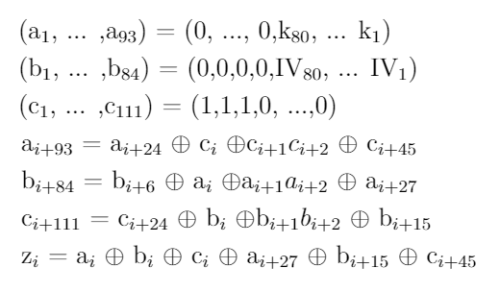
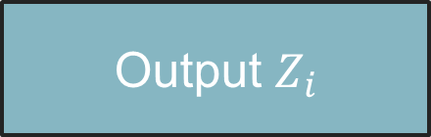
Design Specifications of Trivium
Trivium
Setup time
4x288
Output $Z_{i}$

Slide 17
Attack resynchronization phase of Trivium
Hardware stream cipher
Leakage of information from flip-flops
Causes dynamic power consumption
State changes in flip-flops used to get hypothesis power consumption values
Hamming distance model

Slide 18
CPA on Trivium
CPA
Selection function (key,IV)
Solve non-linear equations
Derive key
CPA for each 8 rounds of initialization process

Slide 19

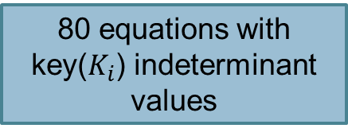
CPA on Trivium
CPA
Intermediate value
Hypothesis
Key
IV
80 equations with key($K_{i}$) indeterminant values
10 CPA attacks
….
Notes:
Evaluation
Kadirage diff video eka and oscilloscope video eka

Slide 20
CPA on Trivium
Hypothetical power consumption
Measured power consumption
Correlation
Recovered hypothesis (σ)
80 equations on the secret key bits can be obtained
Sequentially solve the equations
Derive secret key

Slide 21

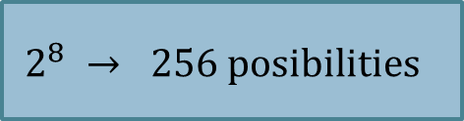
1 CPA attack : real power traces
$$2^{8} → 256 posibilities$$
$2^{8 }$IVs → 256
Obtain 256 real power traces for each IV

Slide 22

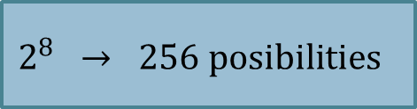
Hypothetical power traces
$$2^{8} → 256 posibilities$$
Attack obtain 256 bits with hypothesis and used IVs with state ($S_{j} , j=1…288)$changes
8 time steps

Slide 23
CPA on Trivium
Hypothetical power consumption
Measured power consumption
Correlation
Recovered hypothesis (σ)
80 equations on the secret key bits can be obtained
Sequentially solve the equations
Derive secret key

Slide 24
Thank You

Slide 25



WBS for CPA

Slide 26
Stream cipher and block ciphers. stream used in https wep dvd encryption(css encrp) gsm encryption Bluetooth
Encryption has long been used by militaries and governments to facilitate secret communication. Encryption is now used in protecting information within many kinds of civilian systems, such as computers, networks (such as for Internet e-commerce), mobile telephones, wireless microphones, wireless intercom systems, Bluetooth devices, and bank automatic teller machines. Encryption is also used in digital rights management to restrict the use of copyrighted material and in software copy protection to protect against reverse engineering and software piracy.

Slide 27
Standards and cryptographic software and hardware to perform encryption are widely available, but successfully using encryption to ensure security is a challenging problem. A single slip-up in system design or execution can allow successful attacks. Sometimes an adversary can obtain unencrypted information without directly undoing the encryption.

Slide 28
Trivium
IV and key used to initialize the state
Iterate state
extract values of 15 specific state bits and use them to update 3 bits of the state and to compute 1 bit of the key stream zi.
state bits then rotated and process repeats

Slide 29
Trivium Key Stream Generation
for i = 1 to N do
t1 ← s66 ⊕ s93
t2 ← s162 ⊕ s177
t3 ← s243 ⊕ s288
zi ← t1 ⊕ t2 ⊕ t3
t1 ← t1 ⊕ s91 ∧ s92 ⊕ s171
t2 ← t2 ⊕ s175 ∧ s176 ⊕ s264
t3 ← t3 ⊕ s286 ∧ s287 ⊕ s69
(s1; s2; : : : ; s93) ← (t3; s1; : : : ; s92)
(s94; s95; : : : ; s177) ← (t1; s94; : : : ; s176)
(s178; s279; : : : ; s288) ←(t2; s178; : : : ; s287)
end for

Slide 30
Trivium Initialization
load 80-bit key and 80-bit IV into 288-bit initial state
set all remaining bits to 0, except for s286, s287, and s288, which are set to 1
state is rotated over 4 full cycles of the for look, but no bits are output (for i = 1 to 4∗288)

Slide 31
Trivium
state bit is not used for at least 64 iterations after it has been modified
up to 64 iterations can be computed at once, provided that 3 AND gates and 11 XOR gates in the original scheme are duplicated a corresponding number of times

Slide 32
Estimated Gate Counts 1-bit to 64-bit hardware implementations
Components | 1-bit | 8-bit | 16-bit | 32-bit | 64-bit
Flip-ops | 288 | 288 | 288 | 288 | 288
AND gates | 3 | 24 | 48 | 96 | 192
XOR gates | 11 | 88 | 176 | 352 | 704
NAND gate count | 3488 | 3712 | 3968 | 4480 | 5504

Slide 33
Software
Stream generation: 12 cycles/byte
Key setup: 55 cycles
IV setup: 2050 cycles
on Intel XeonTM CPU 1.5 GHz

Slide 34
Trivium Security
Linear correlations between key stream bits and internal state bits are easy to find because zi is simply defined to be equal to s66⊕s93 ⊕ s162 ⊕ s177 ⊕ s243 ⊕ s288.
But, as opposed to LFSR based ciphers, Trivium's state evolves in a nonlinear way
not clear how an attacker should combine these equations in order to efficiently recover the state
Estimate: follow linear trails through the cipher and approximate the outputs of all encountered AND gates by 0. However, the positions of the taps in Trivium have been chosen in such a way that any trail of this specific type is forced to approximate at least 72 AND gate outputs
If assume that the correlation of linear combination is completely explained by a specific trail considered, then it would have a correlation coefficient of 2⁻⁷²
Detecting such a correlation would require at least 2¹⁴⁴ bits of key stream
Other more complicated types of linear trails with larger correlations might exist, estimate that no correlations will exceed 2⁻⁴⁰

