Slide 1
Smashville
By Kyle Tuckey & Joshua Petherick
Notes:
BOTH. Welcome screen, introducing ourselves and the name of our game!

Slide 2

What is Smashville?
Smashville is a beat-em-up style fighting game, where two players use their fighting prowess to try and knock the other player(s) off the stage and out of the arena.
With a rooster of characters and stages to choose from, players will be spoilt for choice when it comes to confronting their adversary.
Notes:
JOSH. Talk more about the game itself, such as it’s aim and end goal.
Don’t discuss actual gameplay, as this will be discussed on the following slide.

Slide 3
The Rules (of Smashville!)
The rules of the game are simple (but will not tolerate violation):
Players can move left, right and Double Jump.
Players can hit other players left, right up or down.
Getting hit will increase knockback effect
Getting knocked off screen will result in a loss
Sessions must have a host player
Sessions can hold up to four players
Sessions must have a selected stage
Players connected to sessions must select a character
Only the host can start the session
Player who creates session is the host
Notes:
JOSH. Discuss gameplay and the rules regarding it.
Make sure to explain these as it will go a long way towards other people understanding how our game will work.

Slide 4
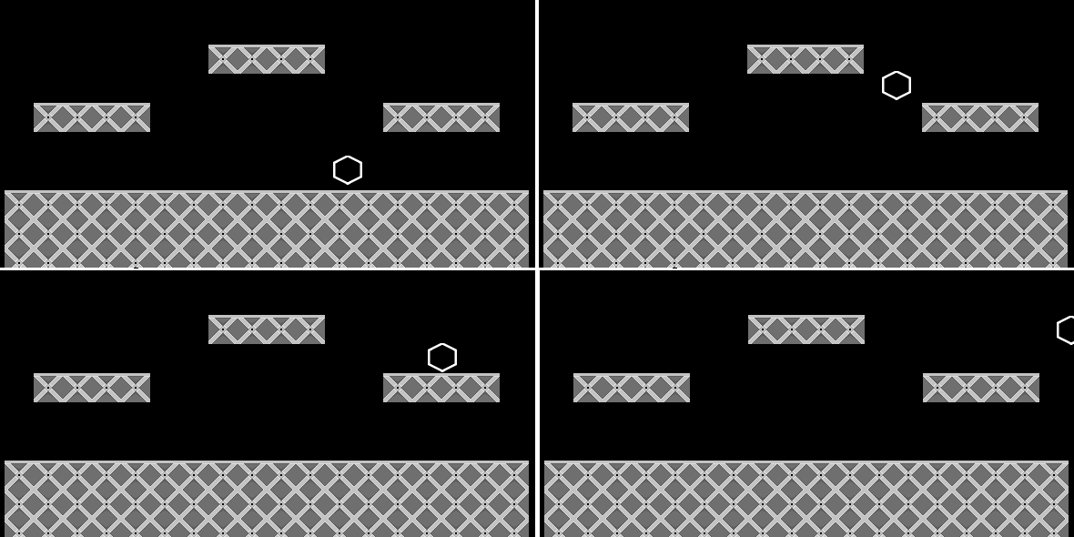
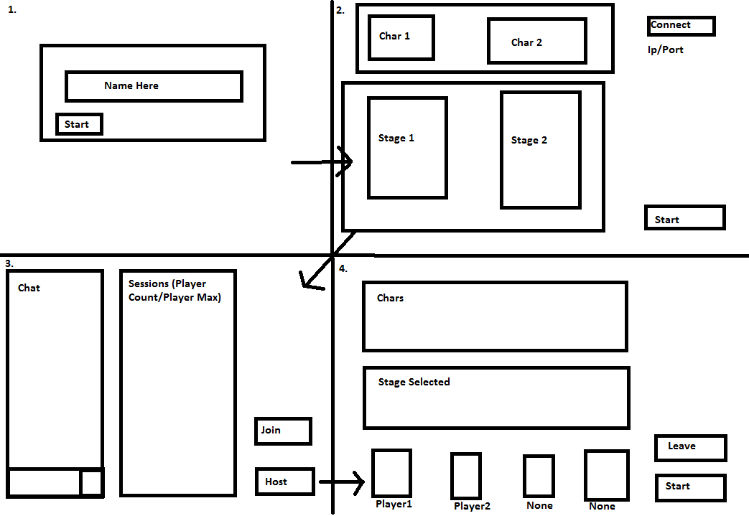
The Storyboards
Game State Storyboard:
Lobby State Storyboard:
local
The storyboard above shows the player moving
around the stage before jumping off of the screen.
The other storyboard shows how the user will navigate the menus to find/host/start a game.
Notes:
KYLE. These storyboard drafts show different parts of the users gaming experience.
Discuss how the users will navigate these storyboards to achieve certain stages (Such as connecting to the server or hosting a new session).
Try to be concise, meaning don’t over explain stuff, as I’m pretty sure we’re on a timer.

Slide 5
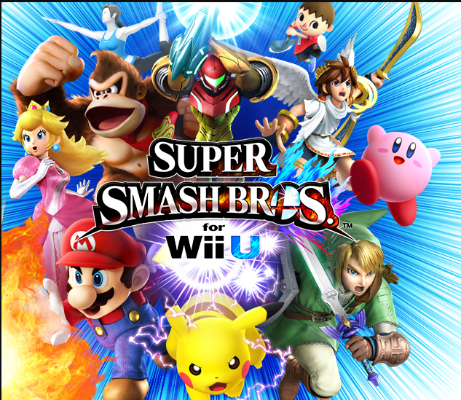


Similar Game Designs
Super Smash Bros. (1999 – 2014)
Tekken (1994)
Street Fighter 2 (1991)
Notes:
KYLE. This slide will be used to discuss our inspirations, and how they have affected the choices we have made.
All these games are licensed to respective owners. No copyrights intended. Their own fault for making such good games.
Title/Developer/Publisher
Super Smash Bros: HAL Laboratory, Nintendo
Tekken: Bandai Namco Studios, Bandai Namco Studios
Street Fighter 2: Capcom, Capcom
Image URLs:
Super Smash Bros: http://www.smashbros.com/en-uk/images/index/image/main-wiiu-logo.png
Tekken: https://upload.wikimedia.org/wikipedia/en/e/e1/Tekken_series_logo_as_of_2012.gif
Street Fighter 2: http://vignette1.wikia.nocookie.net/capcomdatabase/images/f/f1/SFIILogo.png/revision/latest?cb=20110110173220

Slide 6
Our goal & Focus
… is to produce a game containing various multiplayer features, such as:
Chat Systems
Hosting and Joining Sessions
Spectating Sessions
Leader boards
We hope to include more features as the game progresses
Notes:
BOTH. KYLE. Talk about what these goals are and what they mean. Explain (If possible) how they provide a challenge.
JOSH. Go into detail about these individuals goals, particularly the sessions part.

Slide 7
Any Questions?
Notes:
Thank you for reading these notes! Hope you found them, and the presentation slides, useful.

