Slide 1
Torch-Run
Kyle Tuckey

Slide 2
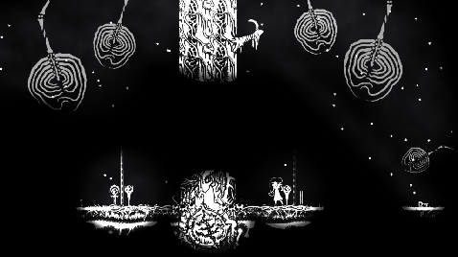
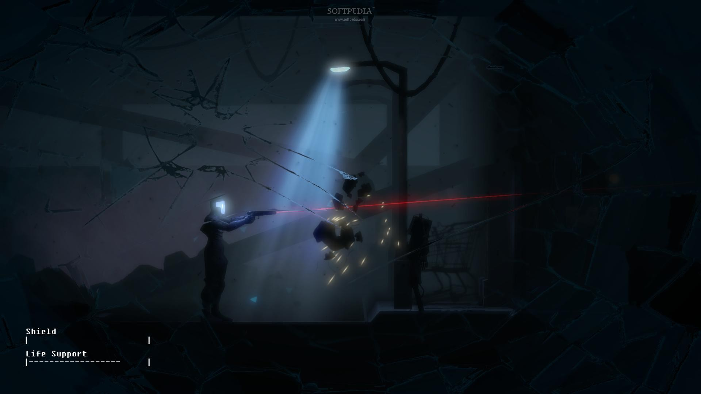
Other games
Closure by Eyebrow Interactive
The Fall by Over The Moon

Slide 3
Original Idea – 2D, topdown, light based
Game Objective: get to the end of the level before your torch runs out
Game rules:
- Pick up lighter fuel to extend the torch duration
- Avoid roaming enemy units
- Complete puzzles to advance quicker to your objective

Slide 4
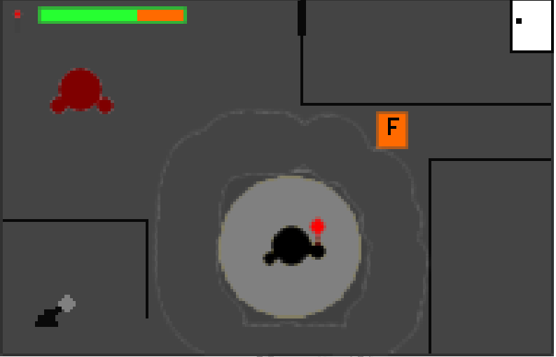
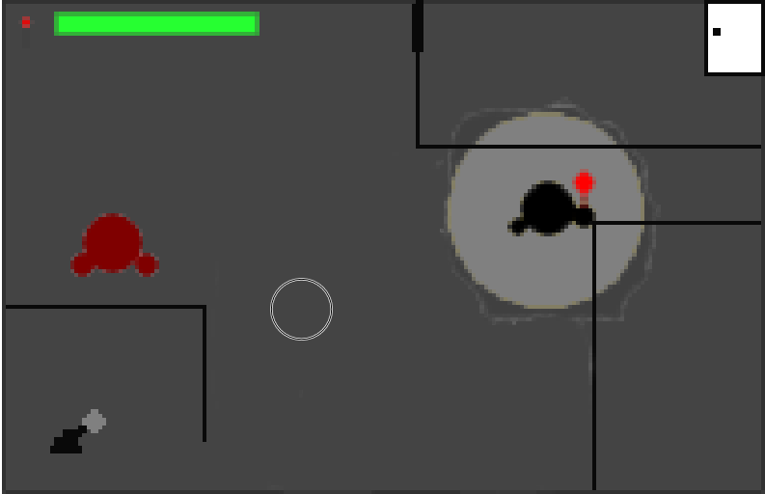
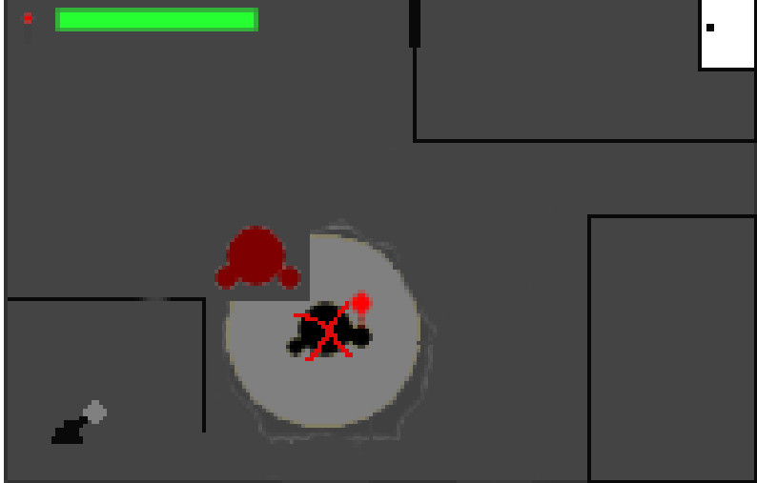
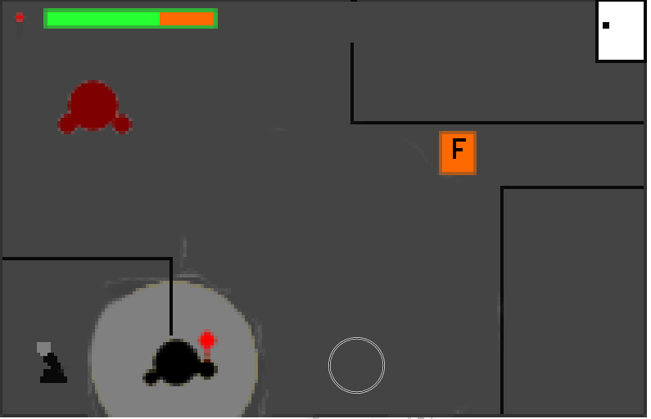
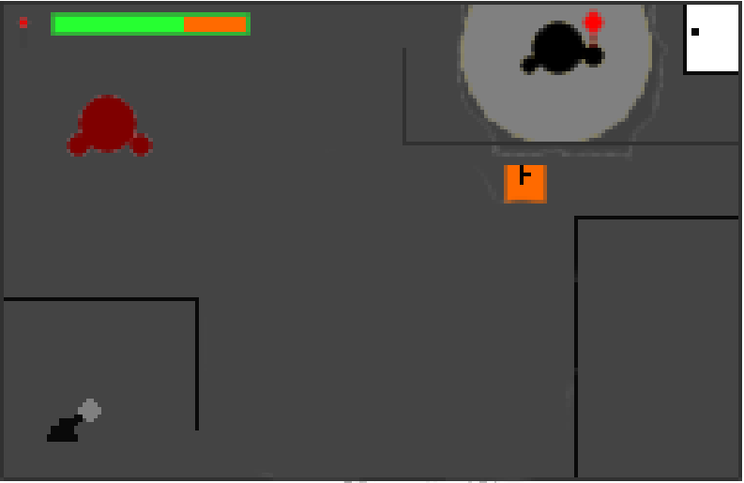
Storyboard

Slide 5
Technical aspects
Light rendering – The main focus of the game
Enemy behaviour – React and move towards the light
Events – pulling lever to open the door
Collectables – Extend the duration of fuel

Slide 6
Any Questions

