Slide 1
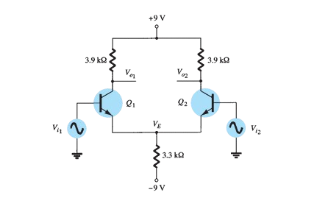
DC bias of differential amplifier circuit.
Buda Tech
biasing is the setting of DC (direct current) operating conditions (current and voltage)

Slide 2
DC bias of differential amplifier circuit.
Buda Tech
Data given
Q1 & Q2 are NPN
VCC = 9V
RC =3.9k
RE = 3.3k
VEE = -9

Slide 3
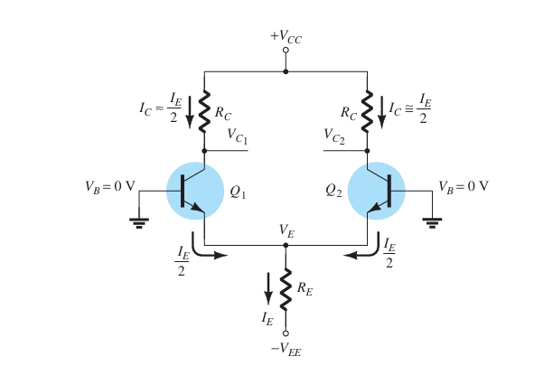
DC bias of differential amplifier circuit.
Buda Tech
$$v_{cc}=v_{c}+ I_{c}R_{c}$$

Slide 4

DC bias of differential amplifier circuit.
Buda Tech
$$v_{cc}=v_{c}+ I_{c}R_{c}$$
$I_{E}R_{E}=v_{E}−{(−V}_{EE}$)
$$v_{EE}=v_{BE}+I_{E}R_{E}$$

Slide 5


DC bias of differential amplifier circuit.
Buda Tech
Emitter current $I_{E }$
$$v_{EE}=v_{BE}+I_{E}R_{E}$$
$$9=0.7+I_{E }x 3.3k$$

Slide 6

DC bias of differential amplifier circuit.
Buda Tech
Emitter current $I_{E }$
$$v_{EE}=v_{BE}+I_{E}R_{E}$$
$$9=0.7+I_{E }x 3.3k$$
$$8.3=I_{E }3.3k$$

Slide 7

DC bias of differential amplifier circuit.
Buda Tech
Emitter current $I_{E }$
$$v_{EE}=v_{BE}+I_{E}R_{E}$$
$$9=0.7+I_{E }x 3.3k$$
$$8.3=I_{E }3.3k$$
$$8.3=I_{E }3.3k$$
$I_{E }= \frac{8.3}{3.3k}$ = 2.5mA

Slide 8


DC bias of differential amplifier circuit.
Buda Tech
Collector Current $I_{c }$
$I_{c }= \frac{I_{E }}{2}$ = $\frac{2.5mA}{2}$
${ I}_{c }=$ 1.25mA

Slide 9


DC bias of differential amplifier circuit.
Buda Tech
Collector Voltage $V_{c }$
$$v_{c}=v_{cc}− I_{c}R_{c}$$
$$v_{c}=9− I_{c}3.9k$$

Slide 10

DC bias of differential amplifier circuit.
Buda Tech
Collector Voltage $V_{c }$
$$v_{c}=v_{cc}− I_{c}R_{c}$$
$$v_{c}=9− I_{c}3.9k$$
$I_{c }= \frac{I_{E }}{2}$ = $\frac{2.5mA}{2}$
${ I}_{c }=$ 1.25mA

Slide 11

DC bias of differential amplifier circuit.
Buda Tech
Collector Voltage $V_{c }$
$$v_{c}=v_{cc}− I_{c}R_{c}$$
$$v_{c}=9− I_{c}3.9k$$
$I_{c }= \frac{I_{E }}{2}$ = $\frac{2.5mA}{2}$
${ I}_{c }=$ 1.25mA
$v_{c}=9−1.25 x 3.9k$
$v_{c}=\text{4.125}\text{V}$

