Slide 1
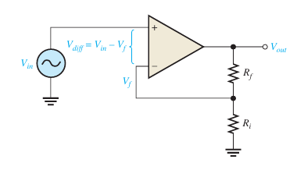

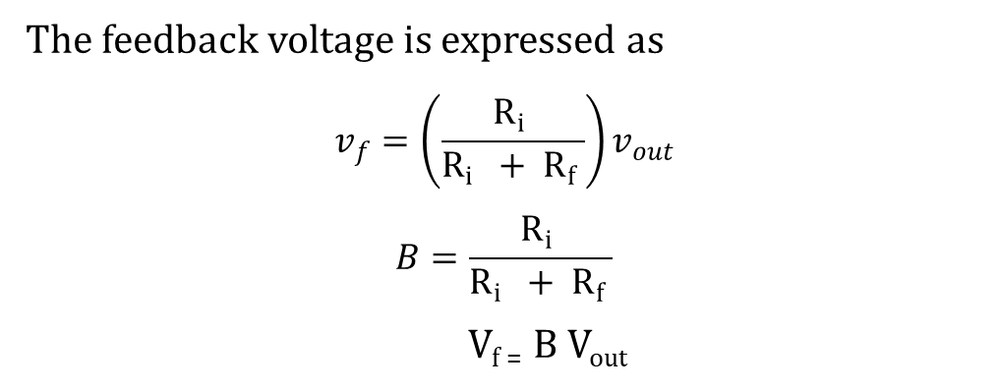

Noninverting amplifier
Buda Tech
Voltage divider
network
$$A_{CL\left(NI\right)}=\frac{R_{i} + R_{f}}{R_{i} }$$
The input signal is applied to the noninverting (+) input.
The output is applied back to the inverting (-) input through the
feedback circuit (closed loop) formed by the input resistor Ri
and the feedback resistor Rf.
The feedback voltage is expressed as
$$v_{f}=\left.\left(\frac{R_{i} }{R_{i} + R_{f} }\right.\right)v_{out}$$
$$B=\frac{R_{i} }{R_{i} + R_{f} }$$
V_{f =} B V_{out}
A_{ol} Open-loop gain
B Attenuation Factor
A_{cl} Closed-loop gain
A_{cl(NI)} Non-inverting closed-loop gain
$R_{i}$ input Resistor
$R_{f}$ Feedback Resistor

Slide 2

Noninverting amplifier
Buda Tech
V_{out} = A_{ol}(V_{in}- V_{f})
B attenuation factor/The reduction factor,
Refers to the factor by which the feedback reduces the output
B = $\frac{Ri }{Ri + Rf}$
V_{f =} B V_{out}
Substituting Vf into the equation
V_{out} = A_{ol}(V_{in}- BV_{out})
A_{ol} Open-loop gain
B Attenuation Factor
A_{cl} Closed-loop gain
A_{cl(NI)} Non-inverting closed-loop gain
$R_{i}$ input Resistor
$R_{f}$ Feedback Resistor

Slide 3

Noninverting amplifier
Buda Tech
V_{out} = A_{ol}(V_{in}- BV_{out})
V_{out} = A_{ol}V_{in}- A_{ol}BV_{out}
V_{out} + A_{ol}BV_{out} = A_{ol}V_{in}
V_{out} (1 + A_{ol}B) = A_{ol}V_{in}
V_{out} = $\frac{AolVin}{(1 + AolB) }$
$\frac{Vout }{Vin}$ = $\frac{Aol}{(1 + AolB) }$
A_{ol} Open-loop gain
B Attenuation Factor
A_{cl} Closed-loop gain
A_{cl(NI)} Non-inverting closed-loop gain
$R_{i}$ input Resistor
$R_{f}$ Feedback Resistor

Slide 4

Noninverting amplifier
Buda Tech
$\frac{Vout }{Vin}$ = $\frac{Aol}{(1 + AolB) }$
A_{ol}B > 1 Neglecting 1 from the equation
$\frac{Vout }{Vin}$ = $\frac{Aol}{ AolB }$
$\frac{Vout }{Vin}$ = $\frac{1}{ B }$
$A_{CL\left(NI\right)}$₌ $\frac{Vout }{Vin}$ = $\frac{1}{ B }$ = $\frac{Ri +Rf}{Ri } A_{CL\left(NI\right)}=\frac{R_{i} + R_{f}}{R_{i} }$
$A_{CL\left(NI\right)}$= 1$+\frac{ Rf}{Ri }$
A_{ol} Open-loop gain
B Attenuation Factor
A_{cl} Closed-loop gain
A_{cl(NI)} Non-inverting closed-loop gain
$R_{i}$ input Resistor
$R_{f}$ Feedback Resistor

Slide 5
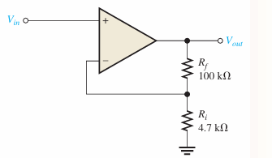

Example
Buda Tech
Determine A_{cl(NI)} Non inverting closed-loop gain
From
A_{cl(NI)}= 1$+\frac{ Rf}{Ri }$
Data
Rf 100k
Ri 4.7K
A_{cl(NI)}= 1$+\frac{ 100}{4.7 }$
A_{cl(NI)} = 22.3

