Slide 1
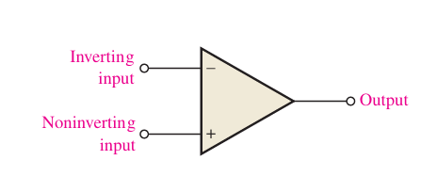
OPAMP
Buda Tech
The standard operational amplifier (op-amp) It has two input terminals, the inverting (-) input and the noninverting (+) input, and one output terminal.

Slide 2
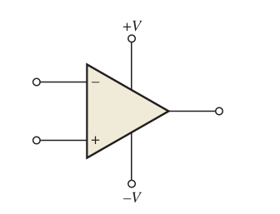
OPAMP
Buda Tech
The standard operational amplifier (op-amp) It has two input terminals, the inverting (-) input and the noninverting (+) input, and one output terminal.
After adding DC supply

Slide 3
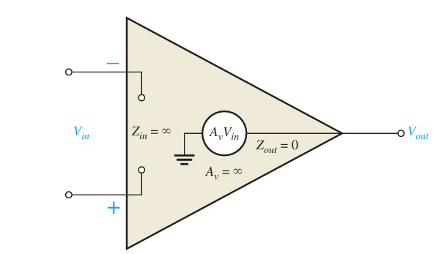
OPAMP
IDEAL OPAMP
Buda Tech
The practical op-amp characteristics (Integrated Circuit op-amp)
infinite voltage gain and infinite bandwidth.
Has an infinite input impedance (open), so it does not load the driving source.
Finally, it has a zero-output impedance
The input voltage, Vin, appears between the two input terminals,
Output voltage is AvVin
! the ideal device can never be made

Slide 4
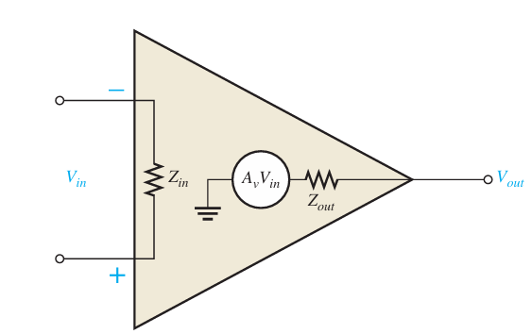
OPAMP
PRACTICAL OPAMP
Buda Tech
The practical op-amp characteristics (Integrated Circuit op-amp)
can be treated as ideal in many cases.
very high voltage gain.
very high input impedance.
very low output impedance.
Always noise generated within the op-amp
Noise is an undesired signal that affects the quality of a desired signal.

Slide 5
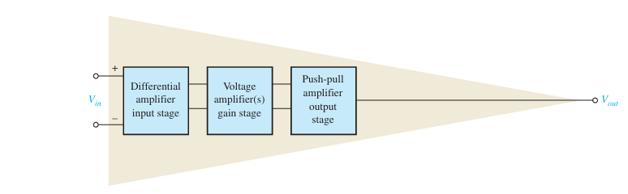
OPAMP
Internal Block Diagram of an Op-Amp
Buda Tech
1. The differential amplifier is the input stage for the op-amp. It provides amplification of the difference voltage between the two inputs.
2. The second stage is usually a class A amplifier that provides additional gain.
3. The third stage is the amplifier stage. A push-pull class B amplifier is typically used for the output stage.

Slide 6
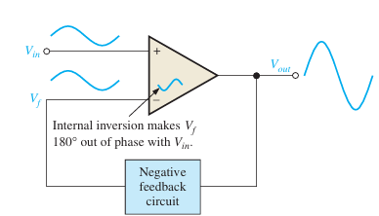
Negative feedback
Buda Tech
A portion of the output voltage of an amplifier is returned to the input with a phase angle that opposes (or subtracts from) the input signal.
The inverting (-) input effectively makes the feedback signal 180° out of phase with the input signal.

Slide 7
Why negative feedback for amplification
Buda Tech
Stabilizes the gain.
Linearizes the response.
Increases bandwidth and reduces distortion.
Makes the op-amp behave predictably.

Slide 8
Buda Tech
OPEN-LOOP GAIN VS CLOSED-LOOP GAIN
Aol | Acl
Too high for linear amplifier application | Set to desired value by the feedback
Input impedance relatively high | Input impedance can be controlled (increased or reduced) depending on circuit type
Output impedance relatively low | Output impedance can be controlled (increased or reduced) to desired value
Narrow bandwidth because the gain is so high | Wide bandwidth

Slide 9
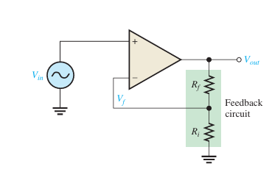
Noninverting amplifier
Buda Tech
The input signal is applied to the noninverting (+) input.
The output is applied back to the inverting (-) input through the feedback circuit (closed loop) formed by the input resistor Ri and the feedback resistor Rf.

Slide 10
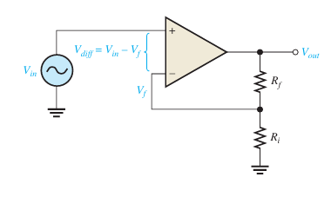

Noninverting amplifier
Buda Tech
V_{out} = A_{ol}(V_{in}- V_{f})
B attenuation factor/The reduction factor,
Refers to the factor by which the feedback reduces the output
B = $\frac{Ri }{Ri + Rf}$
V_{f =} B V_{out}
V_{out} = A_{ol}(V_{in}- BV_{out})
A_{ol} Open-loop gain
B Attenuation
A_{cl} Closed-loop gain

Slide 11

Noninverting amplifier
Buda Tech
V_{out} = A_{ol}(V_{in}- BV_{out})
V_{out} = A_{ol}V_{in}- A_{ol}BV_{out}
V_{out} + A_{ol}BV_{out} = A_{ol}V_{in}
V_{out} (1 + A_{ol}B) = A_{ol}V_{in}
V_{out} = $\frac{AolVin}{(1 + AolB) }$
$\frac{Vout }{Vin}$ = $\frac{Aol}{(1 + AolB) }$
A_{ol} Open-loop gain
B Attenuation
A_{cl} Closed-loop gain

Slide 12

Noninverting amplifier
Buda Tech
$\frac{Vout }{Vin}$ = $\frac{Aol}{(1 + AolB) }$
A_{ol}B > 1
$\frac{Vout }{Vin}$ = $\frac{Aol}{ AolB }$
$\frac{Vout }{Vin}$ = $\frac{1}{ B }$
A_{cl(NI) =} $\frac{Vout }{Vin}$ = $\frac{1}{ B }$ = $\frac{Ri +Rf}{Ri }$
A_{cl(NI)}= 1$+\frac{ Rf}{Ri }$
A_{ol} Open-loop gain
B Attenuation
A_{cl} Closed-loop gain
A_{cl(NI)} Non inverting closed-loop gain

Slide 13
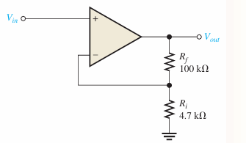

Example
Buda Tech
Determine A_{cl(NI)} Non inverting closed-loop gain
From
A_{cl(NI)}= 1$+\frac{ Rf}{Ri }$
Data
Rf 100k
Ri 4.7K
A_{cl(NI)}= 1$+\frac{ 100}{4.7 }$
A_{cl(NI)} = 22.3

Slide 14
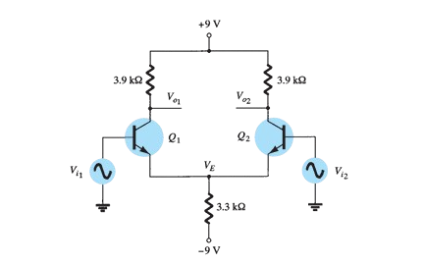
DC bias of differential amplifier circuit.
Buda Tech
biasing is the setting of DC (direct current) operating conditions (current and voltage)

Slide 15
DC bias of differential amplifier circuit.
Buda Tech
Data given
Q1 & Q2 are NPN
VCC = 9V
RC =3.9k
RE = 3.3k
VEE = -9

Slide 16
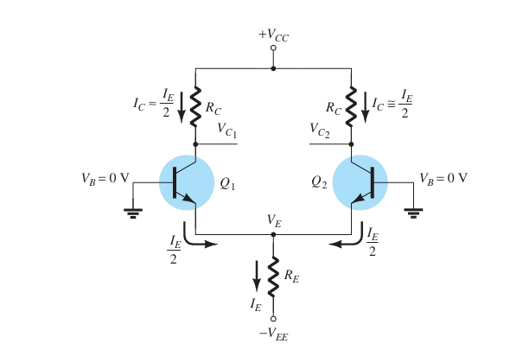
DC bias of differential amplifier circuit.
Buda Tech
$$v_{cc}=v_{c}+ I_{c}R_{c}$$

Slide 17
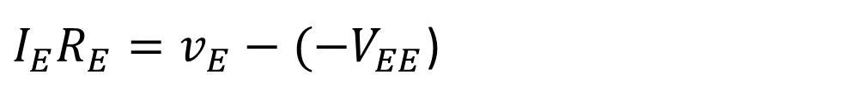
DC bias of differential amplifier circuit.
Buda Tech
$$v_{cc}=v_{c}+ I_{c}R_{c}$$
$I_{E}R_{E}=v_{E}−{(−V}_{EE}$)
$$v_{EE}=v_{BE}+I_{E}R_{E}$$

Slide 18


DC bias of differential amplifier circuit.
Buda Tech
Emitter current $I_{E }$
$$v_{EE}=v_{BE}+I_{E}R_{E}$$
$$9=0.7+I_{E }x 3.3k$$

Slide 19

DC bias of differential amplifier circuit.
Buda Tech
Emitter current $I_{E }$
$$v_{EE}=v_{BE}+I_{E}R_{E}$$
$$9=0.7+I_{E }x 3.3k$$
$$8.3=I_{E }3.3k$$

Slide 20

DC bias of differential amplifier circuit.
Buda Tech
Emitter current $I_{E }$
$$v_{EE}=v_{BE}+I_{E}R_{E}$$
$$9=0.7+I_{E }x 3.3k$$
$$8.3=I_{E }3.3k$$
$$8.3=I_{E }3.3k$$
$I_{E }= \frac{8.3}{3.3k}$ = 2.5mA

Slide 21


DC bias of differential amplifier circuit.
Buda Tech
Collector Current $I_{c }$
$I_{c }= \frac{I_{E }}{2}$ = $\frac{2.5mA}{2}$
${ I}_{c }=$ 1.25mA

Slide 22


DC bias of differential amplifier circuit.
Buda Tech
Collector Voltage $V_{c }$
$$v_{c}=v_{cc}− I_{c}R_{c}$$
$$v_{c}=9− I_{c}3.9k$$

Slide 23

DC bias of differential amplifier circuit.
Buda Tech
Collector Voltage $V_{c }$
$$v_{c}=v_{cc}− I_{c}R_{c}$$
$$v_{c}=9− I_{c}3.9k$$
$I_{c }= \frac{I_{E }}{2}$ = $\frac{2.5mA}{2}$
${ I}_{c }=$ 1.25mA

Slide 24

DC bias of differential amplifier circuit.
Buda Tech
Collector Voltage $V_{c }$
$$v_{c}=v_{cc}− I_{c}R_{c}$$
$$v_{c}=9− I_{c}3.9k$$
$I_{c }= \frac{I_{E }}{2}$ = $\frac{2.5mA}{2}$
${ I}_{c }=$ 1.25mA
$v_{c}=9−1.25 x 3.9k$
$v_{c}=\text{4.125}\text{V}$

