Slide 1
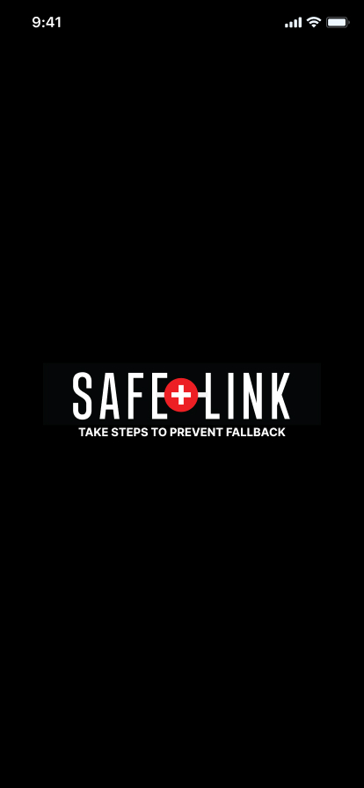
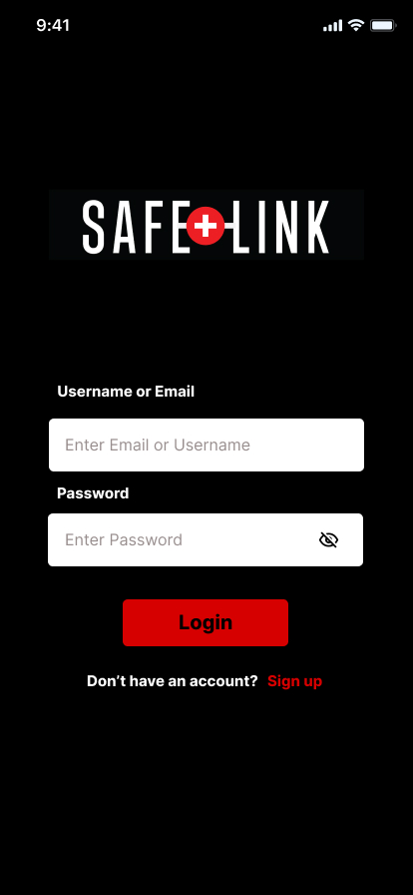
Safe Link
TAKE STEPS TO PREVENT FALLBACK

Slide 2
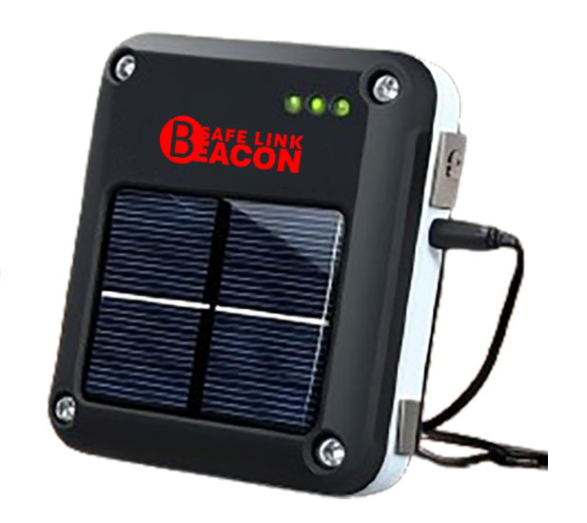
Introduction for
SAFE LINK Application
SAFE LINK is an emergency app designed for comprehensive support in critical situations. It enables users to contact vehicle emergency services, medical help, police, and fire departments easily. The app automatically detects accidents and notifies relevant parties. For areas without cellular coverage, it connects to a small satellite communication device, ensuring constant connectivity. This device provides reliable emergency communication through satellite technology.

Slide 3

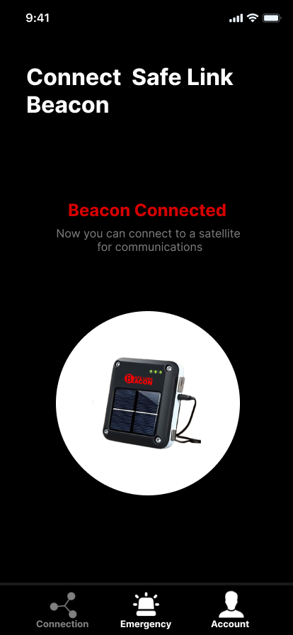
SAFE LINK Beacon is the device that connects your mobile phone to the satellite for reliable emergency communication.

Slide 4
Technology
Technology
These are the technologies we use to implement this SAFE LINK application and device,
Satellite Communication
Gyroscope
Accelerometer
Global Positioning System (GPS)
Solar Power
Bluetooth

Slide 5
Key Features
Technology
These are the Key Features in SAFE LINK application and device,
Crash Detection
Satellite Communication
Emergency Contacts
Medical Information
Call for help with medical emergencies (sickness or injury)
Report a crime in progress

Slide 6
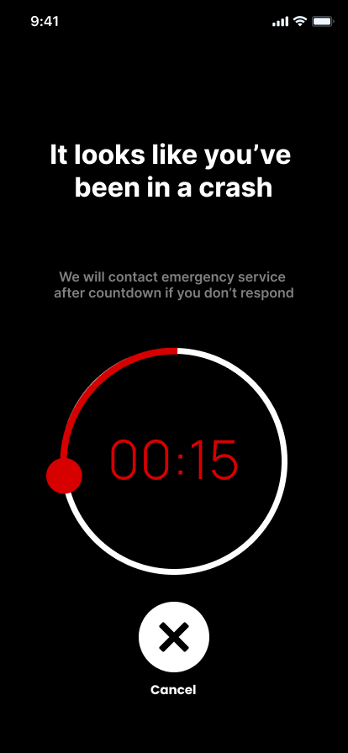
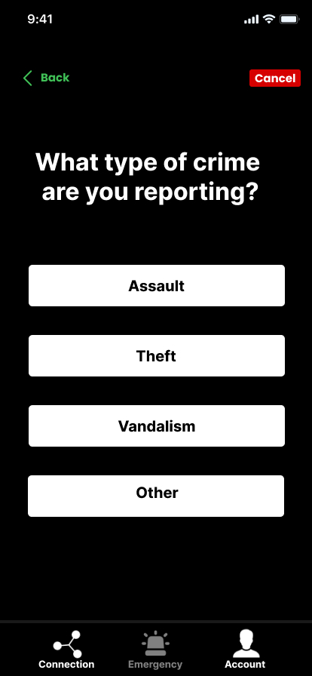
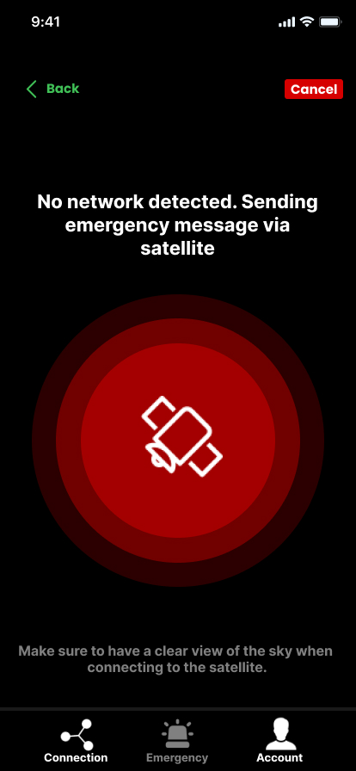
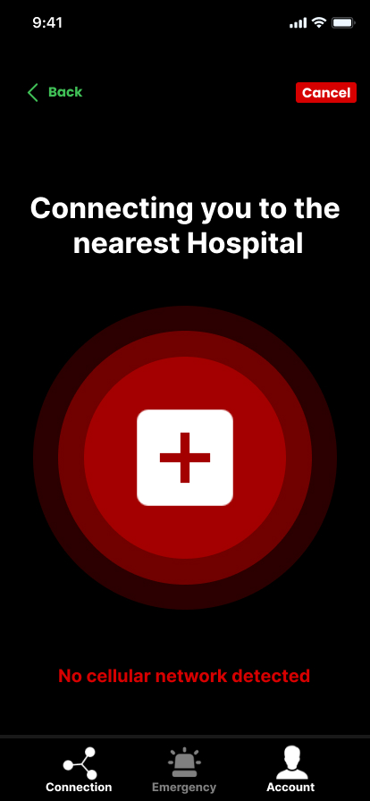
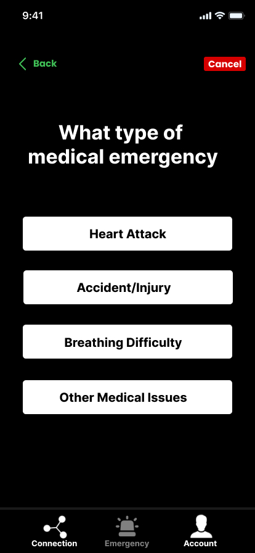
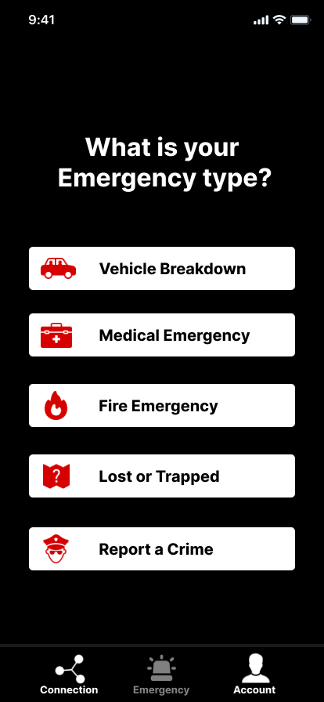
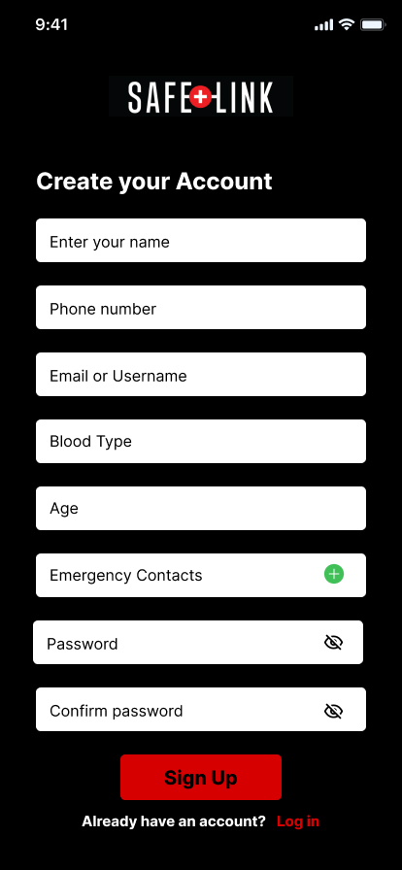
Crime Reporting
Crash Detection
Contact Hospital
Prototype of Mobile App
Contact via Satellite
Medical Emergencies
Home Page
Sign Up Page
Login Page

Slide 7
Prototype of Mobile App
Crash Detection
Crime Reporting
Contact via Satellite
Contact Hospital
Medical Emergencies
Home Page
Sign Up Page
Login Page

Slide 8
Business Plan

Slide 9
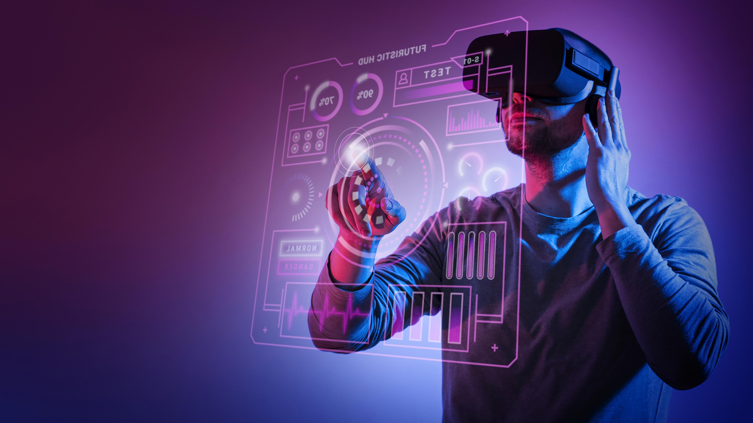
Business Overview
Technology
LINK Solutions provides an emergency communication app that connects users to vehicle emergency services, medical assistance, police, and fire departments. It features automatic accident detection and satellite communication through the SAFE LINK Beacon, ensuring connectivity even in remote areas.

Slide 10
Market Analysis and Target Market
Target Market
Vehicle Owners
  Individuals who own personal vehicles.
  Concerned about safety and emergency preparedness.
Outdoor Enthusiasts
  Adventurers and travelers who frequent remote areas.
  Require reliable communication for emergencies in areas without cellular coverage.
Families
  Households with children and elderly members.
  Ensure safety and quick access to emergency services.

Slide 11
Market Analysis and Target Market
Market Analysis
Expanding Emergency Communication Market
  Growing safety awareness among consumers.
  Increasing adoption of technology for emergency preparedness.
Technological Advancements
  Improved satellite communication technology.
  Development of innovative emergency response solutions.
Rising Demand
  Higher demand for reliable emergency communication devices.
  Increased investment in safety and security products.

Slide 12
Competition
Main Competitors
Apple Emergency SOS
OnStar
Life360
While other emergency apps exist, SAFE LINK Solutions stands out with its automatic accident detection and satellite communication. We offer a more comprehensive and reliable service compared to competitors.

Slide 13
Milestones and Metrics
Launch app and Beacon within six months
Obtain funding for scaling and expansion.
Achieve 10,000 downloads in the first year.

Slide 14
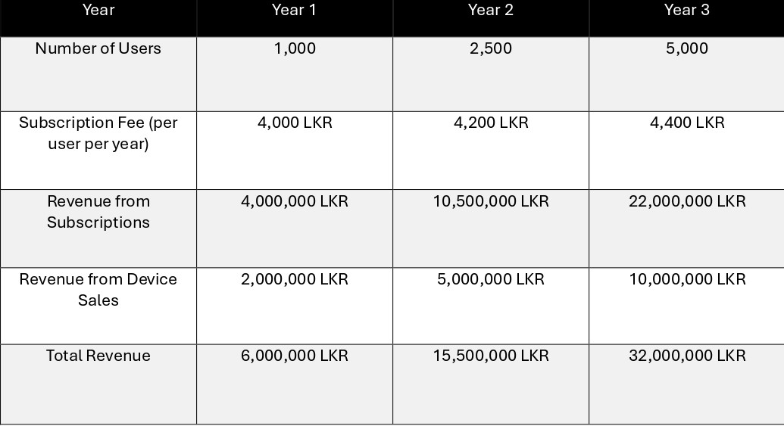
Projection
Revenue Projection

Slide 15
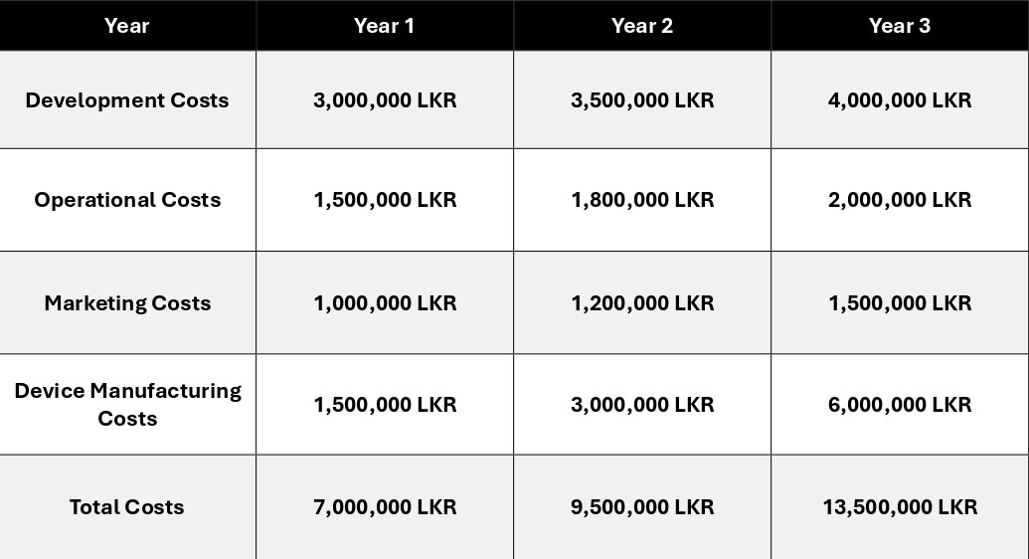
Projection
Cost Projection

Slide 16
Revenue Model
Device Sales
SAFE LINK Beacon
Users purchase this satellite communication device for a one-time fee. The Beacon is essential for maintaining communication in remote areas, providing peace of mind and safety assurance.

Slide 17
In App Purchases
Premium Features
  Users can buy additional features such as advanced tracking, enhanced accident detection, and personalized emergency response plans. These features can be accessed through a one-time fee or by upgrading their subscription.

Slide 18
SWOT Analysis

Slide 19
SWOT Analysis
Innovative Technology: Utilizes advanced satellite communication for reliable emergency connectivity in no-network areas.
Automatic Accident Detection: Features automatic detection of accidents and immediate notification to emergency services.
User-Friendly Interface: Companion app is intuitive and easy to navigate, enhancing user experience.
Initial Cost: The high initial cost of the device and app may be a barrier for some users.
Dependence on External Hardware: Requires an additional device for satellite communication, which may be inconvenient for some users.
Battery Life: Limited battery life could be a concern during extended periods of use without recharging.
S
W
T
O
Competitive Market: Emerging competitors offering similar emergency communication solutions.
Economic Factors: Economic downturns could affect consumer spending on non-essential devices.
Network Limitations: Reliance on satellite networks that may have their own coverage and reliability issues.
Growing Demand for Safety Devices: Increasing awareness of personal safety and the need for reliable emergency communication.
Technological Advancements: Leveraging ongoing advancements in satellite and mobile technology to improve product features.
Customization for Different Industries: Tailoring the SAFE LINK Beacon for specific industries such as adventure tourism, construction, and transportation.

Slide 20
Funding For Startup

Slide 21

Medical Emergencies
Home Page
Sign Up Page
Login Page
Funding Options in SAFE LINK
Bootstrapping
Using personal savings and revenue from early sales to finance the startup, allowing for full control and equity retention.
Angel Investors
Securing investment from high-net-worth individuals who provide capital in exchange for equity or convertible debt, often bringing valuable mentorship and connections.
Bank Loans and Lines Of Credit
Obtaining funds from financial institutions that need to be repaid with interest, providing capital for operational costs and expansion.

Slide 22
Medical Emergencies
Home Page
Sign Up Page
Login Page
Way to Spend Funds In SAFE LINK
Product Development
Invest in technology, software development, and device manufacturing.
Marketing and Sales
Allocate budget for promoting the app, acquiring users, and building brand awareness.
Research and Development
Enhance app features and integrate new technologies for continuous improvement.

Slide 23
Legal Steps

Slide 24
Legal Steps
Business Registration
Register SAFE LINK Solutions with the Department of Registrar of Companies in Sri Lanka.
Obtain necessary business licenses from local authorities.
Trademark and Brand Protection
Register the business name and logo with the National Intellectual Property Office of Sri Lanka.
Monitor for trademark infringements.

Slide 25
Legal Steps
Patent Application
File for patents with the National Intellectual Property Office of Sri Lanka to protect the unique technology of the SAFE LINK Beacon.
Licensing and Permits
Obtain necessary licenses from the Telecommunications Regulatory Commission of Sri Lanka for telecommunications and satellite communication.
Ensure compliance with all relevant regulations and standards for operating in Sri Lanka.

Slide 26
Establish Location

Slide 27
Medical Emergencies
Home Page
Sign Up Page
Login Page
Establish a Location in SAFE LINK
We choose a physical location to optimize operations, support growth, and create a productive work environment.
Office Space
Location: Select a tech-friendly city with convenient access for the team.
Office Setup: Rent space equipped with high-speed internet, workstations, meeting rooms, and a secure server room.
Facilities: Provide amenities such as a break room, ergonomic furniture, and collaboration areas.

Slide 28
Medical Emergencies
Home Page
Sign Up Page
Login Page
Establish a Location in SAFE LINK
Manufacturing Facility
Production Needs: Establish a facility for assembling and testing SAFE LINK Beacon devices, considering either in-house or contract manufacturing.
Scalability: Choose a location that allows for future expansion and is near suppliers and logistics partners.

Slide 29
Marketing Plan

Slide 30
Medical Emergencies
Home Page
Sign Up Page
Login Page
Marketing Plan in SAFE LINK
Digital Marketing
Social Media Marketing:
Focus on Facebook, Instagram, LinkedIn, and Twitter to reach diverse customer segments.
Share engaging content, including safety tips, user testimonials, product demonstrations, and behind-the-scenes looks at development.
Content Marketing:
Regularly publish informative and educational blog posts on safety, emergency preparedness, and how SAFE LINK enhances personal security.
Create tutorial videos, product demos, and user testimonials to share on YouTube and social media platforms.

Slide 31
Medical Emergencies
Home Page
Sign Up Page
Login Page
Marketing Plan in SAFE LINK
Traditional Marketing
Print Media
Magazines and Newspapers: Advertise in popular publications focused on automotive, travel, and outdoor adventure.
Brochures and Flyers: Distribute at automotive shops, outdoor gear stores, and travel agencies
Events and Trade Shows
Community Events: Participate in local events and safety fairs to demonstrate the product and engage with the community.
Partnerships and Collaborations
Insurance Companies: Partner with insurance companies to offer SAFE LINK as part of their safety and emergency response packages.
Automotive Manufacturers: Collaborate with car manufacturers to integrate SAFE LINK as an optional safety feature in their vehicles.

Slide 32
Customer Base

Slide 33
Customer Base
Individuals and Families
Adults and caregivers who need a reliable way to ensure safety and quick access to emergency services for themselves and their families..
Vehicle Owners
Car owners seeking enhanced safety features, automatic accident detection, and immediate assistance for breakdowns or accidents.
Outdoor Seekers
Hikers and adventurers requiring dependable communication and emergency access while exploring remote or off-grid locations
Travelers
Frequent travelers and tourists needing a secure communication solution and emergency support in unfamiliar or low-coverage areas.

Slide 34
Safe Link
Thank You
TAKE STEPS TO PREVENT FALLBACK
Presented By :
COHNDIS241F-023
COHNDIS241F-025
COHNDIS241F-026
COHNDIS241F-027

