Slide 1
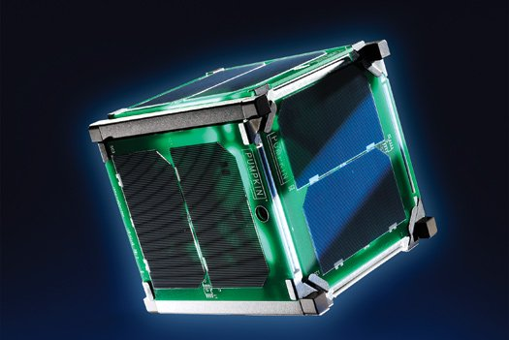
Olympus 2.0
Overview of the CubeSAT mission to Venus. Main objective: Study the atmosphere of Venus.

Slide 2
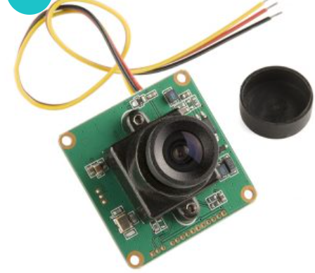
Mission Objectives:
Measuring Venus's Atmospheric Parameters
1. Atmospheric Parameters to Measure
Temperature :Map thermal gradients at various altitudes to understand atmospheric layers and heat distribution.
Pressure :Profile pressure changes across altitude to study atmospheric density and structure.
Chemical Composition : Analyze key gases (CO₂, SO₂, trace gases) to determine atmospheric composition.
Cloud Dynamics : Track cloud layers and wind patterns to study Venus’s super-rotational atmosphere.
UV and Light Absorption : Assess photochemical reactions and detect UV-absorbing species in the clouds.
Radiation Level : Measure solar and cosmic radiation to understand the radiation environment and its impact on atmospheric behavior.
2. Communication and Data Transmission
High-Gain Antennas :Ensures reliable long-distance communication with Earth despite Venus’s distance and signal attenuation.
Data Compression & Storage :Efficiently manage large data volumes, storing data onboard for batch transmission
during optimal alignments.
Error Correction :Enhances data accuracy by mitigating the effects of radiation on data integrity.

Slide 3
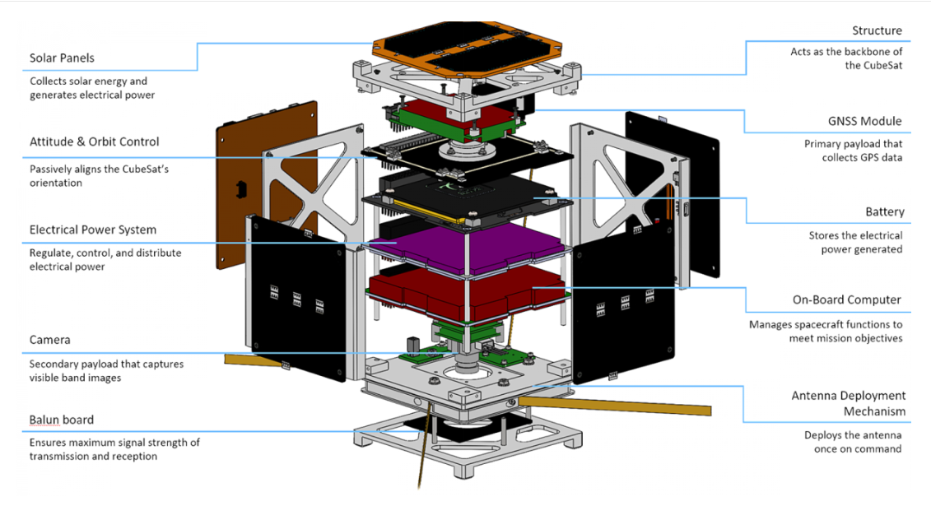
CubeSAT Overview
3D model of the CubeSAT (basic design sketch).
Subsystems:
Communication,
Sensor,
Power,
Mechanical.

Slide 4
Power Subsystem Design
Subsystem | Component | Standard Option | Enhanced Option for Venus Orbit | Weight (Standard) (grams) | Weight (Enhanced) (grams) | Cost (Standard) (INR) | Cost (Enhanced) (INR)
Electrical | Batteries | 18650 Li-ion cells | High-temperature Lithium-Polymer batteries | 100 | 150 | ₹2,500 | ₹10,000
 | Solar Panels | Standard COTS solar panels | High-efficiency GaAs or InP cells with rad-hard tech | 50 | 50 | ₹6,000 | ₹15,000
 | Power Management System (PMS) | Off-the-shelf power distribution board | Custom PDB with radiation-hardening | 30 | 30 | ₹3,000 | ₹8,000
 | Microcontroller | Arduino Nano/Raspberry Pi Zero | Radiation-hardened microcontroller | 20 | 20 | ₹2,500 | ₹6,000
Primary Power Source : High-Temperature Solar Panels:
operate efficiently in the extreme conditions of Venus
can withstand temperatures exceeding 400°C
maintains their efficiency
Purpose: Continuous energy generation
Solar Panel Optimization: Maximize sunlight exposure through adjustable solar panels.

Slide 5
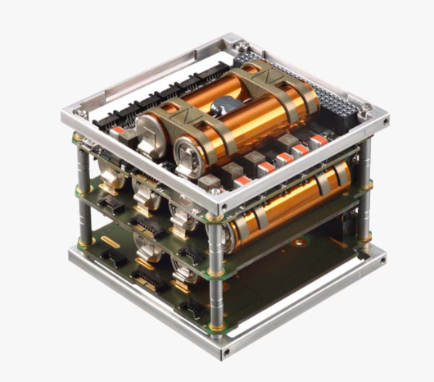
Backup Power Source : Lithium Polymer (LiPo) Batteries:
Provides energy during eclipse periods when the solar panels are not receiving direct sunlight.
Lightweight
High energy density
Can discharge at high rates
Suitable for space applications.
Purpose: Ensures uninterrupted operation of critical subsystems during periods of limited solar exposure, enhancing the reliability of the CubeSAT's overall functionality.
Estimated Power Requirements:
Sensors: Atmospheric sensors, radiation detectors, and temperature probes.
Communication: Transmitters and receivers for data relay to Earth.
Data Processing: Onboard processors for analyzing data and executing commands.
Thermal Management: Systems to regulate temperature within the CubeSAT to protect sensitive components.
Distribution Strategy(hierarchical approach):
Critical Subsystems: Sensors and communication systems receive power immediately upon demand.
Secondary Subsystems: Data processing units and thermal management systems receive power next.
Non-Essential Systems: Any remaining power can be allocated to non-essential functions or scientific experiments.

Slide 6
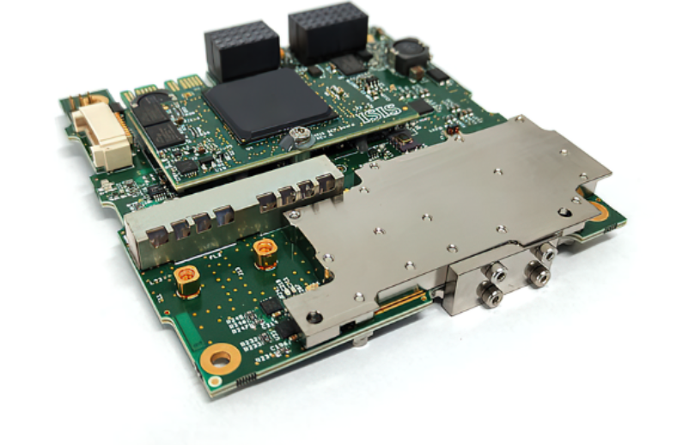
Power Management System (PMS):
essential for maintaining a stable and efficient power supply. Key functions of the PMS include:
Monitoring: Constantly tracks power levels from solar panels and batteries, ensuring all systems stay within
required voltage and current ranges.
Optimization: Dynamically adjusts power distribution based on subsystem demands, solar output, and battery charge levels.
Protection: Safeguards against overvoltage, undervoltage, and overcurrent, protecting electronic components.
Data Logging: Records power usage for analysis and planning.
Operational Functions:
Power Flow Control: Uses algorithms to efficiently allocate power in real-time.
Battery Management: Regulates battery charge cycles to extend lifespan and prevent damage.
Thermal Management Integration: Works with thermal systems to maintain optimal temperatures for electronics.
Communication: Provides ground stations with power status updates and receives commands for power adjustments.

Slide 7
Sensor Subsystem Design
Subsystem | Component | Standard Option | Enhanced Option for Venus Orbit | Weight (Standard) (grams) | Weight (Enhanced) (grams) | Cost (Standard) (INR) | Cost (Enhanced) (INR)
Sensors | Atmospheric Composition Analyzer | None | Compact mass spectrometer for gas analysis | - | 100 | - | ₹40,000
 | Pressure and Temperature Sensors | BMP280, DHT22 | High-temperature-resistant pressure/thermal sensors | 50 | 50 | ₹5,000 | ₹10,000
 | UV-Vis Spectrometer (optional) | None | Compact UV-Vis spectrometer for atmosphere study | - | 50 | - | ₹30,000
 | Cloud Dynamics Sensor | None | LIDAR or Doppler radar for cloud movement tracking | - | 60 | - | ₹25,000
 | Radiation Detector | Basic radiation sensor | Geiger-Müller counter for radiation mapping | 20 | 30 | ₹3,000 | ₹8,000
 | Camera Module | Basic CMOS camera | High-resolution CMOS with thermal shielding | 20 | 30 | ₹6,000 | ₹15,000

Slide 8
Mechanical Subsystem Design
Subsystem | Component | Standard Option | Enhanced Option for Venus Orbit | Weight (Standard) (grams) | Weight (Enhanced) (grams) | Cost (Standard) (INR) | Cost (Enhanced) (INR)
Mechanical | Structural Frame | Aluminum alloy (Al 6061-T6) | Carbon fiber or titanium with corrosion resistance | 150 | 200 | ₹8,000 | ₹20,000
 | Fasteners and Mounts | Aluminum screws and brackets | Acid-resistant, high-temperature alloy | 50 | 50 | ₹1,500 | ₹5,000
 | Thermal Control (MLI) | Basic Mylar sheets | Multi-layer insulation with radiative coatings | 20 | 30 | ₹2,000 | ₹10,000
 | Antenna Deployment Mechanism | Spring-loaded deployment | Burn-wire deployment for reliability | 10 | 10 | ₹3,000 | ₹6,000
The mechanical subsystem design must address weight constraints, structural strength, and optimal placement of components to achieve balance. Here’s a detailed schema:
Component | Placement | Function
Battery Pack | Center, lower layer | Provides balance and stable power source
Power Management System (PMS) | Adjacent to battery, center-left | Controls power flow
Communication Module | Center-right | Supports symmetrical mass distribution
Data Storage Unit | Near PMS, center-right | Stores collected data
External Sensors (Spectrometers, Temperature) | Outer faces | Collects data while maintaining balance
Passive Radiators | External faces, evenly spaced | Dissipates excess heat
Heat Sinks | Near high-heat components | Regulates internal temperatures

Slide 9
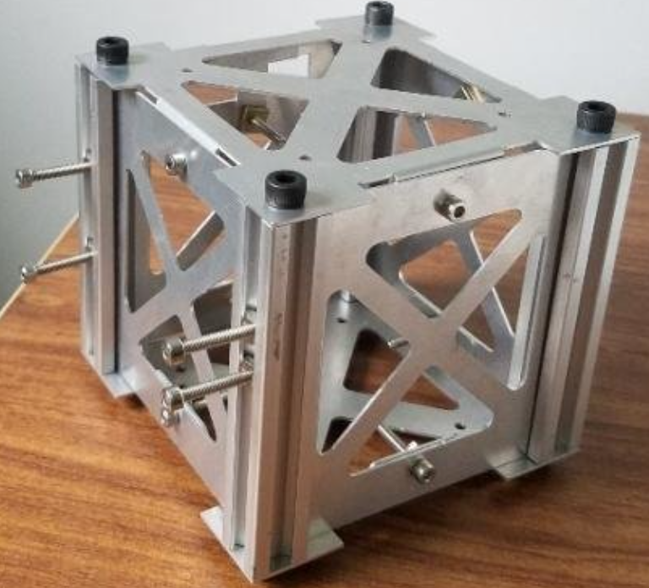
Structural Layout and Material Selection:
Primary Material: Lightweight Aluminum 6061-T6 alloy is used for its high strength-to-weight ratio and corrosion resistance.
Reinforcements: Carbon fiber is added around high-stress points to enhance durability without significantly increasing weight.
.
.
Mass Distribution:
Centralized Power and Battery Pack: for balance and reduced torque during rotation.
Subsystem Modules: Major subsystems (PMS, communication, data storage) are symmetrically distributed around the
battery to minimize wire length and save weight.
3.Sensor Placement: External sensors are balanced on opposite faces, while internal sensors are closer to the center for stability.
Balancing Mechanisms:
Center of Mass Optimization: The center of mass aligns with the geometric center, with counterweights used if necessary.
Moment of Inertia Control: Heavier components are centrally located to minimize the moment of inertia and stabilize rotation
Thermal Control Mechanisms:
Heat Sinks and Passive Radiators: Heat sinks are attached to high-power components, and passive radiators help dissipate heat into space.
Multi-Layer Insulation (MLI): Reflective materials insulate heat-sensitive components from solar radiation
Key Design Considerations:
Symmetry: Minimizes torque-induced rotations.
Thermal Protection: Ensures longevity in extreme temperatures.
Modularity: Allows for easy adjustments to mass distribution for additional payloads.

Slide 10
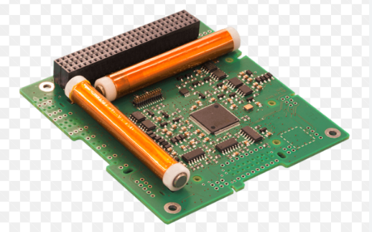
The Attitude Control Subsystem (ACS)
Reaction Wheels:Provide torque for fine control of orientation without using propellant.
Magnetorquers:Interact with Earth’s magnetic field to adjust the CubeSAT’s attitude efficiently.
Inertial Measurement Unit (IMU):Supplies real-time data on orientation and angular velocity for feedback in control algorithms.
Sun Sensors:Detect the Sun’s position to help maintain solar panel alignment.
Star Trackers (Optional):Offer precise attitude determination using star positions.
Estimated Power Requirements & Distribution
Power Requirements:Estimated power consumption ranges from 0.5 to 10 watts depending on component activity.
Power Distribution:The Power Management System (PMS) prioritizes power for the ACS during critical maneuvers, dynamically adjusting allocations as needed.
Control Algorithms:Implement control algorithms (e.g., PID controllers) to manage orientation based on feedback from the IMU and sensors, ensuring efficient adjustments.
Integration with Other Subsystems:The ACS collaborates with the Sensor Subsystem to maintain optimal sensor orientation and works with the PMS to ensure adequate power supply. It also interfaces with thermal management systems to protect components from extreme temperatures.

Slide 11
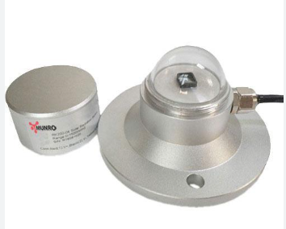
Data Handling and Storage
1. Onboard Data Processing: minimizing the amount of unnecessary data stored or transmitted.
Components: A small, radiation-hardened processor or microcontroller (e.g., ARM Cortex-M or FPGA) is used for rapid data analysis.
Functionality: manages sensor data, compresses it, and prepares it for storage and eventual transmission, helping conserve both storage and power resources.
2. Memory Capacity for Data Storage
Memory Type: Non-volatile memory (like flash or radiation-hardened SSDs) is preferred to avoid data loss in harsh conditions.
Capacity: Typically around 8-16 GB, depending on mission requirements, to store high-resolution data until it can be transmitted to Earth.
Data Prioritization: Essential data (like critical atmospheric readings) is flagged for transmission priority, while less critical data may be overwritten to conserve space.
3. Data Compression Techniques
Purpose: Data compression minimizes transmission size, making it feasible to send larger amounts of information despite limited bandwidth.
Techniques: Lossless compression algorithms (such as Huffman coding or Lempel-Ziv-Welch) are used to retain data integrity while reducing file sizes.
Transmission Optimization: Compressing the data significantly reduces the transmission time and power needed, essential for long-distance communications to Earth.

Slide 12
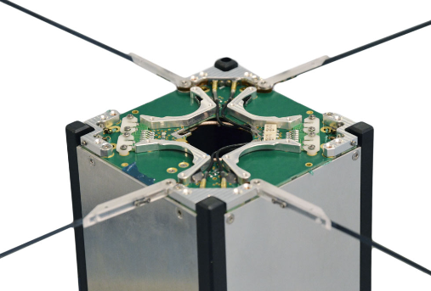
Communication subsystem design
Subsystem | Component | Standard Option | Enhanced Option for Venus Orbit | Weight (Standard) (grams) | Weight (Enhanced) (grams) | Cost (Standard) (INR) | Cost (Enhanced) (INR)
Communication | Transceiver | Basic UHF/VHF transceiver | SDR transceiver with radiation-hardened components | 50 | 100 | ₹15,000 | ₹30,000
 | Antenna | Standard dipole antenna | High-gain antenna with radiation shielding | 10 | 20 | ₹2,000 | ₹8,000
 | Processor for Communication | Basic microcontroller | Radiation-hardened processor with error correction | 20 | 20 | ₹2,500 | ₹5,000
Communication Module Selection:
Primary Module: S-band (2-4 GHz) Transceiver is chosen for its balance of high data rate and reliability, efficiently transmitting scientific data from Venus to Earth with lower interference.
Backup Module: UHF/VHF Radio (UHF: 300-1000 MHz, VHF: 30-300 MHz) serves as a reliable backup for emergency communication, offering lower data rates but higher resistance to interference and lower power requirements.

Slide 13
Data Transmission Rate and Range:
Data Rate: The S-band transceiver manages continuous data transfer, optimizing for Venus’s variable distance from Earth (38 to 261 million km) while considering the CubeSAT's limited power and storage capacity.
Range: The S-band is suitable for planetary distances, allowing stable connections with Earth’s ground stations, even with slight orbital changes.
Antenna Placement and Deployment Mechanism:
Antenna Placement: A compact, foldable, low-profile high-gain antenna is stowed within the CubeSAT frame for protection during launch.
Deployment Mechanism:
Storage and Restraint: The antenna is secured with a burn wire or mechanical latch while stowed.
Activation: The CubeSAT sends a command to release the antenna, heating the burn wire or triggering an electro-mechanical release.
Spring-Loaded Action: Springs or small actuators assist in quickly unfolding the antenna.
Final Locking Position: The antenna locks into place, ensuring optimal transmission and signal stability with Earth-based receivers.
Feasibility Analysis:
Cost estimation:
Build Type | Total Weight (grams) | Total Cost (INR)
Standard Build | ~750-800 | ₹60,000 - ₹90,000
Enhanced Venus Build | ~900-950 | ₹1,50,000 - ₹2,50,000

Slide 14
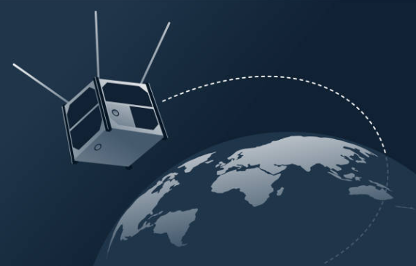
Challenges & Potential Failures
Key Differences (compared with earth orbit)
Proximity to Sun: Venus orbits at 0.72 AU, resulting in high solar radiation and heat.
Orbital Dynamics
Higher orbital speed due to 90% Earth gravity.
Shorter orbit period with stronger solar tides, requiring frequent orbit adjustments.
Atmospheric Conditions
Dense, CO₂-rich, acidic atmosphere causes drag and high temperatures (~100-200°C).
Sulfuric acid clouds can corrode satellite materials.
Challenges in Venus Orbit
Thermal Management: Risk of overheating from solar radiation and atmospheric heat.
Atmospheric Drag: Causes orbital decay in low altitudes, requiring frequent adjustments.
Corrosion: Sulfuric acid clouds threaten component durability.
Power Generation: Solar panels degrade faster due to intense sunlight.
Communication with Earth: Long distances require strong transmitters and high-gain antennas.
Radiation Protection: Increased solar radiation can damage electronics.

Slide 15
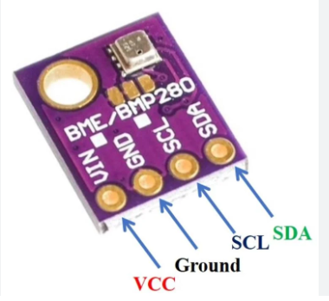
Solutions & Strategies for Venusian Orbit
Thermal Management: Use multi-layer insulation (MLI), radiators, and phase-change materials.
Higher Orbit & Station-Keeping: Use low-thrust propulsion to stay above 250-300 km and combat drag.
Corrosion-Resistant Coatings: Use acid-resistant materials like Teflon or ceramics.
High-Efficiency Power Systems: Employ radiation-hardened, high-efficiency GaAs solar cells.
Advanced Communication: High-gain antennas, error correction, and store-and-forward data strategies.
Radiation-Hardened Electronics: Use shielded, redundant electronics with error-correcting algorithms.
Unique Features or Design Innovations
Modular Architecture
Integrated Power Management
Advanced Sensor Array
Automated Communication Protocol
Future Improvements or Modular Design Considerations
Expandable Payload Options
Enhanced Thermal Control
AI for Data Analysis

