Slide 1
A Technical Seminar on Beacon technology
Seminar Report Submitted To J.N.T.U Hyderabad
in partial fulfilment of the requirement for the award of degree
“Bachelor Of Technology”
In
Computer Science And Engineering
By
MALLADI POOJITHA 186Y1A0562

Slide 2
CONTENT:
INTRODUCTION
WORKING
WHY BEACON TECHNOLOGY?
ADVANTAGES
DISADVANTAGES
APPLICATIONS
CONCLUSION
FUTURE SCOPE

Slide 3
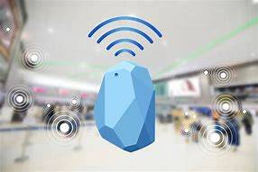
INTRODUCTION
Beacons are small, wireless transmitters that use low-energy Bluetooth technology to send signals to the smart devices nearby.
They are one of the latest developments in location technology and proximity marketing.
They connect and transmit information to smart devices making location-based searching and interaction easier and more accurate.

Slide 4
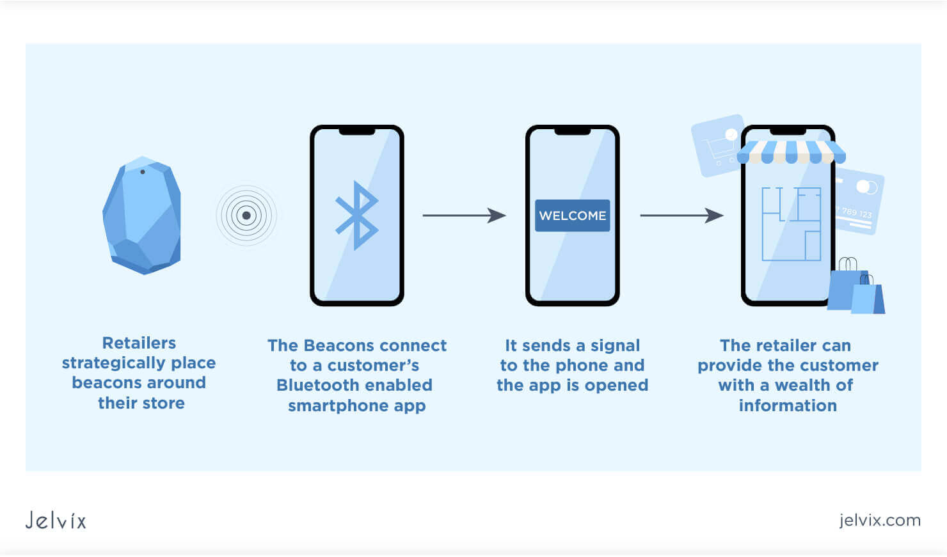
CONTINUATION:
Each device contains a CPU, radio, and batteries, and it works by repeatedly broadcasting out an identifier.
The identifier is a unique id number that your smartphone recognizes as unique to the beacon.
Once connected, the beacon will carry out whatever function it has been programmed to perform.

Slide 5
Working:
Beacons are the small, low cost, battery-operated wireless devices which continuously convey the simple Bluetooth signals. The signals which are emitted by the Beacons can be picked and receive by the apps installed on the smartphones. On the basis of the location, proximity and time, Beacons can perform an endless array of tasks.

Slide 6
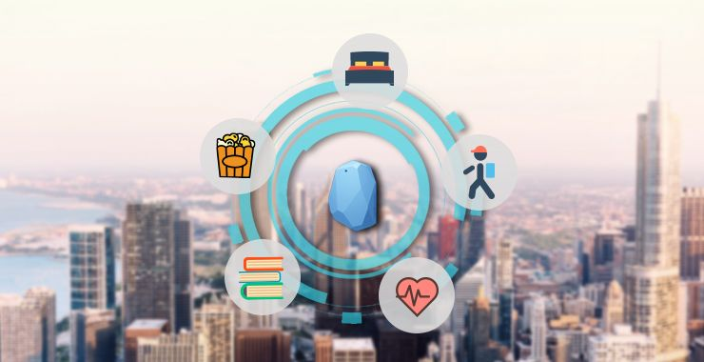
Why beacon technology ?
The technology itself has lots of applications and potential.
By using this location-based technology, you can personalize your out-of-store marketing, helping you monetize any potential foot traffic.
With mobiles now an integral part of everyday life, proximity marketing will only continue to grow.

Slide 7
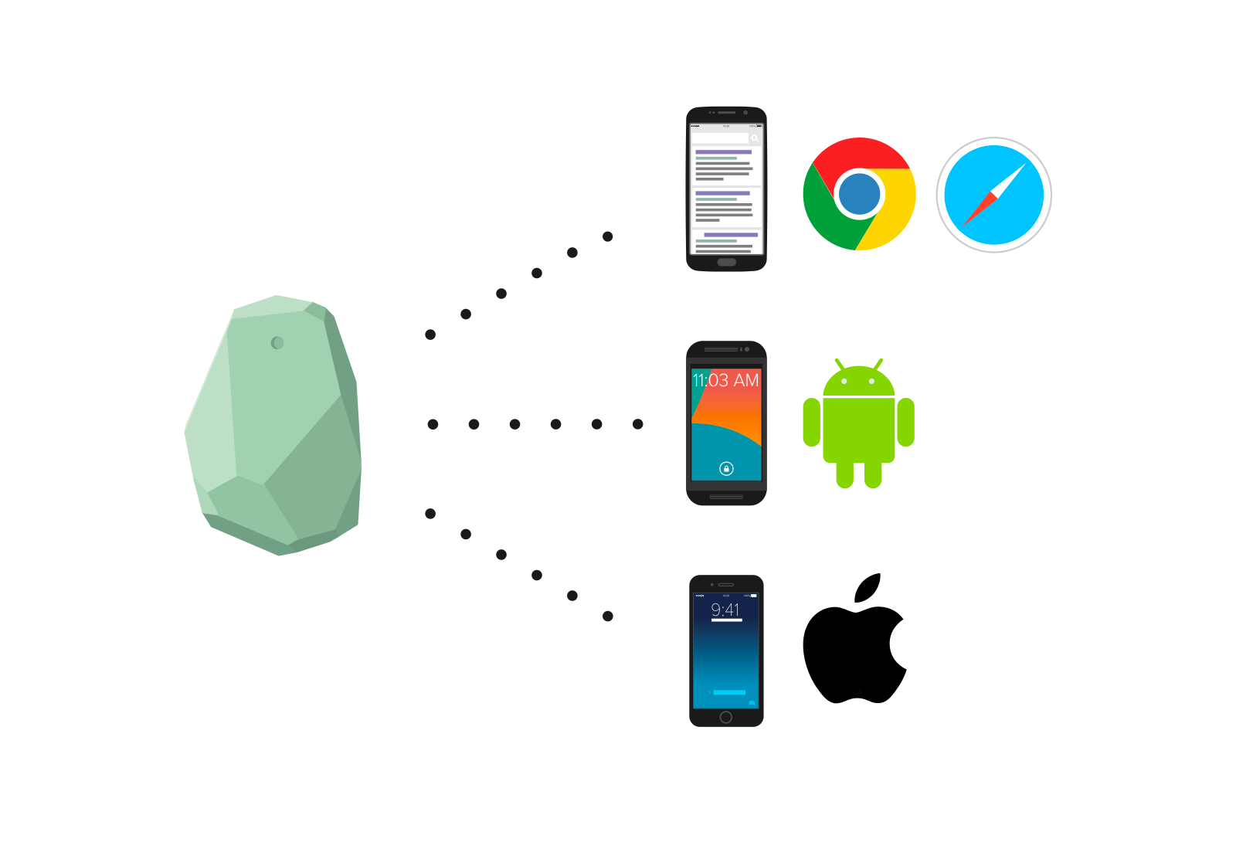
TECHNOLOGy
We can develop the beacon application for andriod platform using an andriod API, which offers a Bluetooth adapter and BLE scanner.
The beacon application for IOS can be developed with HTML/JavaScript.
For ibeacon functionality , we must use the cordova-ibeacon plugin. To deploy the application, we can develop a native application.

Slide 8
ADVANTAGES:
It is affordable and relatively easy to install and setup, which makes it low risk and high possible return on investment.
Establishing a Fulfilling Customer Experience.
Driving Customer loyalty
Security and Asset Tracking
Increased Productivity
Interactive In-store Experiences

Slide 9
Disadvantages:
Beacons do not work on their own
Tracking movement is not simple
It don’t offer a lot of analyzable data
Beacon marketing is limited to Bluetooth signal
Beacons rely on installed brand apps in order for the beacon technology to communicate with the customer’s device.

Slide 10
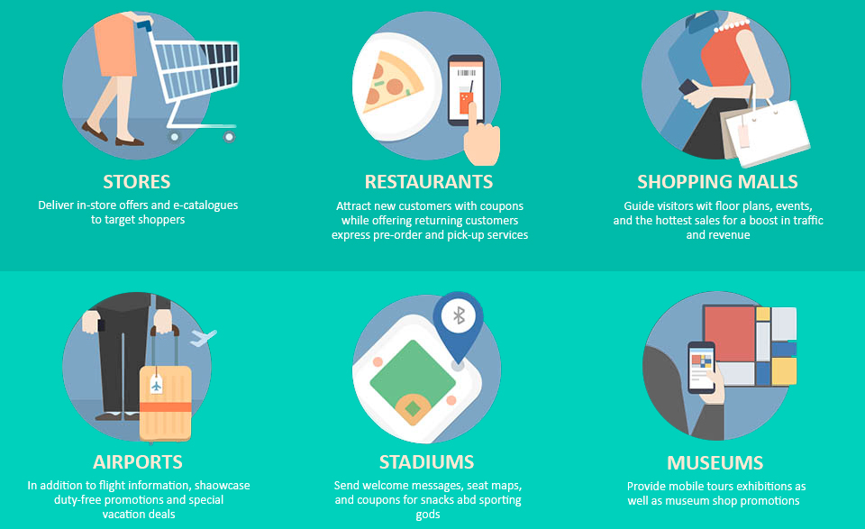
APPLICATIONS
In the retail sector – to communicate with the customer in real-time and provide timely suggestions.
In daily life – to send helpful reminders to people, in smart homes, etc.
Travel/transport – to send people useful notifications regarding the schedule of train/plane/bus, information about the change in time, current running status, etc. ...
Concert venues – to send concert details, updates and news to the people who have already arrived.

Slide 11
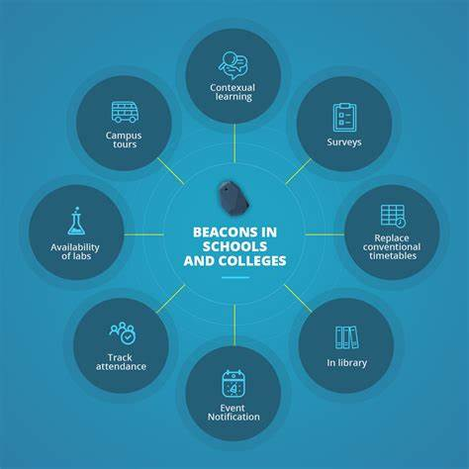
Sports – to share updates with the fans in the stadium, regarding seat upgrades, game schedule, upcoming games, etc.
Business – to record the attendance and to communicate with the employees and management In the offices.

Slide 12
conclusion
More to the point, our experience with beacons makes it clear that they allow for much safer transactions and business operations than not.
Beacon technology is a powerful tool to engage the audience and deliver them relevant information on short notice.
Thus, if anyone is looking for a solution to increase engagement with their office audience or make their event management app even more convenient, this solution is right for them.

Slide 13
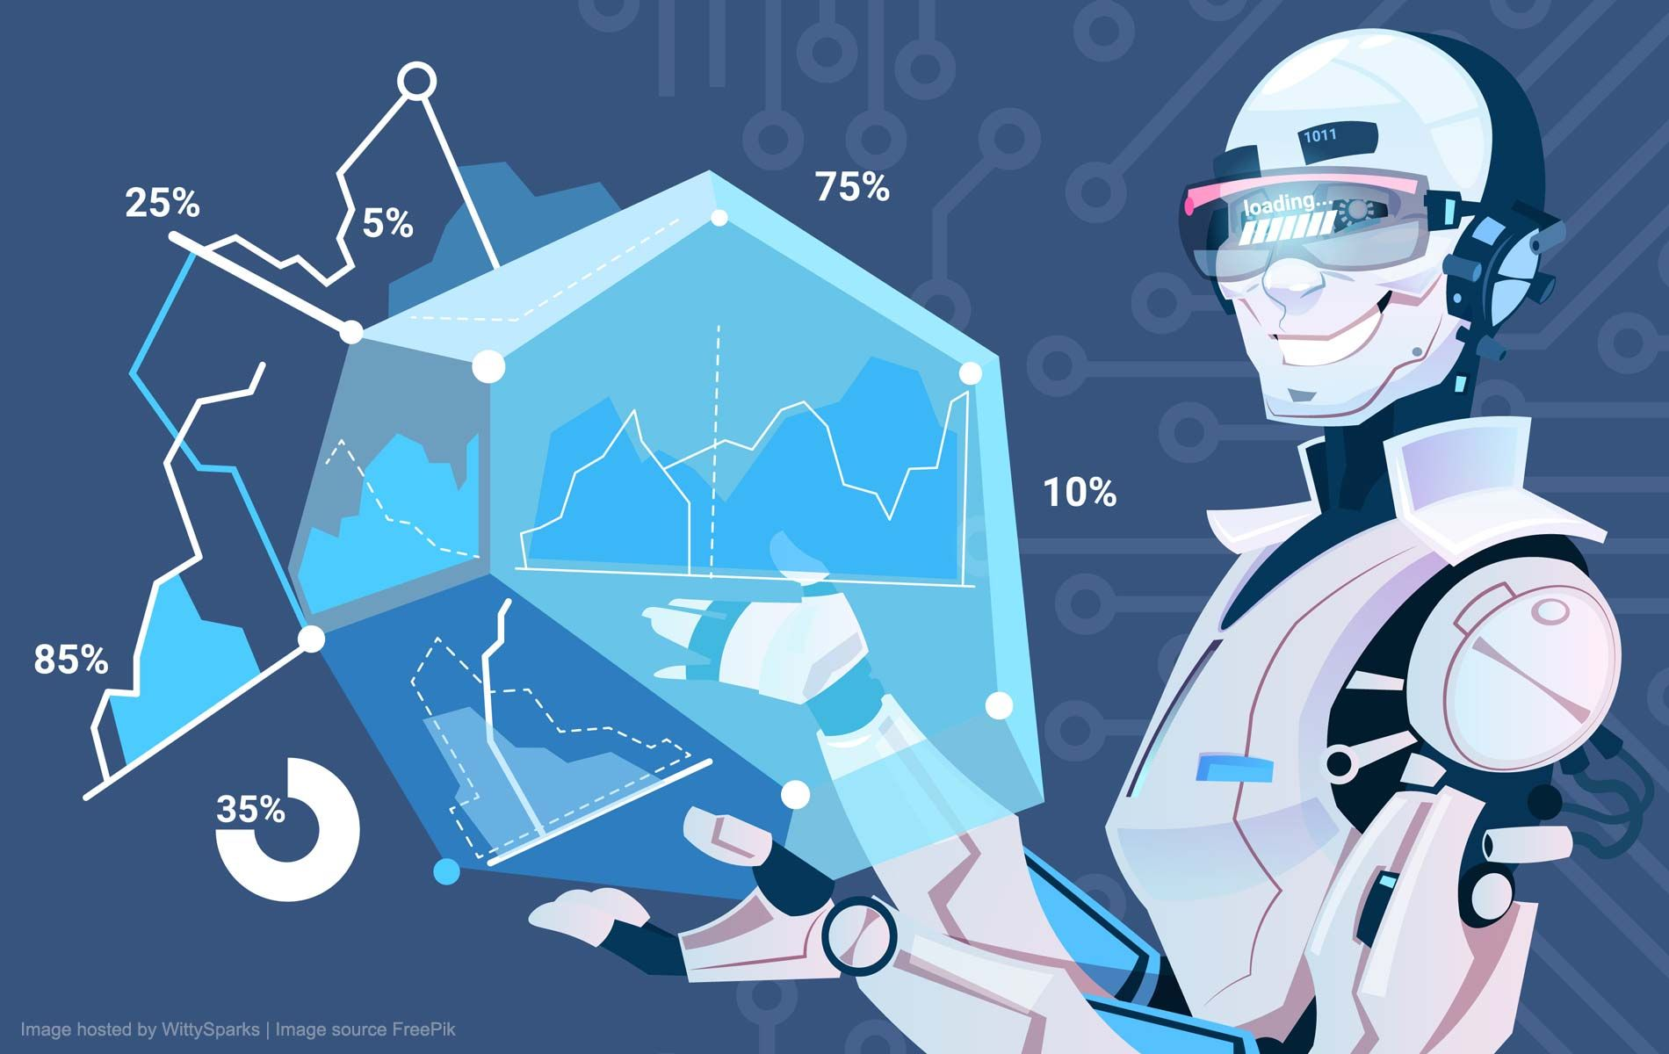
FUTURE SCOPE
According to Global Market Insights, the beacon technology market is projected to surpass $25 billion in 2025.
On airports and Railways- To notify the user about the departure, delays, gate, platforms.
Schools and colleges- It can be used in schools and colleges at the time of counselling.
Shopping malls- To notify the user about the deals and discounts.

Slide 14
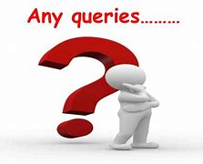

Slide 15
Thank you

