Slide 1
M.SIVA RAM KRISHNA
Final Project
3/21/2024 Annual Review

Slide 2
KEYLOGGER AND SECURITY
3/21/2024 Annual Review

Slide 3



AGENDA
What is Keylogger?
A key logger is a program that runs in the background or hardware, recording all the
keystrokes once keystrokes are logged, they are hidden in the machine for later retrieval,
or shipped raw to the attacker.
Attacker checks files carefully in the hopes of either finding passwords, or possibly other
useful information.
3/21/2024 Annual Review

Slide 4
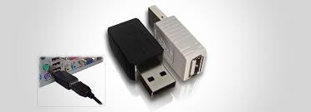
Types of keyloggers
There are two types of keyloggers.
1.Software Keylogger
2.Hardware Keylogger
1. Software Keylogger
Programs installed on a computer to monitor and record keystrokes. These are more common due to their
ease of installation and use.
Hardware Keylogger
Physical devices that intercept keystrokes. They are often plugged between the keyboard and the computer.
Hardware Keylogger

Slide 5

PROBLEM STATEMENT
Keyloggers can potentially capture sensitive information, such as passwords, credit card numbers,
and personal messages. If this data falls into the wrong hands due to a malicious keylogger, it can
lead to identity theft, financial loss, and other serious consequences.
The proliferation of keyloggers presents a dual-edged sword in the realm of cyber security.
On one hand, keyloggers can be utilized for authorized monitoring and safeguarding of systems;
on the other hand, they are a potent tool for cybercriminals to conduct malicious activities such as
identity theft, corporate espionage, and unauthorized surveillance. This dichotomy
underscores the necessity for robust detection, prevention, and legal measures
to mitigate the security threats posed by keyloggers.
3/21/2024 Annual Review

Slide 6

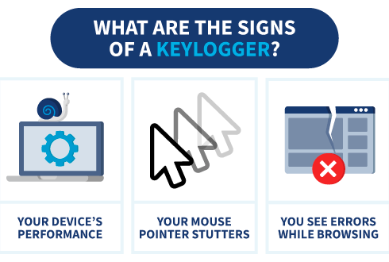
PROJECT OVERVIEW
A keylogger or keystroke logger/keyboard capturing is a form of malware or hardware that
keeps track of and records your keystrokes as you type. It takes the information and sends it
to a hacker using a command-and-control (C&C) server.
Effect of Keylogger
A keylogger or keystroke logger/keyboard capturing is a form of malware or hardware
that keeps track of and records your keystrokes as you type. It takes the information
and sends it to a hacker using a command-and-control (C&C) server.
3/21/2024 Annual Review

Slide 7

WHO ARE THE END USERS?
Keyloggers can be used by a variety of end users, each with different motives and purposes.
Malicious End Users
1. Cybercriminals:
These individuals or groups use keyloggers to steal sensitive information such as passwords, credit card numbers, and personal identification details for financial gain, identity theft, or selling the information on the dark web.
2. Hackers:
Hackers might use keyloggers to gain unauthorized access to computer systems, steal confidential data, or carry
out other malicious activities.
3. Government and Intelligence Agencies:
In some cases, state-sponsored actors or intelligence agencies might deploy keyloggers as part of surveillance or espionage operations to monitor individuals, organizations, or other governments.
3/21/2024 Annual Review

Slide 8
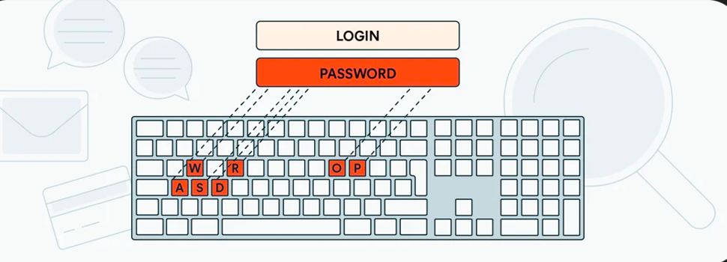
Non-Malicious End Users
1. Employers:
Some employers use keyloggers to monitor employee activity to ensure productivity, compliance
with company policies, or to prevent unauthorized access to sensitive company information. However,
this practice is often controversial and raises significant ethical and legal concerns.
2. Parents:
Parents might use keyloggers to monitor their children's online activities to protect them from online
predators, cyber bullying, or inappropriate content. This use also raises ethical issues regarding privacy.

Slide 9
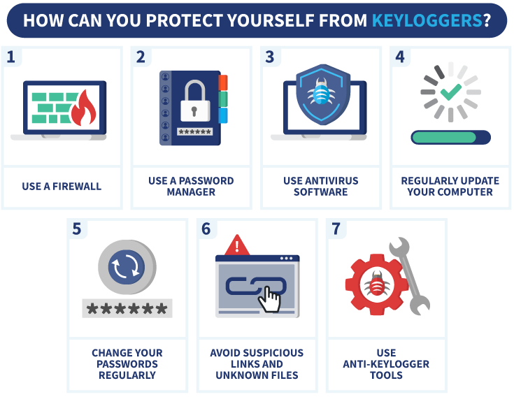

YOUR SOLUTION AND ITS VALUE PROPOSITION
There are several ways to prevent keyloggers. They are;
1. Anti-Virus/spyware & Firewalls.
2. Automatic Form Fillers.
3. Alternative Keyboard Layouts.
4. On screen keyboards.
5. Using Anti-Keyloggers.
3/21/2024 Annual Review

Slide 10


THE WOW IN YOUR SOLUTION
Let us discuss about WOW factors:
1. Behavioral Analysis:
Leveraging AI and machine learning to detect abnormal behavior indicative of keylogging activity. By analyzing
patterns and behaviors, these systems can identify and flag potential keyloggers before they can do any harm.
2. Anomaly Detection:
Implementing systems that can detect deviations from normal usage patterns, alerting users or IT staff
to potential keylogger installations.
3/21/2024 Annual Review
10

Slide 11
MODELLING
Teams cam add wireframes
Creating wireframes for a keylogger solution involves visualizing the interface of
anti-keylogger software. Here's a conceptual overview of the wireframes for
various components of an anti-key logger solution.
1. Dashboard
Purpose: The main screen that provides an overview of the system's status
and key metrics.
2. Real-Time Protection
Purpose: Monitor and manage real-time protection settings and view active
threats.
3. Reports
Purpose: View detailed reports of scans, detected threats, and actions
taken.
3/21/2024 Annual Review
11

Slide 12
RESULTS
Keyloggers, a type of malware designed to record keystrokes on a user's device, pose a significant threat
to information security. These malicious programs can capture sensitive information such as usernames,
passwords, credit card numbers, and other personal data, leading to identity theft, financial loss, and
privacy breaches.
There are two types of keyloggers, Hardware keylogger and Software keylogger.
The detection of keylogger is difficult so we need to use anti-malwares to prevent or avoid keylogger.
We can prevent keylogger by using Anti-keyloggers , Anti-viruses ect.
There are several measures can be taken to protect against keyloggers.
3/21/2024 Annual Review
12

Slide 13

THANK YOU
FOR YOUR ATTENTION

