Slide 1
New QRS Detection Algorithm
Based on Hilbert Transform
Presentation by :
Ch.Mallesh
B131088
E3-ECE
AB2-212

Slide 2
Contents
Introduction
Hilbert Transform
Approach
Block diagram
Calculations
Future Scope
Conclusion

Slide 3
Introduction
ECG signals are extracted to analyse the heart performance.
Accurate detection of the R wave peak in QRS complex for a correct measurement of Heart Rate Variability (HRV).
Morphological differences in the ECG waveform increase the
complexity of QRS detection.
For better analysis of noise contaminated signals this is best appraoch to evaluate the heart behavior of any living organism.

Slide 4
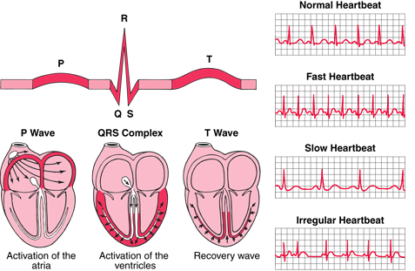
QRS-Complex Generartion

Slide 5

Hilbert Transform
Odd function
Time domain to time domain conversion
Hilbert transform ŷ(t) of a function is hormonic conjugate of y(t)

Slide 6
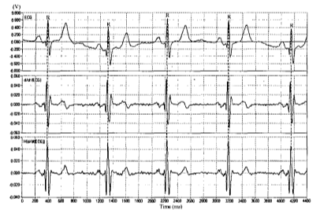
Approach
Hilbert transform results in crossing of zero on the x-axis every time that there is an inflexion point in the original waveform.
Crossing of the zero is represented as a
peak in its Hilbert transformed conjugate.

Slide 7

Block Diagram
ECG
Subset Window
x(n)
Differentiation
Filtering
y(n)=d/dt[x(n)]
y(n)
Hilbert Transform
h(n)
Threshold Peak
Detection
h(n)=H[y(n)]
QRS

Slide 8
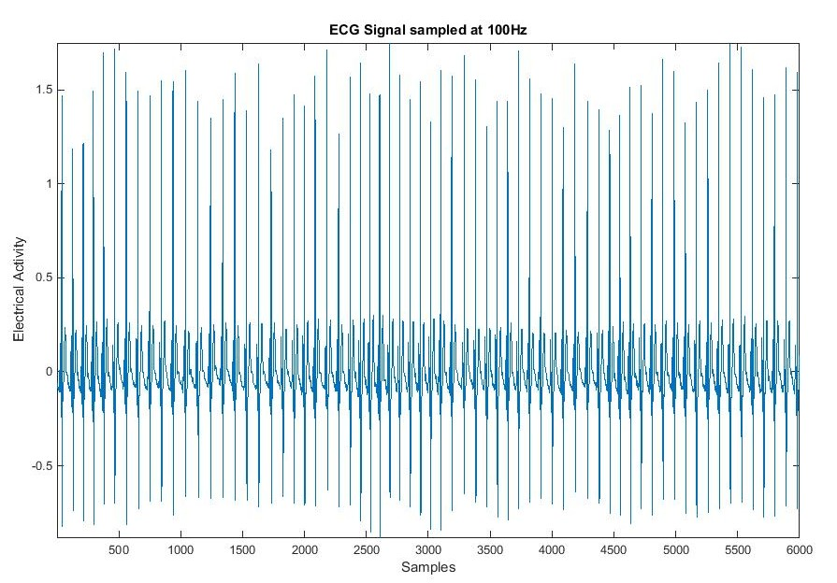
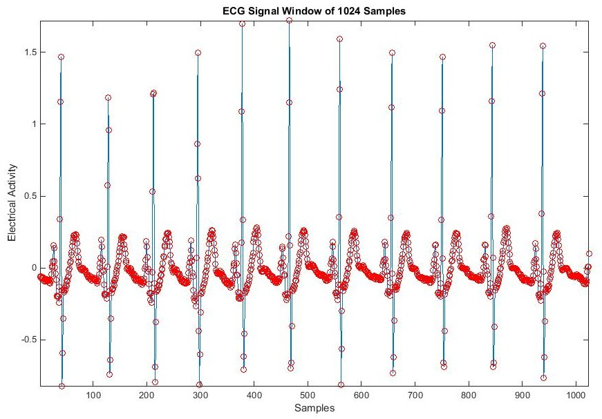
Graphs

Slide 9
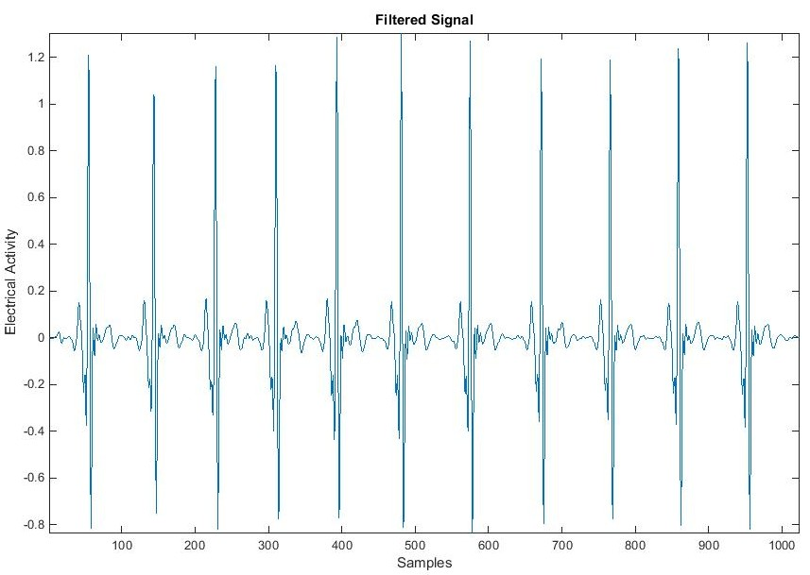
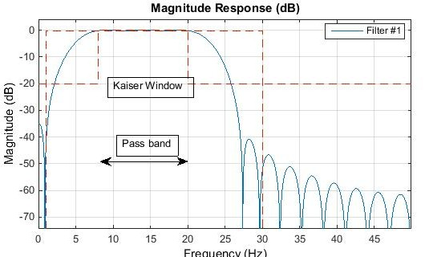
Graphs

Slide 10
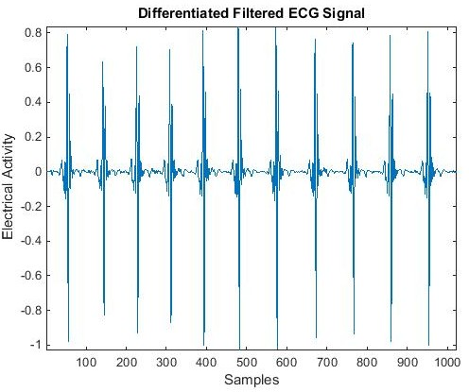
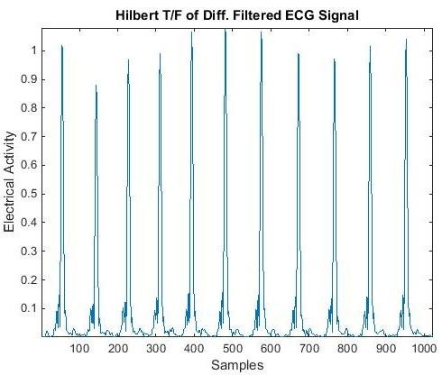
Graphs

Slide 11
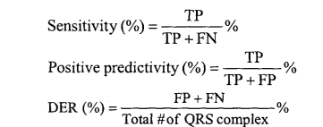
Calculations
= 99.81 %
= 99.83 %
= 0.36 %

Slide 12
Advantages
Elegent and easier way.
Can perform excellently even in the presence of significant noise cotamination.
Less error rate
High sensitivity and positive prediction.

Slide 13
Future Scope
Error rate can be decreased by considering good threshold peak value.

Slide 14
Conclusion
The robust noise rejection algorithm is proposed for accurate QRS peak detection for high noise contaminated signals by utilising the properties of hilbert trnsform.

Slide 15

References
[1]. A New QRS Detection Algorithm Based on the Hilbert Transform
DS Benitez', PA Gaydecki', A Zaidi', AP Fitzpatrick2
[2]. www.mathworks.com
[3]. Oppenheim, A.V., Schafer, R.W., Discrete-Time Signal
Processing, Englewood Cliffs, NJ, Pretince-Hall, 1989.

Slide 16
Thank you

