Slide 1


Department of Computer Science and Engineering
KAMMIAN, E-COMMERCE WEBSITE FOR ARTISANS AND POTTERY MAKERS WITHOUT INTERMEDIATORS
Mr. V. KARTHICK
ASSOCIATIVE PROFESSOR
TEAM ID – B21A2425C13
210701145 MALLESH U
210701323 NARESH KUMAR V

Slide 2
Problem Statement and Motivation
Traditional artisans and pottery makers, especially from rural and tribal areas, face challenges in accessing broader markets due to limited digital literacy, lack of resources, and dependence on intermediaries who reduce their profits. As a result, their unique craftsmanship remains underrepresented, leading to economic struggles and the fading of cultural heritage. This e-commerce initiative aims to empower these artisans by providing a user-friendly digital platform to showcase and sell their handmade products globally. By ensuring fair compensation and eliminating intermediaries, the platform fosters economic independence and cultural preservation. With features like AI chatbots for guidance and multi-language support for accessibility, it bridges the gap between artisans and customers worldwide, creating a sustainable model to celebrate and support traditional crafts in the digital era.

Slide 3
Objectives
The objective of this project is to develop a comprehensive e-commerce platform that empowers traditional artisans and pottery makers by providing them with a global marketplace to showcase and sell their handmade products. The platform aims to ensure fair pricing, eliminate intermediaries, and foster economic independence for artisans, particularly those from rural and tribal areas. By integrating features such as multi-language support and AI-driven chatbots, the project seeks to enhance user accessibility and provide seamless support for both sellers and buyers. Ultimately, the initiative aspires to preserve cultural heritage, promote sustainable livelihoods, and connect artisans with a wider audience in the digital age.

Slide 4
Abstract
Kammian is an innovative web application developed to empower local artisans in Tamil Nadu, particularly pottery makers, by addressing the significant challenges they face in accessing broader markets and achieving fair compensation for their craftsmanship. Artisans often struggle with limited market visibility, reliance on intermediaries, and the high costs associated with marketing platforms. Kammian seeks to resolve these issues by providing a dedicated e-commerce platform where artisans can directly showcase and sell their products to customers. This approach not only eliminates intermediaries but also reduces operational costs, ensuring that artisans retain a larger share of their earnings. The platform leverages advanced real-time database capabilities to deliver a seamless, secure, and user-friendly e-commerce experience. Customers benefit from access to a curated selection of high-quality, handcrafted products at affordable prices, coupled with minimal delivery times to enhance satisfaction.

Slide 5
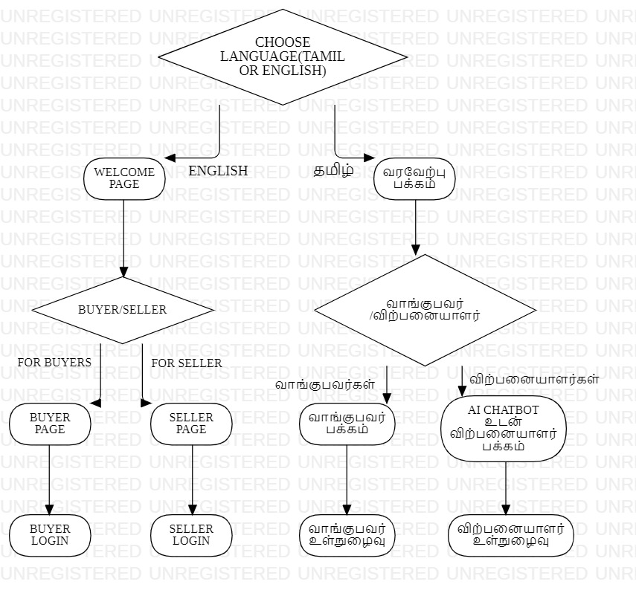
System Architecture

Slide 6
List of Modules
1. User Management Module
2. Product Management Module (Seller-Side)
3. AI Chatbot Module (Seller-Side)
4. Search and Recommendation Module (Buyer-Side)
5. Marketplace Module

Slide 7
Functional Description for each modules
1. User Management Module:
The User Management Module facilitates secure registration, authentication, and profile management for both buyers and sellers. Buyers can create accounts, set preferences, save wishlists, and track orders, while sellers can set up detailed profiles, manage products, and analyze sales. The module includes features like OTP verification, password recovery, and role-based access control to ensure tailored experiences. It tracks user activity for personalized recommendations and allows updates or deactivation of accounts. Administrators oversee accounts for compliance and provide support, ensuring a seamless and secure user experience across the platform.

Slide 8
Functional Description for each modules
2. Product Management Module (Seller-Side)
The Product Management Module enables sellers to upload and manage their products efficiently. Sellers can add product details such as images, descriptions, pricing, and categories while tracking stock and inventory in real time. It supports editing, deleting, and updating product information as needed. The module ensures proper organization through tags and categories, enhancing searchability for buyers. Notifications for low stock levels help sellers maintain inventory efficiently.

Slide 9
Functional Description for each modules
3. AI Chatbot Module (Seller-Side)
The AI Chatbot Module assists sellers by providing real-time guidance and support for managing their storefronts. It helps with product listing, pricing suggestions, and addressing FAQs related to sales, delivery, and platform usage. The chatbot sends notifications for important updates, such as low stock or new orders, and offers multilingual support to enhance accessibility. It leverages AI to learn seller behavior and provide personalized recommendations for better engagement and efficiency.

Slide 10
Functional Description for each modules
4. Search and Recommendation Module (Buyer-Side)
The Search and Recommendation Module enhances the buyer experience by offering personalized product recommendations based on browsing history, preferences, and popular trends. It includes an intelligent search feature with filters like category, price, location, and availability, ensuring relevant results. The recommendation system uses collaborative filtering and machine learning to suggest products tailored to individual interests. It dynamically updates suggestions as buyers interact with the platform, improving engagement. This module ensures seamless discovery and connection to desired products.

Slide 11
Functional Description for each modules
5. Marketplace Module
The Marketplace Module provides a central hub where buyers can browse, discover, and purchase products from various sellers. It displays categorized products, featured items, and trending crafts, ensuring an easy navigation experience. Buyers can filter products by type, price range, and availability. The module also showcases product details, reviews, and ratings to help buyers make informed decisions. It facilitates seamless transactions by integrating the cart and checkout functionalities for a smooth buying process.

Slide 12
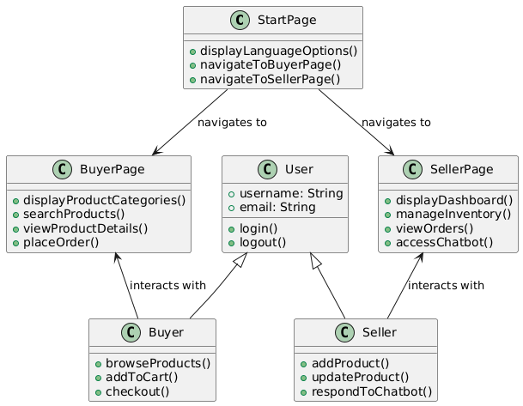
CLASS DIAGRAM

Slide 13
Conclusion & Work for Phase II
The proposed e-commerce platform for artisans and pottery makers is thus intended to empower local talent, providing a digital marketplace that bridges the gap between the creators and the consumers. The platform eliminates the layer of intermediaries and makes good use of intuitive technology so that fair value is returned to artisans for their craftsmanship. For phase 2, Advanced Features to Make the Platform More Engaging The features of the e-commerce platform developed for artisans and pottery makers are further reinforced with a recommendation system, enhanced UI/UX design, and an improved version of the chatbot in Phase 2. The recommendation system will be done using various machine learning algorithms, such as collaborative filtering and content-based filtering, to analyze user behavior, preferences, and purchasing history.

Slide 14
References
[1] C. V. Kalyan, V. V. S. N. Akhila Sree Rajeswari, Y. S. D. Phaneendra and S. R. Kishan, "Lokart: Empowering Local Artisans through Mobile E-commerce," 2024 International Conference on Emerging Technologies in Computer Science for Interdisciplinary Applications (ICETCS), Bengaluru, India, 2024, pp. 1-6, doi: 10.1109/ICETCS61022.2024.10543943.

Slide 15
References
[2] S. Rajendrakumar et al., "Native Nest: An E-Commerce Platform for Promoting Tribal Products and Culture," 2024 8th International Conference on I-SMAC (IoT in Social, Mobile, Analytics and Cloud) (I-SMAC), Kirtipur, Nepal, 2024, pp. 1083-1089, doi: 10.1109/I-SMAC61858.2024.10714642

Slide 16
References
[3] V. Altintas and M. Kilinc, "Automated Categorization of Turkish E-commerce Product Reviews Using BERTurk," 2024 8th International Artificial Intelligence and Data Processing Symposium (IDAP), Malatya, Turkiye, 2024, pp. 1-6, doi: 10.1109/IDAP64064.2024.10710859.

Slide 17
Paper Publication Status
Paper plague report generated and accepted for conference

Slide 18
Thank You

