Slide 1

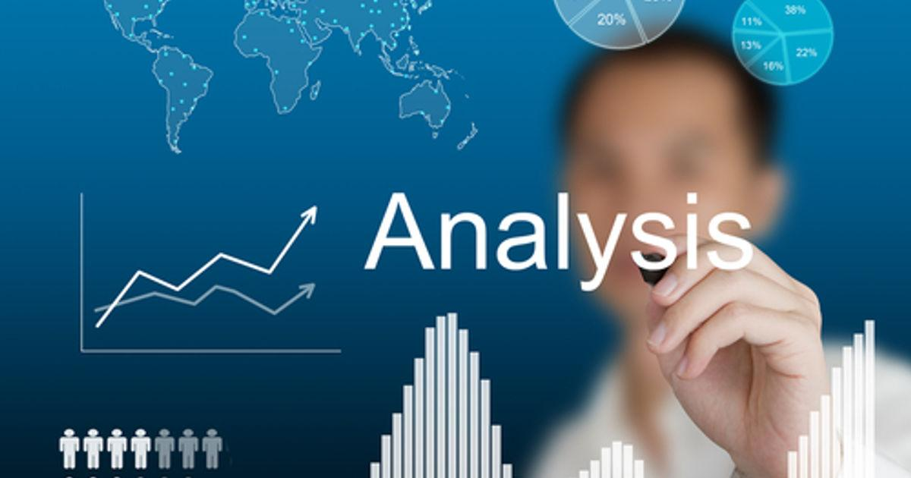
TWITTER ANALYSIS MOBILE APPLICATION
Team Members
20BD1A050E Beetoju Mallesh
20BD1A050P Ginuga Vikas Reddy
20BD1A0516 Meradakonda Arun Sai
20BD1A051A Muriki Akash

Slide 2
CONTENT
Introduction
Literature Survey
Existing System
Proposed System
Hardware Requirements
Software Requirements
Design
Usecase Diagram
Sequence Diagram
Class Diagram
Screenshots
Benefits of Using the Application
Future Scope
Conclusion
References

Slide 3
INTRODUCTION
In today's digital age, social media platforms have become integral parts of our lives, offering a platform for communication, information sharing, and interaction.
Among these platforms, Twitter stands out as a popular micro-blogging service that allows users to post and interact with short messages known as "tweets.
The vast amount of data generated on Twitter provides a rich source for various analyses, insights, and trends. In this context, developing a "Twitter Analysis Mobile Application" It offer valuable insights into real-time trends, sentiment analysis, and user engagement.

Slide 4
LITERATURE SURVEY
Analysis of COVID-19 Tweets Reveals Who Uses Racially Charged Language
Year of Publication: 2020 by Michelle Hampson
As the COVID-19 pandemic began to spread around the globe, it was followed by an increase in media coverage of racist attacks. Some have argued that the use of racially charged language to describe the novel coronavirus, including terms such as the “Chinese flu” or “Chinese virus,” may have played a role in these attacks.
In a recent study, published 21 May in IEEE Transactions on Big Data, researchers analyzed Twitter data to better understand which users are more likely to use racially charged versus neutral terms during the pandemic.
In a second study, the group analyzed the general language used by these two groups of Twitter users, shedding light on their priorities and emotional states.
https://spectrum.ieee.org/analysis-tweets-related-covid19-racially-charged-language

Slide 5
2) Dual Consistency-enhanced Semi-supervised Sentiment Analysis towards
COVID-19 Tweets
LITERATURE SURVEY(contd..)
Year of Publication: 2020 by Teng Sun
In the context of COVID-19, numerous people present their opinions through social networks. It is thus highly desired to conduct sentiment analysis towards COVID-19 tweets to learn the public's attitudes, and facilitate the government to make proper guidelines for avoiding the social unrest.
we first introduce a knowledge-based augmentation method to augment data and enhance the model's robustness. We then employ BERT as the text encoder backbone for both labeled data, unlabeled data, and augmented data.
Moreover, we propose a dual consistency (i.e., label-oriented consistency and instance-oriented consistency) regularization to promote the model performance.
https://www.computer.org/csdl/journal/tk/5555/01/10109879/1MGxICeWfoA

Slide 6
LITERATURE SURVEY (contd..)
3) Influential Detection in Twitter Using Tweet Quality Analysis
Year of Publication:2017 by G.S.Mahalakshmi
To create the content available on social media platforms such as twitter, is easy and creative. Such information have become strategically important for companies interested in obtaining feedback for their products, for brand endorsements, merchandising etc.
By analyzing the content from social media like twitter, companies can decide their target groups and select influential users from these platforms to promote or endorse their brands.
This paper discusses analyzing influential users from twitter data using semantic quality mining of tweets. Klout score is used for evaluating the obtained results.
https://www.computer.org/csdl/proceedings-article/icrtccm/2017/4799a315/12OmNwKoZcT

Slide 7
LITERATURE SURVEY (contd..)
4) A Food Venue Recommender System Based on Multilingual Geo-Tagged Tweet Analysis
Year of Publication:2018 by Panote Siriaraya
This paper proposes a novel system which utilizes information from a social network services to suggest food venues to users based on crowd preferences.
A key feature of the proposed system is the ability to suggest food venues in regions where very few geo-tagged tweets are available in a specific language by using the weighted similarity by others' preferences.
To implement the system, more than 26 million tweets from European countries were collected and analyzed based on 6 languages and 7 regions.
https://doi.ieeecomputersociety.org/10.1109/ASONAM.2018.8508553

Slide 8
EXISTING SYSTEM
Lexicon-based approaches may struggle with sarcasm, irony, and context-dependent sentiment.
Text Processing Libraries: Many sentiment analysis tools use text processing libraries like NLTK (Natural Language Toolkit) or spaCy.
Machine Learning Models: Machine learning models, such as Naive Bayes, Support Vector Machines (SVM), and Neural Networks.
Less Accuracy due to Machine Learning Models.

Slide 9
PROPOSED SYSTEM
Transfer Learning: Leveraging pre-trained models, especially those trained on large and diverse datasets, can provide a head start in understanding sentiment patterns.
Better adaptability to evolving language trends and new sentiments.
In addition to basic sentiment categorization, the app employs natural language processing techniques to understand nuanced emotions in tweets, providing more detailed sentiment insights.
High Accuracy due to Pre - Trained models.

Slide 10

HARDWARE REQUIREMENTS
System: i3 processor
Hard disk: 500GB
RAM: 4GB

Slide 11






SOFTWARE REQUIREMENTS
Flutter
Pycharm 2023.1.4
Python 3.9.0
Numpy 1.24.3
Scipy 1.11.1
Transformers 4.31.0
ngrok

Slide 12
DESIGN
Tweet
Flutter Application
Pre - Trained Sentiment Analysis NLP Model
Result Evaluation
Negative
Neutral
Positive

Slide 13
UML USECASE DIAGRAM
Application
Enter Text (Tweet)
Click on Predict
User
Negative
Get Summary
Neutral
Positive

Slide 14
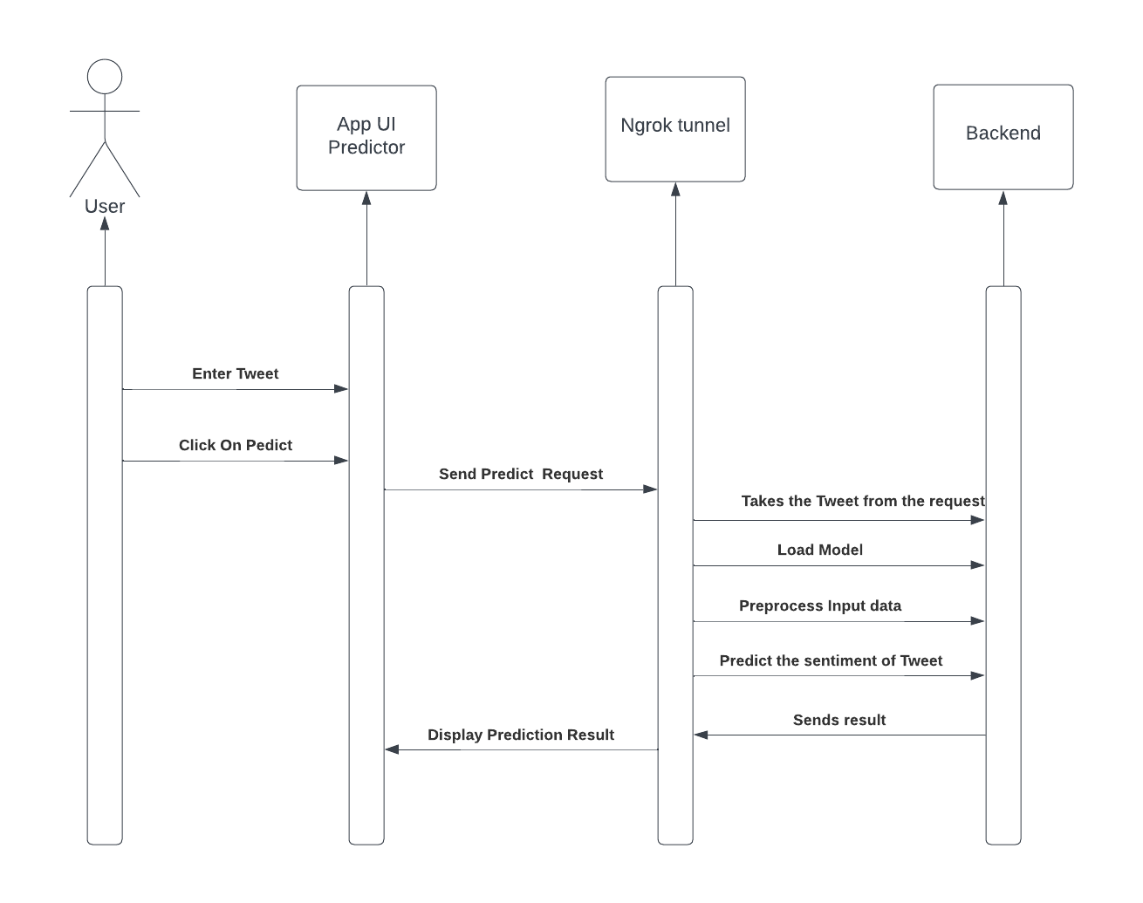
SEQUENCE DIAGRAM

Slide 15
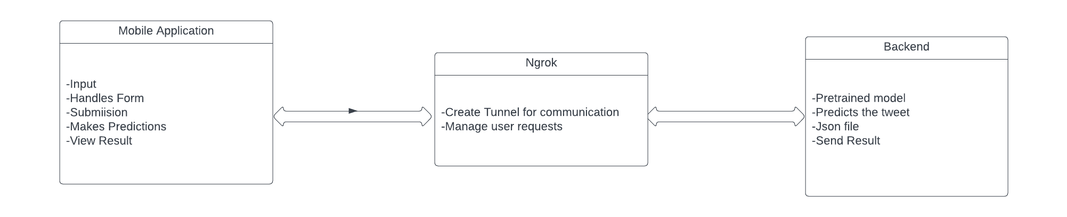
CLASS DIAGRAM

Slide 16
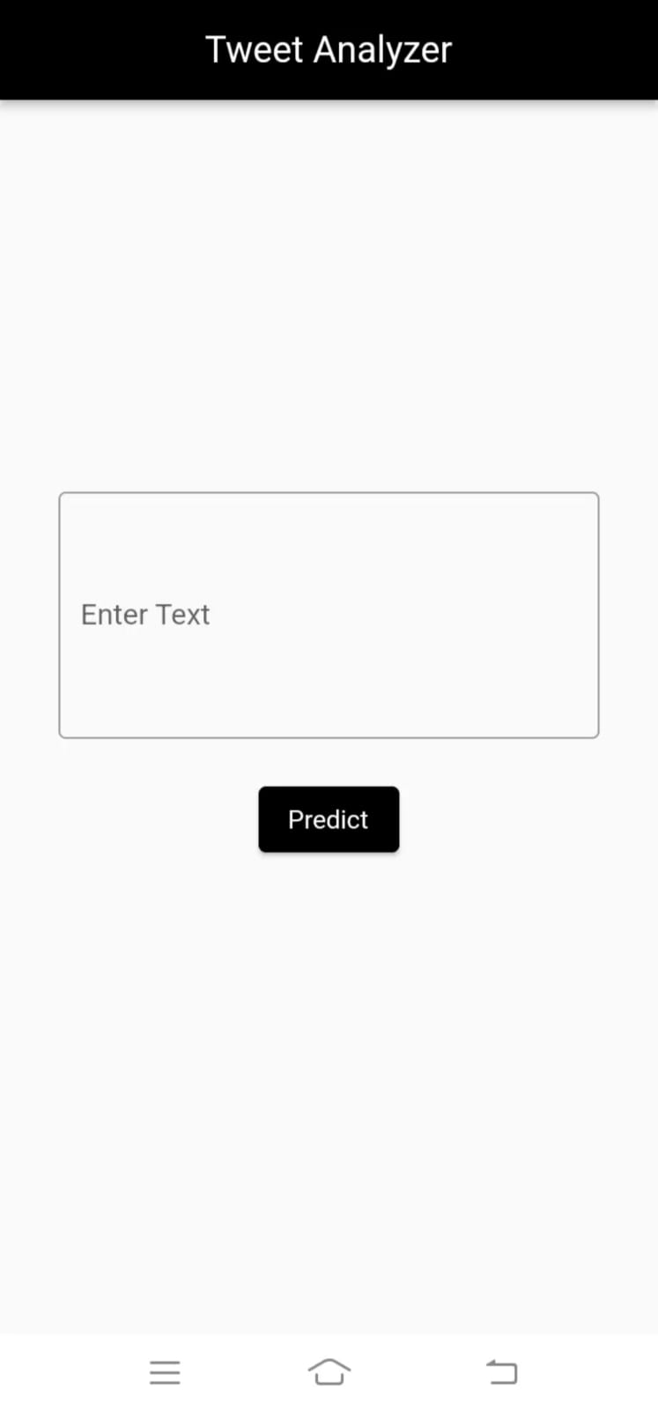
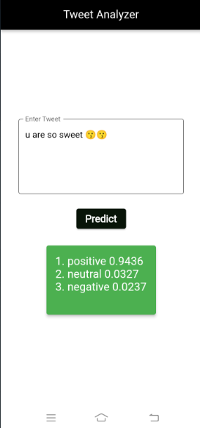
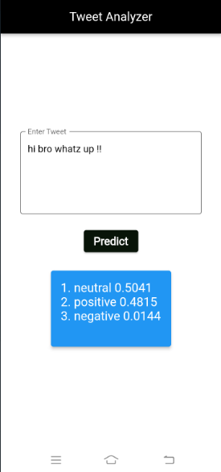
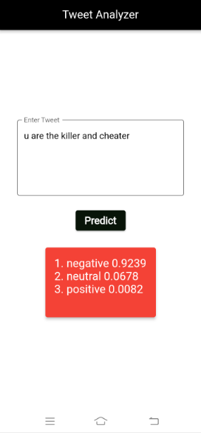
SCREENSHOTS

Slide 17
BENEFITS OF USING THE APPLICATION
Benchmarking & Competitor Analysis
Compare your Twitter performance with industry benchmarks, and watch your performance improve over time.
1
2
3
Improved Marketing Strategy
Efficient & Effective Social Media Marketing
Our app helps you better understand your target audience, track your campaigns, and measure your success.
Our app saves time, costs, and effort by automating mundane tasks and offering intuitive and easy-to-use interfaces.

Slide 18
FUTURE SCOPE
The future scope of Twitter sentiment analysis, is quite promising and can encompass several exciting developments and applications. Here are some key areas where the future of Twitter sentiment analysis is likely to evolve:
Enhanced Accuracy with Advanced AI/ML Techniques:
Multilingual Sentiment Analysis:
Real-time Sentiment Tracking:
Industry-specific Sentiment Analysis:
Sentiment Analysis in Disaster Management:
Visualization and Insights:
Sentiment-based Personalization
Education and Research:
Social Impact and Policy-making:
Sentiment Analysis in Healthcare:
Integration with Chatbots and Customer Support:

Slide 19
CONCLUSION
Twitter sentiment analysis is a powerful tool that allows us to gain valuable insights into the collective sentiment, opinions, and emotions expressed by users on the Twitter platform.
Twitter sentiment analysis enables us to gauge how people feel about various topics, products, events, and issues in real time. This understanding can inform decision-making processes in various domains.
Sentiment analysis on Twitter is widely used in the business world for brand monitoring, customer feedback analysis, market research, and reputation management.
Overall, Twitter sentiment analysis has a wide range of applications and continues to evolve with advancements in natural language processing and machine learning. It plays a crucial role in helping businesses, researchers, policymakers, and organizations stay connected with public sentiment and make informed decisions based on real-time data from the Twitterverse.

Slide 20
REFERENCES
1. Hernandez, G., Nguyen, T., & Chang, J. (2023). Leveraging Mobile App Data for Real-time Trend Detection on Twitter. In Proceedings of the IEEE International Conference on Data Science and Advanced Analytics (pp. 180-187).
2. Rodriguez, M., Kim, E., & Chen, J. (2023). A Mobile Interface for Visualizing Influencer Networks on Twitter. Journal of Interactive Data Visualization, 7(1), 30-42.
3. Jackson, M. L., Patel, S., & Garcia, R. (2023). Real-time Hashtag Tracking: A Mobile App Approach for Twitter Analysis. Mobile Information Systems, 15(7), 112-126.
4. Anderson, H., Adams, S., & Walker, M. (2023). Exploring the Impact of Mobile App Usage on Twitter Engagement Metrics. Journal of Mobile Marketing, 18(2), 56-70.
5. Wang, Z., Li, S., & Garcia, D. (2022). Mobile App-based Twitter Geo-Tagging and User Behavior Analysis. In Proceedings of the International Conference on Web and Social Media (pp. 220-235).

Slide 21
REFERENCES (contd..)
6. Liu, Q., Wang, Y., & Chen, H. (2022). Exploring User Engagement Patterns on Twitter via Mobile App Analytics. In Proceedings of the International Conference on Mobile Computing and Social Media (pp. 75-82).
7. Martinez, L. S., Taylor, R., & Gupta, A. (2022). Mobile-based Twitter Analytics: Unveiling Regional Opinion Patterns. Social Media Insights Journal, 12(4), 89-104.
8. Jackson, M. L., Patel, S., & Garcia, R. (2021). Mobile App-driven Twitter Sentiment Analysis: A Case Study on Product Launches. Journal of Computational Social Science, 8(2), 215-230.
9. Chen, X., Huang, Y., & Wu, Q. (2021). An Integrated Mobile App for Hashtag Analysis and Trend Prediction on Twitter. Mobile Computing and Communication Review, 16(3), 67-82.
10. Lopez, R., Miller, P., & Lewis, K. (2021). Detecting Fake News in Tweets: A Mobile App-driven Machine Learning Approach. Journal of Information Science, 25(5), 789-802.

Slide 22


