Slide 1
Credit Card Fraud Detection using Machine Learning

Slide 2
Problem Statement
Credit card fraud is rare but costly.
Fraudulent transactions = only 0.17% of all transactions.
Traditional detection systems fail to catch many frauds.
Machine Learning can identify fraud patterns effectively.

Slide 3
Dataset
Source: Kaggle – Credit Card Fraud Dataset
Transactions: 284,807
Fraud cases: 492 (0.17%)
Features:
V1–V28 (PCA anonymized features)
Time, Amount
Target: Class (0 = Normal, 1 = Fraud)

Slide 4
Methodology / Workflow
Data exploration & visualization
Preprocessing (scaling Time & Amount)
Train-test split (80/20)
Models: Logistic Regression, Random Forest
Handling imbalance → SMOTE (oversampling)
Evaluation with ROC, PR curve, Confusion Matrix

Slide 5
Evaluation Metrics
Accuracy (misleading with imbalance)
ROC-AUC (Area Under Curve)
Precision (how many predicted frauds are correct)
Recall (how many frauds are detected)
F1-Score (balance between Precision & Recall)
Confusion Matrix

Slide 6
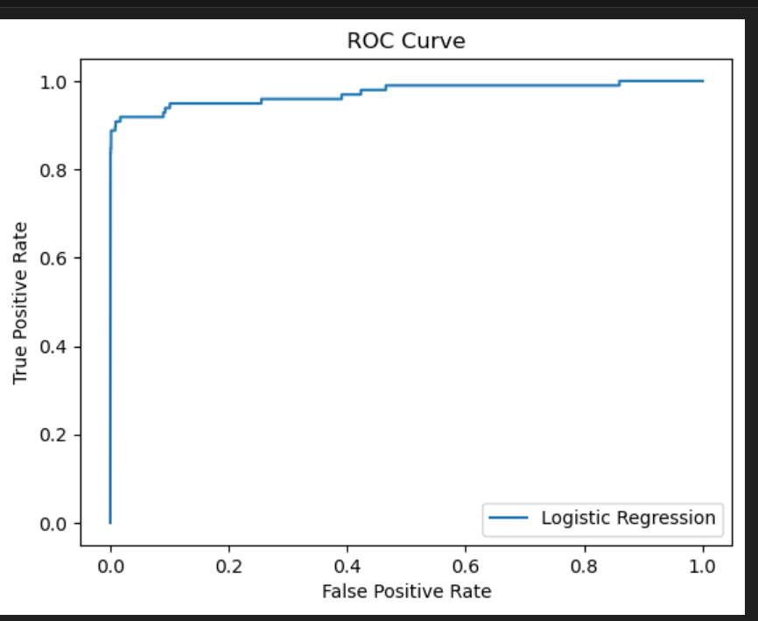
Results (ROC Curve)
Logistic Regression: baseline, decent AUC
Random Forest: higher AUC, stronger detection
Random Forest + SMOTE: best recall & precision balance

Slide 7
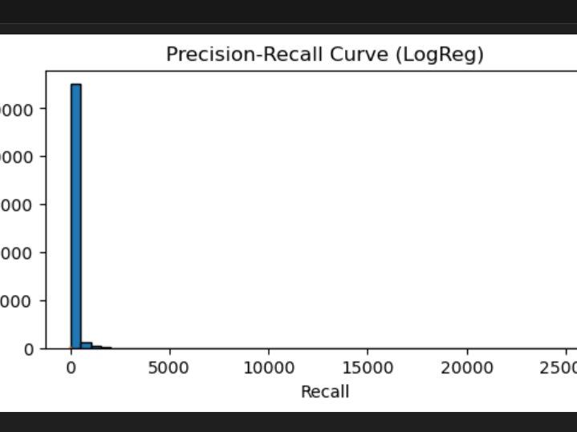
Precision-Recall Curve
Shows trade-off between catching fraud (recall) and avoiding false alarms (precision).
Model performs better than random guessing.

Slide 8
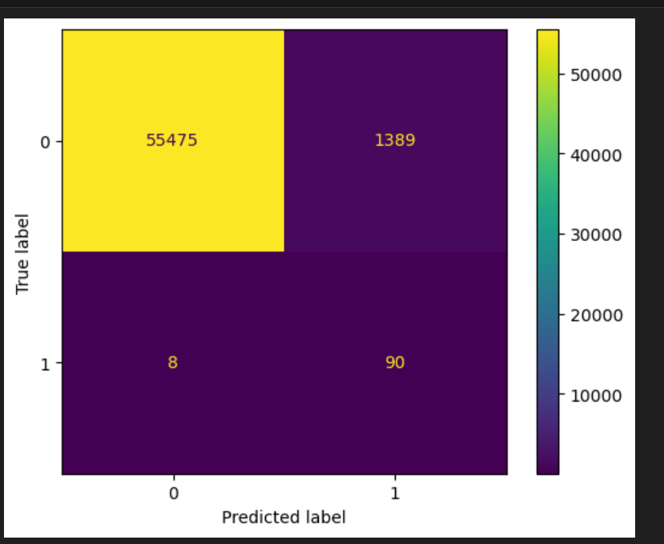
Confusion Matrix
TN (True Negative): 55,475 legitimate transactions correctly classified
FP (False Positive): 1,389 legitimate flagged as fraud
FN (False Negative): 8 frauds missed
TP (True Positive): 90 frauds correctly detected

Slide 9
Conclusion
Best model: Random Forest + SMOTE
Detected frauds with high recall & good precision
Machine Learning improves fraud detection significantly
Future Work: Hyperparameter tuning, XGBoost/LightGBM, SHAP explainability, API deployment

Slide 10
THANK YOU

