Slide 1

User-Defined System Calls in Linux and Graceful Shutdown

Slide 2
What is a User-Defined System Call?
System calls allow programs to interact with the operating system
User-defined system calls involve creating or modifying system behaviors with custom code
File I/O, process management, hardware access

Slide 3
Concept: Graceful Shutdown Using a Signal Handler
Handling SIGINT to perform cleanup before shutdown
Save data and gracefully shut down when Ctrl+C is pressed

Slide 4

Overview of the Custom System Call
Create a custom system call in Linux that saves data and initiates system shutdown
Define the system call in the kernel
Modify the syscall table
Recompile the kernel
Call the system call from user space

Slide 5
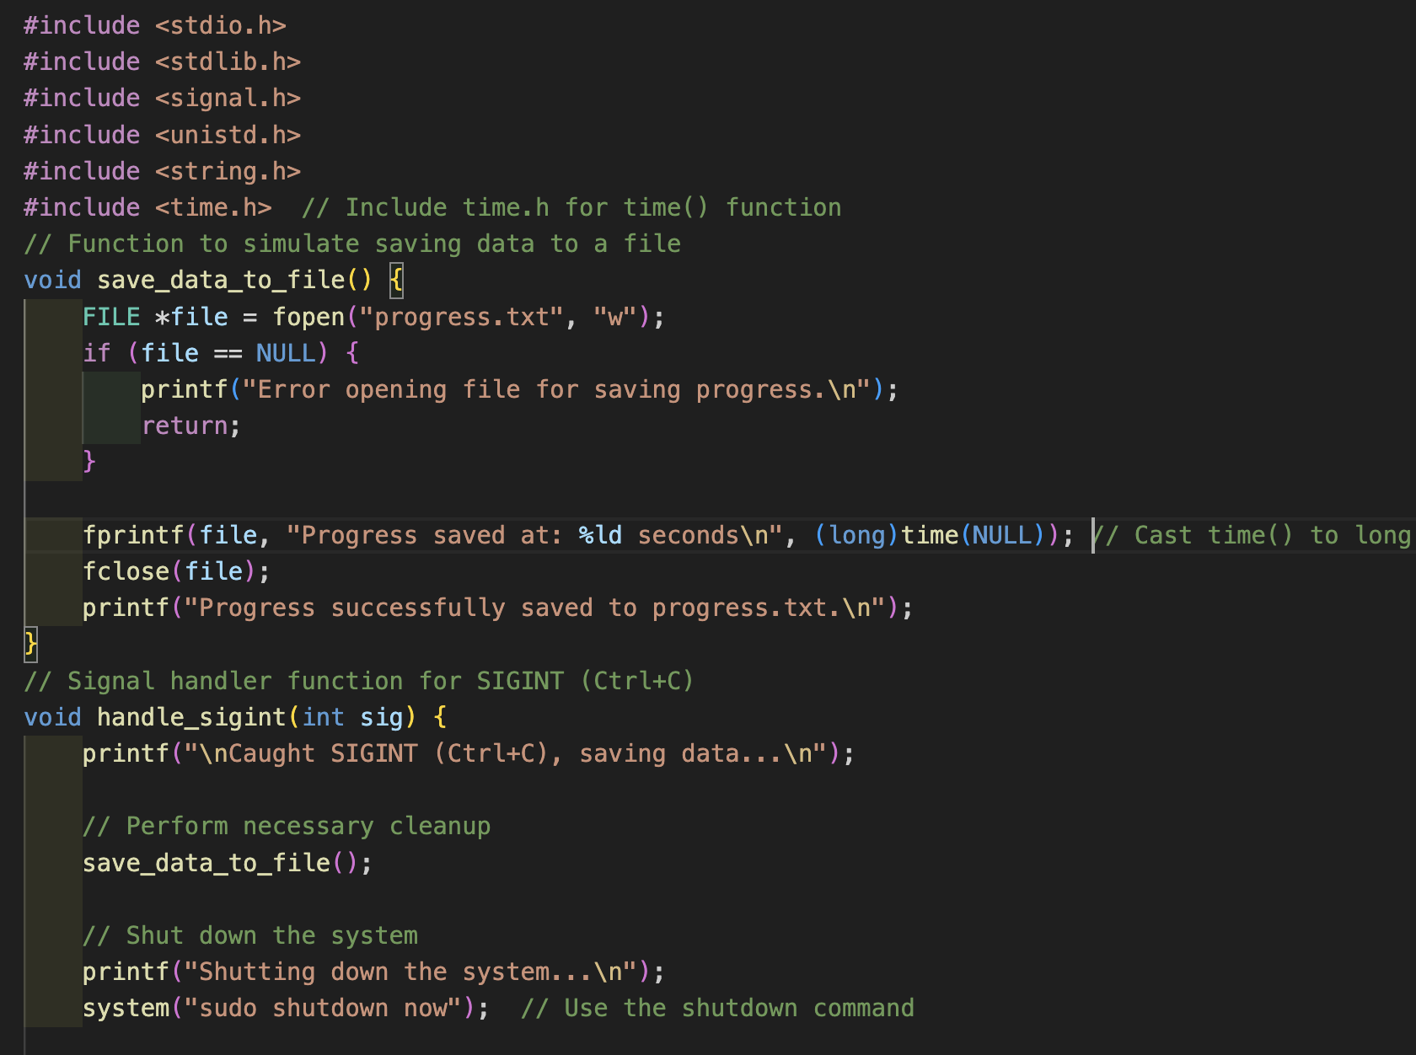
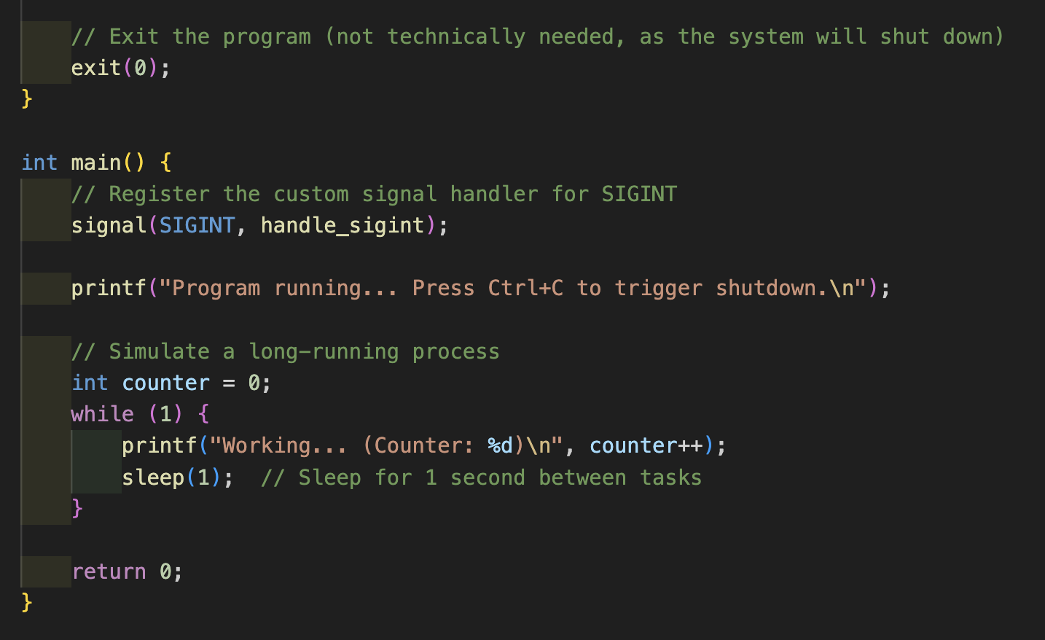
Step 1 - Define the System Call
Creating the System Call in the Kernel (mycall.c):

Slide 6
Step 1 - Define the System Call
Saves progress to a file
Calls kernel_power_off to shut down the system

Slide 7
Step 2 - Modify the Syscall Table
Open the syscall table
1
File: arch/x86/entry/syscalls/syscall_64.tbl
Add an entry for your system call : 549 64 graceful_shutdown sys_graceful_shutdown
2

Slide 8

Step 3 - Configure the Kernel
1)Navigate to the kernel source directory:
cd /usr/src/linux
2)Clean the source tree: make clean
3)Update the kernel configuration to include your custom changes:make menuconfig
4)Save and exit the configuration tool

Slide 9
Step 4 - Compile the Kernel
Compile the kernel: make -j$(nproc)
Compile and install the modules: sudo make modules_install

Slide 10
Step 5 - Install and Reboot the Kernel
Install the new kernel:sudo make install
1
Update GRUB to recognize the new kernel:sudo update-grub
2
Reboot the system to use the new kernel:sudo reboot
3

Slide 11

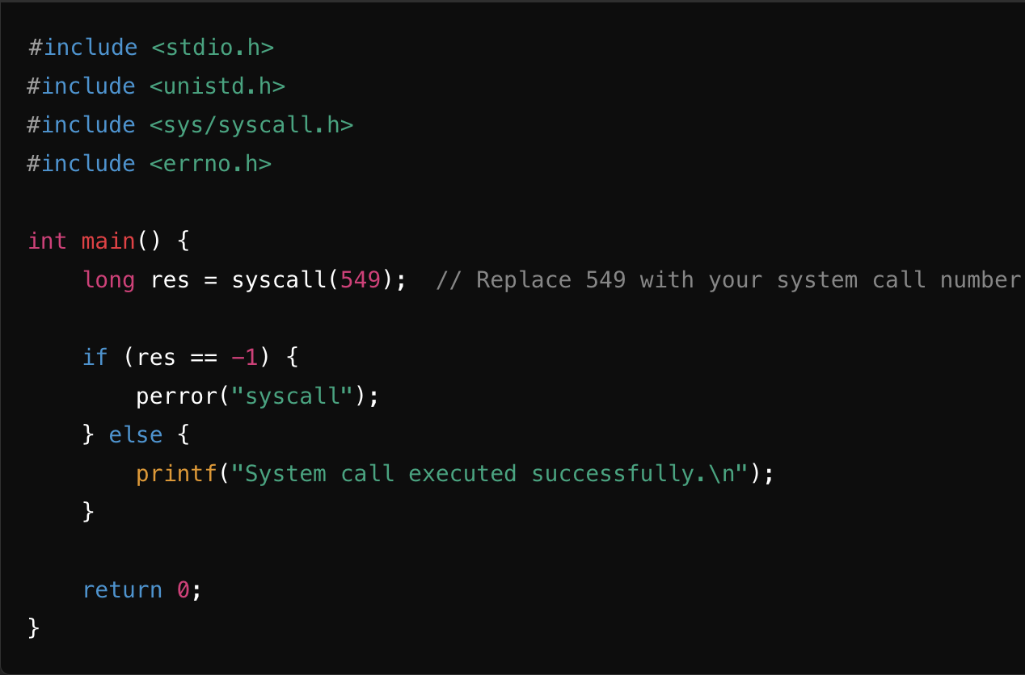
Call the System Call from User Space

Slide 12
Compile and Run the User-Space Program
Compile user space program :
gcc test_graceful_shutdown.c -o test_graceful_shutdown
2) Run the program:
./test_graceful_shutdown
The program calls the custom system call to save progress and initiate shutdown

Slide 13
Modifying sudoers for Password-Free Shutdown
Open the sudoers file: sudo visudo
Add this line: your_username ALL=(ALL) NOPASSWD: /sbin/shutdown

Slide 14
Use Case and Benefits of Graceful Shutdown
Server applications needing a controlled shutdown process
Data Integrity: Saves progress before shutting down, preventing data loss
Resource Management: Releases resources during shutdown
Automation: Allows the system to automatically manage shutdown gracefully

Slide 15
Output During Execution
On SIGINT:Caught SIGINT, saving data and shutting down...
Progress saved to progress.txt, then system shutdown is initiated.

Slide 16
Conclusion
Implemented a custom system call in Linux
Demonstrated how to handle signals and initiate a graceful shutdown
Enhanced control over system behavior, ensuring data integrity and proper resource management
Custom system calls and signal handling are powerful Linux features for creating system-level control

Slide 17
GITHUB LINK https://github.com/Malli-Santhosh/Linux-Custom-Signals

Slide 18
Thank you

