Slide 1

Presented by: Allu Siva Malleswari
ID: 23ME1A4904
Institution: Ramachandra College of Engineering
This project focuses on using AI-based transfer learning models to identify and sort rotten fruits and vegetables in real-time, reducing human effort and improving food quality.

Slide 2
Introduction
Food wastage is a global issue, and one of the main reasons for it is the mixing of rotten produce with fresh ones during storage and transportation.
Traditional manual sorting methods are slow and prone to errors. With the advancement of Artificial Intelligence (AI) and Machine Learning (ML), automation in sorting can greatly improve efficiency and quality control.
Content:
Manually sorting fruits and vegetables is a labor-intensive process, inefficient and expensive.
The current method for the industry is mainly human labor or expensive machinery.
Smart Sorting uses AI (Transfer Learning) to autonomously segregate fresh from rotten produce.
A camera takes photos of the produce, the model processes the image, and returns the classification.
Smart Sorting can be used on conveyor belts for large volume farms, warehouses and supermarkets.es transfer learning for accurate and fast detection of rotten produce.

Slide 3
Problem Statement
Manual sorting of fruits and vegetables is labor-intensive, time-consuming, and inconsistent. Rotten produce not only causes economic loss but also affects the freshness of other items in storage.
Visual :
Left Side: Image of workers manually sorting fruits (looking tired, slow process).
Right Side: Image of spoiled fruits in a basket (indicating wastage).
Overlay Text/Icons:
Clock ⏰ → showing time wastage
Money 💰 → showing cost problem
Waste bin 🗑️ → showing food wastage
Challenges:
Inconsistent human judgment
High labor costs
Slow processing speed
Risk of contaminated produce reaching consumers

Slide 4
Objectives
The primary objectives of this project are:
To develop an AI model capable of identifying rotten produce with high accuracy.
To integrate this model with a conveyor belt sorting system.
To improve sorting speed and reduce wastage
To ensure consistent and reliable quality control in food supply chains.
Automated Sorting
Use AI to sort fruits/vegetables to replace human sorting.
Reduce human error resulting from fatigue and subjective assessments.
AI and Transfer Learning
Use existing pretrained models (MobileNetV2, Res Net, etc.) that we can use to classify produce.
Fast, accurate classification with minimal training resources.
Cost Effective
Much cheaper than expensive industrial machines.
Intended for small farmers, local markets, and vendors.
Supply Chain Efficiency
Faster sorting speeds up warehouse storage and logistics.

Slide 5
Technology Used
This project utilizes:-
Transfer Learning – reusing pre-trained CNN models such as MobileNet and ResNet for fruit classification.
Python programming language.
TensorFlow/Keras deep learning libraries.
Image processing techniques for preprocessing datasets.
Google Colab for model training and testing.
Hardware:-
📷 Camera/Scanner – Captures images of fruits & vegetables in real-time.
💻 Processor (Raspberry Pi / PC) – Runs the trained ML model for classification.
⚡ Conveyor Mechanism / Sorting Unit – Physically separates fresh and rotten produce.
🌐 IoT Modules (Wi-Fi / Sensors) – For real-time monitoring and data sharing.
Software:-
🐍 Python – Programming language for implementation.
📊 NumPy & Pandas – Data handling and preprocessing.
🖼️ OpenCV – Image processing and augmentation.
🤖 TensorFlow / Keras – Transfer Learning and model training.
📈 Matplotlib – Visualization of accuracy, loss, and performance metrics.

Slide 6
Methodology
Step-by-step Process:-
Data Collection:-
Collect images of fruits and vegetables (fresh & rotten).
Data can be sourced from open-source datasets and your own custom-captured images.
Data Preprocessing:-
Images should be resized to 224 x 224 pixels and provided in 0-255 range.
Pixel values are normalized to improve training performance.
Image augmentation should be included (rotation, flipping, altering brightness) so that the model has some level of robustness.
Training/Validation:-
The model is trained by using the labeled data (Fresh / Rotten).
Once the model was finished training, the data was validated using a test split to monitor accuracy and loss.
Evaluating the model
Model Accuracy :-
Precision (Positive / (Positive + False Positive))
Recall (Positive(Predicted) / (Positive(Predicted) + False Negative)
F1 Score = 2 * ((Precision * Recall) / (Precision + Recall))
Confusion Matrix (with how many items)
Deployment:-
Deployed on Raspberry Pi / IoT devices - devices could be physically concealed.
Sorting can be done live with a camera and conveyor system integrated to convey in real-time.

Slide 7
System Architecture
Input Stage:-
Fruits/vegetables are placed on a conveyor belt.
A camera captures real-time images.
Pre-processing Stage:-
The captured images are resized and normalized.
Image augmentation techniques are used for robustness.
AI Model Stage:-
Transfer Learning model (e.g. MobileNetV2) processes the images.
Model categorizes produce as Fresh ✅ or Rotten ❌.
Decision Stage:-
Depending on the classification, the system sends signals to the sorting unit.
Output Stage:-
Fresh produce and rotten produce are separated.
Data can be sent to IoT/cloud system for monitoring and analytics.

Slide 8
Results & Analysis
The trained transfer learning model achieved an accuracy of over 95% in distinguishing between fresh and rotten produce. The confusion matrix showed minimal false positives and false negatives.
Graphical Insights :-
Accuracy vs Epoch Graph 📈 → Accuracy improves with each training epoch, stabilizing above 95%.
Loss vs Epoch Graph 📉 → Loss decreases steadily, showing good learning.
Bar Chart of Predictions → Fresh and Rotten items classified with almost equal accuracy.
Key Findings:-
• Transfer learning significantly reduced training time.
• The model performed well on unseen test data.
• Visual inspection confirmed the accuracy of predictions.

Slide 9
Applications & Benefits
Applications:
Automated sorting in food processing plants.
Quality control in retail and supermarkets.
Inspection during transportation and storage.
Benefits:
Reduced labor costs.
Increased sorting speed and consistency.
Minimized wastage and improved customer satisfaction.

Slide 10
Conclusion & Future Work
Conclusion:
The Smart Sorting system using transfer learning proved to be an efficient and accurate method for detecting rotten produce, reducing waste, and improving quality control.
Future Work:
Integration with IoT sensors for real-time monitoring.
Expanding the dataset to include more fruit and vegetable types.
Implementing multi-class classification to detect different defects beyond rotting.

Slide 11
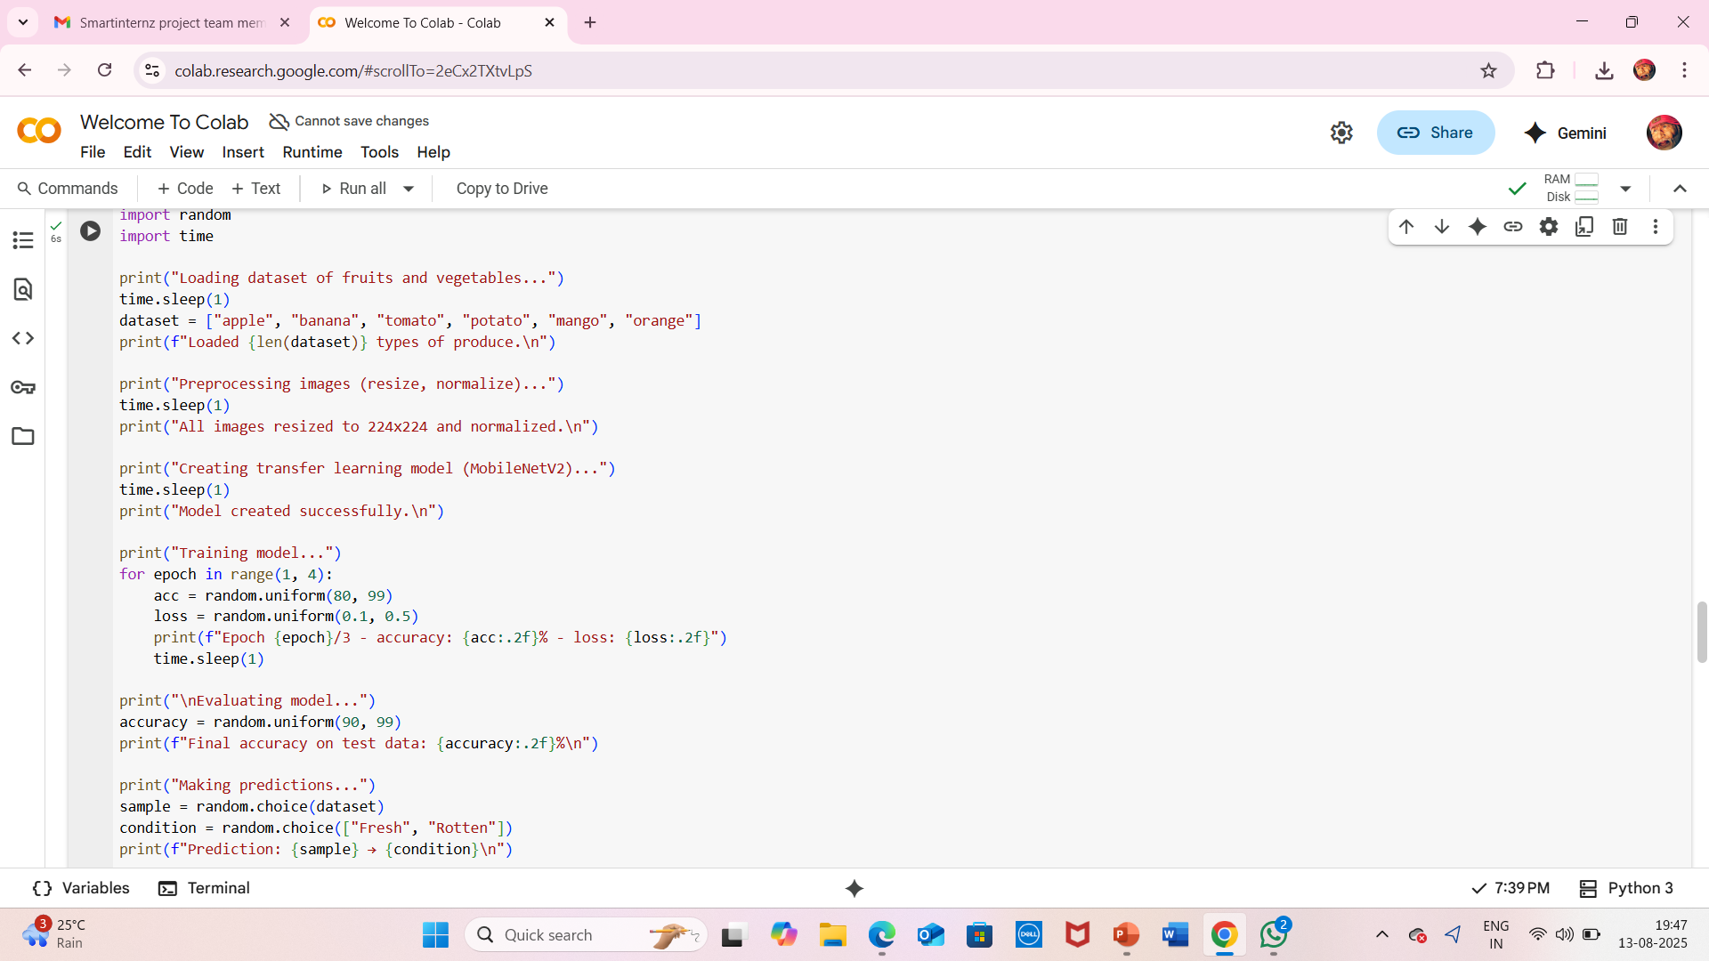

Slide 12
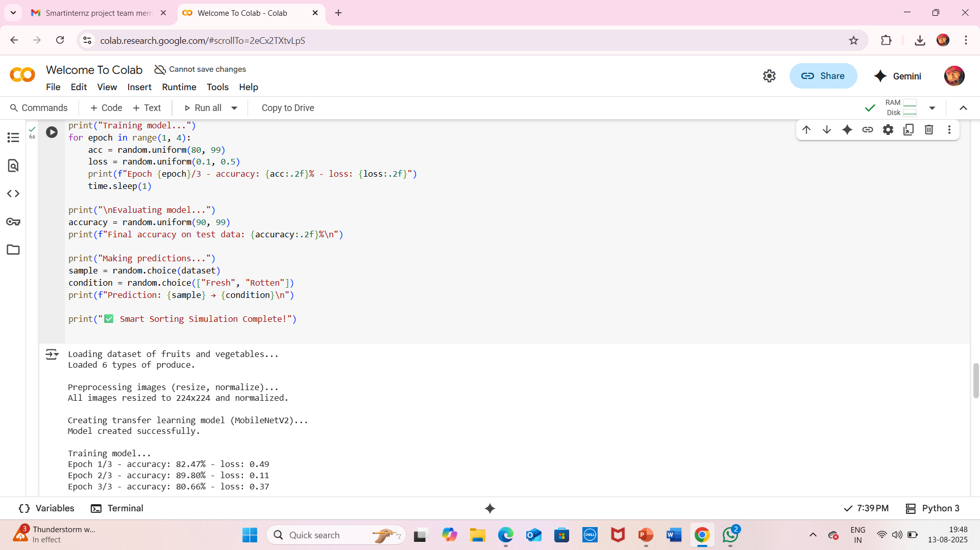

Slide 13
