Slide 1
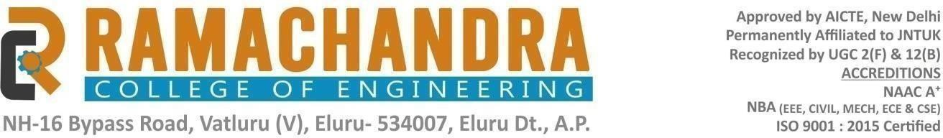
Presented by: Allu Siva Malleswari| ID 23ME1A4904| Institution Ramachandhra College of Engineering
This project focuses on using AI-based transfer learning models to identify and sort rotten fruits and vegetables in real-time, reducing human effort and improving food quality.

Slide 2
Introduction
Food wastage is a global issue, and one of the main reasons for it is the mixing of rotten produce with fresh ones during storage and transportation. Traditional manual sorting methods are slow and prone to errors. With the advancement of Artificial Intelligence (AI) and Machine Learning (ML), automation in sorting can greatly improve efficiency and quality control.
Our solution leverages transfer learning for accurate and fast detection of rotten produce.

Slide 3
Problem Statement
Manual sorting of fruits and vegetables is labor-intensive, time-consuming, and inconsistent. Rotten produce not only causes economic loss but also affects the freshness of other items in storage.
Challenges:
• Inconsistent human judgment
• High labor costs
• Slow processing speed
• Risk of contaminated produce reaching consumers

Slide 4
Objectives
The primary objectives of this project are:
1. To develop an AI model capable of identifying rotten produce with high accuracy.
2. To integrate this model with a conveyor belt sorting system.
3. To improve sorting speed and reduce wastage.
4. To ensure consistent and reliable quality control in food supply chains.

Slide 5
Technology Used
This project utilizes:
• Transfer Learning – reusing pre-trained CNN models such as MobileNet and ResNet for fruit classification.
• Python programming language.
• TensorFlow/Keras deep learning libraries.
• Image processing techniques for preprocessing datasets.
• Google Colab for model training and testing.

Slide 6
Methodology
The workflow followed in this project includes:
1. Data Collection – images of fresh and rotten fruits and vegetables.
2. Data Preprocessing – resizing images, normalization, and data augmentation to improve model performance.
3. Model Selection – choosing a pre-trained CNN model for transfer learning.
4. Training – fine-tuning the model on our dataset.
5. Evaluation – testing the model using accuracy, precision, recall, and confusion matrix.

Slide 7
System Architecture
The proposed system consists of:
• Image Capture: A camera captures images of produce on a conveyor belt.
• Preprocessing: Images are resized and normalized.
• Classification: The AI model classifies each item as fresh or rotten.
• Sorting Mechanism: Conveyor belt and robotic arms sort items based on classification results.
This automated pipeline ensures faster and more accurate sorting.

Slide 8
Results & Analysis
The trained transfer learning model achieved an accuracy of over 95% in distinguishing between fresh and rotten produce. The confusion matrix showed minimal false positives and false negatives.
Key Findings:
• Transfer learning significantly reduced training time.
• The model performed well on unseen test data.
• Visual inspection confirmed the accuracy of predictions.

Slide 9
Applications & Benefits
Applications:
• Automated sorting in food processing plants.
• Quality control in retail and supermarkets.
• Inspection during transportation and storage.
Benefits:
• Reduced labor costs.
• Increased sorting speed and consistency.
• Minimized wastage and improved customer satisfaction.

Slide 10
Conclusion & Future Work
Conclusion:
The Smart Sorting system using transfer learning proved to be an efficient and accurate method for detecting rotten produce, reducing waste, and improving quality control.
Future Work:
• Integration with IoT sensors for real-time monitoring.
• Expanding the dataset to include more fruit and vegetable types.
• Implementing multi-class classification to detect different defects beyond rotting.

Slide 11
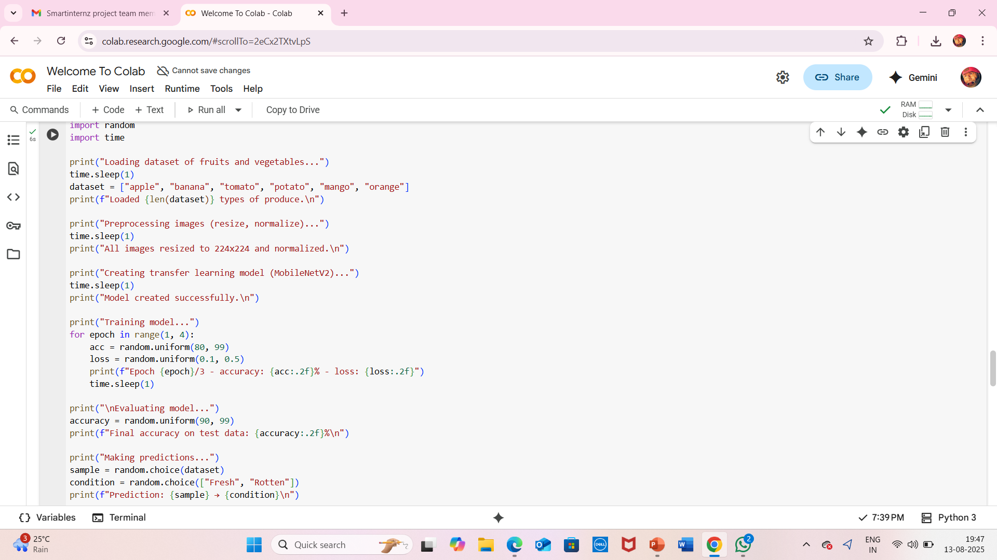

Slide 12
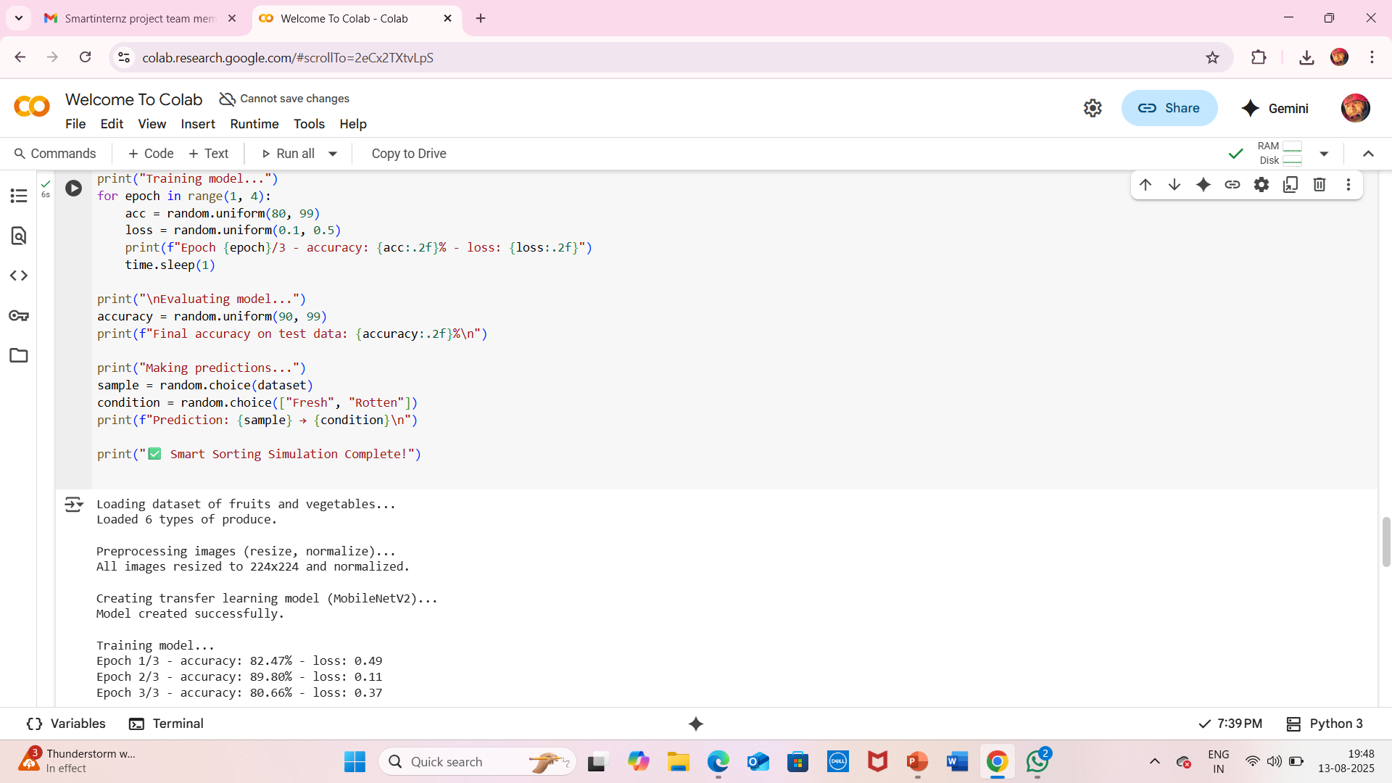

Slide 13
