Slide 1
Analyze Image Distortion and Its Effect on Processing
M.CHANDANA
192472250

Slide 2
What is Image Distortion?
Image distortion is any unwanted change in an image.
It reduces image quality.
It occurs during image capture, transmission, or storage.
Distortion affects computer vision and image processing accuracy.

Slide 3
Causes of Image Distortion
Common Causes
Camera movement
Out-of-focus lens
Low lighting conditions
Sensor noise
Lens defects
Image compression
Transmission errors

Slide 4
Types of Image Distortion
Distortion | Cause | Effect
Blur | Camera shake | Loss of sharpness
Noise | Sensor error | Random pixels
Motion Blur | Moving object | Streaking
Geometric Distortion | Lens defect | Warped image
Compression | JPEG saving | Block artifacts

Slide 5
Effects on Image Processing
Distortion affects:
Edge Detection
Object Detection
Face Recognition
Image Segmentation
OCR (Text Recognition)
Feature Extraction
Result: Lower accuracy and poor system performance.

Slide 6
Tools Used
Software
Python
OpenCV
NumPy
Matplotlib
Techniques Used
Gaussian Blur
Gaussian Noise
JPEG Compression

Slide 7
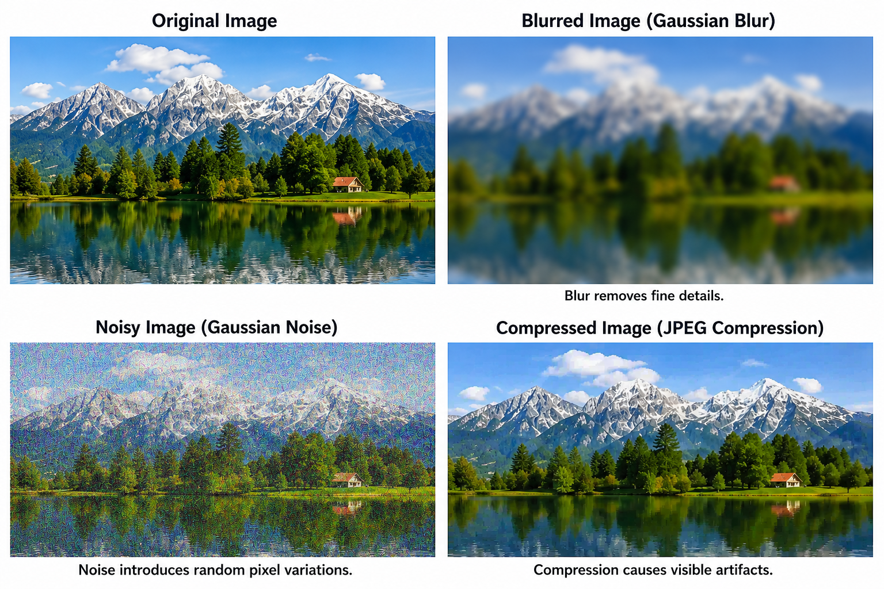
IMAGES

Slide 8
1. Original Image
This is the clear and undistorted reference image with all details preserved.
It is used as the baseline for comparing different types of distortion.
2. Blurred Image — Gaussian Blur
Blurring reduces sharpness and removes fine details from the image.
It can make edges and objects difficult to detect accurately.
3. Noisy Image — Gaussian Noise
Noise adds random pixel variations to the image.
It reduces image quality and can affect feature extraction and object detection.
4. Compressed Image — JPEG Compression
Compression reduces image size by removing some image information.
Excessive compression creates visible artifacts and loss of fine details.

Slide 9
Applications
Image distortion analysis is important in:
Medical Imaging
Autonomous Vehicles
Face Recognition
Satellite Imaging
Robotics
Security Surveillance
Quality Inspection in Manufacturing

Slide 10
Conclusion
Image distortion degrades image quality.
Different distortions have different causes and effects.
Distortions reduce the performance of image processing algorithms.
Understanding distortion helps in designing better image enhancement and restoration methods.
Final Statement:
Analyzing image distortion is essential for improving the reliability and accuracy of computer vision systems.

Slide 11
THANK YOU

