Slide 1

Front End
Development
Task-2

Slide 2
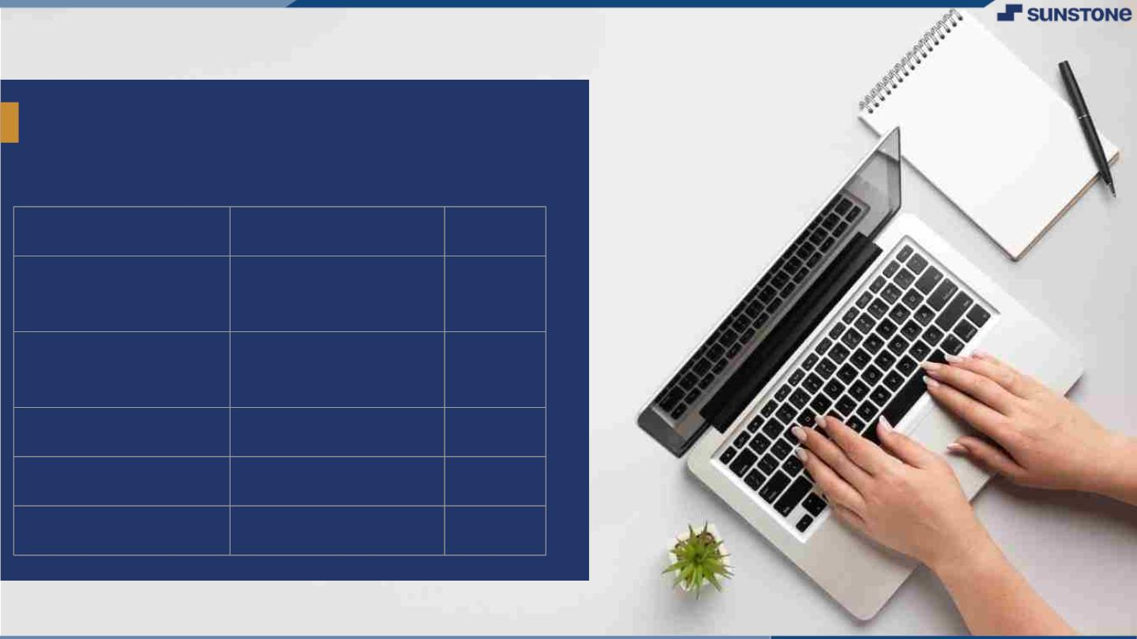
Calendar Using HTML,
CSS, and JavaScript
LMS Username
Name
Batch
A6
2115a619
Vajja mohith
reddy
2115a611
2115a618
Pagadala
malikarjun reddy
A6
Vadlaputi ravi teja A6

Slide 3
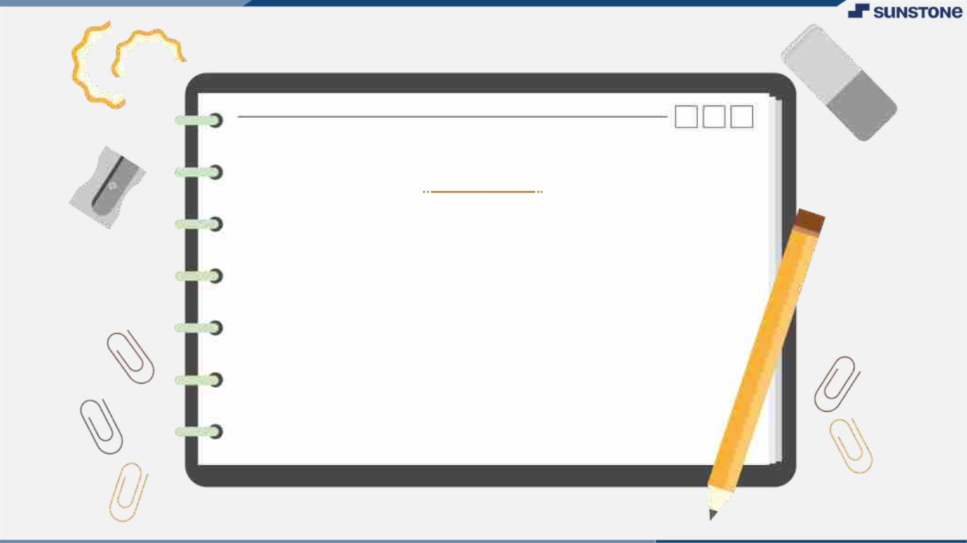
INTRODUCTION
In full-stack development, front-end
development is typically focused on
creating the visual and interactive
elements of the application that users
interact with. Web client-server
architecture is responsible for handling
user interactions and displaying data.

Slide 4

HTML -
▪
HTML is used to create the structure of web
pages; and Bootstrap is a popular CSS
framework that provides predefined styles and
layout options. JavaScript frameworks provide
additional functionality and tools for building
complex, interactive user interfaces. They are
useful to create responsive, interactive, and
efficient user interfaces.
•
•
•
•
•
▪
Web client server architecture
HTML Structure Tags – Forms field
Bootstrap – React.Js
jQuery- ajax - Promises
API integration

Slide 5
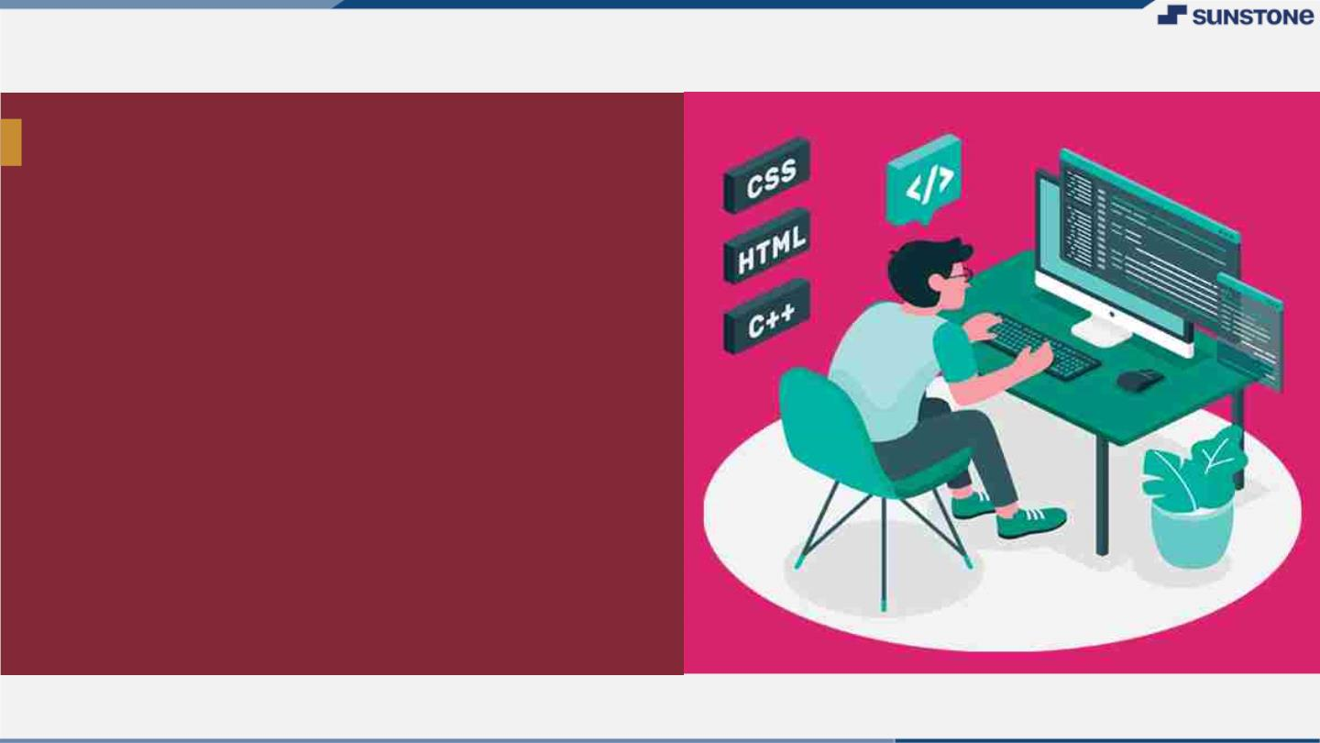
FRONT END DEVELOPMNENT
▪
Developing a user interface webpage by
using front end development.
▪
▪
Using HTML & CSS
For example we have developed a learing
platform for web development ,etc….called
CODETOWN by using “HTML &CSS.

Slide 6

CODETOWN
A. In this example, the page consists of a
header, navigation menu, main content,
and footer. The CSS styles are added in
the head section of the HTML document.
▪
The header contains the page title, and
the navigation menu has links to
different sections of the page. The main
content contains three sections: About
Us, Our Services, and Contact Us. The
Contact Us section has a form for users
to fill out and submit. The footer
contains copyright information.

Slide 7
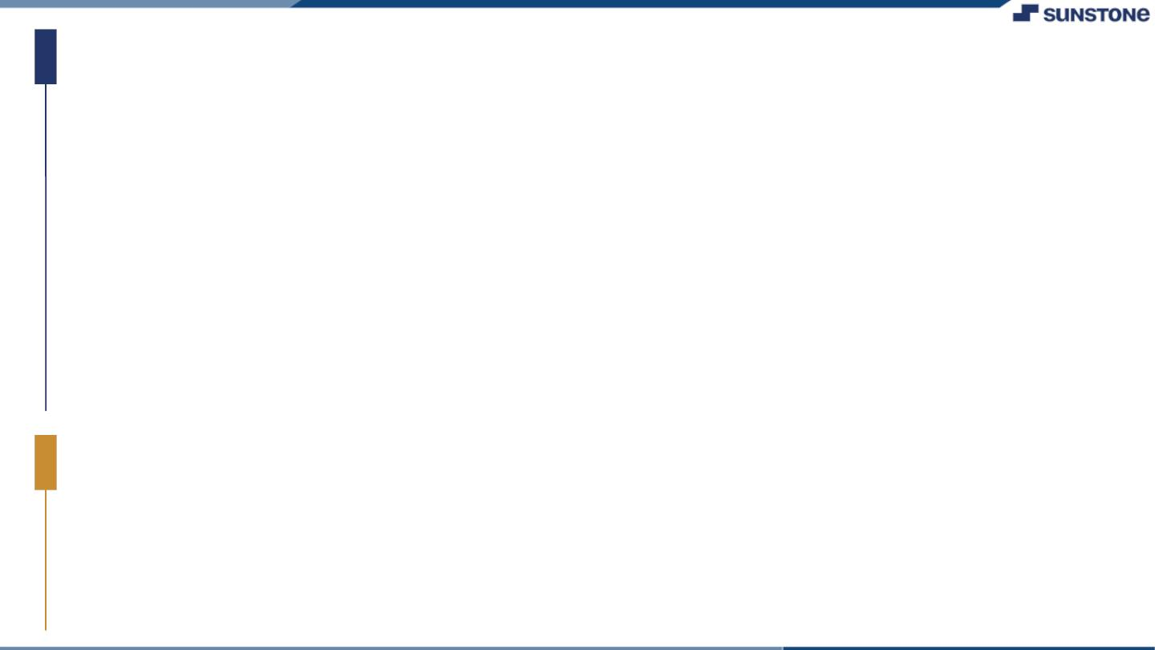
Algorithm :
1.Open a text editor like Notepad or Sublime Text on your computer.
2.Create a new file and save it with the extension ".html". For example,
"index.html".
3.Add the basic HTML structure to the file
4.In the <title> tag, add a title for your web page. This will appear in the
browser tab.
5.In the <body> tag, add the elements that you want to display on your web
page. For example, you can add headings, paragraphs, images, links, forms,
and tables.
6.To add a heading, use the <h1> to <h6>
7.To add a paragraph, use the <p> tag.
8.To add an image, use the <img>
9.To add a link, use the <a> tag.
10.To add a form, use the <form> tag
11.To add a table, use the <table> tag with the <tr>, <th>, and <td> tags.
12.Save the file and open it in a web browser to see how it looks.

Slide 8
SOURCED CODE:
CSS Code For Calendar
body{
background-color: #F5F1E9;
}
#calendar{
margin-left: auto;
margin-right: auto;
width: 320px;
font-family: 'Lato', sans-serif;
}
#calendar_weekdays div{
display:inline-block;
vertical-align:top;
}
#calendar_content, #calendar_weekdays, #calendar_header{
position: relative;
width: 320px;
overflow: hidden;
float: left;
z-index: 10;
}

Slide 9
#calendar_weekdays div, #calendar_content div{
width:40px;
height: 40px;
overflow: hidden;
text-align: center;
background-color: #FFFFFF;
color: #787878;
}
#calendar_content{
-webkit-border-radius: 0px 0px 12px 12px;
-moz-border-radius: 0px 0px 12px 12px;
border-radius: 0px 0px 12px 12px;
}
#calendar_content div{
float: left;
}
#calendar_content div:hover{
background-color: #F8F8F8;
}

Slide 10
#calendar_content div.blank{
background-color: #E8E8E8;
}
#calendar_header, #calendar_content div.today{
zoom: 1;
filter: alpha(opacity=70);
opacity: 0.7;
}
#calendar_content div.today{
color: #FFFFFF;
}
#calendar_header{
width: 100%;
height: 37px;
text-align: center;
background-color: #FF6860;
padding: 18px 0;
-webkit-border-radius: 12px 12px 0px 0px;
-moz-border-radius: 12px 12px 0px 0px;
border-radius: 12px 12px 0px 0px;
}

Slide 11
#calendar_header h1{
font-size: 1.5em;
color: #FFFFFF;
float:left;
width:70%;
}
i[class^=icon-chevron]{
color: #FFFFFF;
float: left;
width:15%;
border-radius: 50%;
}

Slide 12
HTML Code For Calendar
<!DOCTYPE html>
<html lang="en">
<head>
<meta charset="UTF-8" />
<meta http-equiv="X-UA-Compatible" content="IE=edge" />
<meta name="viewport" content="width=device-width, initial-scale=1.0" />
<title>calendar</title>
<link rel="stylesheet" href="style.css">
<link rel="stylesheet" href="https://fonts.googleapis.com/css?family=Lato">
<link rel="stylesheet" href="https://netdna.bootstrapcdn.com/font-awesome/3.2.1/css/font-awesome.css">
</head>
<body>
<div id="calendar">
<div id="calendar_header">
<i class="icon-chevron-left"></i>
<h1></h1>
<i class="icon-chevron-right"></i>
</div>
<div id="calendar_weekdays"></div>
<div id="calendar_content"></div>
</div>
<!-- JAVASCRIPT -->

Slide 13
<script src="app.js"></script>
</body>
</html>
Javascript code For Calendar
$(function () {
function c() {
p();
var e = h();
var r = 0;
var u = false;
l.empty();
while (!u) {
if (s[r] == e[0].weekday) {
u = true;
} else {
l.append('<div class="blank"></div>');
r++;
}
}
for (var c = 0; c < 42 - r; c++) {

Slide 14
if (c >= e.length) {
l.append('<div class="blank"></div>');
} else {
var v = e[c].day;
var m = g(new Date(t, n - 1, v)) ? '<div class="today">' : "<div>";
l.append(m + "" + v + "</div>");
}
}
var y = o[n - 1];
a.css("background-color", y)
.find("h1")
.text(i[n - 1] + " " + t);
f.find("div").css("color", y);
l.find(".today").css("background-color", y);
d();
}
function h() {
var e = [];
for (var r = 1; r < v(t, n) + 1; r++) {
e.push({ day: r, weekday: s[m(t, n, r)] });

Slide 15
}
return e;
}
function p() {
f.empty();
for (var e = 0; e < 7; e++) {
f.append("<div>" + s[e].substring(0, 3) + "</div>");
}
}
function d() {
var t;
var n = $("#calendar").css("width", e + "px");
n.find((t = "#calendar_weekdays, #calendar_content"))
.css("width", e + "px")
.find("div")
.css({
width: e / 7 + "px",
height: e / 7 + "px",
"line-height": e / 7 + "px",
});
n.find("#calendar_header")

Slide 16
.css({ height: e * (1 / 7) + "px" })
.find('i[class^="icon-chevron"]')
.css("line-height", e * (1 / 7) + "px");
}
function v(e, t) {
return new Date(e, t, 0).getDate();
}
function m(e, t, n) {
return new Date(e, t - 1, n).getDay();
}
function g(e) {
return y(new Date()) == y(e);
}
function y(e) {
return e.getFullYear() + "/" + (e.getMonth() + 1) + "/" + e.getDate();
}
function b() {
var e = new Date();
t = e.getFullYear();
n = e.getMonth() + 1;
}

Slide 17
var e = 480;
var t = 2013;
var n = 9;
var r = [];
var i = [
"JANUARY",
"FEBRUARY",
"MARCH",
"APRIL",
"MAY",
"JUNE",
"JULY",
"AUGUST",
"SEPTEMBER",
"OCTOBER",
"NOVEMBER",
"DECEMBER",
];
var s = [
"Sunday",
"Monday",

Slide 18
"Tuesday",
"Wednesday",
"Thursday",
"Friday",
"Saturday",
];
var o = [
"#16a085",
"#1abc9c",
"#c0392b",
"#27ae60",
"#FF6860",
"#f39c12",
"#f1c40f",
"#e67e22",
"#2ecc71",
"#e74c3c",
"#d35400",
"#2c3e50",
];

Slide 19
var u = $("#calendar");
var a = u.find("#calendar_header");
var f = u.find("#calendar_weekdays");
var l = u.find("#calendar_content");
b();
c();
a.find('i[class^="icon-chevron"]').on("click", function () {
var e = $(this);
var r = function (e) {
n = e == "next" ? n + 1 : n - 1;
if (n < 1) {
n = 12;
t--;
} else if (n > 12) {
n = 1;
t++;
}
c();
};
if (e.attr("class").indexOf("left") != -1) {

Slide 20
r("previous");
} else {
r("next");
}
});
});

Slide 21
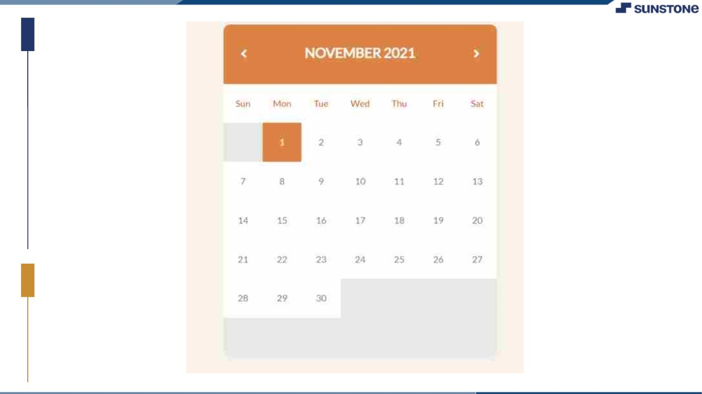
Sample Output:

Slide 22
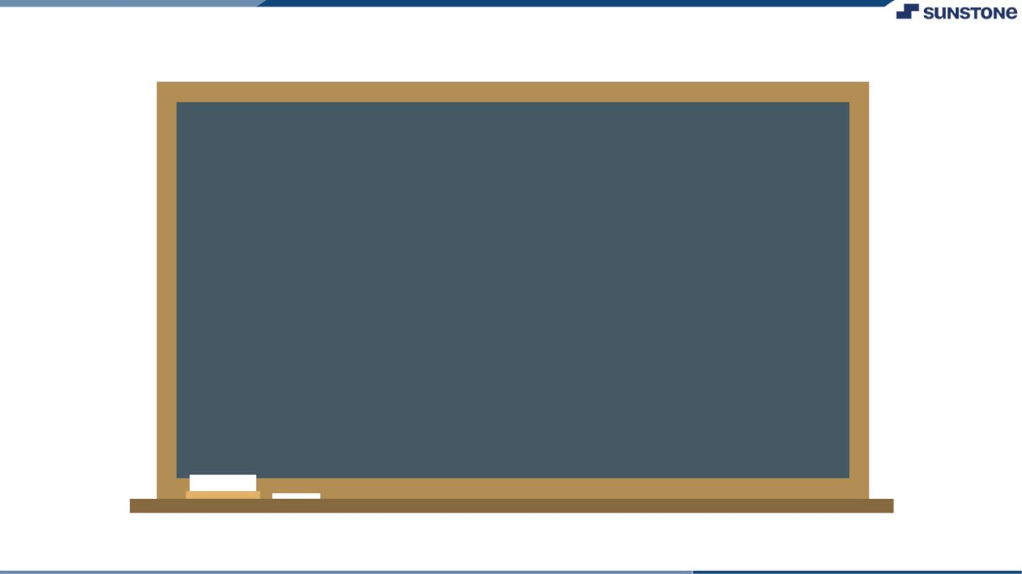
▪
▪
In conclusion, front-end development is a critical
aspect of web development that involves designing
and developing the visual and interactive
components of a website. It requires knowledge of
HTML, CSS, and JavaScript, as well as an
understanding of user experience (UX) and user
interface (UI) design principles.
The front-end developer is responsible for creating
an engaging user experience by designing and
implementing the layout, typography, color
schemes, and graphics of a website. They also
ensure that the website is responsive and
accessible across multiple devices and platforms.

Slide 23

Front-end development is a constantly evolving field, with
new technologies and frameworks emerging regularly.
Therefore, it is crucial for front-end developers to keep up
with the latest trends and developments in the industry to
create modern and functional websites that meet the
needs of users and businesses alike.

Slide 24

In summary, front-end development plays a crucial role in creating
visually appealing and engaging websites that attract and retain
users. With the right skills and knowledge, front-end developers
can create effective user interfaces that provide an exceptional
user experience, thereby contributing to the success of a website
and its business.

Slide 25

Submission Github
https://github.com/Malliakarjun0
7/full-stack

Slide 26


