Slide 2
Lab Setup
Mark Pryce-Maher
AzureDW CSE
Data Architect
maprycem@microsoft.com

Slide 3
Welcome to the Amsterdam Airlift
To enable your test Azure Subscription
https://manage.cloudlabs.ai/#/odl/943bc193-0fc5-4754-a9a6-5d7c4f2e71e0
GitHub
http://aka.ms/AmsterdamArlift

Slide 4
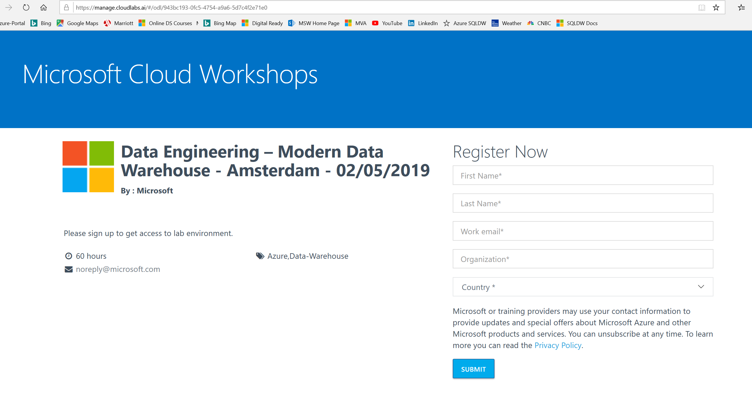
Lab Setup
Enter your details and click submit

Slide 5
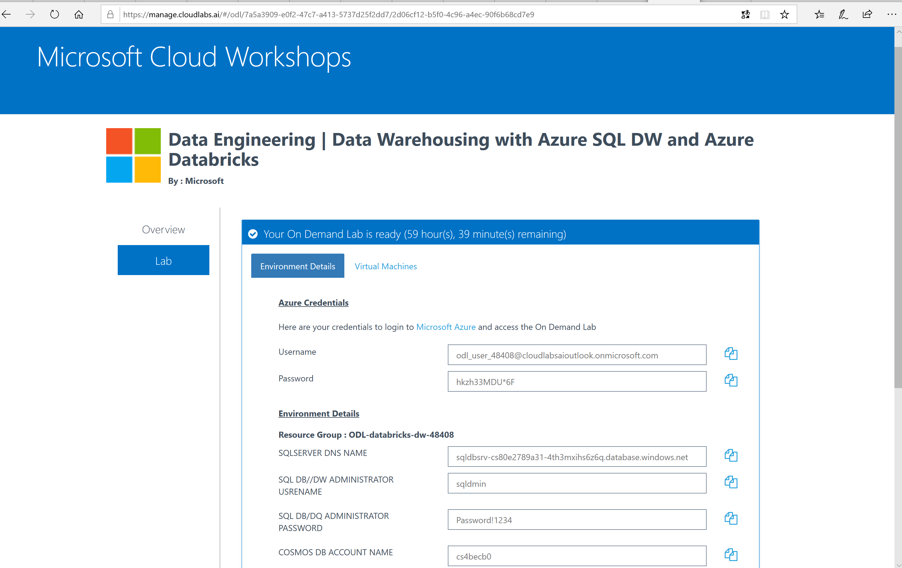
Your test Azure subscription will be created for you

Slide 6
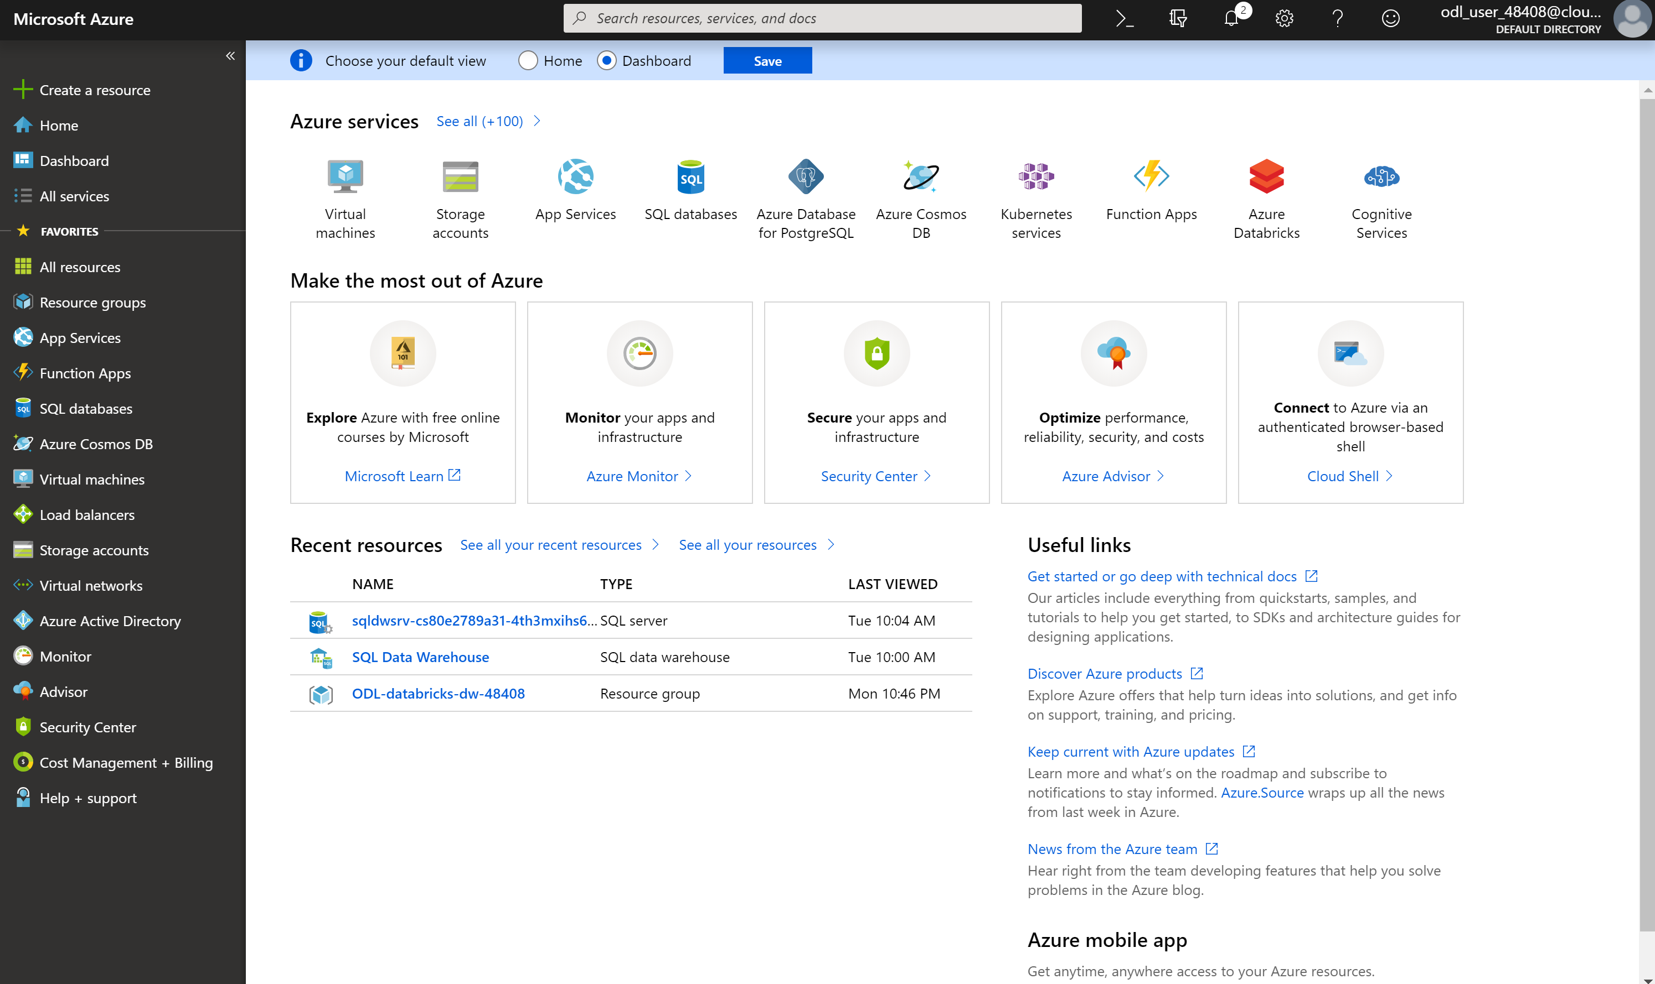
Goto portal.azure.com and login with details from previous screen

Slide 7
Tools
Azure Data Studio - http://aka.ms/azuredatastudio
SQL Server Management Studio 17.x
Azure Storage Explorer - https://azure.microsoft.com/en-us/features/storage-explorer/
*Don’t forget firewalls

Slide 8
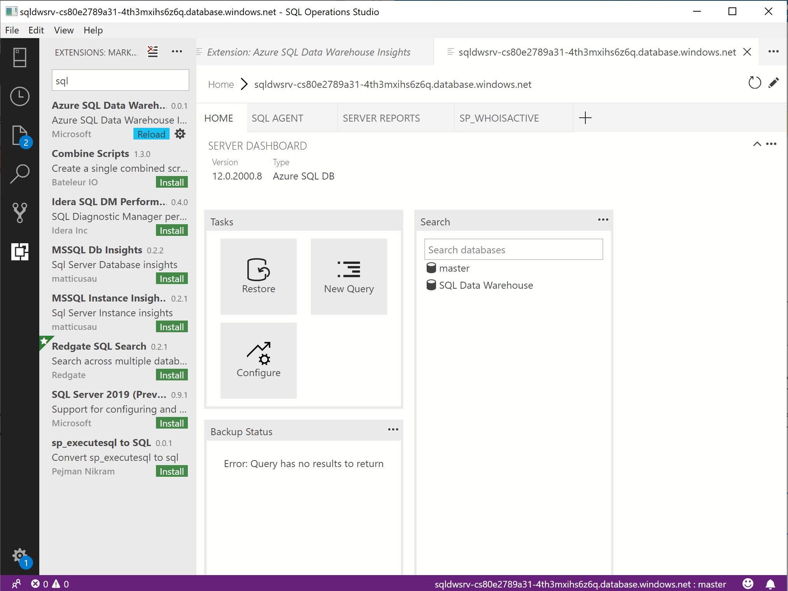

Slide 9
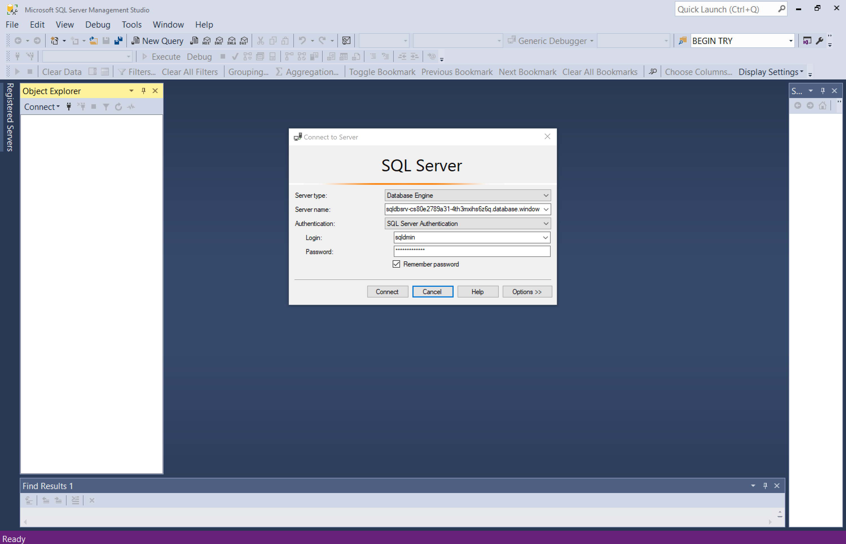

Slide 10
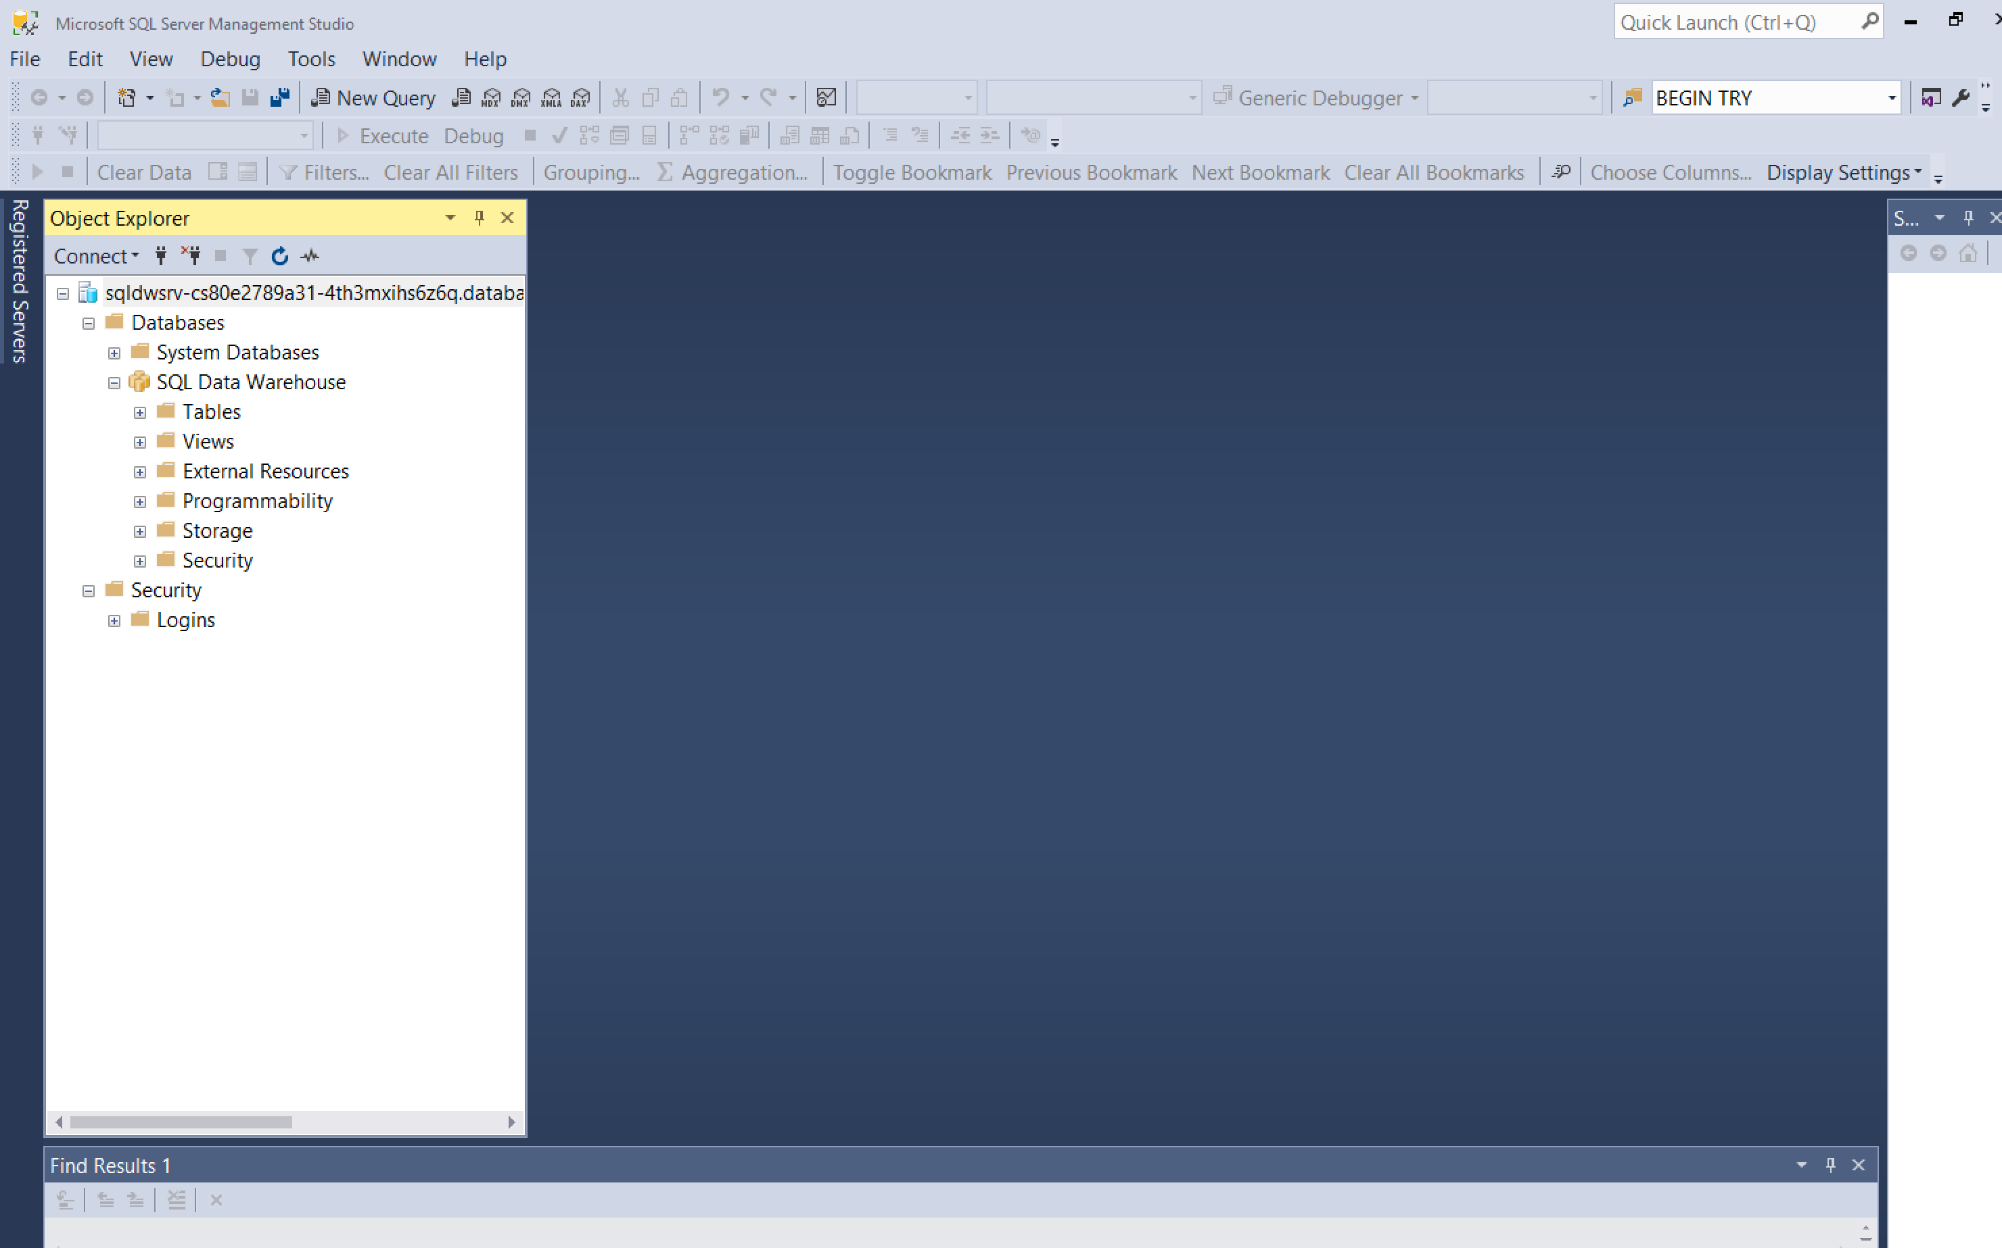

Slide 11
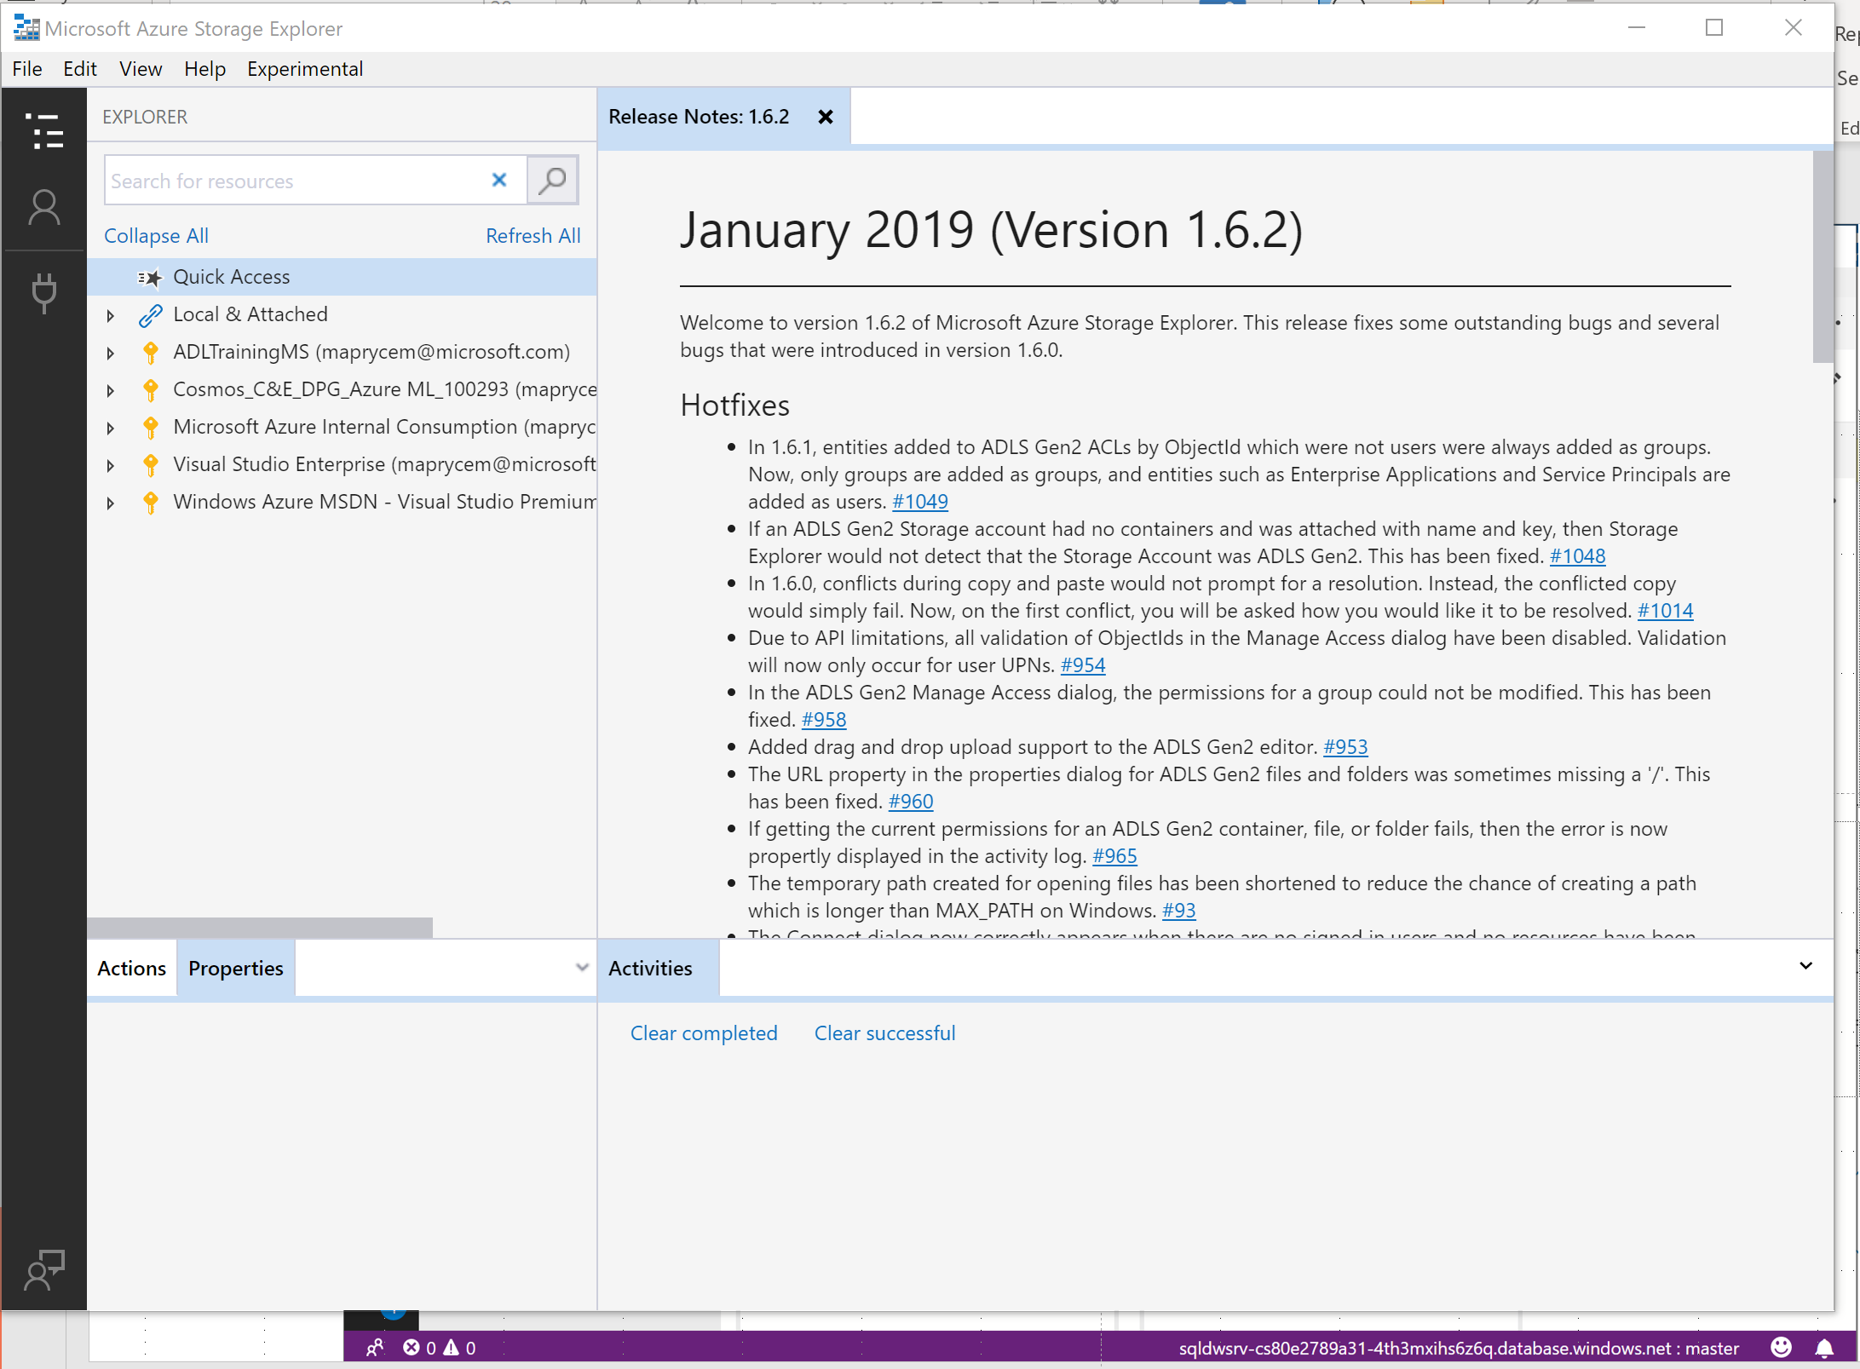

Slide 12
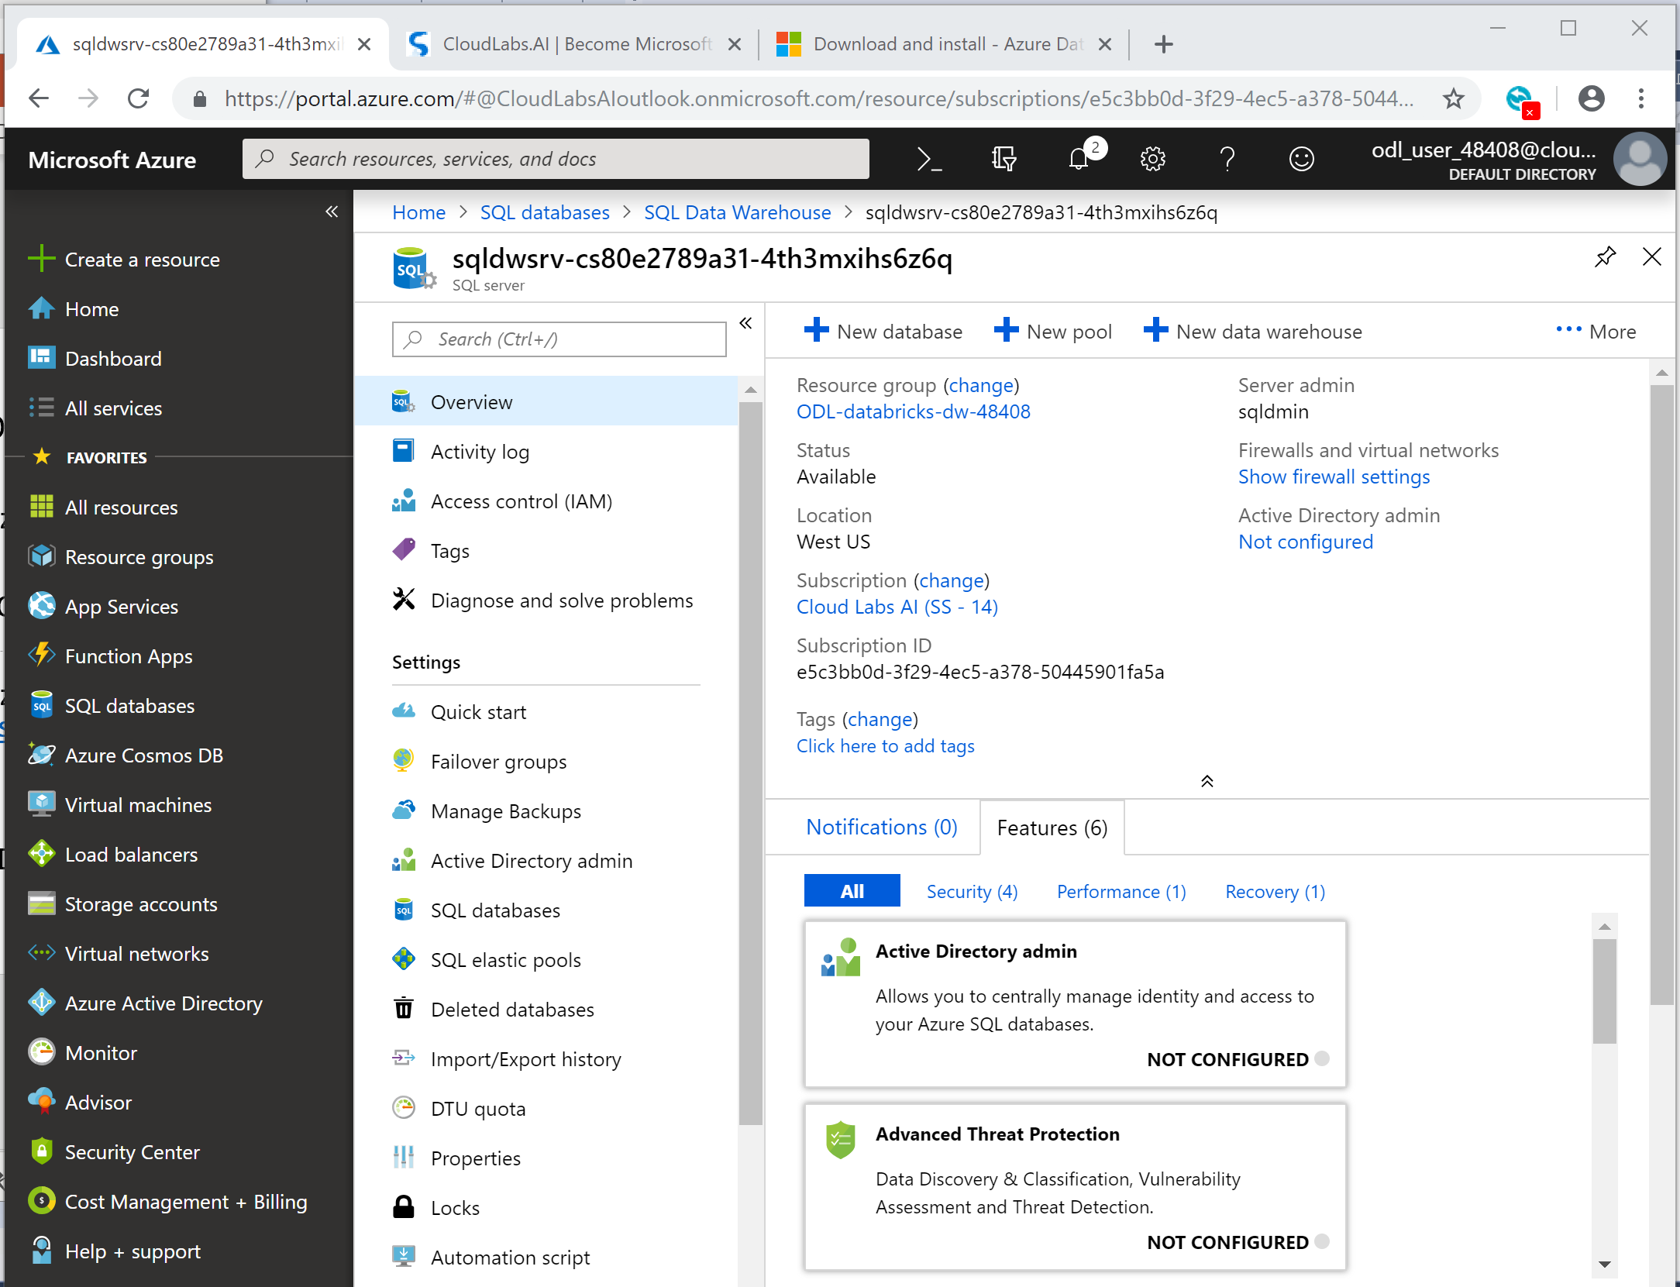

Slide 13
More info
ADF labs : https://github.com/kromerm/adflab
Taxi import: https://github.com/MicrosoftDocs/azure-docs/blob/master/articles/sql-data-warehouse/load-data-from-azure-blob-storage-using-polybase.md
Import tools: https://github.com/Microsoft/AzureDWScriptsandUtilities
Azure DW toolbox: https://github.com/Microsoft/AzureDW_Query_Toolbox
https://azure.microsoft.com/en-us/services/sql-data-warehouse/

