Slide 1

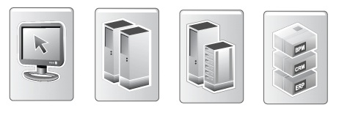
Integration Metadata
Information Delivery
Exception Handling
Presentation Layer
Integration Metadata
Integration Layer / Data Vault
Staging Layer
Source Systems

Slide 2
Figure 2

Slide 3
Figure 3

Slide 4
Figure 4

Slide 5
Figure 5

Slide 6
Figure 6
Batch scheduler (i.e. script or job)
Batch (workflow / container)
Module 1
Module 2
Module 3
Batch start
Module start
Module finish
Batch finish
Repository (event logging and validation)

Slide 7
Figure 7

Slide 8
Figure 7

