Slide 1
Organising a Data Lake
Subtitle or speaker name

Slide 2
Logical Structure
Raw/Source
Cleansed
Curated/Modelled
Sandbox/Experimental
Incoming Data
Original Source
Historical
Changed format only
Tidy up data
Correct format
Create tables
Standardising
Model
Aggregates
More freedom
ML Workloads
Agility

Slide 3
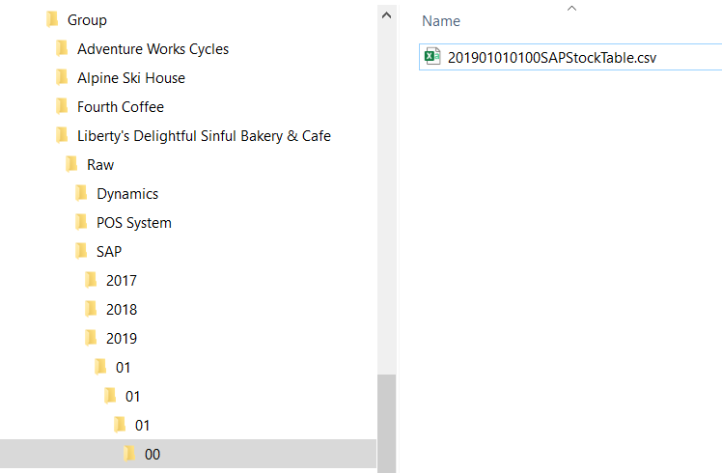
Folder Structure
Purpose (Raw, Refined etc.)
System/Origin
Organisation/Business Unit
Date
Sensor Name/ID

Slide 4
File Naming
Date
Time
System
Table
Format
Purpose
Device Serial Number (IoT)

Slide 5
Examples – Storage Accounts
Group/Company/purpose/System/Date/File
Group/Company/purpose/System/Date/File
Storage Account
Folder Structure
Storage Account
Folder Structure

Slide 6
Examples – Folder and File Structures
group/company/purpose/system/yyyy/MM/dd/HH/file.csv
group/company/system/purpose/yyyy/MM/dd/HH/file.csv
purpose/system/company/yyyyMMddHH.csv
purpose/yyyyMMddHHCompanySystemTable.csv

Slide 7
File Formats
CSV
JSON
AVRO
Parquet

