Slide 1
Organising a Data Lake
Subtitle or speaker name

Slide 2
Plain Text Formats
CSV, TSV
Ubiquitous
Great for human readability
Great for portability
FirstName, LastName, Age
David, Jones, 36
Jodie, Nichols, 45
Adam, Simpson, 22

Slide 3
Structured Text Formats
<person>
<FirstName>David</FirstName>
<LastName>Jones</LastName>
<Age>36</Age>
</person>
<person>
<FirstName>Jodie</FirstName>
<LastName>Nichols</LastName>
<Age>45</Age>
</person>
JSON, XML
Easy to open
Good structure
Allows many to one/many
Great for portability
Great for interoperability
People : [
{
“FirstName” : “David”,
“LastName” : “Jones”,
“Age” : 36
}
{
“FirstName” : “Jodie”,
“LastName” : “Nichols”,
“Age” : 45
}
]

Slide 4
Columnar Formats
Compressed File
FirstName
LastName
Age
David
Jones
36
Parquet, ORC
Good compression
Fast to process
Great for reading
Great for batch movement
Great for Queries
Poor for individual writes
Jodie
Nichols
45
Adam
Simpson
22
Schema/Metadata

Slide 5
Row based formats
Binary File
FirstName
LastName
Age
AVRO
Fast appends
Great for writing event data
Poor for reading
David
Jones
36
Jodie
Nichols
45
Adam
Simpson
22

Slide 6
Logical Structure
Raw/Source
Cleansed
Curated/Modelled
Sandbox/Experimental
Incoming Data
Original Source
Historical
Changed format only
Tidy up data
Correct format
Create tables
Standardising
Model
Aggregates
More freedom
ML Workloads
Agility

Slide 7
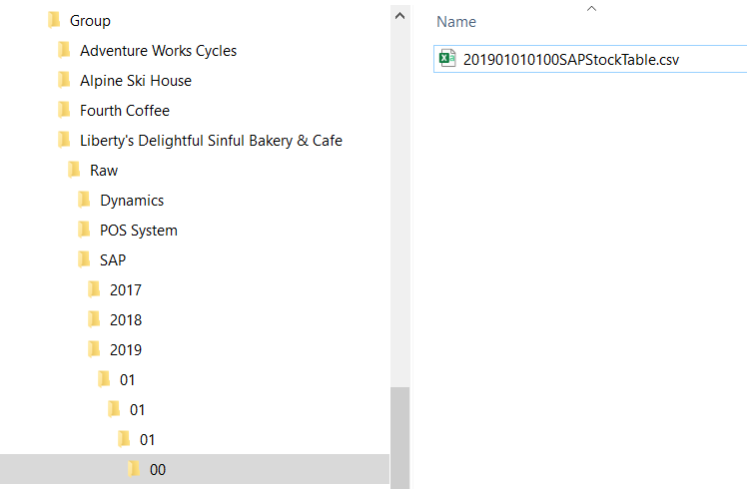
Folder Structure
Purpose (Raw, Refined etc.)
System/Origin
Organisation/Business Unit
Date
Sensor Name/ID

Slide 8
File Naming
Date
Time
System
Table
Format
Purpose
Device Serial Number (IoT)

Slide 9
Examples – Storage Accounts
Group/Company/purpose/System/Date/File
Group/Company/purpose/System/Date/File
Storage Account
Folder Structure
Storage Account
Folder Structure

Slide 10
Examples – Folder and File Structures
group/company/purpose/system/yyyy/MM/dd/HH/file.csv
group/company/system/purpose/yyyy/MM/dd/HH/file.csv
purpose/system/company/yyyyMMddHH.csv
purpose/yyyyMMddHHCompanySystemTable.csv

