Slide 1
Using Adaboost Algorithm to Enhance the Prediction Accuracy of Decision Trees

Slide 2
Outline
Adaboost Algorithm
The Dataset
Data Exploration and Visualization
Prediction Using a Single Decision Tree
Prediction Using with Random Forest
Prediction Using Adaboost
Can we improve even further?
Comparison
References

Slide 3
Bagging (Bootstrap aggregating)-Random Forest
Take M bootstrap samples (with replacement)
Train M different classifiers on these bootstrap samples
For a new query, let all classifiers predict and take an average (or majority vote)
If the classifiers make independent errors, then their ensemble can improve performance.
Stated differently: the variance in the prediction is reduced (we don’t suffer from the random errors that a single classifier is bound to make).

Slide 4
Random Forest
Ensemble consisting of a bagging of un-pruned
decision tree learners with a randomized selection of
features at each split.
Grow many trees on datasets sampled from the original dataset with replacement (a bootstrap sample).
Draw K bootstrap samples of a fixed size
Grow a DT, randomly sampling a few attributes/dimensions to split on at each internal node
Average the predictions of the trees for a new query (or take majority vote)
Random Forests are state of the art classifiers!

Slide 5
Boosting
Train classifiers (e.g. decision trees) in a sequence.
A new classifier should focus on those cases which were incorrectly classified in the last round.
Combine the classifiers by letting them vote on the final prediction (like bagging).
Each classifier is “weak” but the ensemble is “strong.”
AdaBoost is a specific boosting method.

Slide 6
Adaboost Algorithm
Adaboost is short for “Adaptive Boosting”
Created by Yoav Freund and Robert Schapire in 1997
Aaboost is a meta-algorithm (provides a sufficiently good solution to an optimization problem)
Can be used with other learning algorithms to improve their performance
Makes the weak classifiers strong by combining them
Typically, decision trees (which we’ll use in this project)

Slide 7
Adaboost Algorithm (cont.)
Weak models are added sequentially after being trained on the training data
The process continues until:
No further improvement can be made on the training data set
A threshold number of weak classifiers is created
Predication are then made by taking the weighted average of the weak classifiers
Each weak classifier has a weight (its classification result is multiplied by its weight)

Slide 8
Adaboost Algorithm (cont.)
It is better to have these characteristics in the data before processing it with adaboost:
Quality Data:
Ensemble method attempts to correct misclassifications in the training data
Make sure that the training data is of high-quality
Outliers:
Outliers will force the ensemble to work very hard in order to correct for cases that are unrealistic
Best to remove them from dataset
Noisy Data:
Noise in the output variable can be problematic for ensemble
Isolate and clean the noisy data from your training dataset

Slide 9
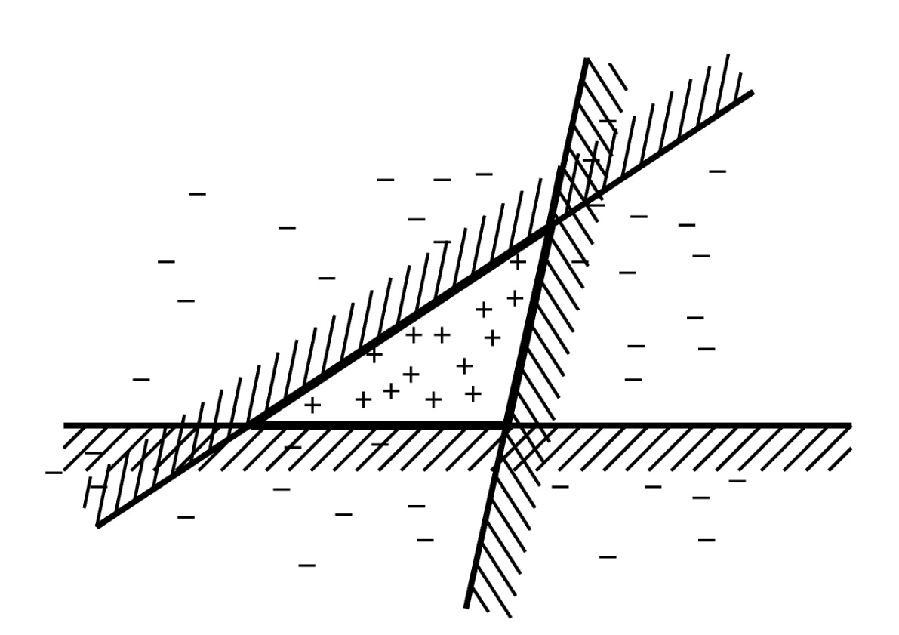
Example
This line is one simple classifier saying that
everything to the left + and everything to the right
is -

Slide 10
Boosting Intuition
We adaptively weigh each data case.
Data cases which are wrongly classified get high weight (the algorithm will focus on them)
Each boosting round learns a new (simple) classifier on the weighed dataset.
These classifiers are weighed to combine them into a single powerful classifier.
Classifiers that that obtain low training error rate have high weight.
We stop by using monitoring a hold out set (cross-validation).

Slide 11
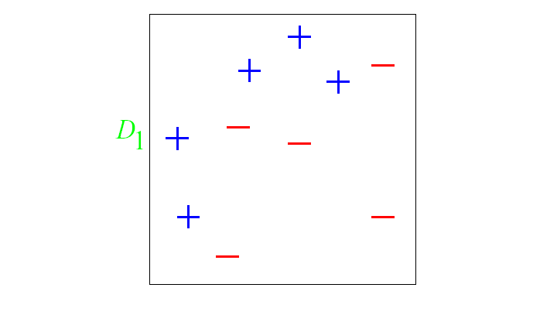
And in animation
Original training set: equal weights to all training samples
Taken from “A Tutorial on Boosting” by Yoav Freund and Rob Schapire

Slide 12
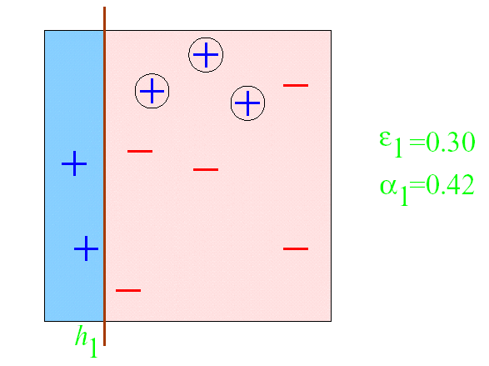
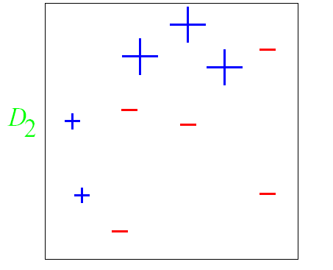
AdaBoost example
ε = error rate of classifier
α = weight of classifier
ROUND 1

Slide 13
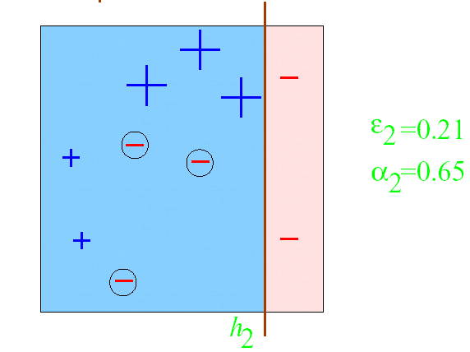
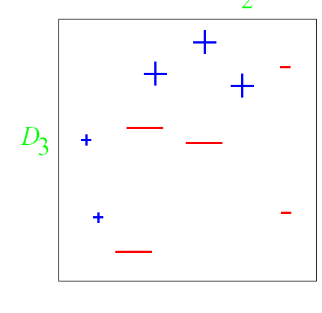
AdaBoost example
ROUND 2

Slide 14
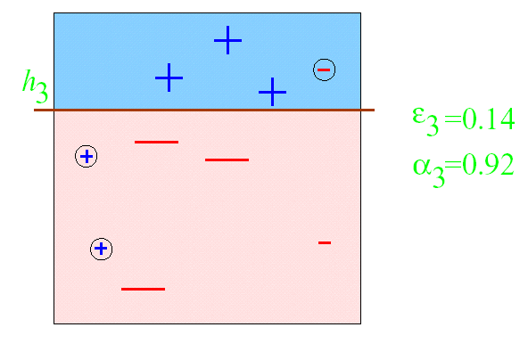
AdaBoost example
ROUND 3

Slide 15
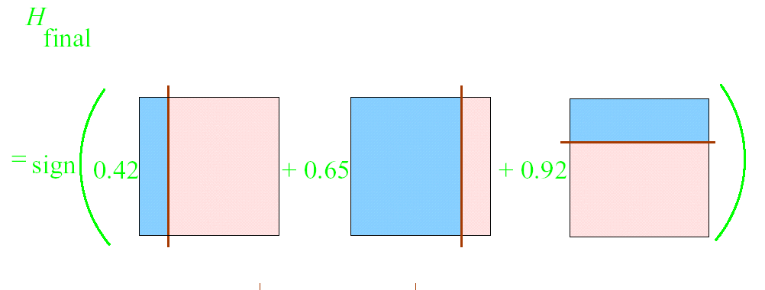
AdaBoost example

Slide 16
The Data Set & Rattle()
For facilitations of comparisons:
We continue our discussion with the weather dataset
We shall also continue with the rattle() package

Slide 17
References
Boosting and AdaBoost for Machine Learning
What is AdaBoost - Quora
Adaboost – Wikipedia
Identify, describe, plot, and remove the outliers from the dataset
Try-Out: Wine Quality Data Set - UCI Machine Learning Repository

