Slide 1
Cleaning and Analyzing Crime Data
Project 1
IE6400 Foundations Data Analytics Engineering
Fall 2023 Semester
Group 6-
Giridhar Babu
Hemant Manohar Deshmukh
Mallika Gaikwad
Sharvari Pravin Deshpande
Medhavi Uday Pande

Slide 2
Introduction
With the help of this project, we will be able to identify which areas in the United States are safer than others by analyzing various trends related to the crime rates that occur in various regions and creating distinct trends based on the types of crimes that occur in various cities and regions. We forecast and create a time series model forecasting the future crime timeline based on historical data in order to obtain additional insights into local and timely crimes. We discovered the underlying cause of crimes and the economic elements influencing them. To evaluate the correlations between the economic variables and crime rates, we examined correlational events and statistical techniques. Understanding how large incidents like thefts and violence affect specific people reveals insights and useful trends.

Slide 3
Data Sources
Official Government Website
Data has been derived from paper format, hence can have inaccuracies.
Instances where specific location data was missing are denoted as (0°, 0°).
In preparing the crime dataset, crucial steps were taken, encompassing data acquisition, thorough inspection, meticulous cleaning, and exploratory data analysis (EDA).
Feature extraction technique was implemented to extract valuable insights from the available data.

Slide 4
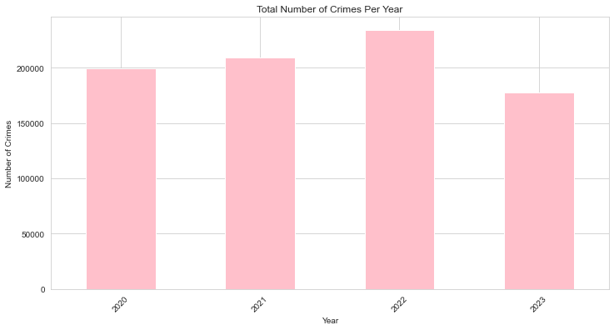
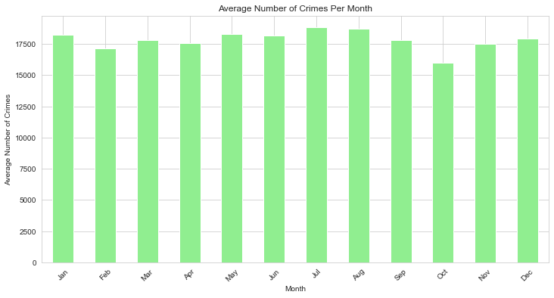
Results and Methods
Overall crime trends
Seasonal Patterns

Slide 5
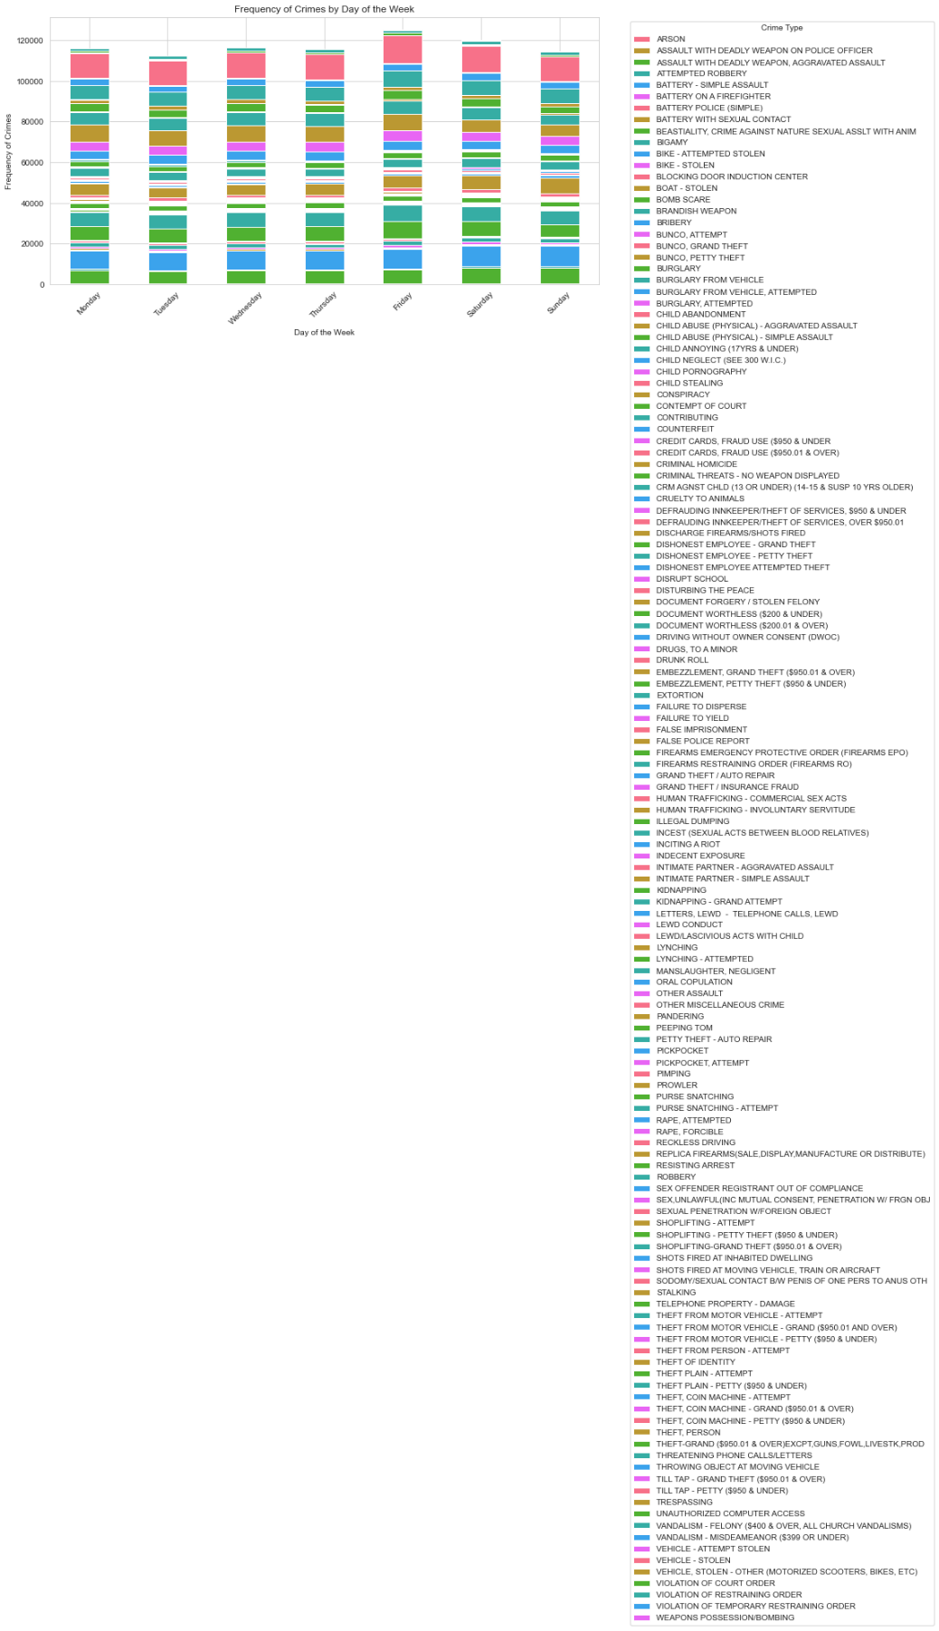
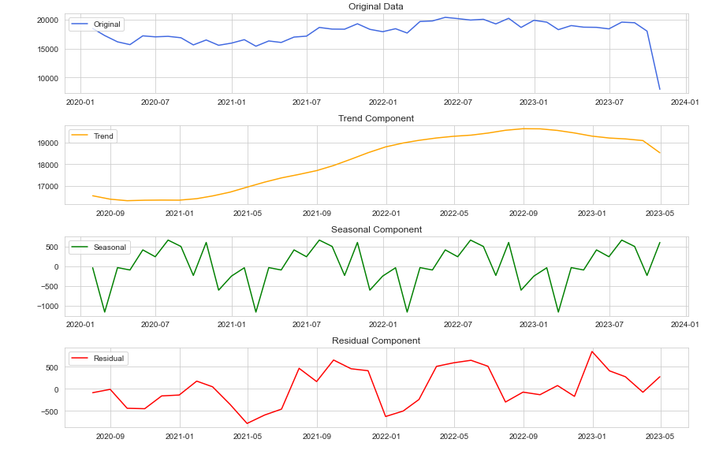
Analysis and visualization of seasonal patterns in crime data.
Analysis of the relationship between the day of the week and the frequency of certain types of crimes

Slide 6
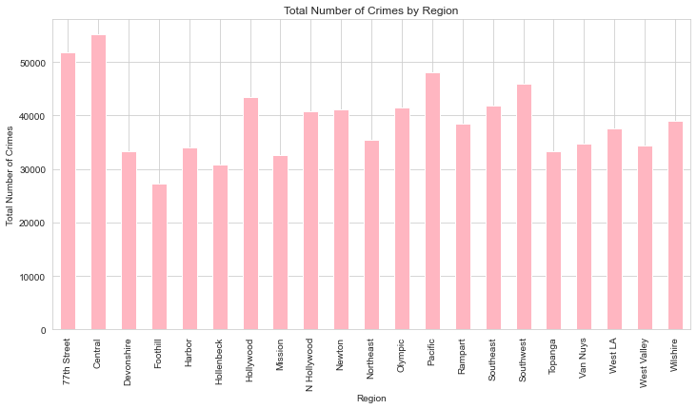
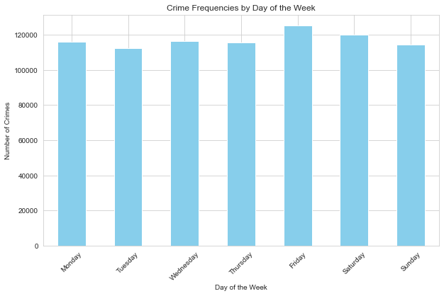
Day of the week analysis
Regional differences

Slide 7
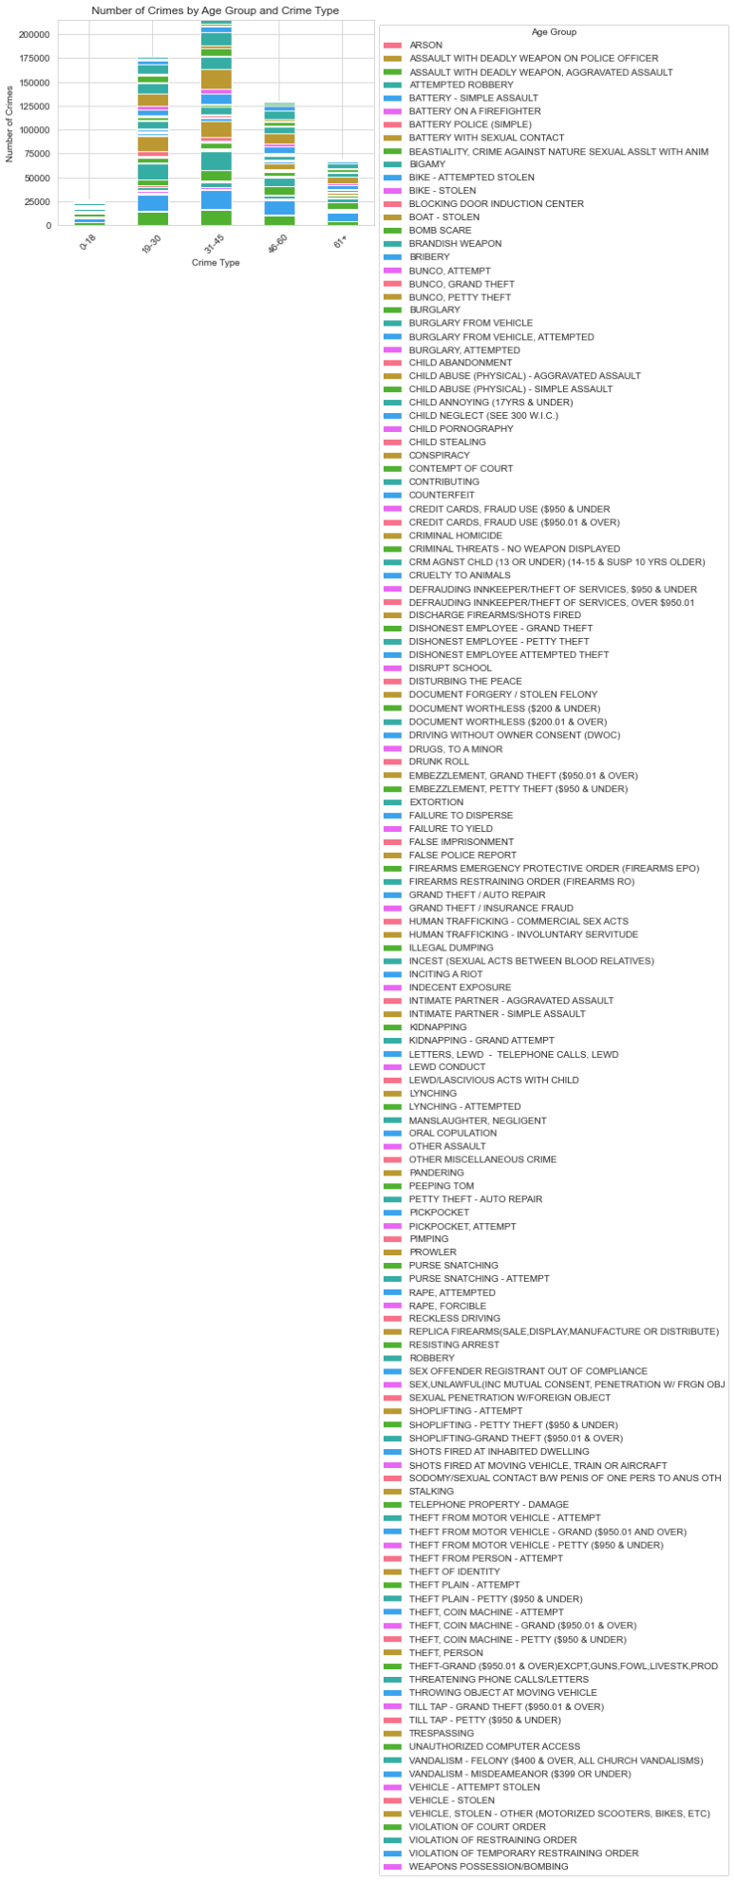
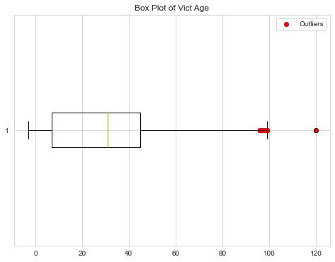
Demographic factors
Outliers and anomalies

Slide 8
Limitations
Possibility of lack of Completeness of Data for 2023.
Inclusion of contextual information about impact of policy changes on crimes.
No categorization of identity thefts leading to lack of analysis.
Subjective judgment leading to biased data.

Slide 9
Future Scope
Improve data quality and completeness.
Study identity thefts, their bifurcations for new law creation.
Influence of policy changes on the data can be analyzed.
Include more specifics for geographical analysis to make area specific decisions.
Predictive modelling and time series forecasting methods can be used for developing law enforcement strategies.
Include sociological factors since criminal activities can be linked to these.
Correlation analysis between crime and economic factors like unemployment, low income cab be done to take appropriate measures.

Slide 10
Thank you! ☺

