Slide 1
Predicting Mortality Rate of Lung Cancer Patients Within One Year of Surgery
Mallika Thanky
Snigdha Prabhu
Cagatay Dursun

Slide 2
AGENDA
Background and Problem Statement
Data
Two Modeling Approaches and Insights From Each Method
Model Comparisons
Overall Findings and Recommendations

Slide 3
Background and Problem Statement

Slide 4
Lung Cancer and Mortality Statistics
Lung cancer is the leading cancer killer in both men and women in the U.S., and it’s the most common cancer worldwide.
An estimated 158,080 Americans are expected to die from lung cancer in 2016, accounting for approximately 27% of all cancer deaths.
During 2016, an estimated 224,390 new cases of lung cancer were expected to be diagnosed, representing about 13 percent of all cancer diagnoses.
The majority of living lung cancer patients have been diagnosed within the last five years.
Lung cancer is mostly a disease of the elderly. In 2013, 83 percent of those living with lung cancer were 60 years of age or older.
The lung cancer five-year survival rate is 17.7 percent, which is lower than many other cancers.
More than half of people with lung cancer die within one year of being diagnosed.
Notes:
leading cancer killer (27% of all cancer deaths)
5 year survival rate is 17.7%
> 50% die within a year of DX

Slide 5
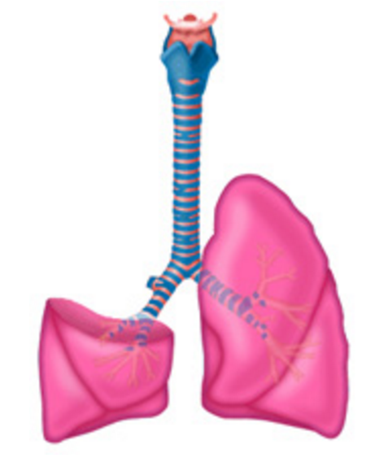
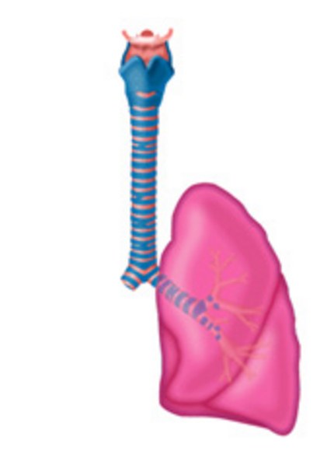
Surgical Intervention for Lung Cancer
One course of treatment is surgical intervention, but major considerations include immediate postoperative mortality (through 30 days post-op) and long-term mortality rates (1 year and on).
there are many types of surgical intervention
Major lung resections for primary lung cancer include:
Pneumonectomy: removal of entire lung; open chest technique
Lobectomy: removal of a lobe
Notes:
major surgery; significant risk involved

Slide 6
Problem Statement
Identify characteristics of lung cancer patients who are more likely to die within the year after a major lung resection, to help clinicians decide who are good/bad candidates for surgery:
Dying within a year means surgery did not help the patient, or may have even contributed to death (stress on body)
Given a new patient’s information, get a better idea whether they are a good or bad candidate for surgery (given absence or presence of risky characteristics)
Obtain the probability of surviving past a year - is it worth the stress on the body and other considerations?
If probability is low, explore other treatment options or palliative care?
Notes:
problem: lung cancer has high mortality rate; lots of people die within a year of surgery
Dying within a year of surgery means the surgery did not “work” - not saying surgery kills patient

Slide 7
Data

Slide 8
Data Source
From Wroclaw Thoracic Surgery Center (Poland) and includes 16 variables related to pre-operative features
American Lung Association: racial and gender factors are heavily correlated to survival rates of lung cancer, but our data does not include those variables²
123 other variables for pre, intra- and post-operative features recorded at the surgery center, but were not included in this dataset¹
Data was collected for 1200 patients who underwent major lung resections between 2007 and 2011; 470 patients’ records had no missing data, and are included in our dataset¹
70 patients (15%) died within one year of surgery, 400 (85%) remained alive

Slide 9
Data Overview - Variables
AGE: Age at Surgery
DGN: Diagnosis Code Group
PRE4: Forced Vital Capacity – total amount of air exhaled during test
PRE5: FEV1 – the amount of air expelled in first second of forced expiration
PRE6: Perf. Status – 0=asymptomatic, 2=symptomatic with <50% day in bed, 5=death
PRE7: Pain before surgery
PRE8: Coughing blood before surgery
PRE9: Shortness of breath before surgery
PRE10: Cough before surgery
PRE11: Weakness before surgery
PRE14: Tumor Size – 1 through 4 (largest)
PRE17: Type II diabetes
PRE19: Heart attack within 6 months prior to surgery
PRE25: Peripheral Arterial Disease
PRE30: Smoking
PRE32: Asthma
Notes:
Performance status goes to 5, which is dead

Slide 10
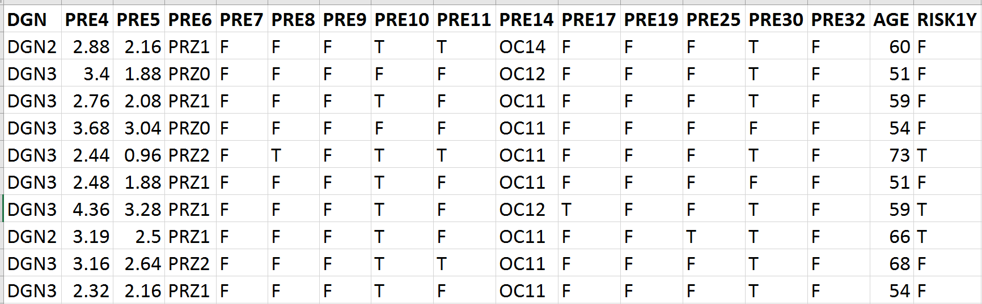
Data Overview
Each row contains characteristics of one patient who had a major lung resection
Data includes 16 independent variables:
10 binary
3 interval
2 ordinal
1 nominal
Binary target variable (Risk1Y, where T=died)
470 total observations
70/30 partition - 329 obs in Training Set and 141 in Validation Set
Notes:
Add the one where we added patient ID - discuss each row is one patient

Slide 11
Frequency of Input Variables
 | Frequency | Percent
Risk1Y- F | 400 | 85.11
Risk1Y- T | 70 | 14.89
PRE30- F | 84 | 17.87
PRE30 - T | 386 | 82.13
PRE17 - F | 435 | 92.55
PRE17 - T | 35 | 7.45
PRE9 - F | 439 | 93.40
PRE9 - T | 31 | 6.60
 | Frequency | Percent
DGN1 | 1 | 0.21
DGN2 | 52 | 11.06
DGN3 | 349 | 74.26
DGN4 | 47 | 10.00
DGN5 | 15 | 3.19
DGN6 | 4 | 0.85
DGN8 | 2 | 0.43
Notes:
highlighted sections “go together” ie: add up to 100%

Slide 12
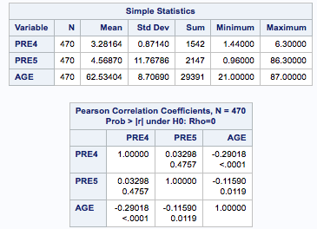
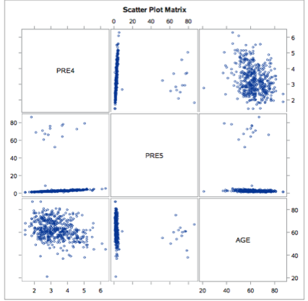
Correlation of Interval Variables
Slight negative correlation between age and PRE4/PRE5 (forced exhalation test-related)
Notes:
This (negative) correlation makes sense, since PRE4 and PRE5 are related to forced exhalation testing, and lung capacity diminishes with age.

Slide 13
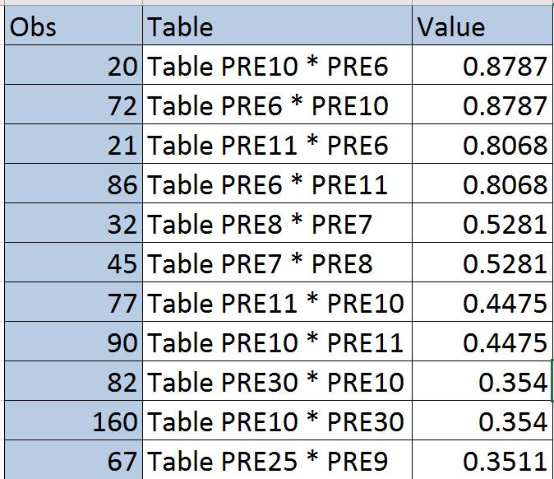
Correlation of Categorical Variables
cough (PRE10) and weakness (PRE11) before surgery both highly correlated with seriousness of condition (PRE6)
coughing blood (PRE8) and pain (PRE7) before surgery highly correlated

Slide 14
Two Approaches to Prediction

Slide 15
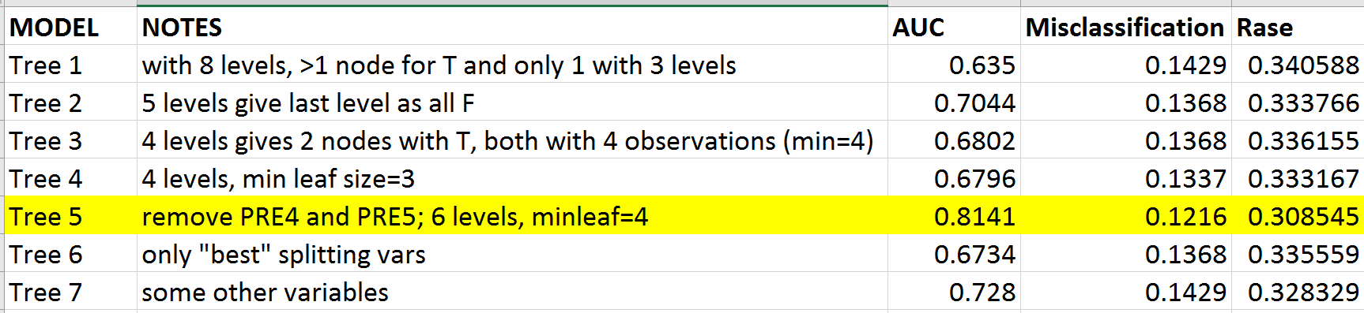
First Approach: Decision Trees
Looked at different combinations of tree depth, min leaf size, and independent variables
Checked AUC, Misclassification Rate and RASE for each
The best diagnostics we found for tree that used 14/16 variables, had six levels and min leaf size of 4 :

Slide 16
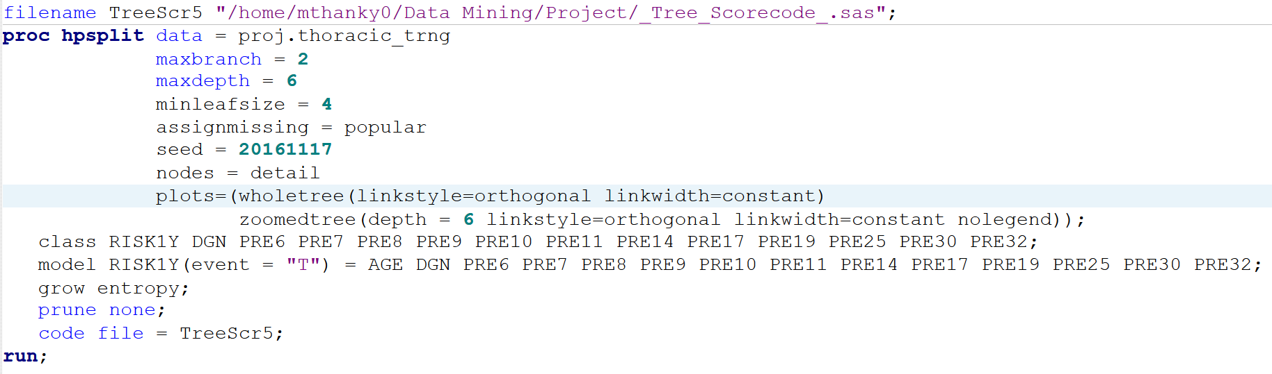
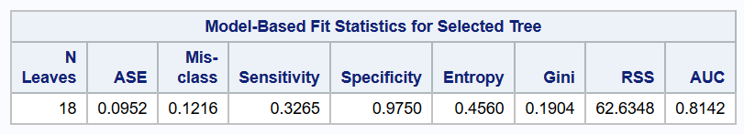
Selected Decision Tree Model
Notes:
misclass rate explained next slide
16 terminal leaves, of which 4 were T

Slide 17
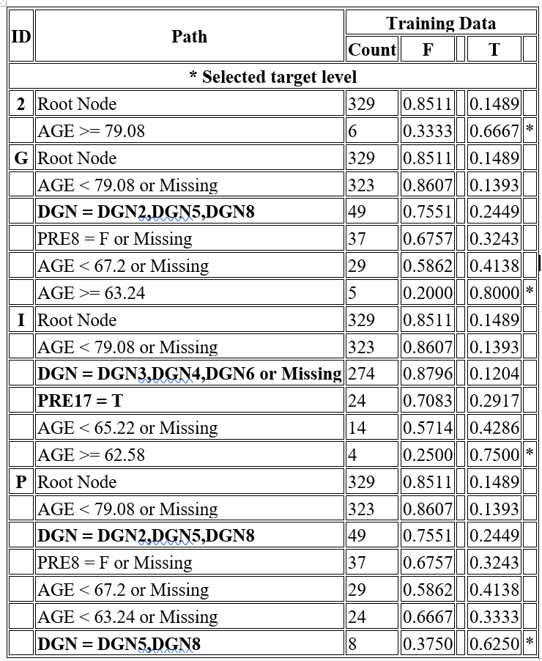
Splitting Criteria
Splitting criteria which led to the 4 nodes with majority RISK1Y=T outcomes
impt criteria include:
Age
DGN - diagnosis codes
PRE8 - coughing blood
PRE17 - diabetes
Notes:
only 2 nodes had 75%+ where obs were = T
(2 others had much lower %)

Slide 18
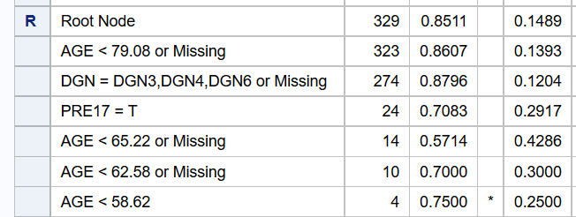
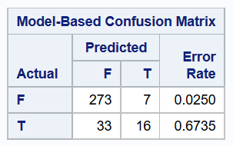
Decision Tree – Insights
some of the variables are more important, such as AGE, which was split on 4x for some nodes
certain important variables were more obvious (age, coughing blood); others were not (diabetes)
false neg led to higher misclassification rate (false pos rate good)
Not pruning was necessary to produce any results
Notes:
Pruning is done to reduce overfitting and remove sections of tree that do little to properly classify data points
However, not pruning may have led to overfitting data -- we see later that this tree didnt do well on validation data

Slide 19
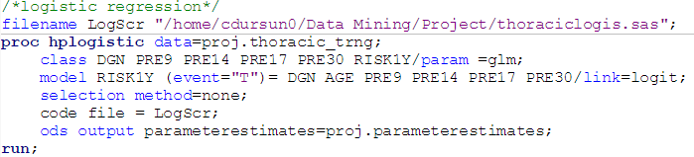
Second Approach: Logistic Regression
First ran regression on all variables
Then ran regression using variables that were significant in first model or “made sense” in context of problem
DGN - diagnosis code
AGE
PRE9 - coughing blood
PRE14 - tumor size
PRE17 - diabetes
PRE30 - smoking
Notes:
Used binary logistic model as our target variable is binary

Slide 20
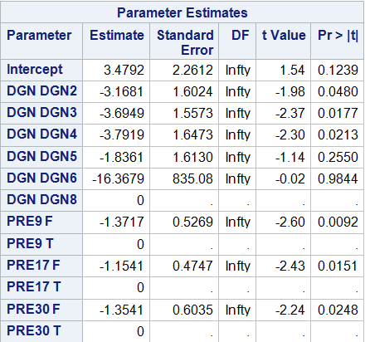
Parameter Estimates
Significant (at .05 level) parameters include:
DGN2, DGN3, DGN4
PRE9 (labored breath)
PRE17 (diabetes)
PRE30 (smoking)
PRE30=F (-1.3541) one unit change means log odds decrease by 1.3541 (odds of dying decrease if you don’t smoke)
while keeping all other predictors the same, the odds of dying versus not dying will shrink by a factor of 0.2616 if you don’t smoke
DGN6 has only 4 observations - all F - so high coefficient is likely due to small group and it doesn’t appear to affect model fit (only 4 obs)
Notes:
diabetes = F (-1.04)
labored breath = F (-1.47)DGN6 is only 4 observations - all F - so high coefficient is likely due to small group and it doesn’t appear to affect model fit (
only 4 obs)

Slide 21

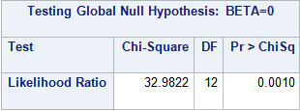
Logistic Regression – Insights
The second model was better than the first in all our measurements:
Our second model is significantly different (p-value < 0.01) from the null hypothesis.
Smoking, shortness of breath before surgery, diabetes and certain diagnoses significantly impact the odds of dying one year post surgery

Slide 22
Model Comparison

Slide 23
Which Approach Predicted Best?
AUC, misclassification rate and RASE values were compared for decision tree and logistic regression.
Decision Tree:
Logistic Regression:

Slide 24
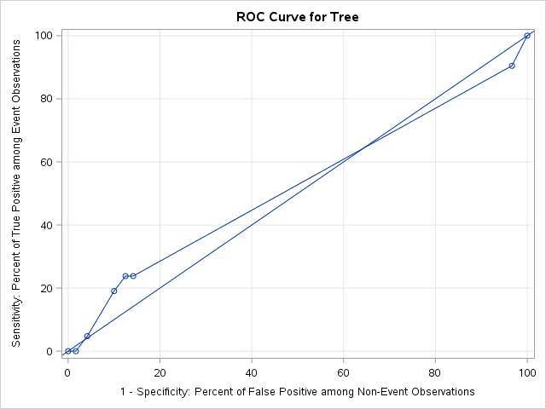
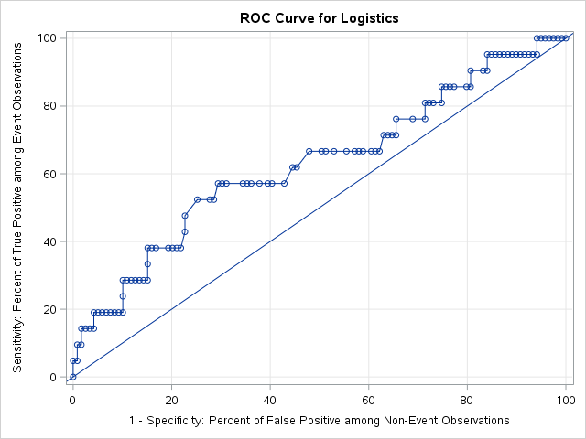
ROC Curves
Notes:
Our tree model was good for training data but not well for validation
may be overfitting problem because of not pruning

Slide 25
Findings and Recommendations

Slide 26
Key Findings
Logistic regression performed better than the decision tree as it had higher AUC and lower RASE value.
Decision tree may have been overfit.
The two model types produced different “important” variables (risk factors), but certain predictors were common to both models, such as: diabetes and diagnosis codes
Smoking, shortness of breath before surgery, diabetes and certain diagnoses significantly impact the odds of dying one year post surgery
Notes:
We can talk about findings from an analytics standpoint (first bullets) and from the business problem standpoint (last bullet)

Slide 27
Recommendations
Try to obtain a larger dataset for better predictions
Try hybrid model with larger dataset (can contain missing values) - first use decision tree one level deep and then logistics regression to try and alleviate separation issues
Providers should consider all of the risk factors with particular attention to those shared between both model types (diabetes and diagnosis code)
Providers caring for patients should carefully evaluate their patients’ fitness for surgery and prognosis, given these risk factors, before undertaking surgical procedures
Notes:
Our dataset had 470 obs, none of which had missing values. If we did a decision tree, we could probably use the larger dataset since decision trees handle missing values, although that’s a big consideration for other model types.

Slide 28
Questions?

